Slide 1

Climate Week 3
g7+
The Way Forward
Hunter Mills
Yeosu, Republic of Korea
24 April 2026

Slide 2
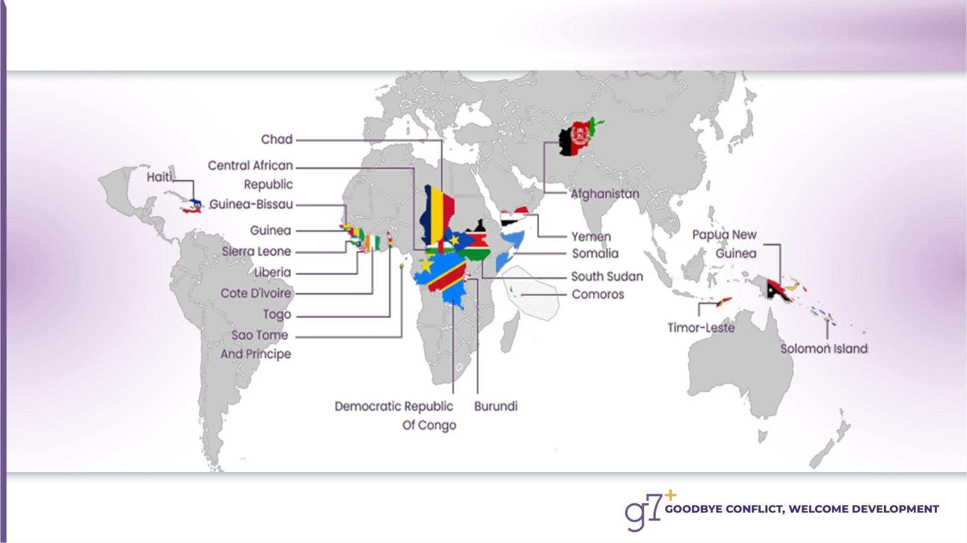
The g7+ Member States

Slide 3

The Objectives of g7+
To achieve peace, stability and development by:
Reclaiming voice & agency
Asserting national ownership in building peace & stability
Advocating for self-reliance
Demanding a global system that is inclusive

Slide 4
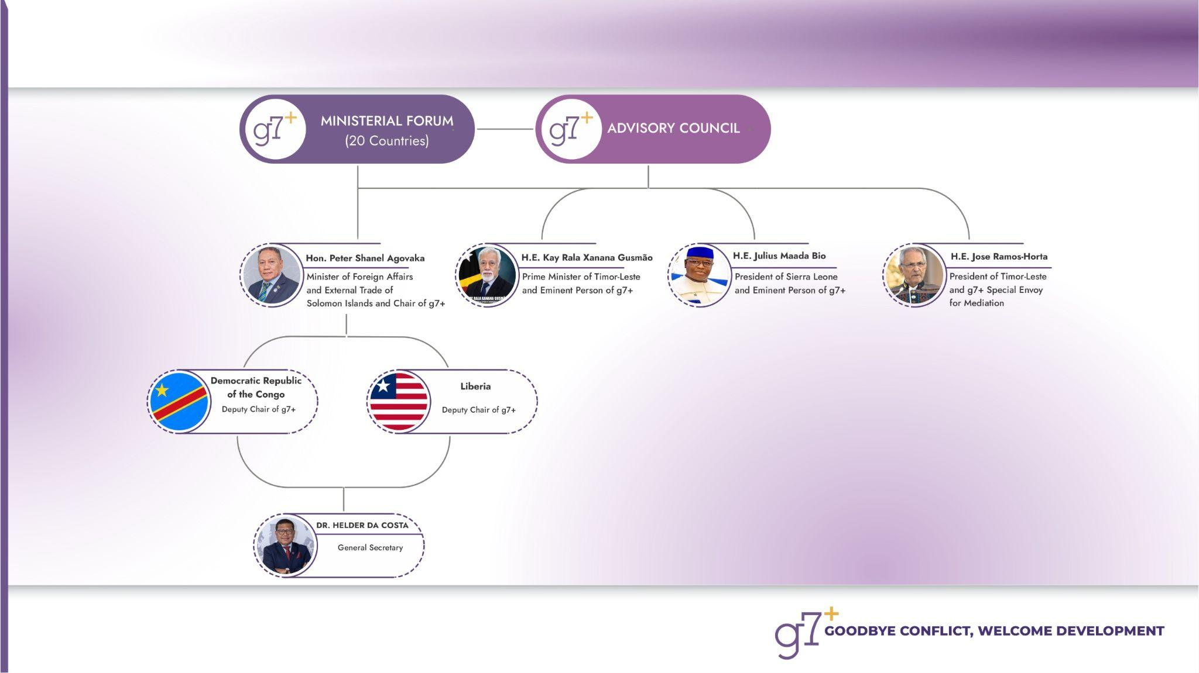
The g7+ Governance

Slide 5

Dili Resolution: Outcome of the 6th g7+ Ministerial Meeting
“We reiterate our call for a significant increase in climate financing for regions disproportionately affected by climate change, particularly conflict-affected states, where vulnerability is compounded by fragility. We urge international climate financing agencies, funds, and donors to urgently reform climate finance mechanisms, ensuring they are more flexible, accessible, and responsive to the realities of these countries. We insist that conflict-affected states be empowered to directly lead, manage, and implement climate adaptation initiatives, ensuring solutions that are context-specific, sustainable, and aligned with national priorities.”
Link to Outcome Document
Dili, Timor-Leste | 12 April 2025

Slide 6

Challenges
Shifting global power dynamics & changes in the world order
Climate-conflict nexus
"threat multiplier" worsening existing social, economic, and political tensions, which in turn diminishes the capacity for climate adaptation
Erosion of multilateral cooperation
Interconnected crises ("polycrises") amplifying global fragility
Escalating geopolitical tensions & a new “cold war” climate
Climate change & its compounding humanitarian impacts
Climate change & its compounding impacts
Persistent gap between international commitments & action

Slide 7
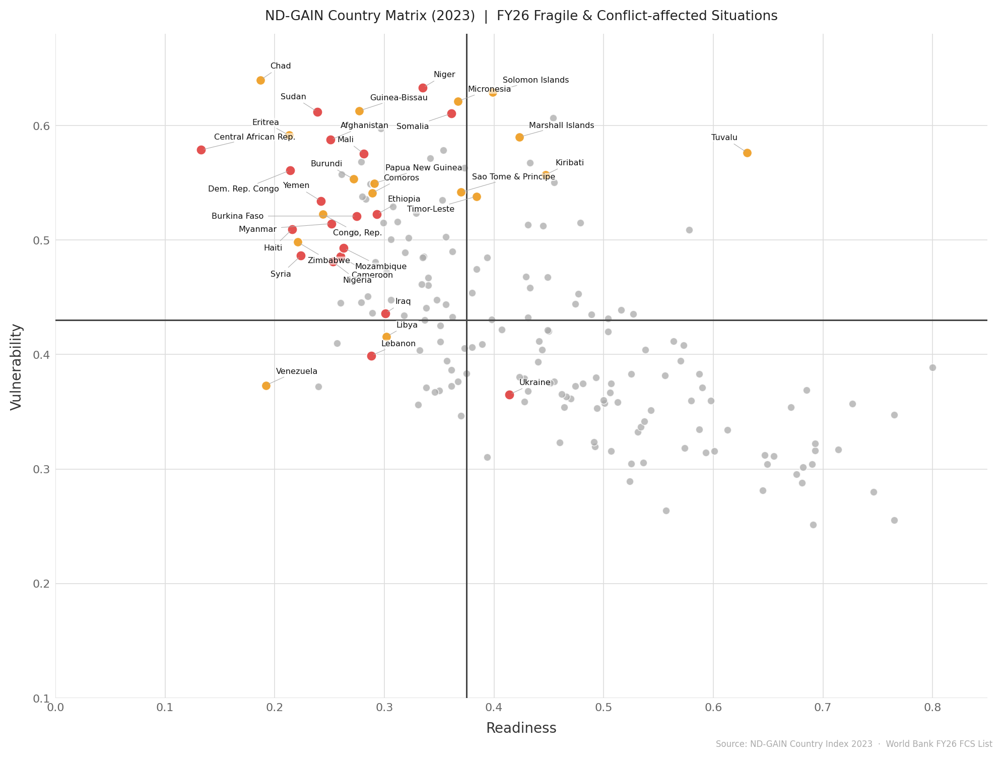
FCAS Vulnerability & Readiness
Conflict-affected countries are first hit and last to recover
from global crises
FCAS disproportionately concentrated in the most vulnerable quartile of the ND-GAIN index.
Significant structural overlap between climate vulnerability and fragility.
Climate-conflict nexus compounding ability to adapt.
Poverty and hunger are disproportionately concentrated in fragile contexts
These crises are becoming “left behind” as global attention shifts elsewhere
These countries sit at the intersection of geopolitics and instability
Without stability, large populations will remain trapped
in cycles of vulnerability and recurring crises

Slide 8
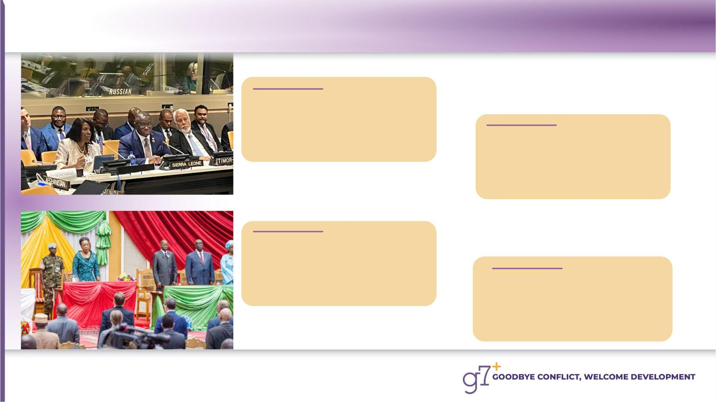
What we do?
Collective Advocacy
Speaking with one voice
to influence global policy
and reshape narrative
Peer Learning & Solidarity
Sharing lived experience
to inspire and accelerate
recovery
Reforming Global Cooperation
Speaking with one voice
to influence global policy
and reshape narrative
Dialogue & Reconciliation
Addressing root causes of
conflict through nationally
owned peace processes

Slide 9

Way Forward
Strengthen the g7+ as a group —more consolidation
Strengthen Fragile-to-Fragile cooperation
Push for inclusive global governance
Ensure peace-first approaches remain central to development policies
Enhance capacity for dialogue and reconciliation
Engage with emerging actors
Partnerships

Slide 10
Utilizing the g7+ & NBF FINCOAHN platform
Partnerships
F2F and South-to-South Knowledge Sharing
Matchmaking and Brokering
Conflict-affected countries are first hit and last to recover
from global crises
Poverty and hunger are disproportionately concentrated in fragile contexts
These crises are becoming “left behind” as global attention shifts elsewhere
These countries sit at the intersection of geopolitics and instability
Without stability, large populations will remain trapped
in cycles of vulnerability and recurring crises

Slide 11
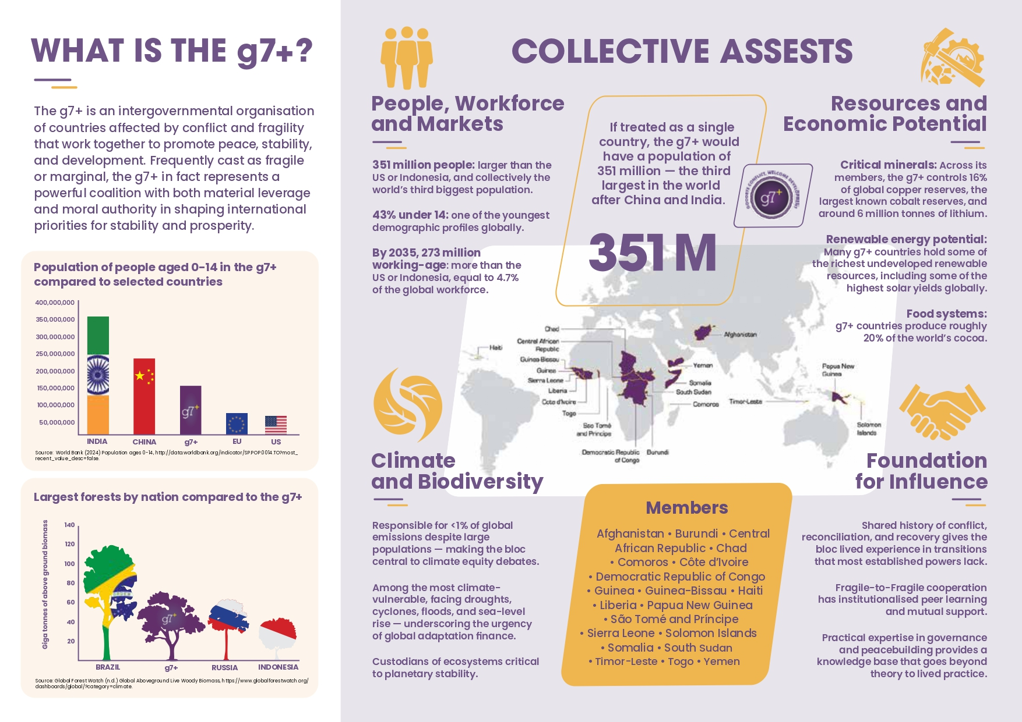

Utilising the g7+ platform
Conflict-affected countries are first hit and last to recover
from global crises
Poverty and hunger are disproportionately concentrated in fragile contexts
These crises are becoming “left behind” as global attention shifts elsewhere
These countries sit at the intersection of geopolitics and instability
Without stability, large populations will remain trapped
in cycles of vulnerability and recurring crises

Slide 12

FOLLOW US
THE g7+ HEADQUARTERS
Kobe House, Rua Palacio do Governo,
Dili, Timor-Leste.
(+670) 3310 126
THE g7+ EUROPEAN HUB
Av. 24 de Julho no.118 B/C/D Santos,
Lisboa, Portugal.
(+351) 211322371
THE g7+ NEW YORK OFFICE
The g7+ New York Office 305.
East 47th Street, 10th Floor
New York, NY 10017
(+1) 646 370 5560
THANK YOU
@g7plus
The g7plus
g7+
www.g7plus.org
g7plus.secretariat@gmail.com

