Slide 1

Mitigation actions in the Waste sector in Uruguay
Climate Week
Addis Abeba, Ethiopia. September 4th, 2025
Andrea De Nigris
Manager of Climate Action for Sustainable Development
National Directorate of Climate Change
Ministry of Environment, Uruguay

Slide 2
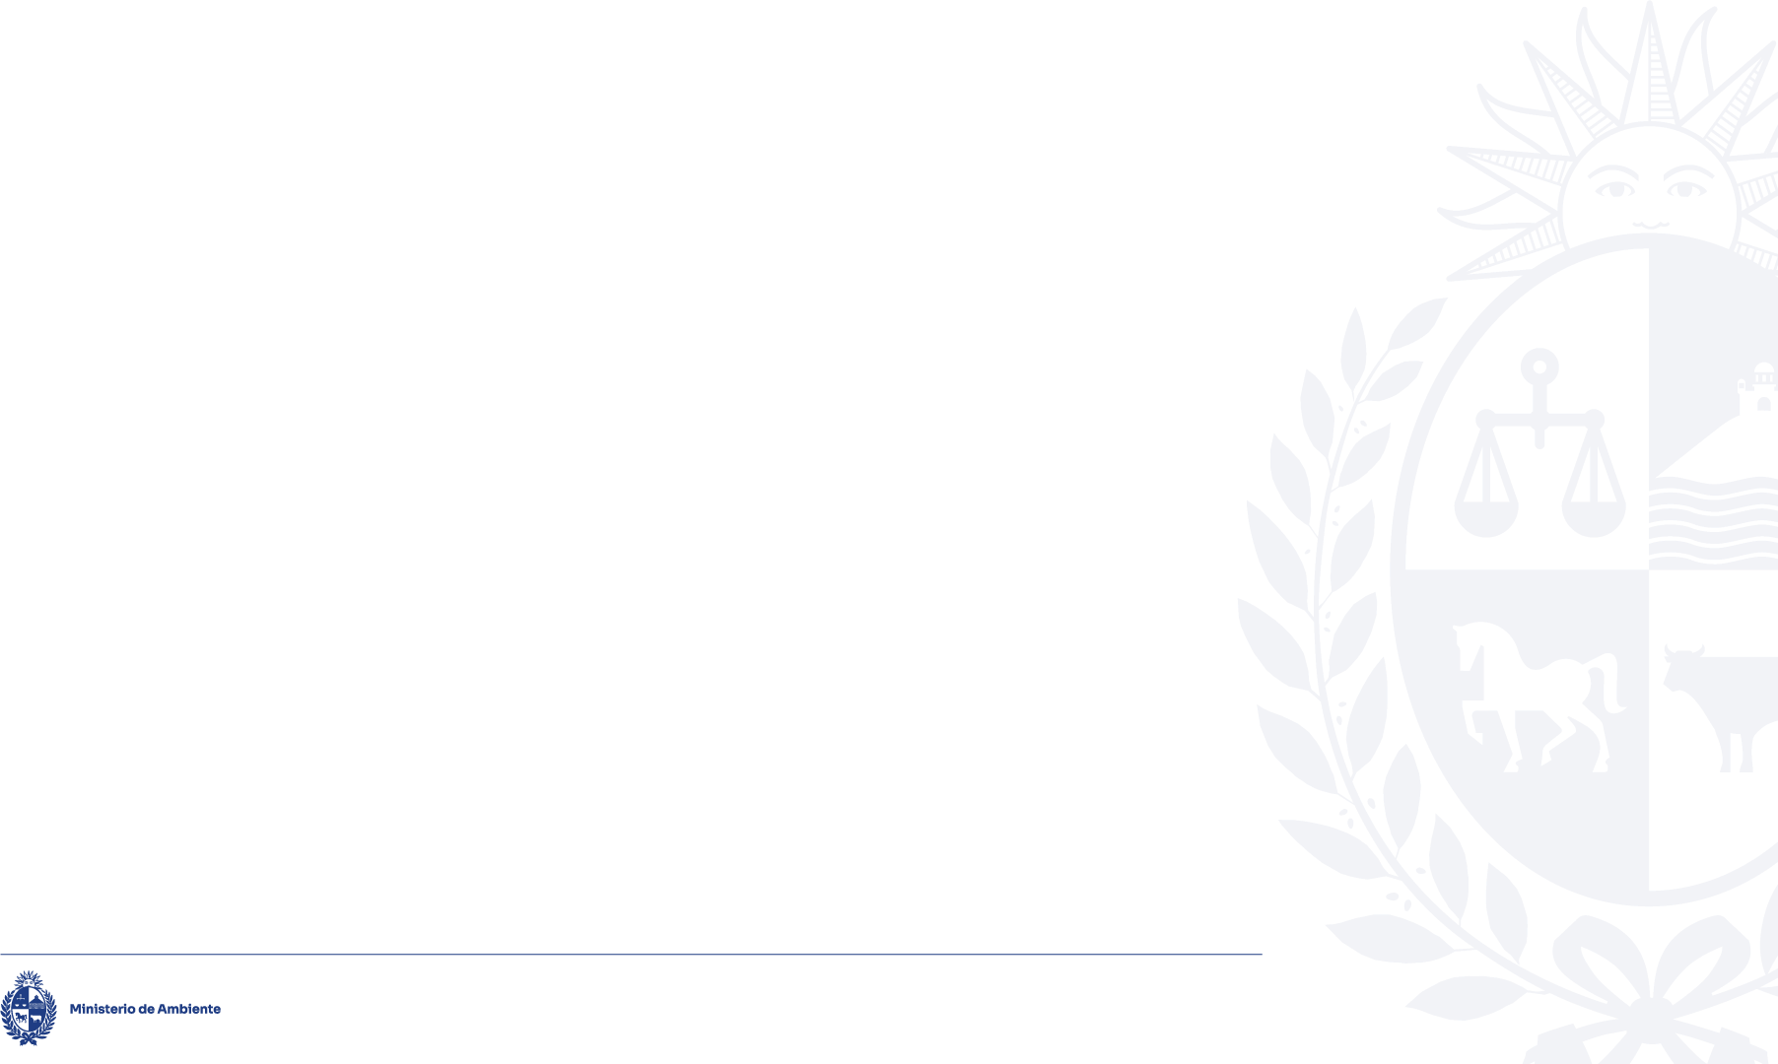
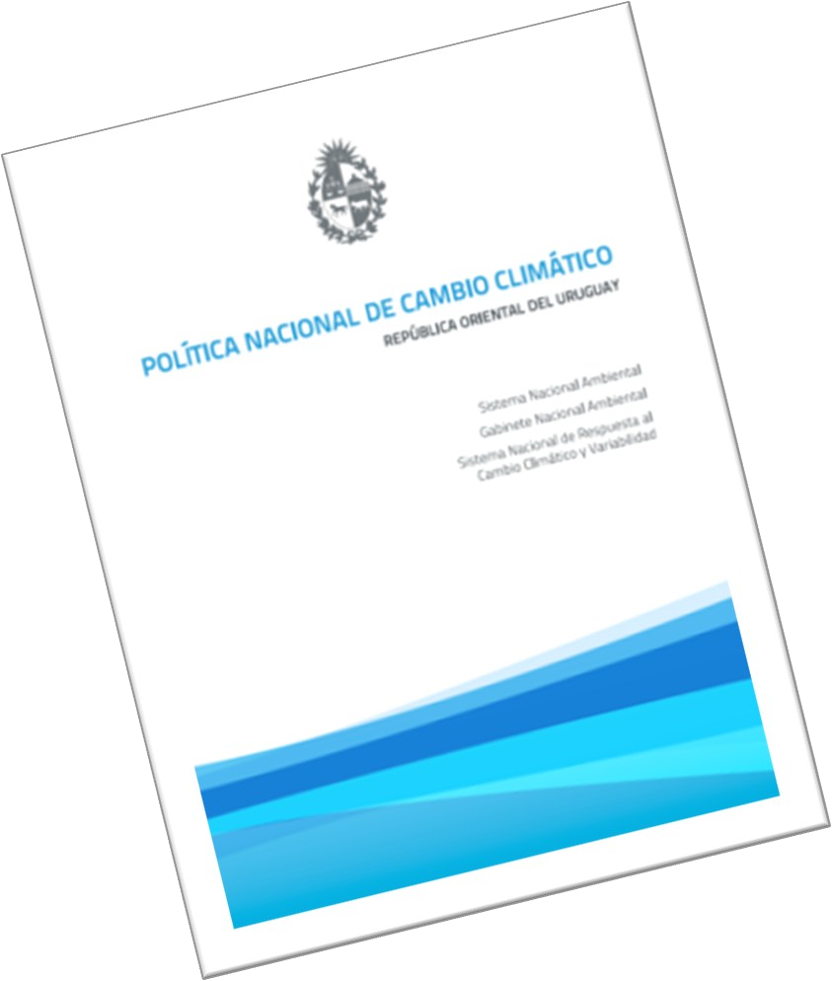
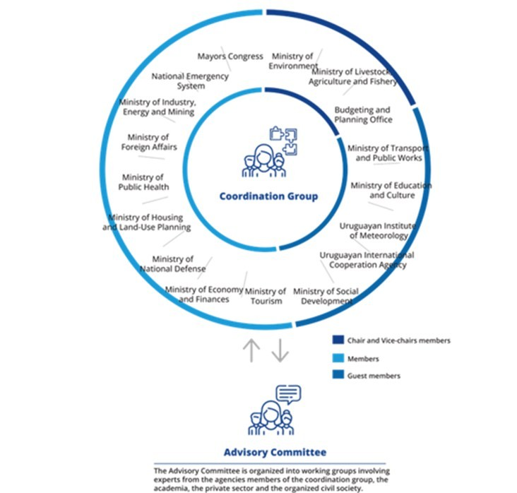
National Climate Change Policy
https://www.gub.uy/ministerio-ambiente/comunicacion/publicaciones/politica-nacional-cambio-climatico

Slide 3
URUGUAY First Nationally Determined Contribution to the Paris Agreement- 2020
Introduction of CH₄ capture and burning in final disposal systems of solid urban waste by the statement of 60% of urban solid waste generated placed in final disposal sites with this technology.

Slide 4
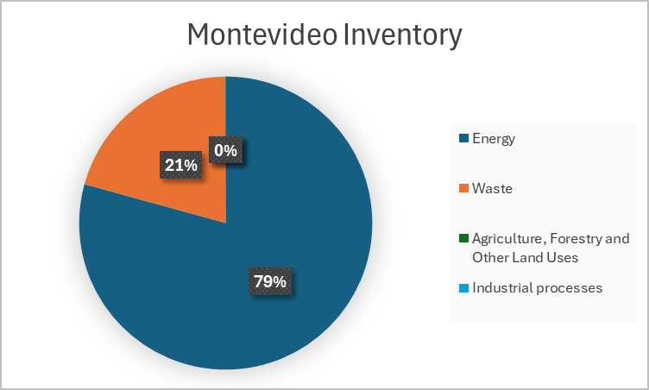
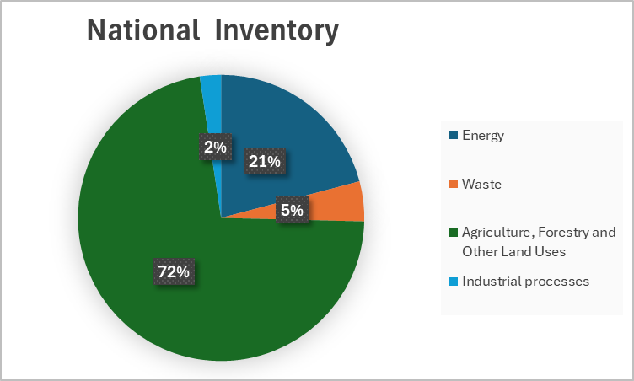
Difference in national and subnational inventories

Slide 5
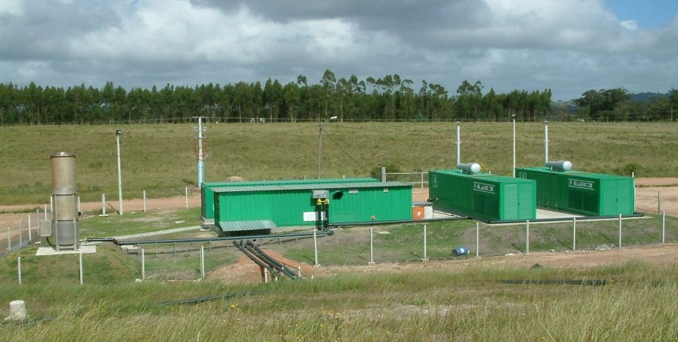
Pilot Project Las Rosas Landfill, Maldonado Uruguay
Pilot Project Launched in 2005
Partially financed through GEF Project.
By 2023 - 4% of urban solid waste generated in Maldonado are placed in final disposal site with CH4 capture and electric power generation (2023).

Slide 6
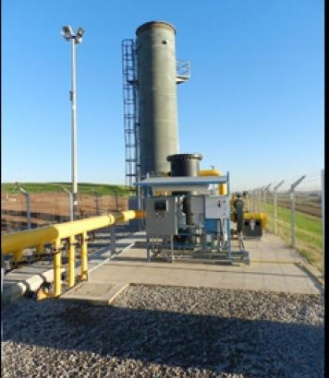
Biogas capture plant in Montevideo Landfill
Started operations: 2011
Population 1.300.954 inhabitants Annual waste income 380.000 tons
Participation in the Clean Development mechanism (CDM)
By 2023, 56% of urban solid waste generated in Montevideo are placed in final disposal site with CH4 capture and burning.

Slide 7
Second Nationally Determined Contribution wich comes into effect next year, aligns with the National Waste Management Plan (PNGR).
National Strategy for the Prevention and Reduction of Food Loss and Waste and an Action
Plan in prioritized sectors are being implemented, mainstreaming climate change.
Selective collection systems have been promoted to reduce the tons of recyclable waste
sent to final disposal, and the impact on GHG emission reduction has been determined.
Incorporation of organic waste recovery strategies in departmental waste management plans
has been promoted.

Slide 8
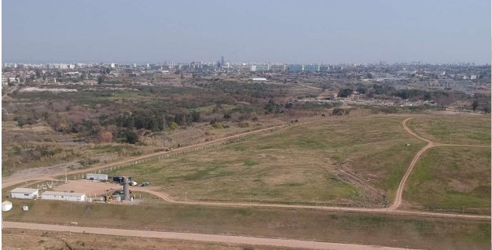
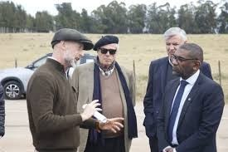
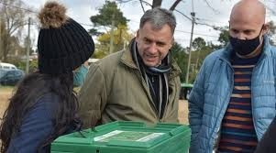
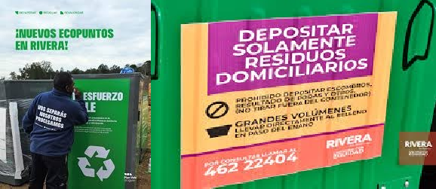
Many local authorities are already aware of the problem and are addressing it.
Montevideo, after closing the last three cells, an expansion of the final disposal site was carried out. New project started in 2025- Financed by an IDB loan
Maldonado, signing an agreement between the Ministry of Environment and the Maldonado Municipality to expand the process to all waste in the department. Funded by the National and Departmental Governments
Canelones published its waste management plan with an express declaration of promoting the circular economy, source separation, and recovery. Funded by the National and Departmental Governments
Rivera developed its management plan, beginning with decentralization and communication, also includes a project for the downtown area called "More Circular Downtown.“ Funded by the National and Departmental Governments

Slide 9
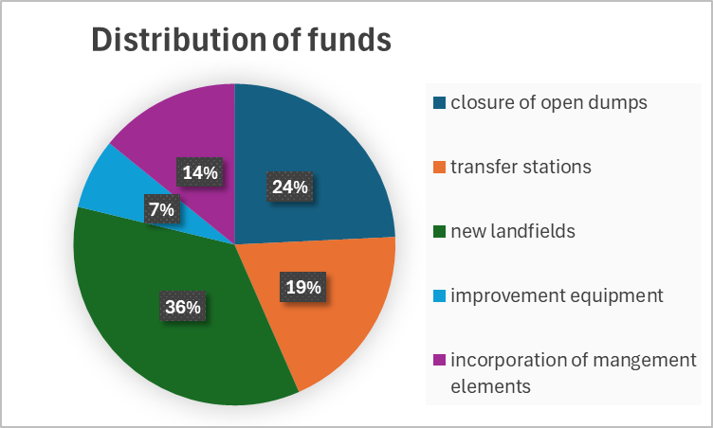
So far we are in the prosses of Implementation of the National Waste Management Plan (PNGR)
More than US$34 million will be allocated to implement the plan, with contributions from the central government amounting to US$17 million, in addition to funds provided by local authorities.
But we know it's not enough, so we're seeking funding to continue implementing the plan

Slide 10
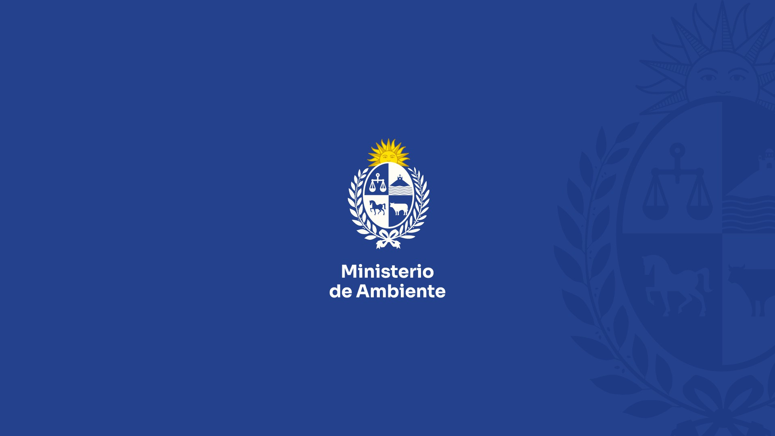
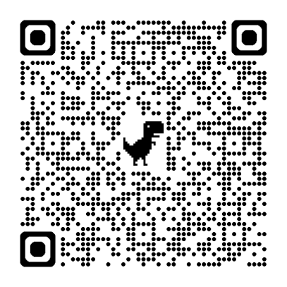

Thank you for your attention.

