Slide 1
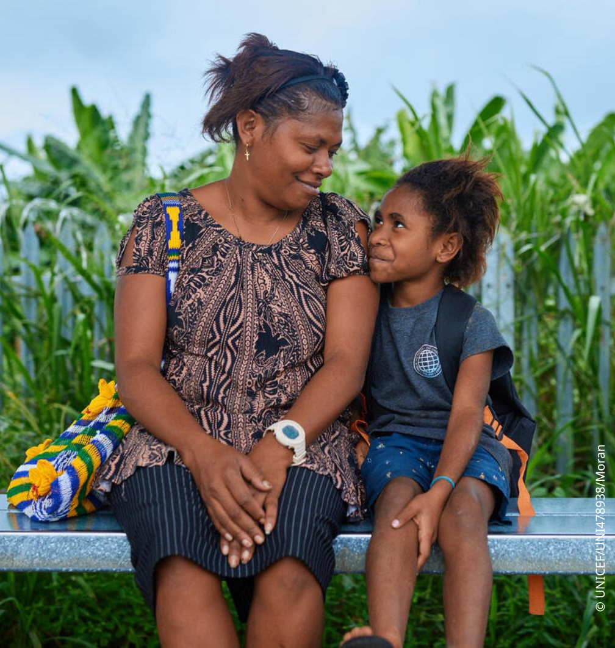
Climate Change and Environment
UNICEF Papua New Guinea
24 April 2026

Slide 2
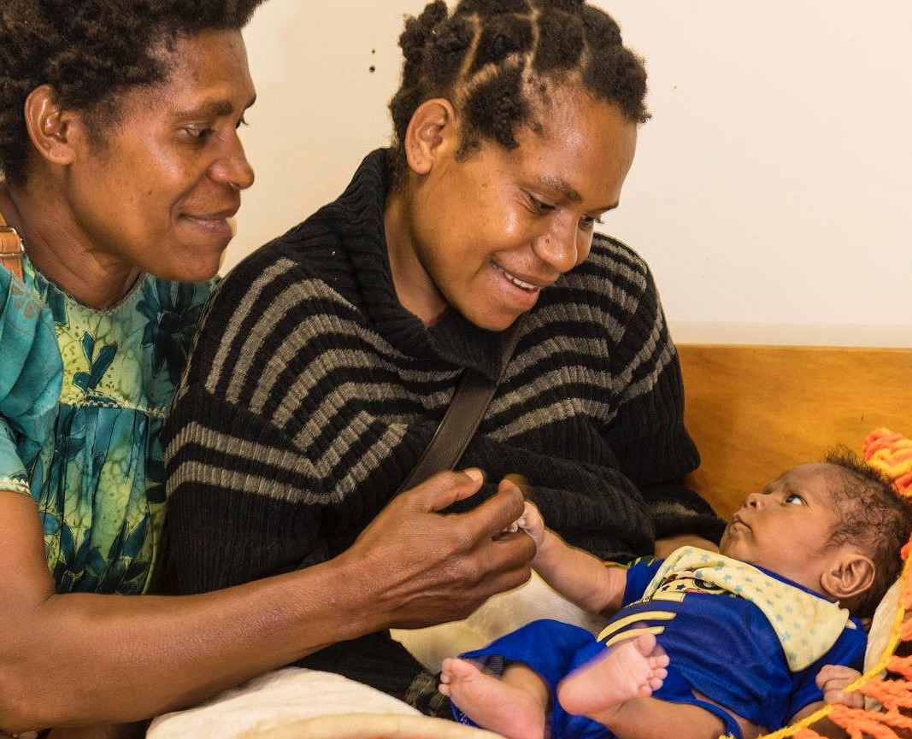
Structural Bottlenecks in PNG’s Climate Response
Data & Evidence
Climate data exists, but is not translated into actionable information for communities
Limited sub-national data on where climate risks and vulnerability intersect
Governance
Weak coordination across CCDA, NWS, and line ministries
Climate not yet integrated into sub-national planning and service delivery
Finance & Capacity
Infrastructure investments often outlast O&M funding
Limited capacity to access and manage climate finance
Last Mile Access
Remote, coastal, and island communities remain consistently underserved
© UNICEF/UN0298705/Dozier

Slide 3
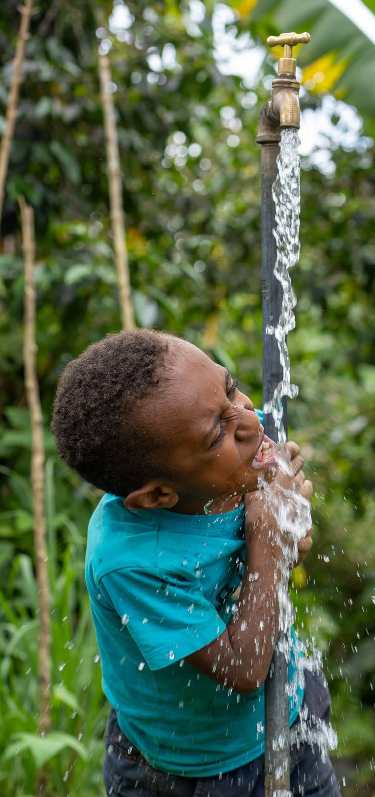
What UNICEF Can Deliver
(Next 6 Months)
Climate Information and Early Warning System
Integrating climate risk information into PNG NWS systems
Supporting sustained, government-led operation of flood and drought risk bulletins
Children's Climate Risk Index
Developing a sub-national Climate Risk Index with a focus on children
Providing evidence to support targeted interventions in priority areas
Nationally Determined Contributions (NDC) 3.0 for PNG
Supporting CCDA to finalise inputs across mitigation, adaptation, and cross-cutting areas
Strengthening integration of social dimensions, including child-sensitive measures
Green Climate Fund (GCF)
Mobilising climate finance for priority investments
Enabling scaled, government-led implementation of climate-resilient services
© UNICEF PNG Facebook 24 May 2024

Slide 4

Keeping Follow-Up Country-Led
Key Principle
The most technically advanced solution is not always the most sustainable
Approach
Start with what government can realistically operate and maintain
Design within existing institutional capacity
Build incrementally and validate at each step
© UNICEF PNG Facebook 15 Oct 2024

