Slide 1


Climate Capital Marketplace
Korea Climate Week, 23–24 April 2026
Yeosu Expo Convention Center, Yeosu, Republic of Korea
Julie Teng, julie.teng@undp.org
Technical Specialist on Adaptation Policy and Planning, UNDP
Climate Promise

Slide 2
UNDPs Climate Change Adaptation Portfolio
An overview
​
Our support to Least Developed Countries on adaptation and resilience (from policy and planning to climate information and Early Warning Systems, coastal adaptation, climate resilient livelihoods and Ecosystem-based Adaptation) spans 42 countries, including 8 Small Island Developing States and 27 LDCs in Africa.
National Adaptation Plans: UNDP has supported 45 of the 75 countries that have submitted a NAP to the UNFCCC as of March 2026, including 18 LDCs and 8 SIDS.
Overall portfolio*
Under implementation*
42 LDCs (Africa, 27; Asia & Pacific, 10; Arab States, 4; Caribbean, 1)
165+ projects completed and under implementation in LDCs: US$1 billion in grant funding and estimated $3.3 billion in co-financing.​
As of April 2026, 56 projects are approved/endorsed or under implementation, representing ~US$645 million (grants) and US$1.5 billion in co-finance.
UNDP | Korea Climate Week 2026
Notes:
*This data is correct: "Projects completed and under implementation in LDCs: US$1billion in grant funding and estimated $3.3 billion in co-financing." And verified from PIMS as of 23 April. The data filter was "projects under implementation", "closed projects" and "reported to donor".

Slide 3
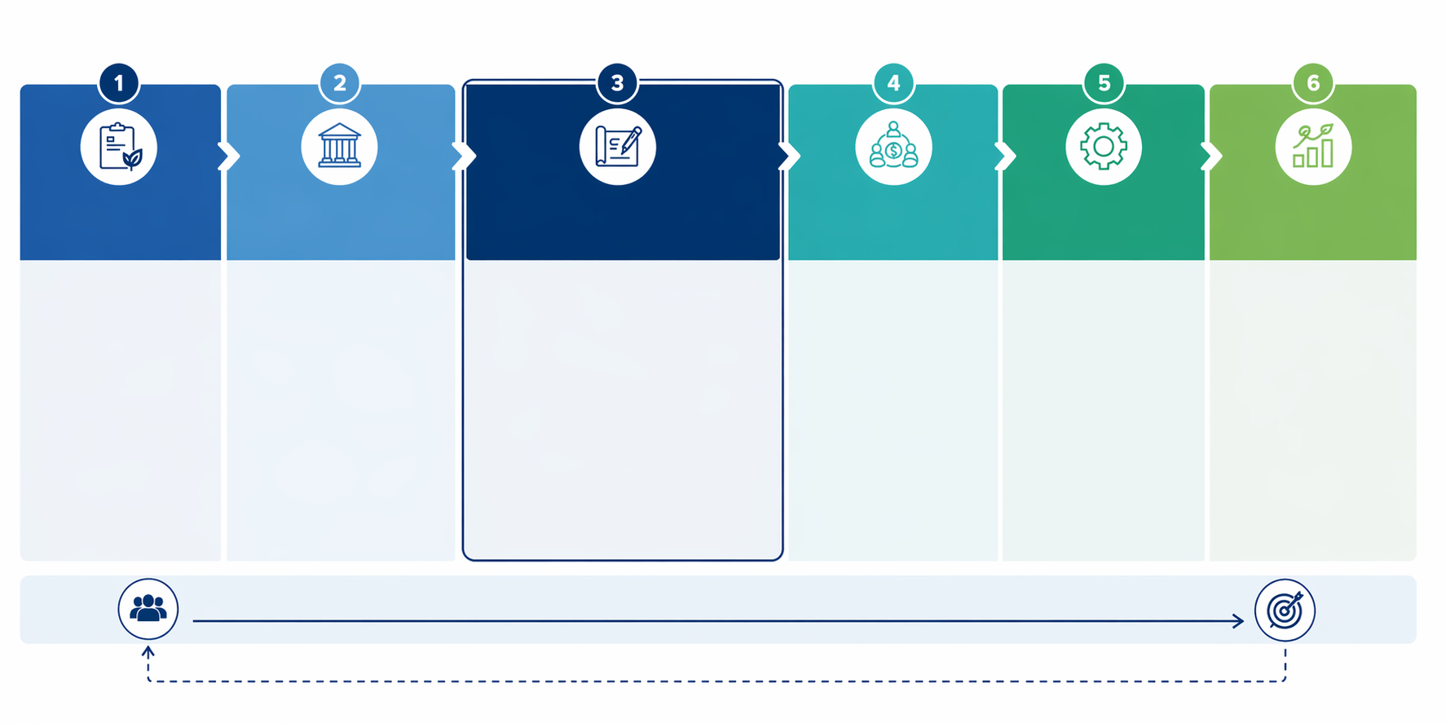
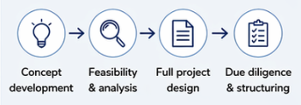
UNDPs support from planning to implementation
Service offer from NAP support to full size project implementation
Adaptation
planning
Institutional capacities and mainstreaming with a focus on finance
Project pipeline
and design
Financing and
partnerships
Implementation
and oversight
Capacity, learning
and scaling
Climate risk & vulnerability assessments
Stakeholder engagement & participation
Prioritization of adaptation actions
Development of NAPs, strategies & roadmaps
Financing & implementation strategies
Strengthening institutions & coordination mechanisms
Policy & regulatory frameworks
Integrating adaptation into sectoral & national planning
Budgeting, public financial management & climate budget tagging
Enabling environment for investment
Financing strategies & resource mobilization
Blended finance & co-financing
Partnerships (governments, IFIs, bilateral, private sector, communities)
Access to climate finance
Technical & financial oversight
Procurement & operational support
Safeguards & risk management
Monitoring, reporting & adaptive management
Alignment with national systems & policies
Capacity building (individual, institutional, systemic)
Strengthening M&E & reporting systems
Knowledge management & peer learning
Innovation & replication of solutions
Scaling & long-term impact
Technical assistance & multi-stakeholder engagement
Results framework & implementation planning
Financial structuring & risk analysis
From planning → investment → delivery → scaled adaptation results
Learning feeds back to strengthen policies, plans and future investment
UNDP | Korea Climate Week 2026
Notes:
Our support often begins upstream through NAPs and readiness processes that help countries move from climate risk awareness to strategic action. This includes climate risk, vulnerability and institutional assessments, policy and regulatory support, stakeholder engagement, governance and coordination mechanisms, sector integration, prioritization of adaptation actions, and the development of financing and implementation strategies. Through this process, countries are supported not only to prepare plans, but to build the institutional and investment foundations for long-term resilience.
From there, we help translate priorities identified through NAPs and related processes into programming opportunities through project conceptualization and design, feasibility work, due diligence inputs, financing strategies, and partnership building across governments, communities, development finance institutions, bilateral partners and the private sector.
Our role also extends beyond design, through advisory, operational and project management support, including technical backstopping, procurement, financial management, safeguards, monitoring, and adaptive oversight during implementation.
Across all stages, we help strengthen national systems, build institutional capacity, and generate learning that can inform replication and future investment.
Suggested Service Lines for the visual:
National Adaptation Planning & Readiness: Supports countries through NAPs and readiness processes, including climate risk and vulnerability assessments, institutional gap analysis, governance arrangements, stakeholder engagement, prioritization of adaptation actions, and financing and implementation strategies.
Policy & Institutional Strengthening: Strengthens policy frameworks, coordination systems, regulatory environments, and institutional capacities needed to advance adaptation priorities and unlock investment.
Project Pipeline & Design: Transforms identified priorities into investment opportunities through concept development, full project design, feasibility assessments, due diligence inputs, results frameworks, and implementation planning.
Financing & Partnerships: Mobilizes finance through co-financing strategies, blended finance approaches, and partnerships with governments, IFIs, bilateral partners, private investors, and accredited entities.
Implementation Oversight & Delivery Support: Provides technical and financial oversight, procurement and operational support, safeguards, risk management, monitoring, reporting, and adaptive management during implementation.
Capacity Building & Systems Strengthening: Builds individual and institutional capacities, strengthens national delivery, monitoring and reporting systems, and supports long-term ownership of adaptation action.
Knowledge, Learning & Innovation: Captures lessons learned, promotes peer exchange, pilots innovative approaches, and supports replication and future investment pipelines.
Tailored Country Support: Provides targeted support for fragile, climate-vulnerable and capacity-constrained contexts, responding to country-specific needs and delivery realities.

Slide 4
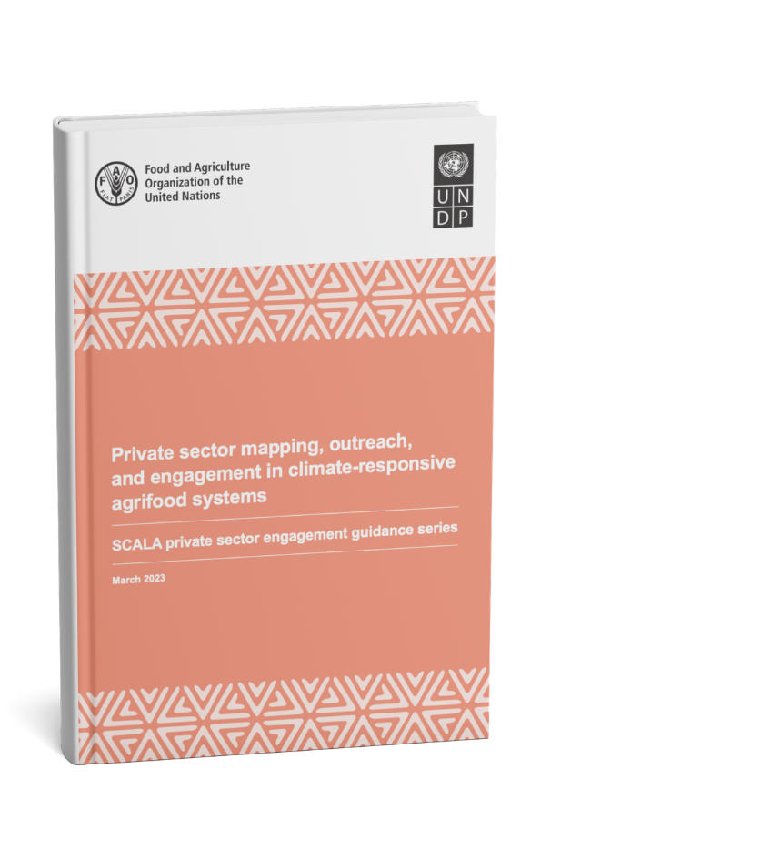

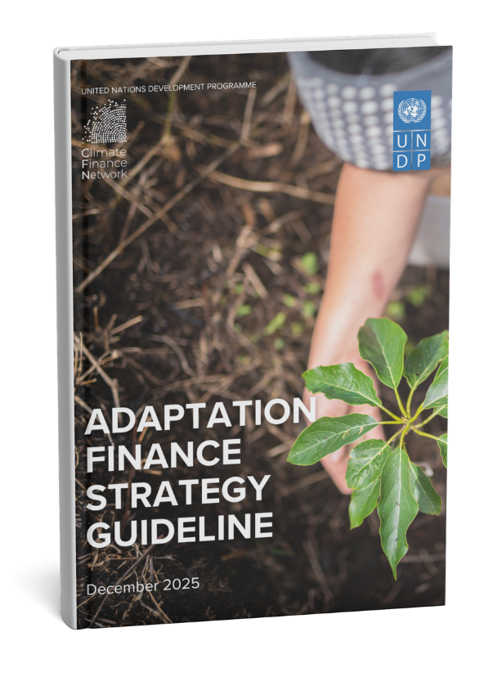
Spotlight: UNDPs tools and approaches
Adaptation Accelerator Hub (AAH) focus on investment readiness, country-owned platforms and strategic alignment, rather than creating new parallel systems.
UNDP-FAO SCALA programme Private Sector Guidance series (Vol 1 & Vol 2)
UNDP’s Climate Finance Network and Adaptation team’s Adaptation Finance Strategy Guidance
Designing innovating financing mechanisms
UNDP | Korea Climate Week 2026

Slide 5
Lessons learned from our support
NAPs anchored in rigorous CRVAs, economic and financial appraisals and inclusive extensive consultations to adopt adaptation should provide clear directions for pipeline development.
Solutions should be locally-driven, incremental, feasible and well timed, and adapted to national contexts.
Limited technical capacity, lack of understanding of funding mechanisms, and challenges in proposal development slows down progress in many LDCs, FACS and SIDS.
Pre-design readiness is a key constraint - Countries require support on coordination, baseline data, partner mapping and early matching, and concept framing before they are ready to advance to a full proposal.
Strong national ownership, community involvement from design stage, and inclusion of traditional/local authorities improve sustainability and impact.
High-cost and complex operating environments, including geographic dispersion and logistical challenges in SIDS, are often not adequately reflected in project design.
Isolated projects and weak coordination between partners reduce effectiveness and threaten sustainability.
Grant-only approaches and sole reliance on international public finance cannot deliver the scale of climate investment required.
UNDP | Korea Climate Week 2026
Notes:
Chad, fragile LDC: phased design, clear partner roles, and realistic sequencing are critical where institutional bandwidth and delivery conditions are constrained.
Mali, fragile context: conflict sensitivity, simpler implementation arrangements, and strong local anchoring are essential to keep adaptation programming feasible.
Ethiopia, large and institutionally complex setting: early scoping, sharper prioritization, and strong coordination across actors help manage complexity and avoid overdesign.
Comoros, SIDS: limited institutional depth and small scale increase preparation costs, so bundled support, strong readiness assistance, and practical implementation arrangements matter more.
Across SIDS more broadly, early partner matching and targeted pre-readiness support help move priorities toward bankable concepts and finance.
While grants remain critical—particularly for capacity-building and vulnerable contexts—grant-only and reliance approaches cannot deliver the scale of climate investment required.

Slide 6



www.undp.org
@UNDP
climatepromise.undp.org
@UNDPClimate
Sign up for our newsletter

