Slide 1
J-Credit Scheme as a Tool to sustainably manage production forest
UNFCCC fifth global dialogue and investment-focused event under the Sharm el-Sheikh mitigation ambition and implementation work programme
May 20, 2025
Panama City, Republic of Panama
30分
Toshimasa Masuyama
Forestry Agency, Japan

Slide 2
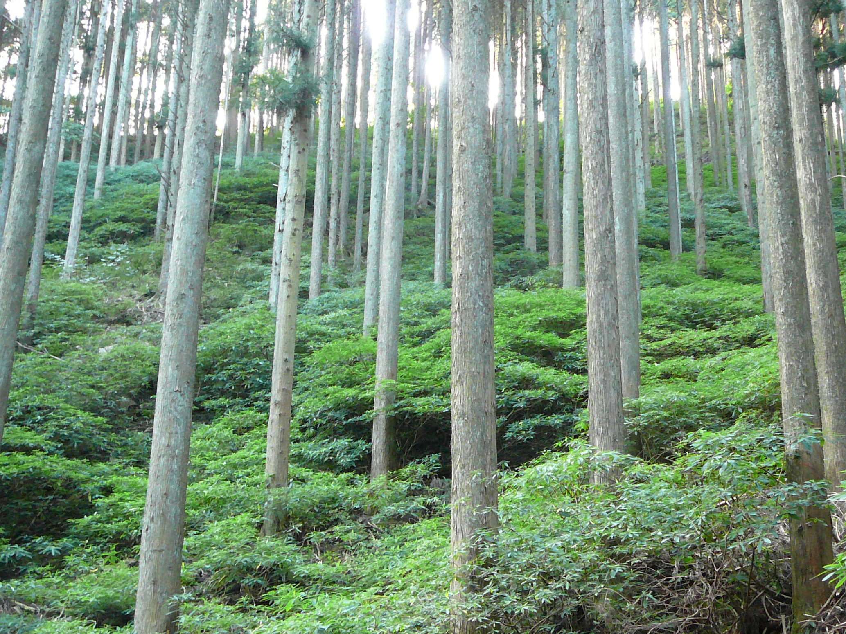
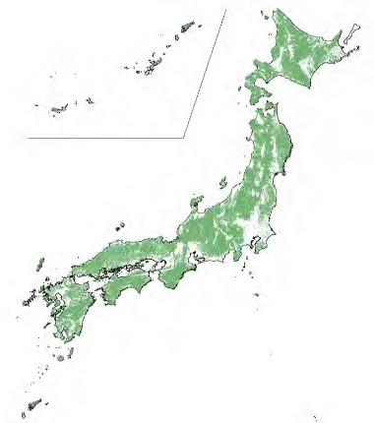

Forests cover nearly 70%
Land use change is not a major issue
Of which 40% = planted forests
Consist of indigenous species
  Contrast to monoculture planation
Well-managed planted forests are as ecologically sound as natural forests
Function as carbon sinks
Purpose grown for production
Means of rural livelihood
72 Mt-CO2 of removals (through carbon stock increment) is targeted in 2040 (Japan’s updated NDC)
2

Slide 3
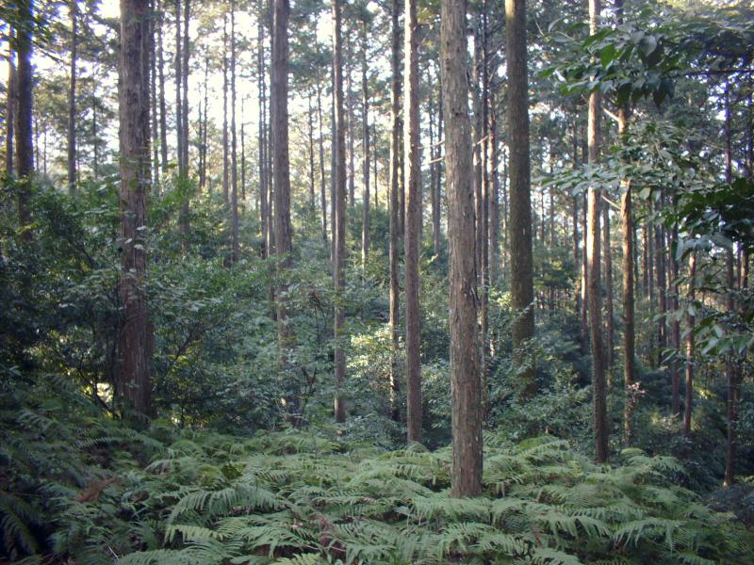
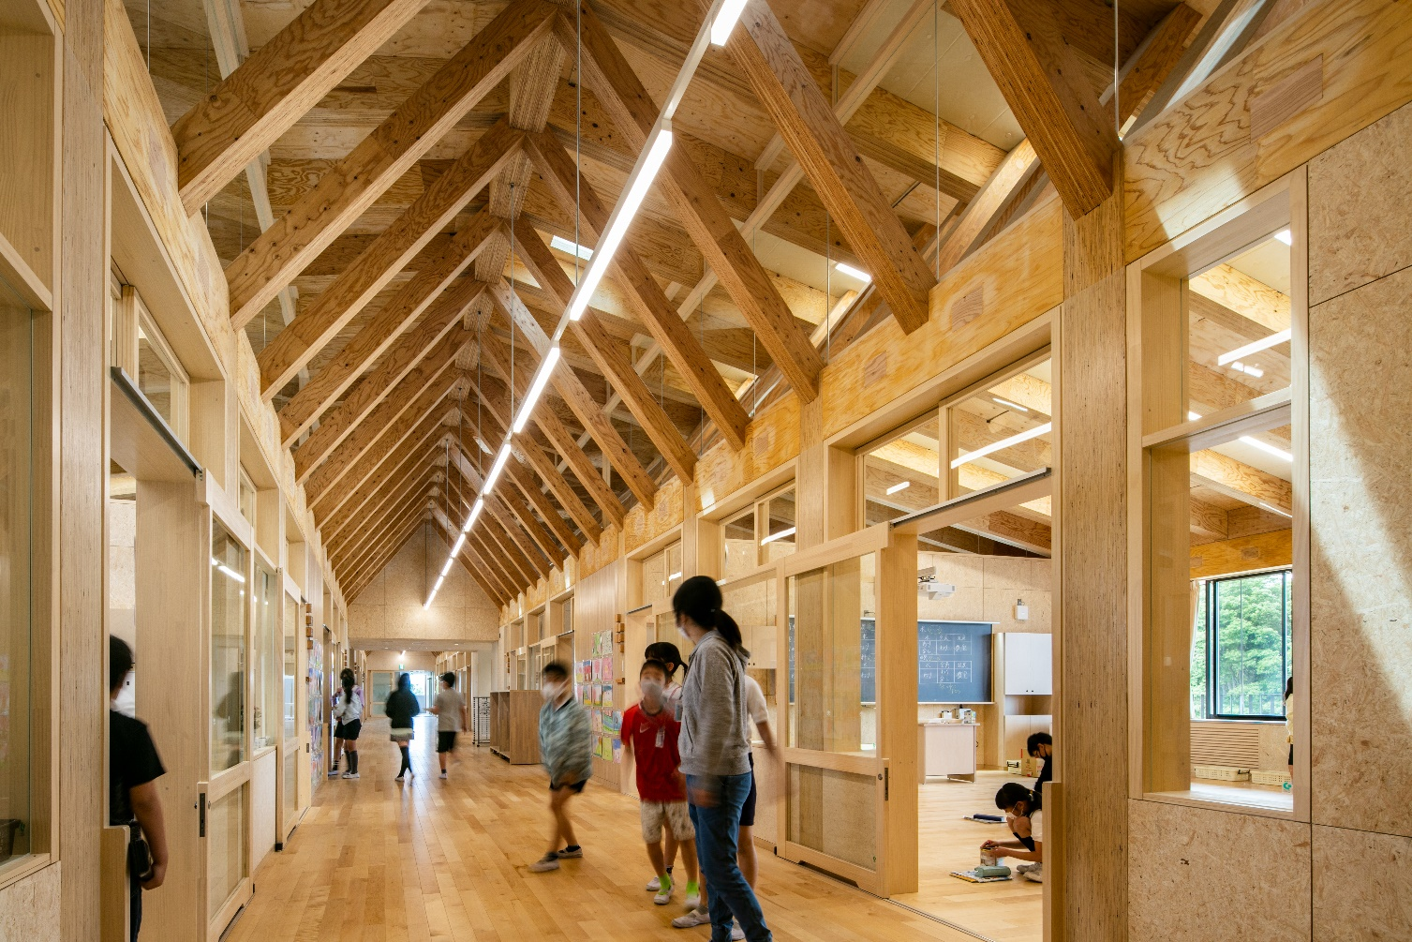
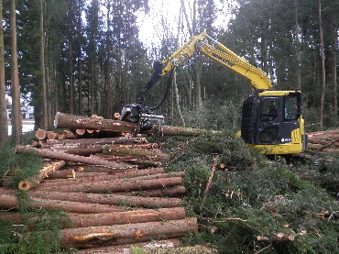
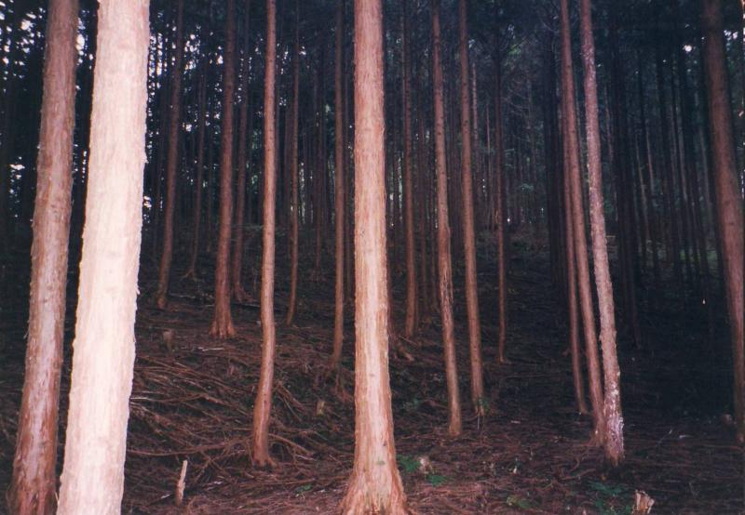
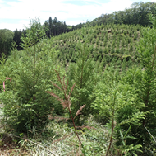
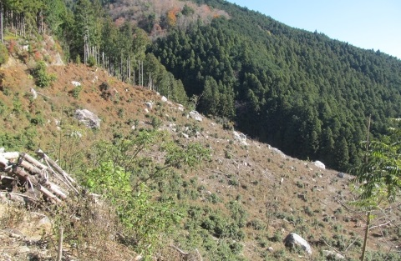
Climate smart forestry is a circular forest management to continue a rotation of “harvest, planting, thinning” while producing less carbon-intensive wood products.
Without economic gain and workforce, the circularity of forestry could discontinue.
Maturity
Harvest
Planting
60-80 yrs
Abandoned
Silviculture
Thinning
Circular Forestry
Less carbon-intensive materials than steel, concrete, etc
Long-term carbon storage in buildings
Abandoned
3

Slide 4
Stable revenue source is indispensable for sustainably managing forests.
Most of ecosystem services well-managed forests can provide are economically external.
Carbon credits could be a new source of revenue on top of timber sale.
Carbon credits
Timber production
Recreation & eco-tourism
CO2 removals
Disaster risk reduction
Headwater conservation
Biodiversity conservation
External economies
Partially money-making
Revenue source
4

Slide 5
No carbon crediting scheme issues credits for shrinking energy-related economic activity (production cut, close-down of plants, etc.)
This principle should apply to production forests.
The forest management methodology under J-Credit scheme is designed to incentivize proper silvicultural practices, otherwise abandoned due to profitability issues, resulting in carbon stock increase at the entire project boundary scale.
J-Credit’s “narrow approach” for setting baseline at zero sets itself apart from other schemes that give incentives to lower production compared with baseline scenarios.
+200
+100
Project boundary
- 500
+200
+200
+100
Baseline=0
Only plots with activity records are eligible for credit accounting.
 | Silviculture activity Stock gain
 | Final felling(clear-cutting) Stock loss
 | No activity conducted
Total with-project removal=300 (100+200+200+100+200-500)
5

Slide 6
Expansion of forest-derived J-Credits is in line with enhanced corporate action toward net-zero.
Gvmnt’s announcement on its goal of net-zero by 2050
6

Slide 7
A growing number of big companies of various sectors are making investment in forest management through the purchase of J-Credits.
Offtake agreement to purchase J-Credits from forest project for multiple years with the aim to take responsibility for ongoing emissions and support synergistic approach for biodiversity conservation | Mazda Motor Corporation News release on 14 Dec 2023 Iino Lines (shipping) News release on 15 Dec 2024 LY Corporation (e-commerce) News release on 15 Dec 2024 NYK Line (shipping) News release on 5 Feb 2025 Yamato Kogyo Co., Ltd. (steelmaker) News release on 12 Feb 2025
LoI to purchase J-Credits from nearby forest to help enhance headwater conservation | Kirishima Shuzo Co., Ltd. (sake brewery)
Branding/promoting differentiated goods and services by offsetting/reducing their carbon footprint with forest-derived J-Credits | Zurich Insurance Co., Ltd. News release on 25 Oct 2023 Saibugas Co., Ltd. (gas manufacturing) News release on 27 Nov 2023 Sakai Moving Service Co., Ltd. News release on 23 Jan 2025
Lowering supply chain emissions of wood products | A local wood market constantly purchasing forest-derived J-Credits to offset emissions generated through truck transportation
7

Slide 8
Thank you for your attention.
Look forward to your questions.

