Slide 1
Work on interoperability with the
UNFCCC Reporting Tool for CRT
(for GHG Inventories)
IPCC TFI: release of the new version of the IPCC Inventory Software for GHG Inventories
Sharm el-Sheikh Climate Change Conference
November 2022

Slide 2

Outline
  Background
  What is interoperability?
  Why is it important?
  Current activities to prepare IPCC Inventory Software to interact with UNFCCC Reporting Tool
  The road ahead

Slide 3
Background
  Beginning 31 December 2024, countries submit a biennial transparency report (BTR) consisting of a narrative document and reporting tables/ formats.
  Reporting must follow the Modalities, Procedures and Guidelines (MPGs) (decision 18/CMA.1)
  Decision 5/CMA.3 mandates the UNFCCC to develop reporting tools for the electronic reporting of the tables and formats, specifically:
    Common reporting tables for GHG inventory (Annex I);
    Common tabular formats for tracking progress made in implementing/achieving NDCs (Annex 2);
    Common tabular formats for financial, technology development and transfer and capacity-building support (Annex 3)
  Requests the UNFCCC secretariat to facilitate interoperability between the reporting tools and the IPCC inventory software and invites the IPCC to participate in this effort.

Slide 4
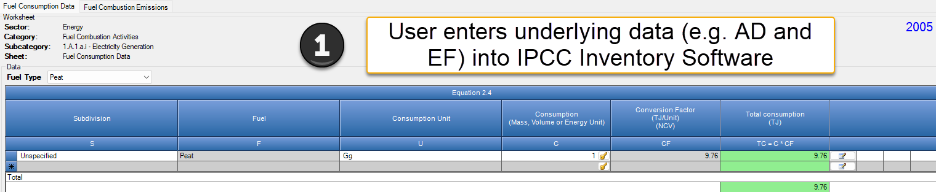
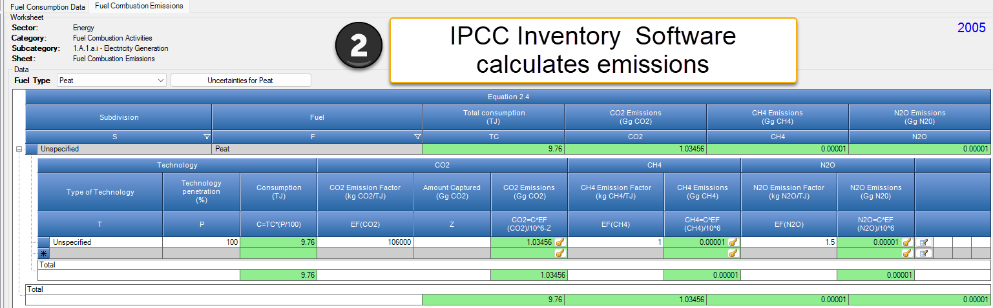
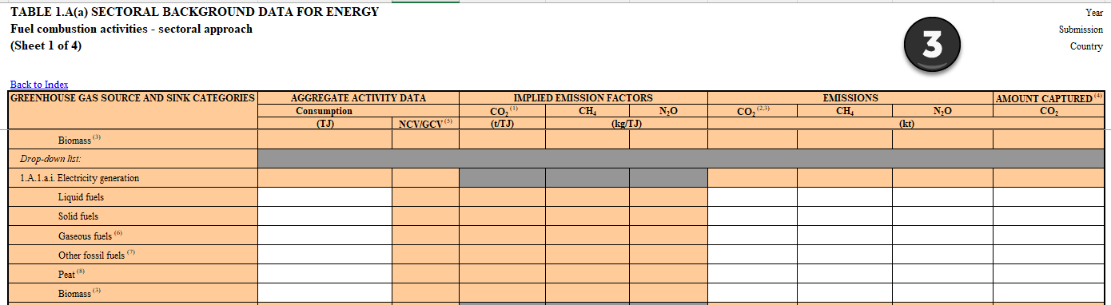
What is interoperability?
Interoperability: “The ability of computer systems or software to exchange and make use of information”
--Oxford Dictionary
AD, EFs and some parameters entered into cells of CRT

Slide 5

Why is interoperability important?
IPCC inventory software becomes a central component of a Party’s institutional arrangements to facilitate meeting UNFCCC national reporting obligations.
  Supports Parties in estimating GHG emissions/removals
  Organizing framework for data collection efforts among entities
  Minimizes error
  Reduces reporting burden

Slide 6
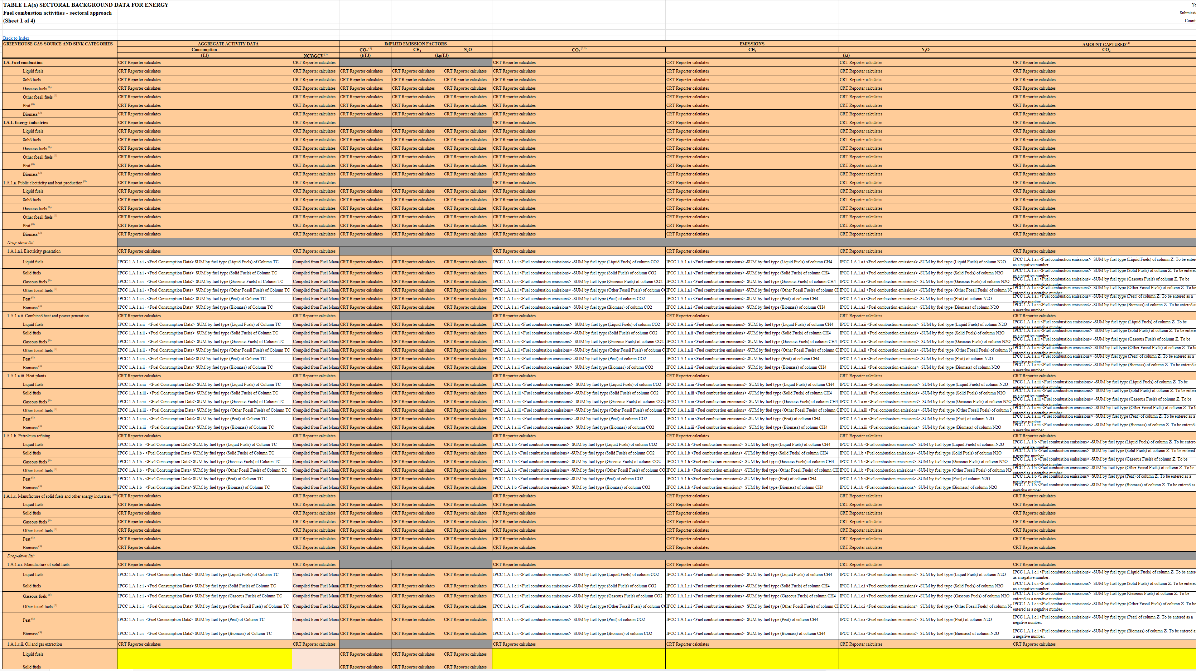
Making the Link
UNFCCC and IPCC working closely together
Identifying differences between the IPCC Inventory software and agreed CRT
Preparing a detailed, cell-by-cell mapping to identify the source data from the IPCC inventory software that will populate the CRT
Prepare a strategy to facilitate population of the CRT data for UNFCCC reporting
Mapping tables to be published to facilitate users’ understanding

Slide 7
Making the Link
  There are a number of categories in the CRT from decision 5/CMA.3 that are from the 2019 Refinement to the 2006 IPCC Guidelines. We are exploring the best ways to accommodate these specific categories in the IPCC Inventory software to enable transparent and comparable mapping
  Examples of (Sub-) Categories from 2019 Refinement/ UNFCCC CRT
  Exploring approach for confidentiality
  Considering role of notation keys in the IPCC software
  Flexibility
Energy | IPPU | Waste
Charcoal and Biochar Production Coke Production Solid to Solid Fuel production Gasification Transformation (CRT further divides into coal-to-liquids and gas-to-liquids) Abandoned Oil Wells Gas Post-Meter Abandoned Gas Wells | HFC production (CRT has HFC-134-a production) PFC Production SF₆ Production NF₃ Production Hydrogen Production Rare Earths Production Microelectromechanical systems Waterproofing of Electronic Circuits | Active-aeration landfills (subcategory of managed waste disposal sites in CRT), and disaggregation into varying degrees of decomposable waste

Slide 8
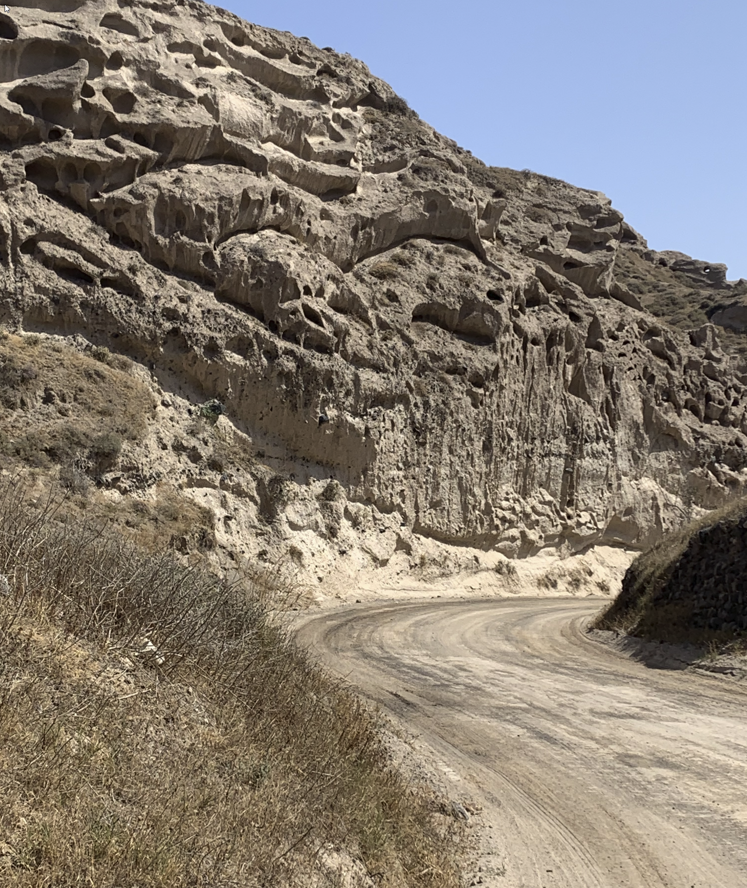
The Road Ahead
June 2024
Final version of CRT: interoperable with IPCC Inventory software
Striving to ensure users will be able to use the IPCC Inventory Software to apply all tiers/ approaches in the 2006 IPCC Guidelines, or a combination thereof, to calculate their GHG inventory.
Actively developing the mapping together with the UNFCCC to enable the updated IPCC Inventory software to “talk” to the UNFCCC CRT reporting tool, in line with Parties’ request at CMA3 (COP26) in Glasgow.
The best way for Parties to prepare for reporting under the ETF, is to start today.
If you are interested in using the software, or testing, please contact ipcc-software@iges.or.jp
  Learn about IPCC inventory software: https://www.ipcc-nggip.iges.or.jp/software/index.html
  Understand the UNFCCC reporting requirements (MPGs and further guidance)
  https://unfccc.int/sites/default/files/resource/cma2018_3_add2_new_advance.pdf https://unfccc.int/sites/default/files/resource/cma2021_10a2_adv_0.pdf
June 2023
Test version of UNFCCC CRT reporting tool available (test functions
of interoperability)
Today
Updating, testing, mapping of IPCC Inventory Software

Slide 9
Thank you
https://www.ipcc-nggip.iges.or.jp/index.html

