Slide 1
IPCC Inventory Software: Waste Sector
IPCC TFI Side Event
Sharm el-Sheikh Climate Change Conference
November 2022

Slide 2
Major updates
Subnational disaggregation at a category level
Tier 3 methods in 2006 IPCC Guidelines (Volume 5)
Methods in Wetlands Supplement (Chapter 6)
Improvements in worksheet structure and layout

Slide 3
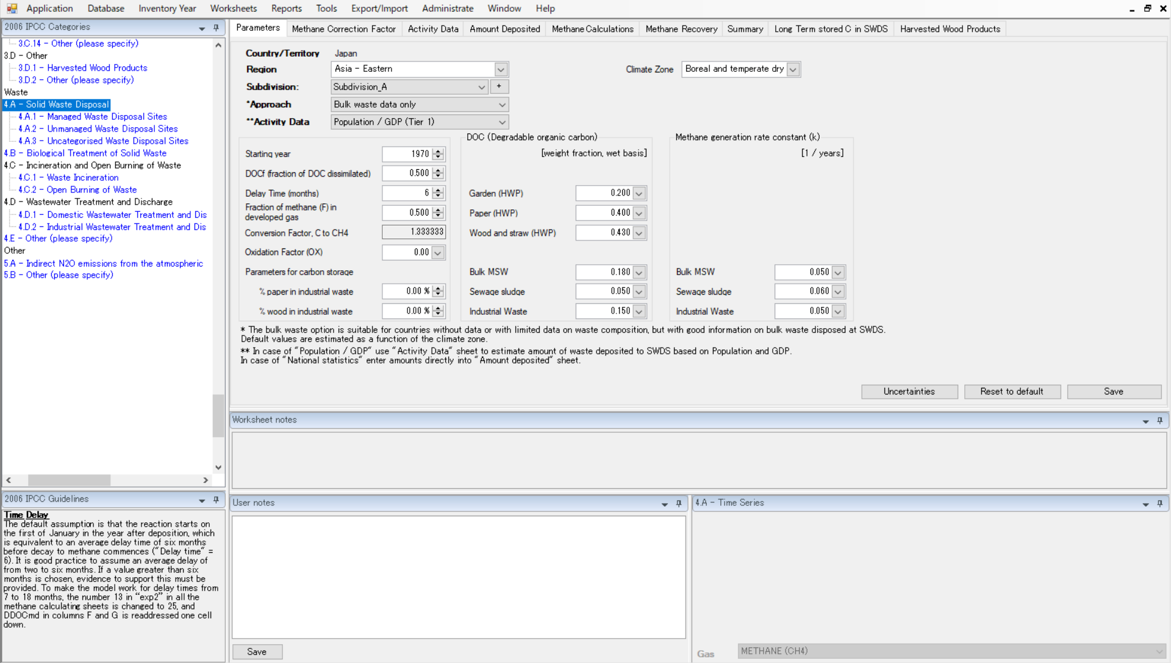
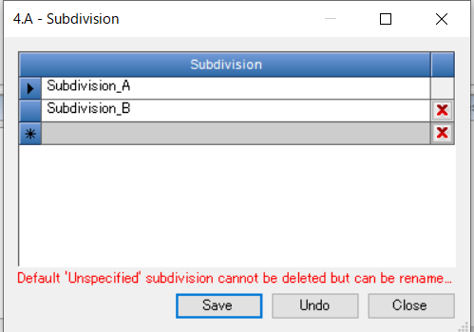
Subnational disaggregation
  Subdivision allows estimation of emissions at subnational level (e.g., regions by climate zone)
Select climate zone
Click to define subdivision

Slide 4
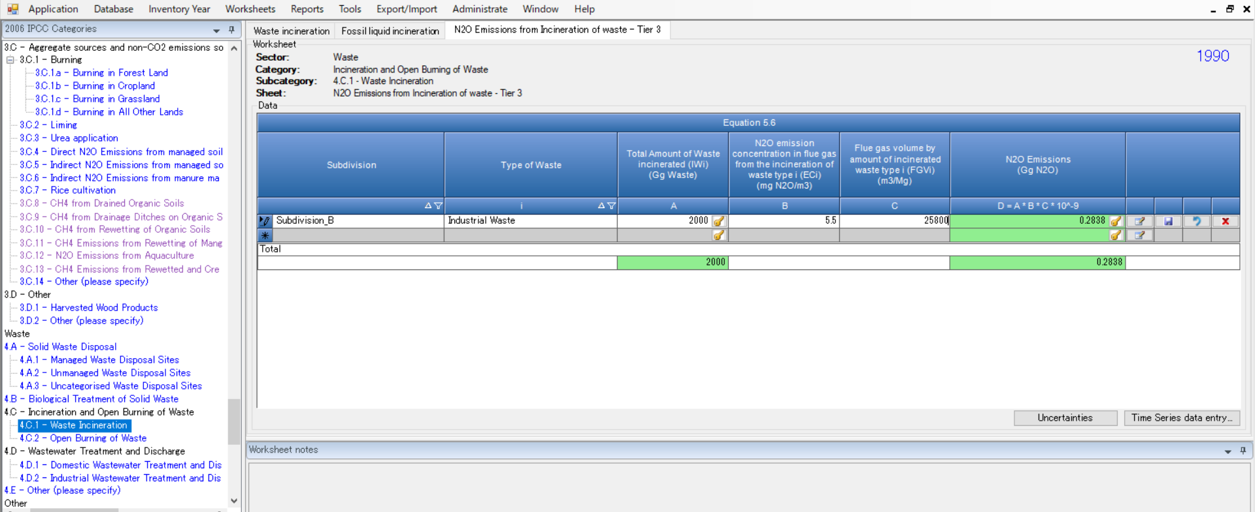
Tier 3 methods
  Estimation of N₂O emissions from waste incineration based on site specific data and flue gas concentration (Equation 5.6, Chapter 5, Volume 5, 2006 IPCC Guidelines)

Slide 5
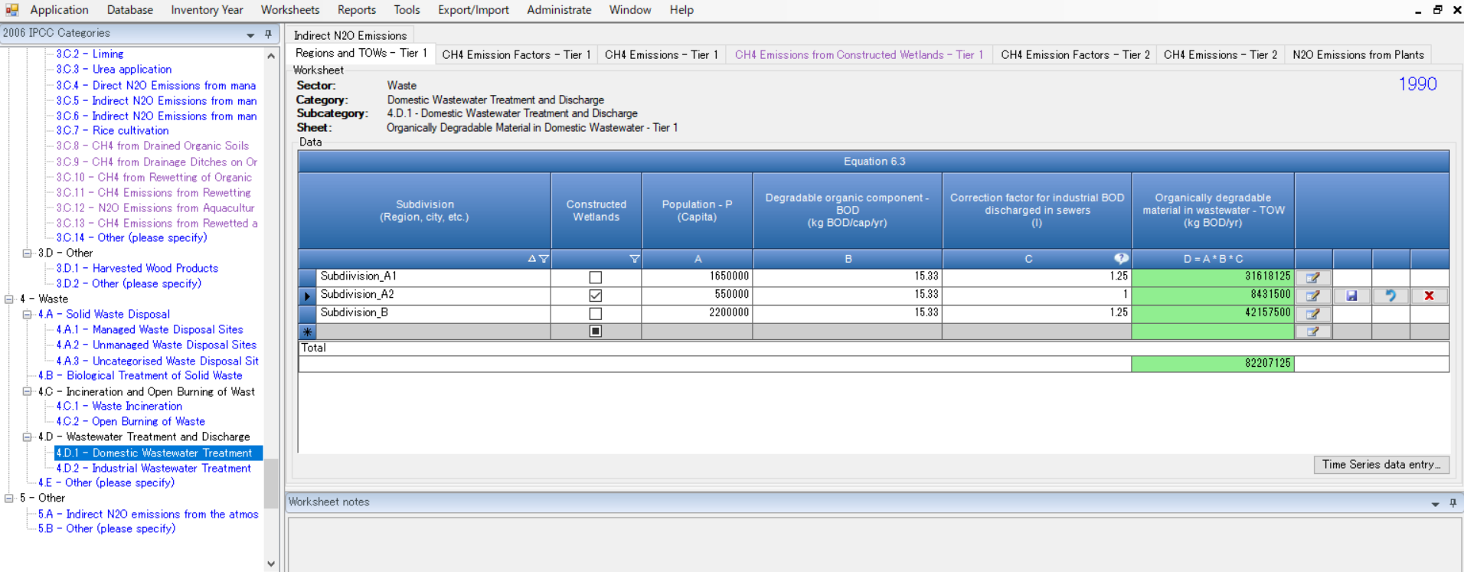
Wetlands Supplement
  Methods for estimation of CH₄ and N₂O emissions from constructed wetlands for wastewater treatment
  Note 1: Worksheets are subject to change due to ongoing update of the software (not updated/changed in beta version 2.83)

Slide 6
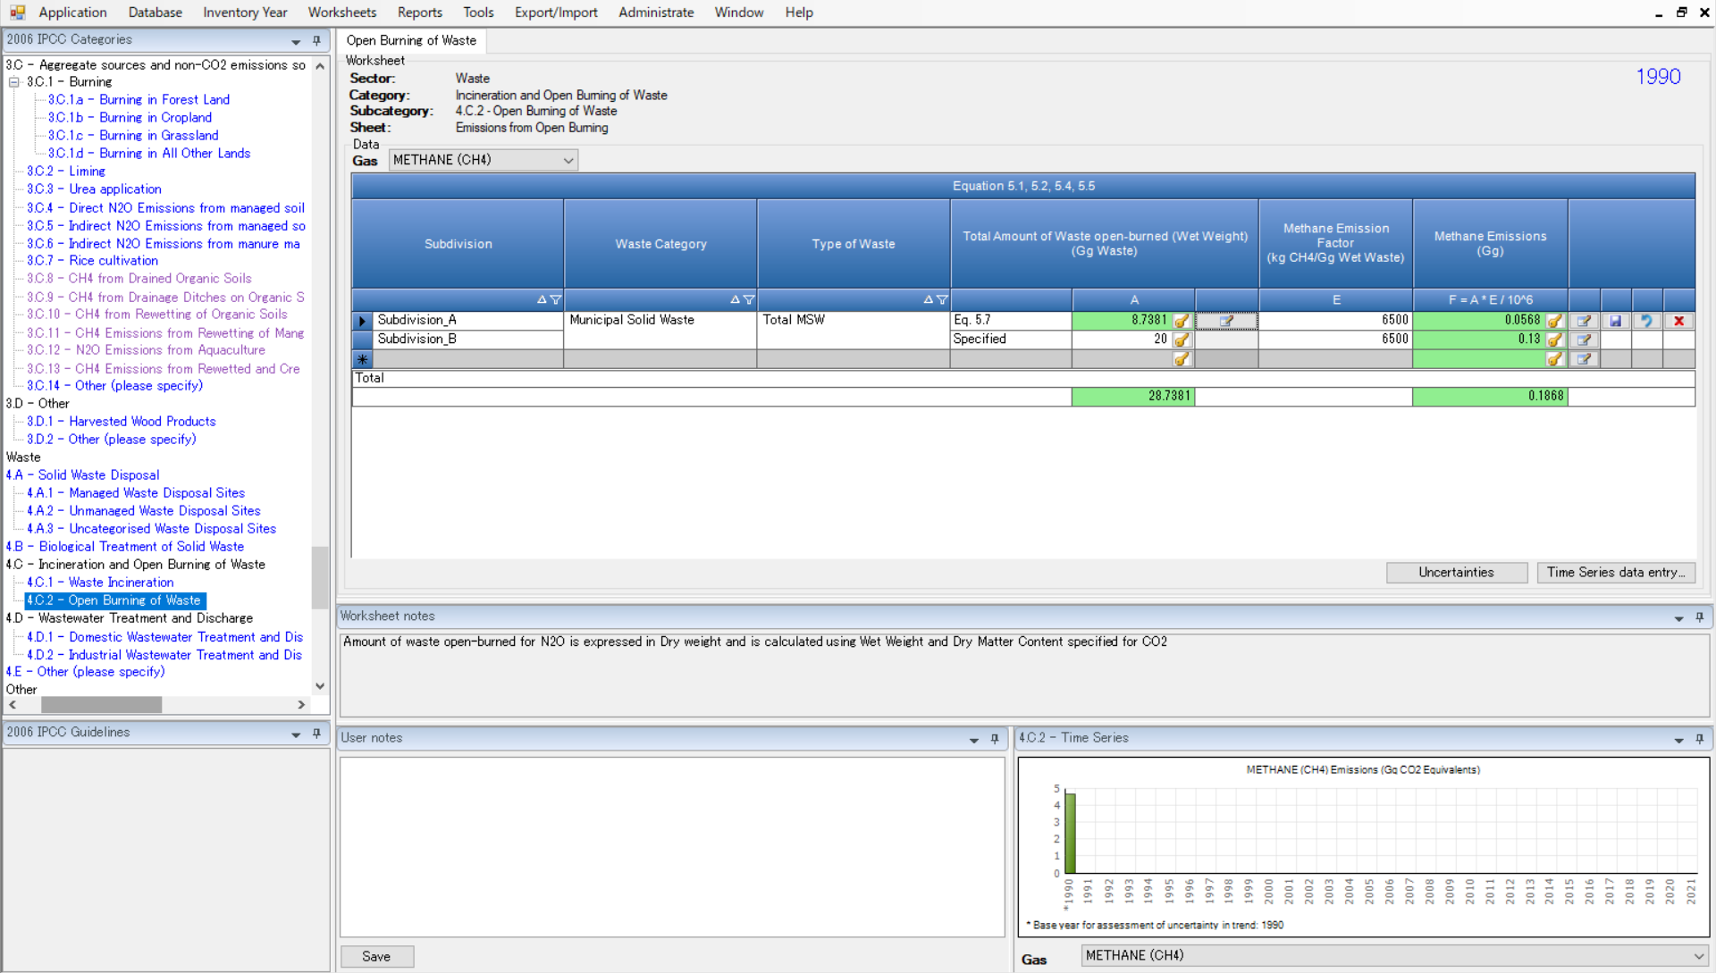
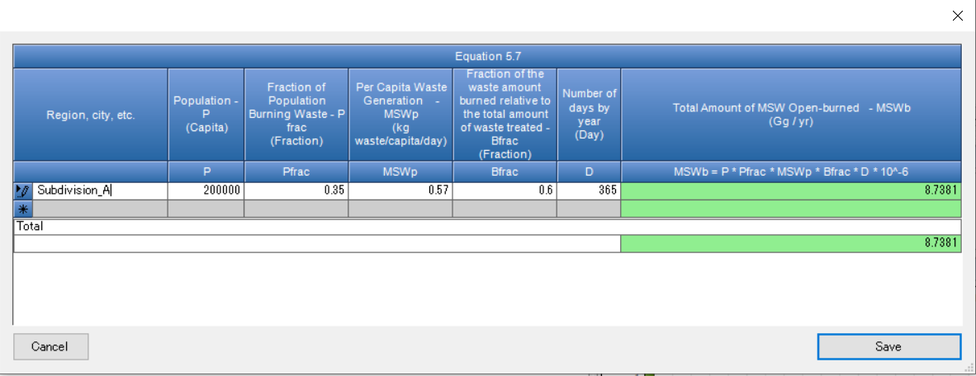
Improvements in worksheet structure and layout
Click here

Slide 7
Worksheets map
IPCC category | Total number of worksheets | Worksheets
 |  | Tier 1 | Tier 2 | Tier 3
4.A Solid Waste Disposal | 9(+3) | 9 |  | －
4.A.1 Managed waste disposal sites | 1*
4.A.2 Unmanaged waste disposal sites | 1*
4.A.3 Uncategorised waste disposal sites | 1*
4.B Biological Treatment of Solid Waste | 1 | 1 |  | －
4.C Incineration and Open Burning of Waste | 4
4.C.1 Waste incineration | 3 | 1 |  | 1
 |  | 1 | － | 1**
4.C.2 Open burning of waste | 1 | 1 |  | －
4.D Wastewater Treatment and Discharge | 13
4.D.1 Domestic wastewater treatment | 8 | 6 | 2
4.D.2 Industrial wastewater treatment | 5 | 4 | 1
4.E Other | 1*** |  | 1
Note 2: Worksheet counts show number of tabs and are subject to change due to ongoing update
* Additional worksheets to allow reporting of CH₄ emissions by solid waste disposal type
** Separate worksheet for Tier 3 estimation of N₂O emissions from waste incineration (Equation 5.6 )
***Implements generic equation (AD x EF). No default values are provided in the 2006 IPCC Guidelines

Slide 8
Worksheets (total)
IPCC category | Total number of worksheets
4.A Solid Waste Disposal | 12
4.B Biological Treatment of Solid Waste | 1
4.C Incineration and Open Burning of Waste | 4
4.D Wastewater Treatment and Discharge | 13
4.E Other | 1
Sectoral total | 31

Slide 9
Summary
Subdivision allows subnational disaggregation of emission estimates and flexibility based on data availability and national circumstances
Implements higher tier methods of the 2006 IPCC Guidelines (Volume 5) and methods of the Wetlands Supplement (Chapter 6)
Improvements in worksheet structure and layout provide more streamlined user interface
Guidebook for Waste sector is under development

Slide 10
Thank you
https://www.ipcc-nggip.iges.or.jp/index.html

