Slide 1
IPCC Inventory Software for National GHG inventories Overview of the AFOLU Sector
IPCC TFI Side Event
Sharm el-Sheikh - Climate Change Conference
UNFCCC COP27
November 2022

Slide 2
Major updates
Subnational disaggregation at a category level
Land Representation Manager
Higher Tiers methods in 2006 IPCC Guidelines (Vol 4) and additional methods in Wetlands Supplement
Improvements in worksheet structure and layout

Slide 3
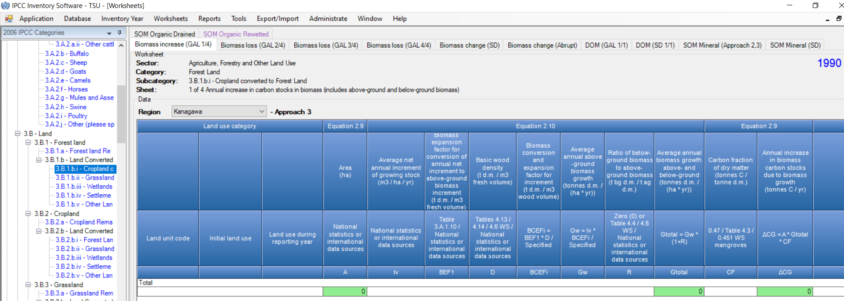
Subnational disaggregation
  Region/Geographical zone stratification allows to report at subnational level as well as to further disaggregate estimates according to e.g. drivers/stakeholders and/or relevant variables

Slide 4
Land Representation Manager (LRM)
Allows to use any of the three IPCC approaches:
  Approach 1 -no land use change identification-
  Approach 2 -land use change identification-
  Approach 3 -land use change identification and tracking across time-
  Ensures consistency of land representation -including through fully spatially explicit tracking of units of land-
  Unit of land, an area homogenous per
    physical conditions -climate/vegetation zone and soil type- and
    current and historical socio-economic functions -land use & management type-
    An excel-based tool to input at once the entire land representation is under preparation

Slide 5
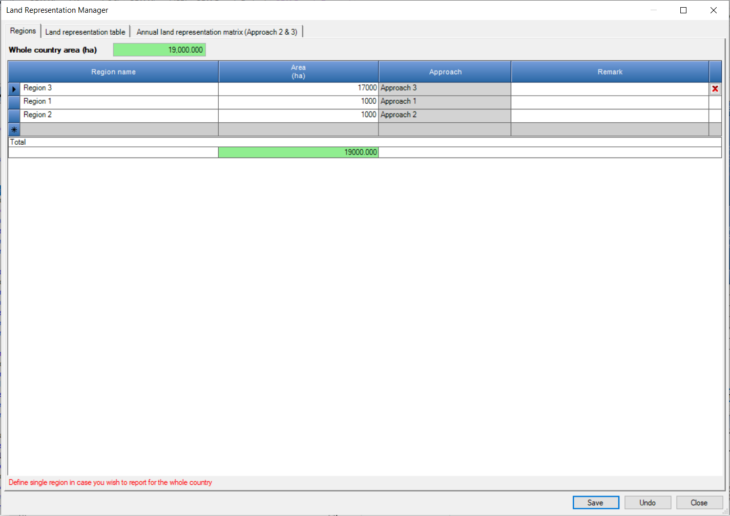
Regions Tab (LRM)
A country can be represented in a single set of National data or in a number of Regions
For each Region the land representation approach is to be selected

Slide 6
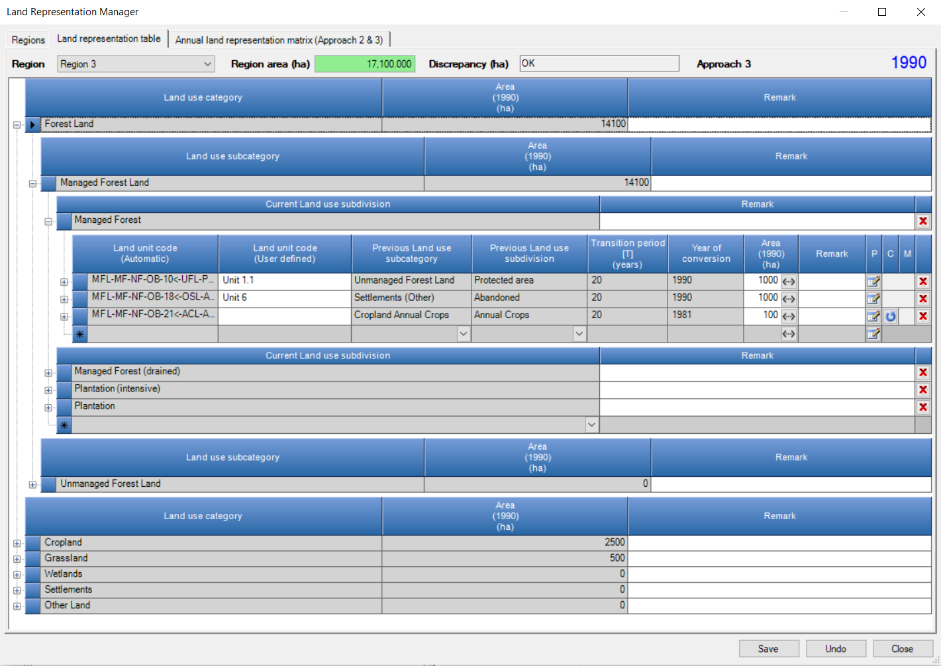
Land Representation Tab
A Table for each Region
All info on land use and land use changes is to be input in this Tab
Each unit of land is identified by a code and contains information on the current and previous land use/management
For each conversion, input Transition Period and Conversion Year, so the software tracks it across time
Data input in the time series is to be done from its first year forward

Slide 7
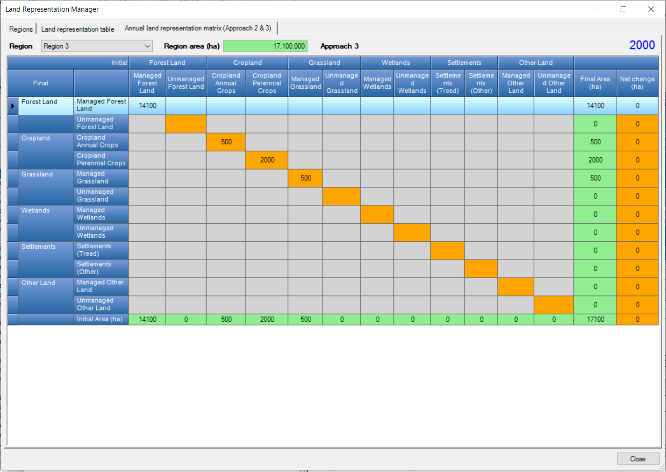
Annual land representation matrix Tab
No data Input, just for verification (not exportable yet)

Slide 8
Higher Tiers and additional methods
Stock difference approach
in each carbon pool of each land use
Formulation B for SOC change in mineral soils
When Approach 3 for land representation is applied, the software calculates SOC net changes associated with land use/management change based on the actual SOC content of the unit of land
Wetlands Supplement
Additional methods provided, identified through the use of Lilac color
Additional source/sink categories, identified through the use of Lilac color

Slide 9
Improvements in worksheet structure and layout
Combination of Tiers within the same set of worksheets, where the structure of IPCC equations allows e.g. Enteric fermentation
Addition of (set of) worksheets for each different Tier, where IPCC equations do not allow combination of multiple tiers e.g. Gain & Loss vs Stock-Difference
492 worksheets in total available, among which the user selects those that better deal with national circumstances.
Such a large number allows any combinations of tiers to be composed to estimate GHG emissions from the AFOLU sector.

Slide 10
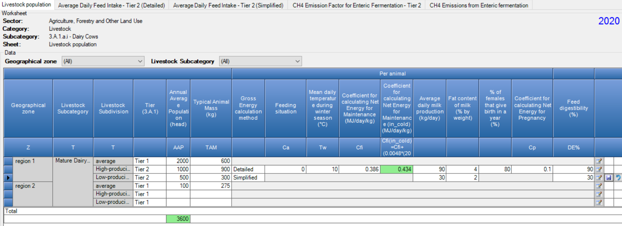
Improvements in worksheet structure and layout
3 methodological options
IPCC Default
Tier 2 – Detailed
Tier 2 – Simplified

Slide 11
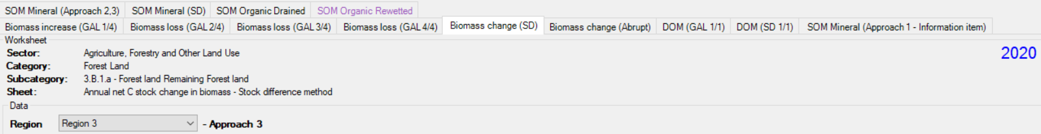
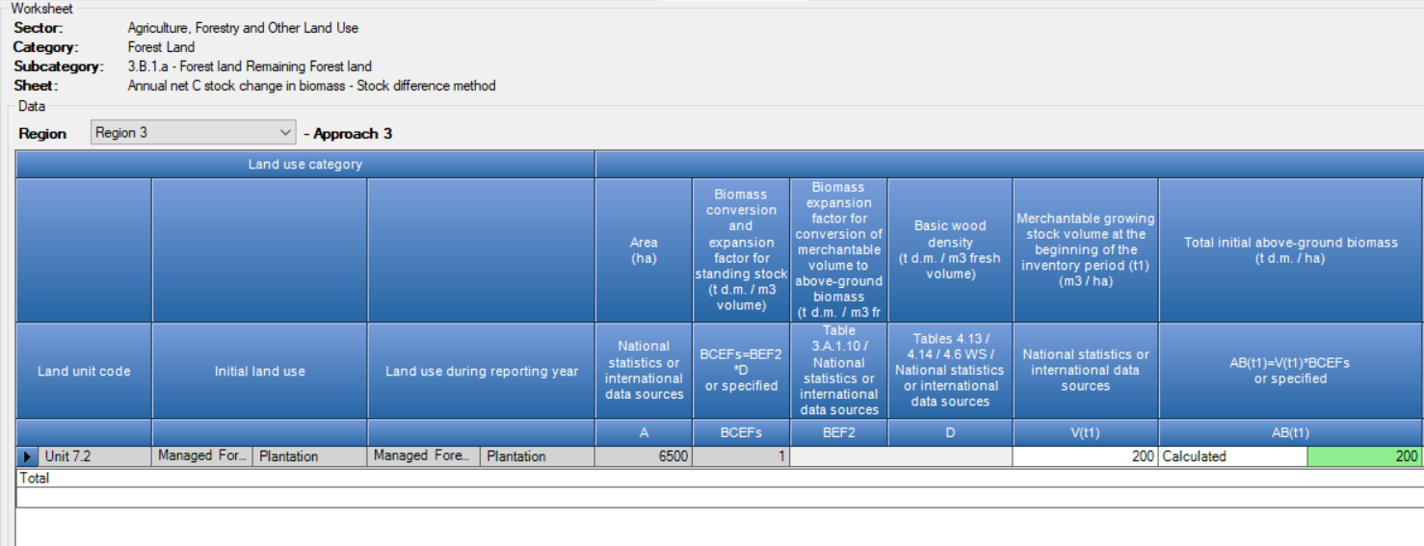
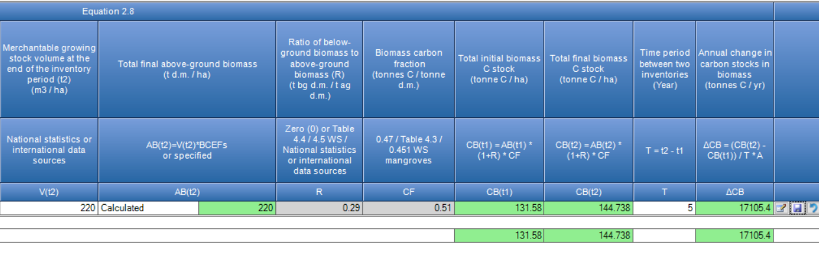


Improvements in worksheet structure and layout
BCEFs or BEF2 x D
Aboveground biomass (both, initial and final values):
  either calculated as Growing Stock (merchantable volume) x BCEF
  or input

Slide 12
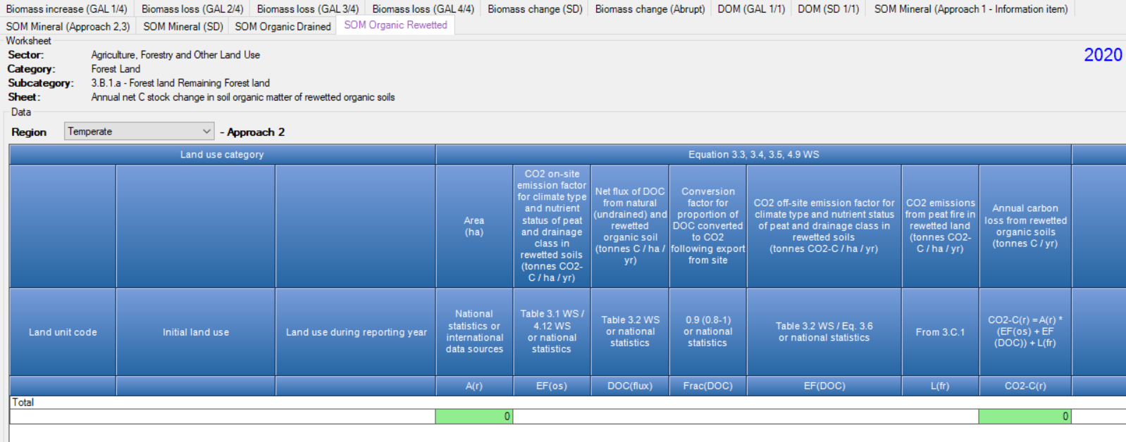
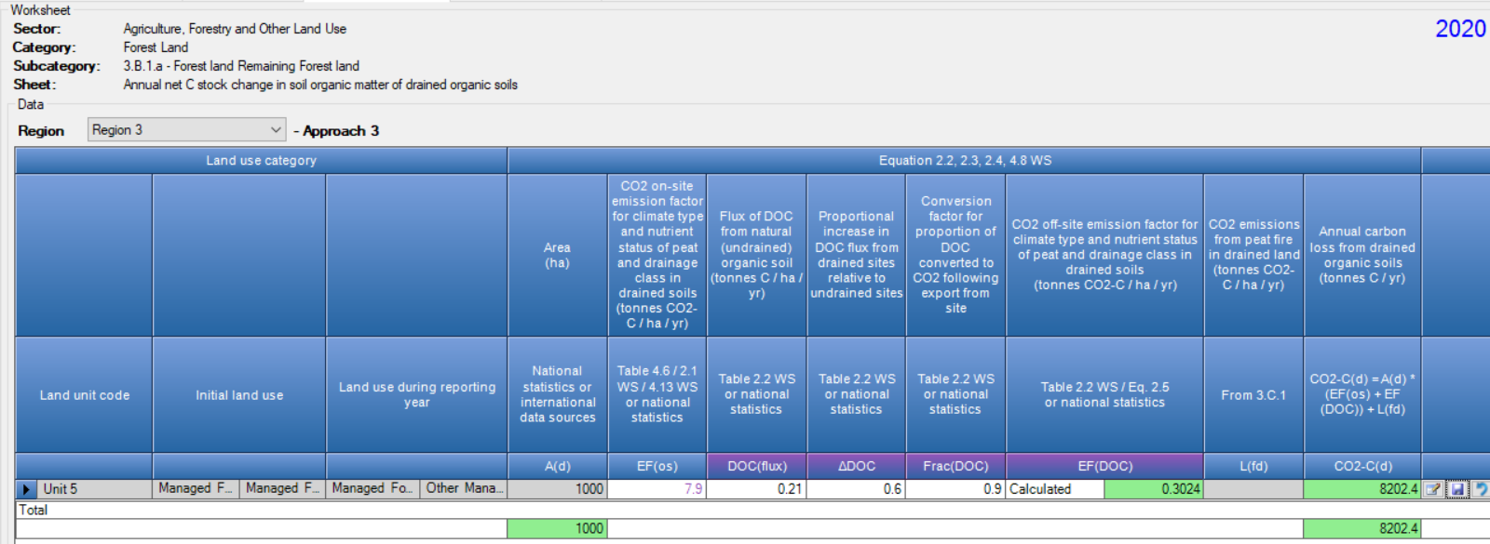

Improvements in worksheet structure and layout
Wetlands Supplement additional methods, identified through the use of Lilac color

Slide 13
Worksheets map
IPCC Category | Number of Worksheets
IPCC Category | Total | IPCC Tier (Equations)
 |  | Tier 1 | Tier 2 | Tier 3
3.A.1 – Enteric fermentation | 44
3.A.1.a – Cattle | 10
3.B.1.a.i – Dairy Cow | 5 | 2
 |  |  | 3
3.A.1.a.ii – Other Cattle | 5 | 2
 |  |  | 3
3.A.1.b – Buffalo | 5 | 2
 |  |  | 3
3.A.1.c – Sheep | 5 | 2
 |  |  | 3
3.A.1.d – Goats | 4 | 2
 |  |  | 2
3.A.1.e – Camels | 4 | 2
 |  |  | 2
3.A.1.f – Horses | 4 | 2
 |  |  | 2
3.A.1.g – Mules and Assess | 4 | 2
 |  |  | 2
3.A.1.h – Swine | 4 | 2
 |  |  | 2
3.A.1.j – Other | 4 | 2
 |  |  | 2
Tier 2 requires an energy balance -i.e. feed intake vs energy uses + manure- to estimate the fraction of energy used by enteric flora and requires stratification of livestock populations by age, diet, productivity and husbandry system. The energy balance can be calculated through a detailed calculation or simply derived from the dry matter intake and its quality (energy content and digestibility)

Slide 14
Worksheets map
IPCC Category | Number of Worksheets
IPCC Category | Total | IPCC Tier (Equations)
 |  | Tier 1 | Tier 2 | Tier 3
3.A.2 – Manure management | 104
3.A.2.a – Cattle | 22
3.B.2.a.i – Dairy Cow | 11 | 5
 |  | 1 | 5
3.A.2.a.ii – Other Cattle | 11 | 5
 |  | 1 | 5
3.A.2.b – Buffalo | 11 | 5
 |  | 1 | 5
3.A.2.c – Sheep | 11 | 5
 |  | 1 | 5
3.A.2.d – Goats | 10 | 5
 |  | 1 | 4
3.A.2.e – Camels | 10 | 5
 |  | 1 | 4
3.A.2.f – Horses | 10 | 5
 |  | 1 | 4
3.A.2.g – Mules and Assess | 10 | 5
 |  | 1 | 4
3.A.2.h – Swine | 10 | 5
 |  | 1 | 4
3.A.2.j – Other | 10 | 5
 |  | 1 | 4
Tier 2 requires an energy balance -i.e. feed intake vs energy uses + manure- to estimate the fraction of energy used by enteric flora and requires stratification of livestock populations by age, diet, productivity and husbandry system. The energy balance can be calculated through a detailed calculation or simply derived from the dry matter intake and its quality (energy content and digestibility). Further Tier 2 requires daily estimates of:
Volatile solid excretion rate, base don additional info on the urinary energy and ash content of manure
N excretion rate, based on daily N intake and N retention rate

Slide 15
Worksheets map
IPCC Category | Number of Worksheets
IPCC Category | Total | IPCC Tier (Equations)
 |  | Tier 1 | Tier 2 | Tier 3
3.B.1 – Forest land | 73
3.B.1.a – Forest land remaining Forest land | 13 | 4 B + (1**)
 |  | 1* SOM 2.25A +1 +1
 |  |  | 1** SOM 2.25B | 3 SD
 |  |  | 1 DOM G&L
3.B.1.b – Land converted to Forest land | 60
3.B.1.b.i – Cropland converted to Forest land | 12 | 4 B + (1)
 |  | 1 SOM 2.25B +1 +1 |  | 3 SD
 |  |  | 1 DOM G&L
3.B.1.b.ii – Grassland converted to Forest land | 12 | 4 B + (1)
 |  | 1 SOM 2.25B +1 +1 |  | 3 SD
3.B.1.b.ii – Grassland converted to Forest Land |  |  | 1 DOM G&L
3.B.1.b.iii – Wetlands converted to Forest land | 12 | 4 B + (1)
 |  | 1 SOM 2.25B +1 +1 |  | 3 SD
3.B.1.b.iii – Wetlands converted to Forest Land |  |  | 1 DOM G&L
3.B.1.b.iv – Settlements converted to Forest land | 12 | 4 B + (1)
 |  | 1 SOM 2.25B +1 +1 |  | 3 SD
3.B.1.b.iv – Settlements converted to Forest Land |  |  | 1 DOM G&L
3.B.1.b.v – Other land converted to Forest land | 12 | 4 B + (1)
 |  | 1 SOM 2.25B +1 +1 |  | 3 SD
3.B.1.b.v – Other land converted to Forest Land |  |  | 1 DOM G&L
The IPCC Default –i.e. the Gain & Loss– method applies to all Tiers (where default values are provided by IPCC), while the Stock-Difference method applies to Tier 3 only
A worksheet for “abrupt biomass loss” is provided (eq 2.16), although it does not apply to harvesting losses

Slide 16
Worksheets map
IPCC Category | Number of Worksheets
IPCC Category | Total | IPCC Tier (Equations)
 |  | Tier 1 | Tier 2 | Tier 3
3.B.2 – Cropland | 55
3.B.2.a – Cropland remaining Cropland | 10 | 1 B + (1)
 |  | 1 SOM 2.25B & 1* SOM 2.25A +1 +1 |  | 3 SD
 |  |  | 1 DOM G&L
3.B.2.b – Land converted to Cropland | 45
3.B.2.b.i – Forest land converted to Cropland | 9 | 1 B + (1)
 |  |  | 1 DOM G&L
 |  | 1 SOM 2.25B +1 +1 |  | 3 SD
3.B.2.b.ii – Grassland converted to Cropland | 9 | 1 B + (1)
 |  |  | 1 DOM G&L
3.B.1.b.ii – Grassland converted to Forest Land |  | 1 SOM 2.25B +1 +1 |  | 3 SD
3.B.2.b.iii – Wetlands converted to Cropland | 9 | 1 B + (1)
 |  |  | 1 DOM G&L
3.B.1.b.iii – Wetlands converted to Forest Land |  | 1 SOM 2.25B +1 +1 |  | 3 SD
3.B.2.b.iv – Settlements converted to Cropland | 9 | 1 B + (1)
 |  |  | 1 DOM G&L
3.B.1.b.iv – Settlements converted to Forest Land |  | 1 SOM 2.25B +1 +1 |  | 3 SD
3.B.2.b.v – Other land converted to Cropland | 9 | 1 B + (1)
 |  |  | 1 DOM G&L
3.B.1.b.v – Other land converted to Forest Land |  | 1 SOM 2.25B +1 +1 |  | 3 SD
The IPCC Default –i.e. the Gain & Loss– method applies to all Tiers (where default values are provided by IPCC), while the Stock-Difference method applies to Tier 3 only

Slide 17
Worksheets map
IPCC Category | Number of Worksheets
IPCC Category | Total | IPCC Tier (Equations)
 |  | Tier 1 | Tier 2 | Tier 3
3.B.3 – Grassland | 55
3.B.3.a – Grassland remaining Grassland | 10 | 1 B + (1)
 |  | 1 SOM 2.25B & 1* SOM 2.25A +1 +1 |  | 3 SD
 |  |  | 1 DOM G&L
3.B.3.b – Land converted to Grassland | 45
3.B.3.b.i – Forest land converted to Grassland | 9 | 1 B + (1)
 |  |  | 1 DOM G&L
 |  | 1 SOM 2.25B +1 +1 |  | 3 SD
3.B.3.b.ii – Cropland converted to Grassland | 9 | 1 B + (1)
 |  |  | 1 DOM G&L
3.B.1.b.ii – Grassland converted to Forest Land |  | 1 SOM 2.25B +1 +1 |  | 3 SD
3.B.3.b.iii – Wetlands converted to Grassland | 9 | 1 B + (1)
 |  |  | 1 DOM G&L
3.B.1.b.iii – Wetlands converted to Forest Land |  | 1 SOM 2.25B +1 +1 |  | 3 SD
3.B.3.b.iv – Settlements converted to Grassland | 9 | 1 B + (1)
 |  |  | 1 DOM G&L
3.B.1.b.iv – Settlements converted to Forest Land |  | 1 SOM 2.25B +1 +1 |  | 3 SD
3.B.3.b.v – Other land converted to Grassland | 9 | 1 B + (1)
 |  |  | 1 DOM G&L
3.B.1.b.v – Other land converted to Forest Land |  | 1 SOM 2.25B +1 +1 |  | 3 SD
The IPCC Default –i.e. the Gain & Loss– method applies to all Tiers (where default values are provided by IPCC), while the Stock-Difference method applies to Tier 3 only

Slide 18
Worksheets map
IPCC Category | Number of Worksheets
IPCC Category | Total | IPCC Tier (Equations)
 |  | Tier 1 | Tier 2 | Tier 3
3.B.4 – Wetlands | 28
3.B.4.a – Wetlands remaining Wetlands | 12
3.B.4.a.i – Peat Extraction remaining Peat Extraction | 3 | +1 +2
3.B.4.a.ii – Flooded land remaining Flooded land
3.B.4.a.iii – Other Wetlands remaining Other Wetlands | 9 | +2 |  | 3 SD
 |  | 1* SOM2.25A
 |  |  | 2 B&DOM G&L
 |  |  | 1 SOM2.25B
3.B.4.b – Land converted to Wetlands | 16
3.B.4.b.i – Land converted for Peat Extraction | 6 | 2 B&DOM +1 +2 |  | 1 SD
3.B.4.b.ii – Land converted to Flooded land | 1 | 1
3.B.4.b.iii – Land converted to Other Wetlands | 9 | 1 SOM2.25B +2 |  | 3 SD
3.B.1.b.iii – Wetlands converted to Forest Land |  | 2 B
 |  |  | 1 DOM G&L
The IPCC Default –i.e. the Gain & Loss– method applies to all Tiers (where default values are provided by IPCC), while the Stock-Difference method applies to Tier 3 only

Slide 19
Worksheets map
IPCC Category | Number of Worksheets
IPCC Category | Total | IPCC Tier (Equations)
 |  | Tier 1 | Tier 2 | Tier 3
3.B.5 – Settlements | 61
3.B.5.a – Settlements remaining Settlements | 11 | +1 +2 | +1 +2
 |  | 1* SOM 2.25A
 |  |  | 2 B&DOM G&L + (1**)
 |  |  | 1** SOM 2.25B | 3 SD
3.B.5.b – Land converted to Settlements | 50
3.B.5.b.i – Forest land converted to Settlements | 10 | 1 B + (1)
 |  |  | 1 DOM G&L
 |  | 1 SOM 2.25B +1 +2 |  | 3 SD
3.B.5.b.ii – Cropland converted to Settlements | 10 | 1 B + (1)
 |  |  | 1 DOM G&L
3.B.1.b.ii – Grassland converted to Forest Land |  | 1 SOM 2.25B +1 +2 |  | 3 SD
3.B.5.b.iii – Grassland converted to Settlements | 10 | 1 B + (1)
 |  |  | 1 DOM G&L
3.B.1.b.iii – Wetlands converted to Forest Land |  | 1 SOM 2.25B +1 +2 |  | 3 SD
3.B.5.b.iv – Wetlands converted to Settlements | 10 | 1 B + (1)
 |  |  | 1 DOM G&L
3.B.1.b.iv – Settlements converted to Forest Land |  | 1 SOM 2.25B +1 +2 |  | 3 SD
3.B.5.b.v – Other land converted to Settlements | 10 | 1 B + (1)
 |  |  | 1 DOM G&L
3.B.1.b.v – Other land converted to Forest Land |  | 1 SOM 2.25B +1 +1 |  | 3 SD
The IPCC Default –i.e. the Gain & Loss– method applies to all Tiers (where default values are provided by IPCC), while the Stock-Difference method applies to Tier 3 only

Slide 20
Worksheets map
IPCC Category | Number of Worksheets
IPCC Category | Total | IPCC Tier (Equations)
 |  | Tier 1 | Tier 2 | Tier 3
3.B.6 – Other land | 20
3.B.6.a – Other land remaining Other land
3.B.6.b – Land converted to Other land | 20
3.B.6.b.i – Forest land converted to Other land | 4 | (1)
 |  |  | 1 DOM SD
 |  | 1 SOM 2.25B +1
3.B.6.b.ii – Cropland converted to Other land | 4 | (1)
 |  |  | 1 DOM SD
3.B.1.b.ii – Grassland converted to Forest Land |  | 1 SOM 2.25B +1
3.B.6.b.iii – Grassland converted to Other land | 4 | (1)
 |  |  | 1 DOM SD
3.B.1.b.iii – Wetlands converted to Forest Land |  | 1 SOM 2.25B +1
3.B.6.b.iv – Wetlands converted to Other land | 4 | (1)
 |  |  | 1 DOM SD
3.B.1.b.iv – Settlements converted to Forest Land |  | 1 SOM 2.25B +1
3.B.6.b.v – Settlements converted to Other land | 4 | (1)
 |  |  | 1 DOM SD
3.B.1.b.v – Other land converted to Forest Land |  | 1 SOM 2.25B +1
The IPCC Default –i.e. the Gain & Loss– method applies to all Tiers (where f\default values are provided by IPCC)

Slide 21
Worksheets map
IPCC Category | Number of Worksheets
IPCC Category | Total | IPCC Tier (Equations)
 |  | Tier 1 |  | Tier 2 | Tier 3
3.C.1 – Biomass burning | 12
3.C.1.a – Biomass burning in Forest land | 3 | 3
3.C.1.b – Biomass burning in Cropland | 3 | 3
3.C.1.c – Biomass burning in Grassland | 3 | 3
3.C.1.d – Biomass burning in all other lands | 3 | 3
3.C.2 – Liming | 1 | 1
3.C.3 – Urea application | 1 | 1
3.C.4 – Direct N₂O emissions | 10 | 9 +1
3.C.5 – Indirect N₂O emissions from managed soils | 2 | 2
3.C.6 – Indirect N₂O emissions from manure management | 4 | 4
3.C.7 – Rice cultivation | 1 | 1
3.C.8 – CH₄ emissions from drained inland organic soils | 1 | 1
3.C.9 – CH₄ from drainage ditches on organic soils | 1 | 1
3.C.10 – CH₄ from rewetting of inland organic soils | 1 | 1
3.C.11 – CH₄ from rewetting of mangroves and tidal marshes | 1 | 1
3.C.12 – N₂O emissions from aquaculture | 1 | 1
3.C.13 – CH₄ from rewetted and created Wetlands in inland wetland mineral soils | 1 | 1
3.C.14 – Other | 1 |  | 1***
3.D.1 – Harvested Wood Products | 13 | 13
3.D.2 – Other | 1 |  | 1***
The methodological tier of CO₂ emissions estimated as C stock losses in 3.B categories could be higher than that of non-CO₂ emissions

Slide 22
IPCC Category | Worksheets Number
IPCC Category | Total
3.A. – Livestock | 148
3.A.1 – Enteric fermentation | 44
3.A.2 – Manure management | 104
3.B. – Land | 292
3.B.1 – Forest land | 73
3.B.2 – Cropland | 55
3.B.3 – Grassland | 55
3.B.4 – Wetlands | 28
3.B.5 – Settlements | 61
3.B.6 – Other land | 20
3.C. – Aggregated Sources and non-CO₂ emissions sources on land | 38
3.C.1 – Biomass burning | 12
3.C.2 – Liming | 1
3.C.3 – Urea application | 1
3.C.4 – Direct N₂O emissions | 10
3.C.5 – Indirect N₂O emissions from managed soils | 2
3.C.6 – Indirect N₂O emissions from manure management | 4
3.C.7 – Rice cultivation | 1
3.C.8 – CH₄ emissions from drained inland organic soils | 1
3.C.9 – CH₄ from drainage ditches on organic soils | 1
3.C.10 – CH₄ from rewetting of inland organic soils | 1
3.C.11 – CH₄ from rewetting of mangroves and tidal marshes | 1
3.C.12 – N₂O emissions from aquaculture | 1
3.C.13 – CH₄ from rewetted and created Wetlands in inland wetland mineral soils | 1
3.C.14 – Other | 1
3.D. - Other | 14
3.D.1 – Harvested Wood Products | 13
3.D.2. – Other | 1
TOTAL AFOLU SECTOR | 492

Slide 23
Worksheets map [notes]
() for biomass and in the year of change only
+1 for drained organic soils only
+2 on-site and off-site emissions associated with extracted peat decay
+1 for rewetted organic soils only
+2 for rewetted organic soil or for SOM excavation in Wetlands
* for regions where Approach 1 of land representation is applied only
** for management changes only
*** The IPCC generic methodology [ADxEF] applies, but no IPCC default values are provided for EF

Slide 24
Summary
All methods in the 2006 IPCC Guidelines are implemented in the IPCC Inventory Software
Thus, needed flexibility to deal with any national circumstances, as per IPCC tiered approach, is ensured
Subnational disaggregation
Thus, tracking of specific activities/projects, and associated emission level & trend, within a national GHG inventory is allowed
AFOLU sector Guidebook – version 1 under development

Slide 25
Thank you
https://www.ipcc-nggip.iges.or.jp/index.html

