Slide 1
Version 2.83 of the IPCC Inventory Software and current development plans
IPCC TFI Side Event
Sharm el-Sheikh - Climate Change Conference
UNFCCC COP27
November 2022

Slide 2
Outline
The Software
Shape
Functionalities
The Version 2.83
Main features
Work in progress
Supporting tools
Downloading and testing
TFI TSU support to users

Slide 3
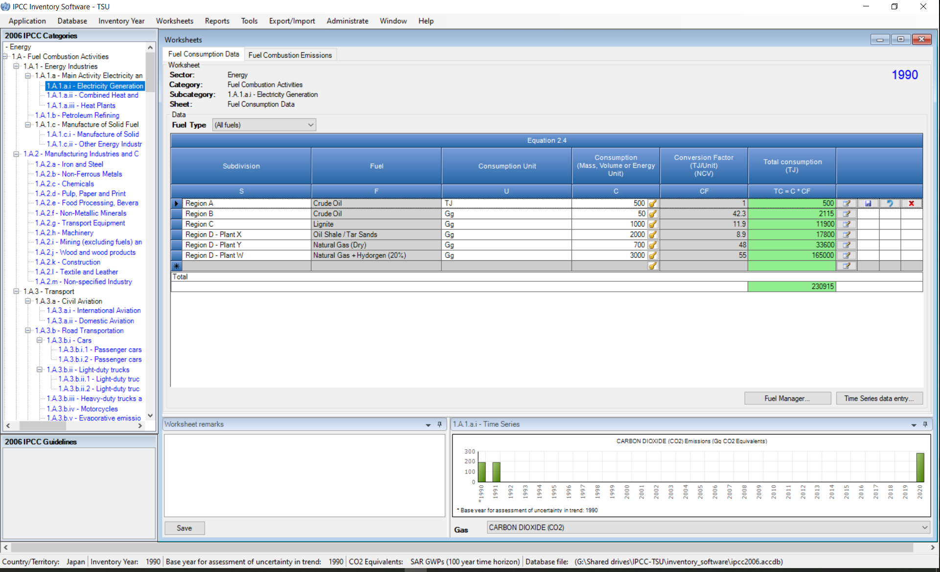
The Software
Selecting Functionalities
Selecting Worksheets
Selecting categories
Free to use

Slide 4
Software Functions
Administration functions: Country, Users, Years
Contains default data
QA/QC: Uncertainty analysis, KCA, Reference method
Worksheets for data entry
Data Managers: *Fuel
*Land Representation
* Land Use
*Livestock
Data Export
and
Import
Data Archive
XML file, single year only
ACCDB file, backup function
MSAccess (ACE OLEDB 12) for WindowsOS
Microsoft .NET Framework 4.6.2

Slide 5
Version 2.83
current beta version 2.83 main features
implements all IPCC Tiers and Approaches to estimate GHG emissions/removals, as provided in the 2006 IPCC Guidelines and its 2013 Wetlands Supplement
allows, in each equation, to input user-specific values for EFs and parameters
allows subnational level of reporting
can be used for the whole inventory or just individual categories
allows different sectors to be developed simultaneously
allows different Tier-worksheets to be used altogether within a category

Slide 6
Ongoing work
Paris Agreement requirements
AR5 GWP100
Indirect CO₂ emissions
(memo item) Indirect N₂O emissions
Interoperability with UNFCCC reporting tool for CRTs (5/CMA.3)
Other
Notation Keys
Time series export/import
Supporting tools

Slide 7
Supporting tools
Excel-based tool for data upload in the IPCC Inventory Software
Harvested Wood Products
Land Representation (mulitple Regions, all Approaches)
Other
User Guidebook for each sector (step-by-step instructions)
Land representation Adds-on:
based on wall-to-wall data collection and analysis (maps)
Under development by FAO SEPAL Team
based on sampling data collection and analysis (inventories)
Under development through FAO-COLLECT EARTH customization

Slide 8
Future work
Uncertainty Analysis, Approach 2
Key Category Analysis, Approach 2
Multiple users at category level
Interconnection with the EFDB

Slide 9
Downloading the file of Version 2.83
Version 2.83 of the IPCC Inventory Software comes with 2 alternative installation packages –i.e. 64bit vs 32bit–.
To select the appropriate file users shall follow the below decision tree:

Slide 10
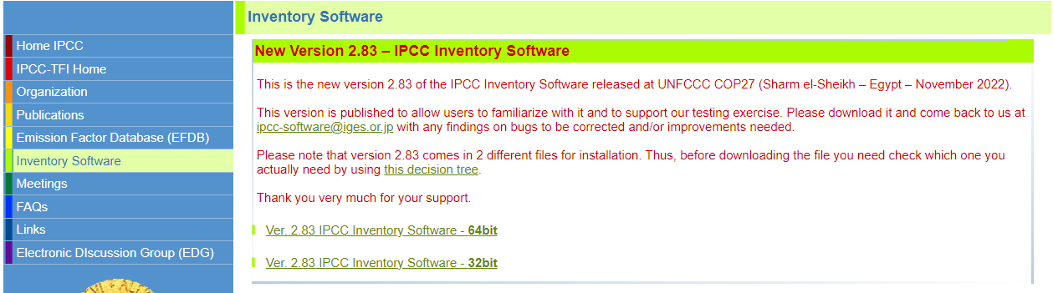
Download it at https://www.ipcc-nggip.iges.or.jp/software/index.html
In coming months, according to the software development plan as well as to feedback from testing, new versions will be released until the work on interoperability is completed
Please support us through testing and reporting your findings at
ipcc-software@iges.or.jp

Slide 11
Support
TFI TSU is supporting the IPCC Inventory Software
User Manual
Help Desk - E-mail ipcc-software@iges.or.jp
Pool of voluntary testers, to support software development and use
Cooperation in the UNFCCC training workshops on the use of the IPPC Inventory Software
Annual meeting on feedback from software users, including issues where support is needed or a software improvements is envisaged
next year focus on IPPU & Waste sectors and interoperability
In the 7th IPCC assessment cycle (from July 2023) the plan and support may be subject to changes, depending on consideration by the IPCC and the new Bureau of the Task Force on National Greenhouse Gas Inventories

Slide 12
Thank you
https://www.ipcc-nggip.iges.or.jp/software/index.html
ipcc-software@iges.or.jp

