Slide 1


Regional scoping workshops on loss & damage under the Santiago network
SYNTHESIS OF ALL REGIONS

Slide 2
TABLE OF CONTENTS
01
02
03
INTRODUCTION
METHODOLOGY
SYNTHESIS – RAPID ONSET
EVENTS
04
SYNTHESIS – SLOW-ONSET
EVENTS

Slide 3
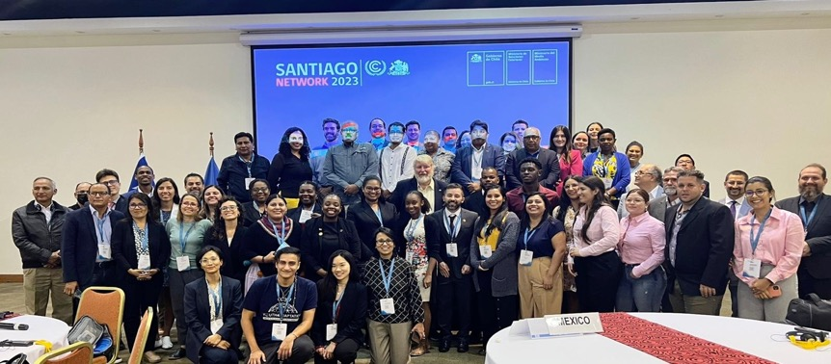
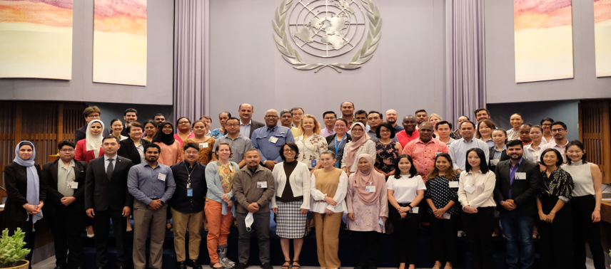
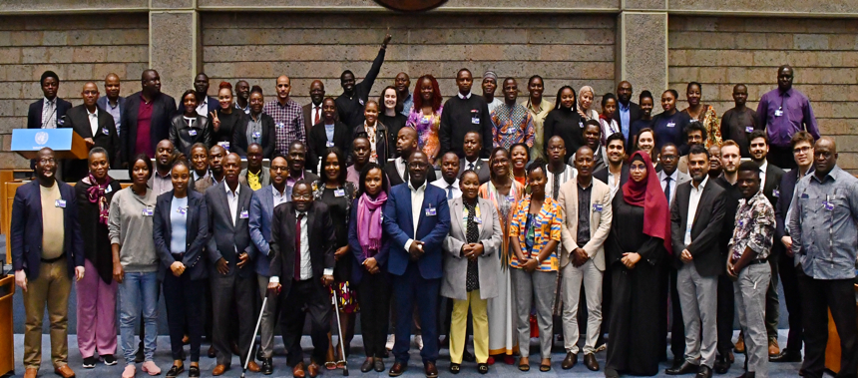
OVERVIEW
The Santiago network for averting, minimizing and addressing loss and damage (Santiago network) brought together relevant focal points from countries in the Latin America and Caribbean regions, Africa region and Asia Pacific region with expertise and direct involvement in dealing with the most pressing climatological hazards of the countries.
The workshop was held pursuant to decision 12/CMA.4, para 15, whereby the UNFCCC secretariat is requested to continue providing support for developing countries that are particularly vulnerable to the adverse effects of climate change that may seek or wish to benefit from the technical assistance available under the Santiago network, until a new the Santiago network secretariat is identified and becomes operational next year.
The objective of the workshop was to engage countries in identifying and synthesizing information and insights on their experience in addressing major impacts of climate change, in particular major losses and damages resulting from hydro-meteorological hazards and extremes, as well as specific needs for technical assistance at different stages of responding to and addressing the losses and damages. The outputs from the workshops will be used to better define and scope the typical technical assistance needs of developing countries in the context of the Santiago network.

Slide 4



TIMELINE OF WORKSHOPS
April 30
Preliminary presentation of LAC findings in the Transitional Committee Workshop
Identifying the most pressing hydrometeorological hazards in Africa, LAC and APAC regions
Workshop planning, logistics and preparation of templates
Synthesis of workshop findings
Seeking feedback and input from countries
FEB
MAR
APR
MAY
JUN
JUL
AUG
SEPT
April 3 – 4
First regional scoping workshop held in Latin America and Caribbean regions (in Santiago)
May 10 - 12
Second regional scoping workshop held in Africa region (Nairobi)
June 19 - 21
Third regional scoping workshop held in Asia Pacific region
Sept 1
Deliverable – Workshop Knowledge Product

Slide 5
Overall framing of spectrum of actions in responding to climate impacts (for time-bound impacts)
Threat identified
Start of impact
Immediate impact ends
Impact under control and reactive adaptation underway
Pre-emptive action
Contingency
measures
Pre-impact actions
Short-term: Deal with immediate impact
Medium-term: Restore essential services
Long-term:
Recovery, building forward better
0
1
2
3
4
5
Planned adaptation (NAPs)
Establish & strengthen early warning systems
Assessments and plans
Contingency measures
e.g. insurance
No time to a few days prior impact for rapid onset events
Months to years for slow onset processes
Anticipatory funding and staging disaster response, evacuations
Formal triggers for assistance
Impact, followed by immediate response
Evacuations, temporary shelter, search and rescue
A few days to weeks
Restoration of essential services
Cleanup
Months to years
Building forward better
Policy adjustment
Integration of actions into reactive adaptation
Timeframe of response

Slide 6
Spectrum of actions in responding to climate impacts
(short-lived events: sudden or instant onset to several days, e.g. landslides, wildfire)
Start of impact
Immediate impact ends
Impact under control and reactive adaptation underway
Short-term: Deal with immediate impact
Medium-term: Restore essential services
Long-term:
Recovery, building forward better
1
2
3
Impact, followed by immediate response
Evacuations, Temporary shelter, search and rescue
Formal triggers for assistance
A few days to weeks
Restoration of essential services
Cleanup
Months to years
Building forward better
Policy adjustment
Integration of actions into reactive adaptation

Slide 7
Spectrum of actions in responding to climate impacts
(short-lived events: rapid onset, hours to several days, e.g. tropical cylones, flooding )
Start of impact
Impact under control and reactive adaptation underway
Immediate impact ends
Short-term: Deal with immediate impact
Medium-term: Restore essential services
Long-term:
Recovery, building forward better
1
2
3
Impact, followed by immediate response
Evacuations, Temporary shelter, search and rescue
Formal triggers for assistance
A few days to weeks
Restoration of essential services
Cleanup
Months to years
Building forward better
Policy adjustment
Integration of actions into reactive adaptation

Slide 8
Spectrum of actions in responding to climate impacts
(medium to long-lived events: months to several years, e.g. drought)
Start of impact
Event ends, recovery and reactive adaptation underway
Response: Deal with immediate impact
Long-term:
Recovery, building forward better
1
2
Impact ongoing, usually over several life cycles for systems and processes
Some response actions similar to rapid onset
Recovery efforts
Policy adjustment
Integration of actions into reactive adaptation

Slide 9
Spectrum of actions in responding to climate impacts
(Permanent events: irreversible changes, e.g. SLR)
Declaration of impact
Impacts steadily increase and expand in extend
Critical thresholds of tolerance reached, requiring transformation actions e.g. relocation
Early stages: Explore policy options
Intermediate stages: Address localized losses
Advanced stages:
Large scale impact and transformational actions
1
2
3
4
Phase 1: Early stages
Phase II: intermediate stages
Phase III: advanced stages
Post phase:
Any rebuilding and reconstruction in another location> transformation

Slide 10
TABLE OF CONTENTS
01
02
03
INTRODUCTION
METHODOLOGY
SYNTHESIS – RAPID ONSET
EVENTS
04
SYNTHESIS – SLOW-ONSET
EVENTS

Slide 11
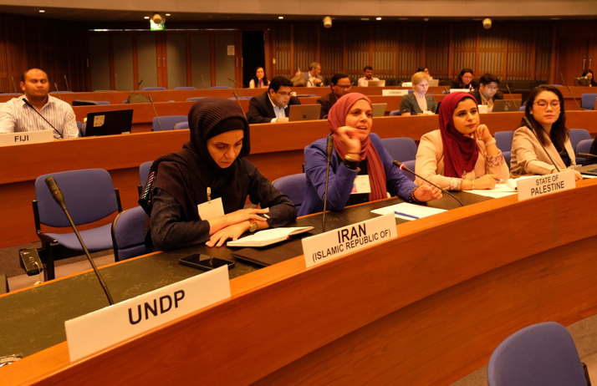
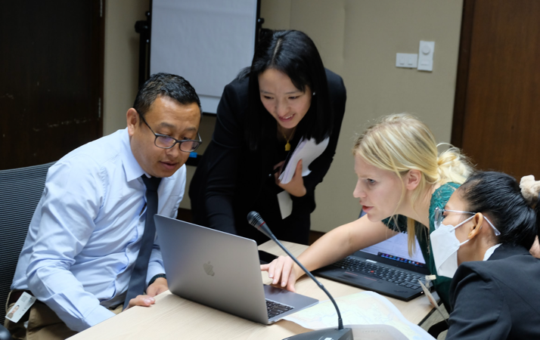
THE PROCESS
The regional scoping workshop sessions were organized into rounds of breakout groups, with participants from each country grouped according to the most pressing slow and rapid onset hydro-metrological hazards and extremes in their respective countries (participants were given the opportunity to self-select).
Interactive sessions were held to gather information on the impacts of climatic hazards and how countries respond to these hazards over time. This included short-, medium- and long-term stages of support through a country-specific mapping exercise followed by collaborative dialogue with countries and relevant agency stakeholders.
Participants were provided with a guided template to gather detailed, descriptive and sequential accounts of post-impact response actions, focusing on:
  Loss and damage resulting from specific hazard and extreme events (e.g. drought, tropical cyclone);
  Broad phases of response (e.g. anticipatory arrangements, response, recovery, and other phases and sub-phases);
  Gaps in response actions and capacity;
  Technical assistance needs for averting, minimizing and addressing loss and damage.
Over the three-day period of the workshops, country participants provided their respective inputs. The first day focused on rapid onset events, the second day on slow onset events, and the final day on detailed loss and damage case studies.
Plenary sessions took place between breakout group rounds to provide country participants and facilitators with the opportunity to provide feedback

Slide 12
TEMPLATES: RAPID ONSET EVENT
EXPLANATORY NOTES | EXAMPLE: NIGERIA
Main event Modulating event that produces one or more hazards | Heavy precipitation
Hazard Single hazardous event causing loss and damage | Floods resulting from heavy precipitation
Description & context Describe the event and its context | Since 20 June 2022, abundant rains were being recorded over localized areas in southern Nigeria, with total amount of rain exceeding 100mm per day so far. Floods also started to be recorded in some parts of the area at risk, mainly in Northern localities and urban areas since the end of June 2022. More flash floods were recorded and general alerts are for the moment in yellow alert with close monitoring of meteorological experts issuing frequent alerts since July.
1. Anticipatory Arrangement (Pre-Phase 1: before event declared including contingency measures such as insurance) Anticipatory arrangements are those that trigger actions after event occurs (eg. payouts) | Flood mapping? Public awareness campaigns? Preparation and provision of emergency services like ambulances, search and rescue teams, evacuation centres? Infrastructure improvement – maintaining drainage systems, improving road networks, reinforcing bridges Social protection, cash transfers? Forecast based finance solutions
2. Date event declared | N days before event impact
1. Anticipatory Arrangement (Phase 1) After event declared/announced, before event hits, more anticipatory actions are possible | Early warning systems Regular communication with public to update on the situation, evacuation plans, relief efforts through radio, television and social media
1. Anticipatory Arrangement (Phase 2) | Day N-3 Advance cash transfers Evacuations Procurement and provision of emergency supplies like food, water, blankets, medical supplies Mobilization of emergency response team set up eg. medical personnel, volunteers

Slide 13
TEMPLATES: RAPID ONSET EVENT
EXPLANATORY NOTES | EXAMPLE: NIGERIA
4. Response (Phase 2) – Actions What are the key actions for the second phase of response? (Name the second phase as appropriate). | Cash transfers for rebuilding livelihoods Damage assessment conducted to quantify resources required Cleanup and debris removal Restoration of most basic services like roads, transport infrastructures, water services, electricity
5. Response (Phase Other) – Duration Are there other phases for Response? What is the duration? (Name the phase as appropriate). | 1 – 5 years
5. Response (Phase Other) - Triggers What is the trigger for this response phase? (Name the phase as appropriate). | Vegetation destroyed; livelihood restoration incomplete based on the evaluations and damage assessments
5. Response (Phase Other) - Actions What are the actions for this response phase? Name the phase as appropriate. | Restoration of natural vegetation Ongoing support to communities affected with healthcare services, counseling, financial support
6. Recovery (Phase 1) - Duration Shifting from immediate response to restoration and recovery efforts from the immediate to the long term. Describe the duration of recovery for the first phase of recovery. (Name the phase as appropriate). | Weeks to a 3 years
6. Recovery (Phase 1) - Triggers What triggers action for recovery on the first phase? | Basic services restored Life starting to go back to normal
6. Recovery (Phase 1) - Actions What are the actions for this recovery phase? | Rebuilding critical infrastructure (bridges, schools, hospitals) Livelihoods restructuring e.g. technologies for farming, flood resistant crops Plans for resilient rebuilding Rebuilding homes Review construction standards Propose policy changes based on experience and lessons learned

Slide 14
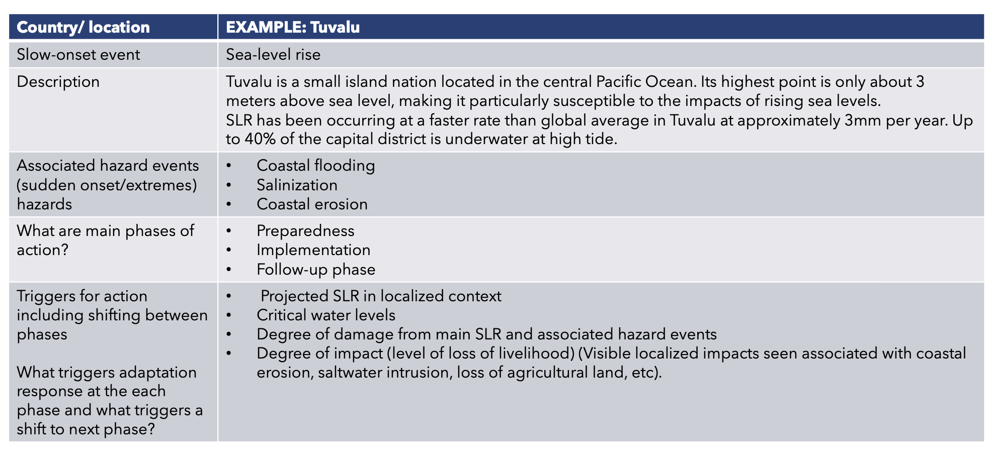
TEMPLATES: SLOW-ONSET EVENT

Slide 15
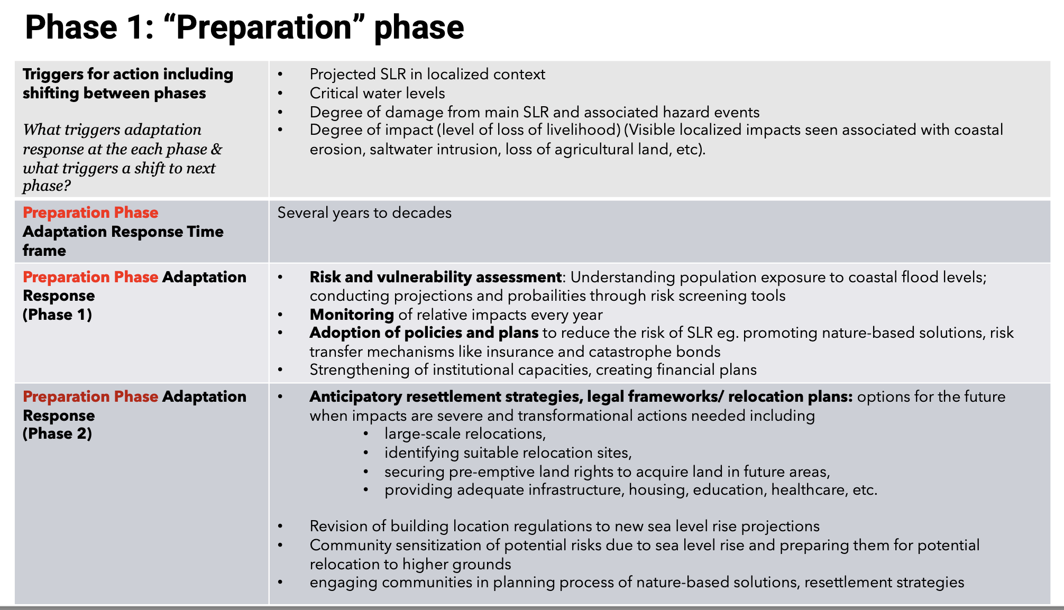
TEMPLATES: SLOW-ONSET EVENT

Slide 16
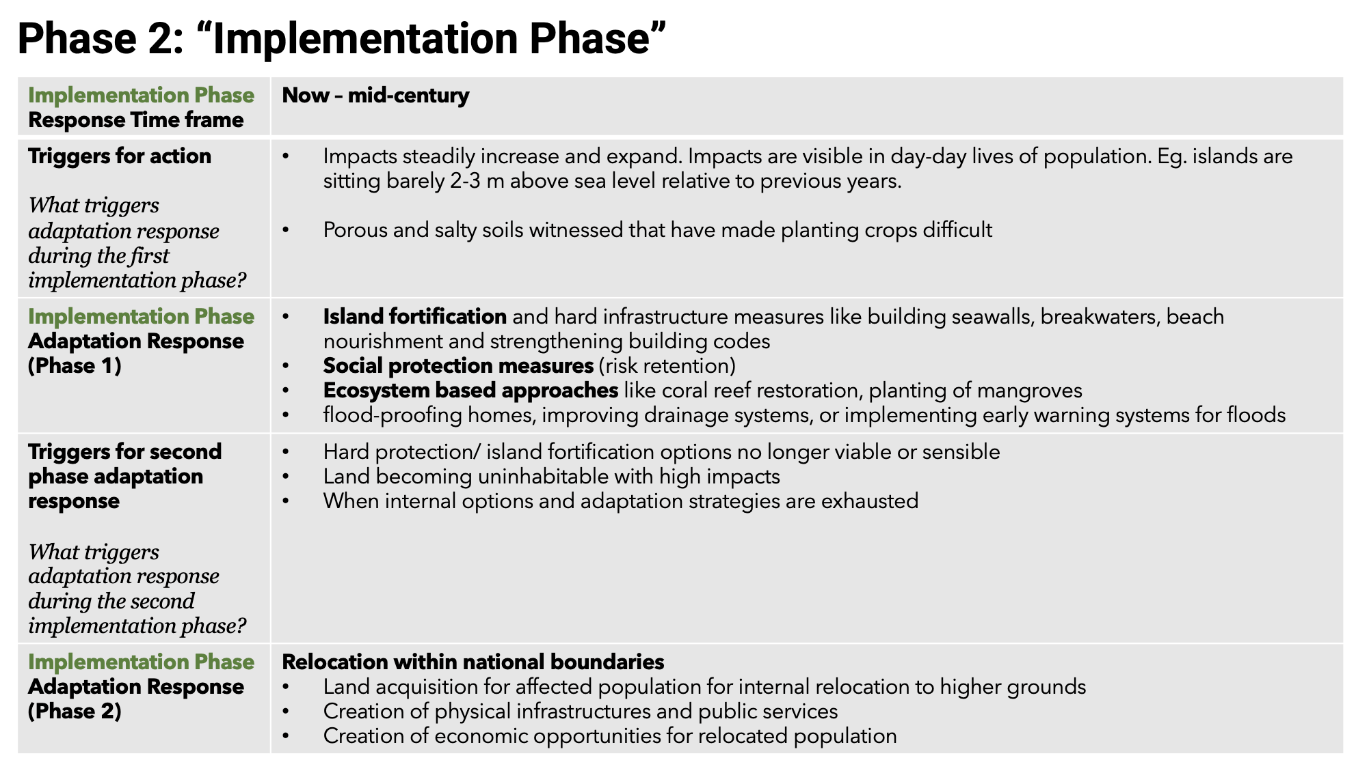
TEMPLATES: SLOW-ONSET EVENT

Slide 17
TABLE OF CONTENTS
01
02
03
INTRODUCTION
METHODOLOGY
SYNTHESIS – RAPID ONSET EVENTS
04
SYNTHESIS – SLOW-ONSET
EVENTS

Slide 18
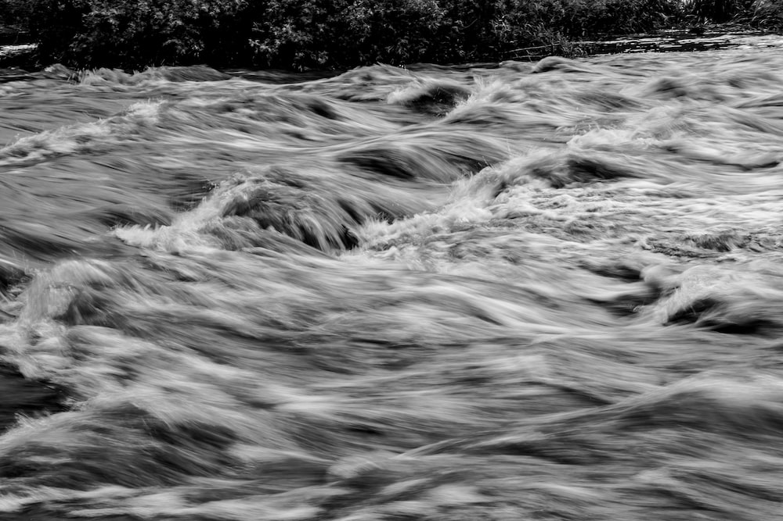
ASIA PACIFIC
Bhutan, Lao PDR, Cambodia, Kazakhstan, Thailand, Sri Lanka
Countries reported significant losses in the agriculture sector, for instance, the destruction of over 100,000 hectares of rice fields in an event. This led to 20 per cent drop in rice production.
Despite the early issuance of warnings, the magnitude and duration of the floods often surpass expectations, causing a substantial loss of property and, in some unfortunate instances, human lives.
LATIN AMERICA AND THE CARIBBEAN (LAC)
Bolivia, Costa Rica, Ecuador, Haiti, Panama, Peru
Soil saturation, river overflows, and infrastructure challenges compound the flood problems.
The outbreak of diseases such as dengue is a major concern.
In instances like Costa Rica's floods, despite not recording high rainfall, the damage was exacerbated by previously saturated soils from earlier hurricanes. In Ecuador, a combination of severe rainstorms and an earthquake resulted in considerable loss and damage to the city of Guayaquil's infrastructure.
Throughout the region, floods lead to the destruction of homes, loss of livestock, crop failure, and displacement of vast populations, requiring urgent and large-scale humanitarian assistance.
Floods
OVERVIEW
AFRICA
Benin, Burundi, Central African Republic, Nigeria, Cote D’Ivoire, Gabon, Ghana, Guinea Bissau, Liberia, Niger, South Africa, South Sudan, Chad, Togo, Zambia
Floods, whether coastal or riverine, often affect a vast portion of a country’s area, e.g. South Sudan reported floods in 80 per cent of the country’s territory.
Cascading impacts of floods include an increased risk of disease outbreaks such as malaria, cholera, and diarrheal diseases, especially in rural areas.
Flooding has resulted in the irreversible loss of land and displacement of populations, which can trigger conflicts.
Drainage issues, particularly waste blocking sewer systems, lead to increased flooding and subsequently, significant damage to infrastructure and human settlements.
Credit: unsplash.com

Slide 19
FLOODS: ANTICIPATORY ARRANGEMENTS
PRE-PHASE 1 ANTICIPATORY ARRANGEMENTS | GAPS | NEEDS
Set up infrastructure measures: Regular desilting of drains and rehabilitation of rainwater drainage systems, tracing level curves in mountain areas, crop fields, tree plantation, development of watersheds, preparation of sandbags to prevent flood waters from causing damage (particularly in Asia), and improving land-use mapping and urban planning by including flood hazards risks. Conduct public awareness and community engagement: Promoting avoiding living in flood-prone areas, regular communication and sensitization of the population on risks of flooding. Other preparedness measures like encouraging citizens to have emergency backpacks with emergency items for relocation. Set up social protection measures: Policies and regulations on cash transfers to victims, resettlement initiatives, individual insurance funds, and disaster management funds. Conduct capacity building: Development of disaster management and contingency plans, and training of search and rescue (SAR) teams. Training for provincial officers on the use of early warning systems and emergency planning. Conduct drills and Simulation Exercises (SimEx). Set up early warning systems, flood forecasting systems: Establishing ydrometeorological forecasting and using flood alert systems like the Global Flood Awareness System (GloFAS) to anticipate floods. | Lack of insurance, funding and forecasting capabilities in many countries Lack of early warning systems in rural areas Lack of risk mapping and vulnerability zone assessments in provincial level and local levels Ineffective warning systems for flash floods Inadequate drainage networks Lack of coordination among different agencies involved in flood management. Existing infrastructure is often weak and does not meet the required standards to withstand flooding. | Comprehensive vulnerability assessments and risk mapping Enhancing the accuracy of flood forecasting and early warning systems Platform for coupling meteorological, oceanographic, and hydrological data. Spatial observation maps to track the evolution of floods Manual of procedures for the prevention and management of risks, based on national and international experience Involvement of the private sector and the finance sector in disaster risk management, like insurance coverage Improve education on flood risks at all levels of society Plant anti-erosion hedges, stabilization of river banks, management of watersheds Pre-disaster investments in asset registers of critical infrastructures Investment in systems and tools to support monitoring, forecasting, analysis, early warning and preparedness for disasters, integrated within regional decision-support systems and platforms Long term anticipatory planning, such as improved land-use mapping and urban planning to reduce the flood risk.
PHASE 1 ANTICIPATORY ARRANGEMENTS | GAPS | NEEDS
Trigger: awareness of an impending flood disaster Establish institutional readiness: Disaster management committees and incident management teams are established to manage and respond to flood events. Conduct preparation meetings: Coordination between the government sector, stakeholders and the private sector to discuss, plan and prepare the necessary equipment, vehicles and personnel for flood response. Communicate to public: Communication through radio and television to keep the public abreast of the situation and sensitize the population to the importance of leaving risk areas immediately. Issue Early Warning: Meteorological agency issues warnings on heavy rain (yellow warning), which could be escalated to amber or red alerts, the highest level of warning. Procure response supplies: procurement of disaster response supplies (food, dry rations, medicine, emergency supplies). Some countries also have advance cash transfer mechanisms, provision of emergency supplies. | Extreme nature of disasters often overwhelms preventive measures, leading to deficiencies in response efforts. Disbelieving warnings – local flood warnings are not taken seriously. Shortage of healthcare providers during the disaster. Availability of accurate models to project the impact of the flooding. Available flood maps and high flood risk area designations are insufficient. Notable weakness in the synergy among actors in collating meteorological, oceanographic, and hydrological information. | Unified methodology for loss and damage assessment and Post Disaster Needs Assessment (PDNAs). Conditional funds transfers. Specific provisions for payments related to gender-specific vulnerabilities. Long-term maintenance of meteorological instruments for accurate and consistent data collection.

Slide 20
FLOODS: ANTICIPATORY ARRANGEMENTS
PHASE 2 ANTICIPATORY ARRANGEMENTS | GAPS | NEEDS
Continued early warning: Continued dissemination of early warning and flood/ landslide alerts through radio, SMS Planning shelter and evacuation: Identification of safe evacuation sites, organization of shelters and using schools as relocation facilities. There is also pre-emptive relocation of population from high risk areas Coordination and planning: General risk management plans, activation of local disaster risk reduction (DRR) platforms, mobilization of emergency response teams, setting up of radio communication systems Other measures: Sandbags are used to prevent water from flooding, and more than 13,000 sacks were laid in the 2011 floods in Thailand. | Lack of advance cash transfer mechanisms Lack of preventive emergency measures beyond early warnings and sensitization Database and early warning system limited for last-mile communities | Regional transboundary EWS and centralized multi-hazard EWS that is capacble of detecting multiple hazards Ways to ensure last mile communication of EWS
PHASE 3 ANTICIPATORY ARRANGEMENTS | GAPS | NEEDS
Day (-2) Operationalize evacuation activities: Coordination with rescue teams, police and civil defense forces to operationalize evacuation centers Relocate as many people as possible to safer areas Activate relief support: Food, housing, temporary camps; pre-positioning of emergency equipment. Advanced cash transfers where relevant Activate Contingent Emergency Response when necessary (access to additional financial resources by reallocating funds from other components) | Lack of trust of the government alert declarations. Lack of understanding amonggovernment and the decision maker of the severity of floods and potential damages based on forecasts. No rescue protocols for livestock and different farm animals. | Tools to monitor increases in water levels and set thresholds for triggering alerts.

Slide 21
FLOODS: RESPONSE
duration of the event; : 2 days to 14 days
overall duration of effects: 3 months to several years
PHASE 1 RESPONSE | GAPS | NEEDS
Duration of response: 5 days to 2 weeks Triggers: Significant loss of life, livestock and infrastructure (including drinking water pipes, homes, commercial premises, vehicles, and home items); increase in water levels beyond a threshold Response triggers depend on types of flood disasters activating local government or the national government Actions: Continue to conduct evacuation of affected families to safer areas Deploy search and rescue teams with basic and advanced equipment (drones) led by national civil protection systems, police Provide of medical aid, food, water and basic services Provide drinking water by tank trucks and waste management facilities. Depending on severity, call for help and coordination with NGOs and other UN entities Conduct rapid assessment of water needs and treatment of wells and surface water. Gather data on flood situation and guide other response and recovery efforts based on loss and damage data Provide psychological support to affected families | Lack of centralized authority or management in some countries, which may complicate disaster response coordination Lack of coordination between national technical bodies for health services, support, and social assistance Lack of standardized tool for evaluating loss and damage | Creation of a national crisis management committee supported by a local crisis committee Banking structure capable of disbursing prompt aid to disaster victims Coordination between various administrative bodies in charge of meteorology, oceanography, hydrology, aquatic ecosystem services, the environment, and forests Standardized tool for evaluating loss and damage
PHASE 2 RESPONSE | GAPS | NEEDS
Triggers: Receding of floodwater and return to normal conditions; occurrence of new or related disasters like landslides following floods or reoccurrence of floods; continued loss of human lives and lack of proper sanitary conditions, electricity, water Duration of response: 2 weeks to 2 months Action: Continue providing temporary shelters and logistical support to affected population (property retrieval and transportation) Continue to distribute immediate relief materials, including tarps, family kits, food, water and WASH facilities Conduct civil defense-led cleanup operations Improve solid waste management infrastructure and services Restore most basic services like roads, transport infrastructure, water services and electricity. Call for/receive/disburse aid from the diaspora community in the form of food and clothing. Ongoing support to affected communities, including healthcare services, counselling, financial support. Provide cash for affected population for rebuilding livelihoods, where appropriate If necessary, conduct treatment of water-borne diseases like diarrhea, malaria and cholera. Conduct damage and loss assessments to quantify resources required. Provide relief assistance until the affected are reintegrated into their normal communities. | The full cost of rehabilitation projects to assist flood victims to relocate is not generally known. Governments do not budget for disaster response | A disaster response fund

Slide 22
FLOODS: RESPONSE
duration of the event; : 2 days to 14 days
overall duration of effects: 3 months to several years
PHASE (OTHER) RESPONSE | GAPS | NEEDS
Triggers: livelihood restoration incomplete, damage of critical infrastructures Pump water from and clean the flooded areas - mobilize volunteer groups to aid in cleanup activities for houses, schools, and places of worship. Immediate restoration of public infrastructure and utilities including improvement of roads, bridges, water supplies, power, and telecommunications network. Ongoing support to communities affected, including healthcare services, counselling, and financial support. Provide shelter repair kits to households with damaged houses. Undertaking educational initiatives to provide communities with the knowledge and tools to rebuild. Formulate strategies to relocate populations from risk areas and inform the people about potential relocation. Formulate strategies to restore natural vegetation. | Additional work needed for flood control dams, canalization and related work, river bunds, flood storage ponds; flood diversion tunnels. | Construction of dykes in some countries

Slide 23
FLOODS: RECOVERY
duration of the event; : 2 days to 14 days
overall duration of effects: 3 months to several years
PHASE 1 RECOVERY | GAPS | NEEDS
Triggers: Water level subsided; restored road connectivity; return to normalcy; affected people return to safe areas Duration: 1 year to 5 years Conduct proper damage assessments for recovery and reconstruction plans. Repair sewerage and drainage network, and implement a waste management plan to prevent blockages leading to flooding. Review and enforce construction standards and urban growth plans to prevent illegal settlements and ensure safe distances from rivers and streams. Provide crop resources such as rice seeds to restore damaged crops and flood-resistant crop technologies. Provide assistance in finding employment or income-generating activities. Review and amend DRR plans. Monitor and support disaster victims through rehousing, reconstruction, compensation, and other forms of support. Find/ create jobs/activities for people to earn an income and help them to adapt to floods. | Gap in the use and knowledge of nature based solutions (NbS) and ecosystem based adaptation (EbA) strategies Full cost of rehabilitation projects designed to assist flood victims in relocating is often not known | Creating a sustainable and efficient plan for relocation Infrastructure development like flood control dams, canalization and related works, river bunds, flood storage ponds, and flood diversion tunnels
PHASE 2 RECOVERY | GAPS | NEEDS
Duration: 3 years to 8 years Action: Identify and allocate government land for permanent settlement. Provide compensation and loans to affected individuals for construction. Improve DRR strategies, putting an emphasis on prevention. Vertical integration of adaptation into the development municipal premises and their annual investment plans. Use the National Adaptation Plan (NAP) process to formulate and carry out specific projects. Put in place economic recovery initiatives. Carry out capacity building and sensitization, especially targeting the youth. Conduct regular analysis of disaster evolution to revise and update contingency plans. Execute infrastructure projects aimed at reducing the likelihood of flooding and sea-level rise. Develop a contingency plan for effective response to potential future disasters. | absence of an appropriate recovery plans | Laws and policies that regulate land ownership and management

Slide 24

LATIN AMERICA AND CARIBBEAN
Brazil, Chile, Paraguay, Uruguay,Bolivia, Argentina
Significant agricultural losses due to drought were reported in LAC region, e.g. in Brazil, 4 million animal deaths were reported in 2012 alone, while Uruguay mentioned a rise in food prices.
Water scarcity affects the day-to-day lives of people and businesses, e.g. in Chile, extreme drought for over 13 years caused water scarcity in almost half of the country’s municipalities.
Droughts have also affected infrastructure, particularly water supply systems. In Panama, the 2015-2016 El Niño phenomenon caused a rainfall deficit, leading to decreased flows in rivers that supply drinking water. The low water levels even led to the Panama Canal announcing possible navigation restrictions.
AFRICA
Angola, Botswana, Ethiopia, Kenya, Mali, Morocco, Namibia, Somalia
Africa has been grappling with severe and frequent droughts over the past few years. Ethiopia and the Horn of Africa in general have been experiencing drought for six consecutive years since 2017. This has resulted in the loss of millions of livestock, crop failure, and subsequent food insecurity and malnutrition.
Known as the "water tower" of Southern Africa, Lesotho is facing significant economic hardship due to decreased water levels in dams and reservoirs during droughts. Moreover, dependence on hydropower has led to power shortages.
Widespread crop failure and livestock deaths lead to severe food insecurity. Moreover, drought conditions contribute to water scarcity, adding another layer of struggle for people.
Drought has caused displacement of communities and increased migration, leading to conflicts over resources and loss of community status and identity.
Drought
OVERVIEW
ASIA PACIFIC
Kiribati, Micronesia, Nauru, Sri Lanka, State of Palestine
Countries in Asia Pacific mainly talked about the impact of drought on safe drinking water and agricultural productivity, linked to food security.
Nauru mentioned how long-term drought conditions have strained the island’s water supply. Soil quality and food security have also suffered, with main crops like coconuts, pandanus, and breadfruit failing to produce fruit.
The loss of trees that maintain soil stability has led to beach erosion and loss of land, posing further environmental and infrastructural challenges.
Credit: unsplash.com

Slide 25
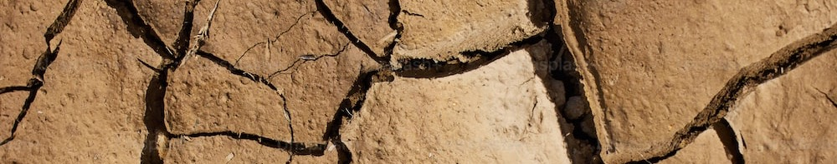
DROUGHT: ANTICIPATORY ARRANGEMENTS
duration of the event; : 4 months to several years
overall duration of effects: several months to a decade
PRE-PHASE 1 ANTICIPATORY ARRANGEMENTS | GAPS | NEEDS
Formulate drought plans and strategies: For example, safeguard water, promote desalination, advanced and centralized irrigation techniques, crop diversification, drought resistant crops, dam constructions, ban drilling wells, etc. Formulate contingency measures: Livestock reserves, seawater desalination projects, banning well-drilling, construction of dams, wastewater reuse, drip irrigation practices, constant monitoring of water salinity Set up alert levels: Drought alert systems based on weather pattern monitoring with pre-set thresholds that trigger various stages of drought response and that engage different sectors depending on the severity of the drought. For example, in Kiribati the alert levels are based on indexes and triggers such as a 3-month index falling below the 40th percentile (Alert Level 1) and a 12-month index falling below the 25th percentile (Alert Level 2). In Lesotho, upon extreme weather warnings, the Disaster Management Authority activates early warnings and response measures are coordinated at the community levels Conduct drought assessments and collect data: Regular data collection and assessments to identify foreseeable risks, ensuring availability of baseline data, maintaining an asset register for water-related assets, and developing surveys to understand access to clean, safe drinking water. Countries in Africa have been focusing on assessment on IPC classification on food security. Weather stations monitor day – day weather Raise community awareness: Raising community awareness by disseminating data and encouraging water conservation practices. Drought communications working groups at government level to communicate about drought conditions. Drought Response Communications Plan being developed in several countries. Monitor drought for early warning: Weather forecasts and outlooks, together with online drought monitor incorporating different atmospheric variables, enabling prediction and monitoring of drought for early warning. For example, Argentina has an Agriculture emergency Monitoring Office, which established drought monitoring tables that provide tools for monitoring meteorological and agronomic conditions. Set up of insurance and financial measures: Safety insurance for droughts for smallholder farmers (e.g. Agrarian Insurance). In some countries, insurance is provided for farmers for certain crops. Some countries have a Special Drought Fund, some have national emergency funds that can be drawn on during drought. Morocco mentions "TAAMINE AL MAHSSOL" (insurance of agricultural yield) that provides farmers comprehensive coverage against drought. Strategies for early emergency response: Preparedness before a drought involves putting resources in place for effective response. For instance, logistics information is updated in Kiribati to assist with planning and accessing the outer islands. A similar strategy is seen in Micronesia, where a drought declaration triggers a response five days before the event. | Comprehensive understanding on drought risks and management Lack of clear and efficient protocols and procedures for disaster response with thresholds tailored to drought No dedicated agency to coordinate drought-related interventions Drought management is embedded within the institutional framework of disaster management, diluting drought planning | Dedicated drought policy and risk financing strategies, pilot projects. National coverage of meteorological and hydrological services. Accessible and efficient early warning platform is needed to reach vulnerable areas. Development of a comprehensive framework for early warnings and strengthening drought forecasting. Sustainable model for drought relief. For example, the current model focuses on food aid and fodder, which are costly and don’t build adaptive capacity in communities. Models that build resilience need to be prioritized.
DROUGHT DECLARATION:
Responses varied on when and how countries declared drought. Some countries in Latin America mentioned that they did not have a clear definition or procedure for drought declaration. But countries in Africa described declarations being made based on assessments of severity, losses in the agricultural sector, threats to water availability and geographical coverage of drought conditions often known 3-6 months in advance. Some countries mentioned that drought is a recurring issue that is expected every year and thus is anticipated one month ahead.

Slide 26
DROUGHT: ANTICIPATORY ARRANGEMENTS
duration of the event; : 4 months to several years
overall duration of effects: several months to a decade
PHASE 1 ANTICIPATORY ARRANGEMENTS (also known as WATCH phase) | GAPS | NEEDS
Triggers: Usually triggered when rainfall levels fall under 40% within a 3 month period Regularly monitor of precipitation levels, river levels, water reserves and daily water pumping rates: Data validation and continuous assessment of rainfall on a 12-month index and increased monitoring, which forms the basis for declaration of emergencies. Tools like the Famine Early Warning Systems Network (FEWS NET) used for estimating crop yields and conducting vulnerability assessments. Establish coordination and decision-making bodies: in many countries, public utilities board handle different aspects of monitoring; there is establishment of an emergency water committee, and the National Disaster Risk Management Committee. Committees makes critical economic decisions based on yield forecasts and provides recommendations to the Cabinet via the Prime Minister office Boost public awareness of heightened risks associated with drought and promote water rationing: Includes installing water purification plants, desalination plants, tanks, setting up boreholes, wells, reservoirs, water troughs. Prohibition of permits for vegetation burning to minimize risk of forest fires. Triggering of rescue organization plans to identify the disaster response action like food aid, medication, fodder, water Conduct continuous assessment and monitoring of changing conditions in water levels | The drought alerts generally does not reach the producers (small and medium-sized) in the adequate time | Link the media and language of the communities so that early warning information can arrive in a timely manner Proper SOPs and drought forecasting
PHASE 2 ANTICIPATORY ARRANGEMENTS (also known as WARNING phase) | GAPS | NEEDS
Triggers: Usually activated when the 12-month rainfall index falls below 25% Coordinate regularly and collate sector specific data: Drought committee collates sector-specific data on drought impacts. This data forms the basis for the decision to trigger public awareness campaigns to preserve water. Assess economic measures and support: In some countries, calculations of potential loss and damage for stakeholders, such as small farmers are carried out. This informs compensation schemes or insurance payouts. Continuously monitor water salinity levels Distribute of groundwater supply in some countries at a certain cost Conduct needs and vulnerability assessments to identify areas requiring water support
PHASE 3 ANTICIPATORY ARRANGEMENTS | GAPS | NEEDS
Triggers: If the water salinity falls under 1000 micro Siemen per cm, then Alert level 3 is triggered (Kiribati) Continue raising and sustaining public and community awareness through district councils and in collaboration with NGOs Provide immediate relief measures: Government starts providing water supplies to communities for drinking and consumption for at least 3 months. This water is intended for human consumption. There is cabinet approval and higher authorities' involvement for resource mobilization to address the crisis. Activate contingency funds: : Ensuring resources are readily available to tackle drought-related challenges as they arise, e.g. Hassan II Fund in Africa.

Slide 27
DROUGHT: RESPONSE
duration of the event; : 4 months to several years
overall duration of effects: several months to a decade
PHASE 1 RESPONSE (duration: 3 months) | GAPS | NEEDS
Triggers: When water salinity falls below a certain amount (for island nations), agricultural damage seen, increased demand at household levels, negative effects on health and education, agricultural yields falling below a certain percentage and projections of x per cent of population facing crisis-levels of food insecurity (e.g. Somalia – 22 per cent of the population would be facing at least crisis-levels of food insecurity). ACTION: Communicate the severity of drought to communities: : Conduct community outreach, educate community members to treat water by boiling or using bleach, to use rainwater harvesting, etc. Promote improved water management: Water truck orders restricted only for essential services Conduct initial rapid HH and community assessment to determine needs Determine the risk and duration of the drought, amount of help needed and develop an action plan Coordinate and organize humanitarian/development partner meetings for resource mobilization Provide emergency responses: Governments supply clean water to communities for at least three months, Provide economic support and insurance: Insurance for farmers through crop insurance systems Tankering, installing water purification plant(s) and water tanks. Water is also rationed and distributed to the areas impacted by the drought. | Social costs of inaction not factored in | GIS mapping system to efficiently manage the operation of water tank trucks For effective deployment of tank trucks, GPS monitoring software is needed to indicate where water is present and where it is needed. Direct financial support to affected communities Strategies to measure the social costs of inaction Tax reduction, improved access to loans, and production insurance
PHASE 2 RESPONSE (duration: 6 months to 3 years)
Triggered based on the initial rapid assessments ACTION: Issue continuous alert and communication to affected communities on water conservation, efficient water usage, waste minimization Based on the initial assessment, work with NGOs to provide drought support which can be: Delivery of relief items to affected communities including food, water Provision of subsidies, seed inputs, and fertilizers to farmers to help them rebound Improve WASH conditions in schools, communities; conduct water quality testing Conduct continuous water quality testing Continually review and update measures based on ongoing assessments, ensuring that measures remain relevant and effective in addressing the drought's impacts. | Current funding is often a one-time payment, which does not cover the entire duration of the drought. | Equipment for water quality testing Data collection support for timely data eg. conducting surveys in resource limited settings Capacity building for communities to develop skills to respond to drought Consistent and long-term funding for community awareness programs.

Slide 28
DROUGHT
duration of the event; : 4 months to several years
overall duration of effects: several months to a decade
PHASE 1 RECOVERY PHASE | GAPS | NEEDS
Triggered when Drought Alert levels 3 is lifted and downgraded to alert levels 2 and level 1 ACTION Continued implementation of drought response measures, ongoing monitoring due to the length of time it takes to implement the response measure Maintain vigilant monitoring due to the time-intensive nature of the hazard Conduct evaluation with communities, prioritizing those who first received support due to the prolonged support delivery and vulnerable communities to assess their needs better Implement adaptive measures and incorporate technologies that enhance water security Provide agricultural support and conservation: Distribute climate-resilient seeds to farmers and communities. Provide capacity building on agricultural methods that conserve water in the soil. Advocate for the replanting of resilient staple foods such as fig trees. National reforestation campaigns and the implementation of the forest policies Marine conservation: Prioritize the conservation of marine resources, given their intrinsic connection to the overall ecosystem. Ensure the strict enforcement of legislations and acts aimed at preserving marine resources. Creation of national drought plans in some countries Continue with health messaging, emphasizing drought-related issues | recovery is not systematic given the persistent negative impacts and their repercussions on the economy. | Post-drought (Disaster) needs assessment from economic, social and environmental perspectives (using baseline data) to identify damage and loss
PHASE 2 RECOVERY PHASE
Triggered when rainfall is normal or above normal levels Conduct the Post Disaster assessment - economic, social and environmental - at community and household levels. Develop report with recommendations for the improvement of any identified economic and environmental gaps, and work with communities and relevant ministry on social gaps identified. Integrate findings into planning or policy as required if there are gaps identified. Update community plans and, if required, the drought management response matrix in earlier alert levels to ensure early warning and early action activities are included. Ensure risks have been identified and addressed during "normal rainfall" times. |  | Agricultural indicators suitable to specific climate conditions Identification of adaptation measures combining local practices and knowledge with precision agriculture technology for small and medium producers in rural areas.

Slide 29
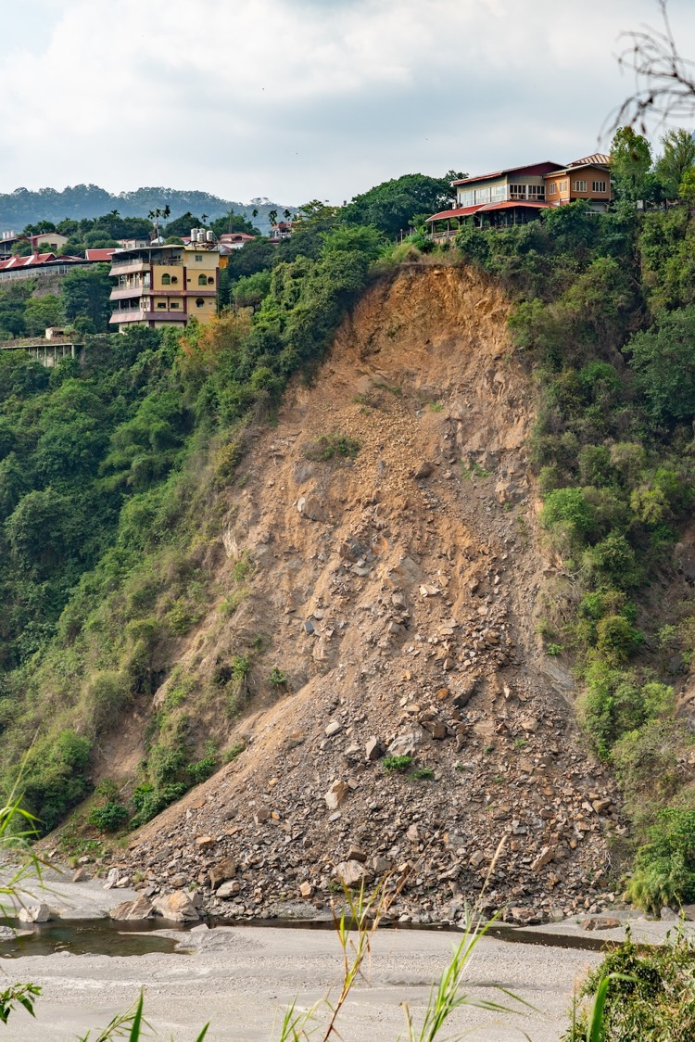
LATIN AMERICA AND CARIBBEAN
Chile, Colombia, Dominican Republic, Ecuador, Brazil
Triggered by various factors, such as heavy rainfall, earthquakes, deforestation and human activities like mining and construction.
In Chile, coordination challenges during landslide disasters have been addressed with the establishment of a new entity in 2023, SENAPRED, which oversees landslide monitoring and alert levels.
In Colombia, landslide susceptibility maps are being incorporated into Land Management Plans.
The Dominican Republic is working on updating their National Plan for Risk Reduction and Disaster, which will now include plans for landslides.
In Brazil, approximately 4 to 8 million people are estimated to live in high-risk areas for landslides, highlighting the severity of the situation.
AFRICA
Burundi, Democratic Republic of Congo, Ethiopia, Sierra Leone, Uganda
In Africa, landslides are driven by various land characteristics such as high annual rainfall, steep slopes, significant weathering and materials with low shear resistance or high clay content.
Deforestation is a major triggering factor in Africa.
The region lacks an accurate system for landslide forecasting, making it challenging to allocate resources and plan for disaster response effectively.
Landslides cause damages including the destruction of crops, damage to water sources, and destruction of homes, with significant impacts on agricultural productivity, livestock, livelihoods, and community well-being.
Landslides
OVERVIEW
ASIA PACIFIC
Nepal, Timor Leste
Countries like Nepal and Timor Leste reported landslides frequently being triggered by heavy rainfall as well as earthquakes.
Landslides often block rivers, forming temporary dams which eventually burst and cause additional flooding, resulting in loss of human life, housing, agricultural land, roads, bridges, livestock, and property.
The impact of such events was evident in April 2021 in Timor Leste when Cyclone Seroja hit, causing significant damage to infrastructure including bridges, buildings and roads throughout the country.
Credit: unsplash.com

Slide 30
LANDSLIDES: ANTICIPATORY ARRANGEMENTS
PRE-PHASE 1 ANTICIPATORY ARRANGEMENTS | GAPS | NEEDS
1. Coordination and planning: Local, district, and national committees preplan for risk reduction and quick response management in coordination with various forces and volunteer organizations. Establishment of ad hoc task forces under the Office of the Prime Minister. 2. Case studies and assessments: Conduct case studies and assessments to identify landslide risk areas in certain countries. Develop slip maps that portray elevation, slope angles, lithology, soil slips, and landslides. 3. Awareness and preparedness: Provide impact based weather forecast systems and climate information briefings to anticipate rainfall; Establish alert mechanisms based on expected rainfall amount. Some countries have siren systems and alerts are carried out by municipal officer 4. Environmental measures: Plantation of trees that coexist with crops (agroecological measures) Development of watersheds Tracing of level curves on mountains and crop fields 5. Financial measures: Establishment of contingency funds and calamity funds for effective emergency response Ensure social protection with subsidy programs based on land survey and population categorization 6. Infrastructure and training: Conduct infrastructure work for drainage, land containment Build capacity of local municipal governments in risk management, including training on risk assessment, early warning systems | The inhabitants of risk areas have little confidence in the alerts, and there is a lack of training in the communities and no clear directions of where to go. Many countries have risk minimization plans, but cannot cope as the plans are not designed to deal with an increased number of calamities. | National and subnational maps that describe areas most susceptible to landslides. Availability of live maps (in the form of phone apps) could be helpful to prepare for future events. Updating of outdated risk maps. Development of accurate risk scenarios with specific and detailed characterization of risk areas, e.g. incorporating climate variables in land use planning. Harmonization of methodologies and methodologies, the Sendai Framework for DRR, IPCC and others.
PHASE 1 ANTICIPATORY ARRANGEMENTS | GAPS | NEEDS
1. Coordination systems Establish coordination systems involving relevant actors, institutions responsible for risk assessment, data generation & alert activation 2. Alert issuance Issue alerts based on chances of rain and based on geological and hydrological risk maps 3. Logistics preparation Develop logistics preparedness plan to distribute essential supplies to affected population Establish ways for quick intervention like pre-positioning food, equipment, monetary resources | Alerts are less efficient for landslides unlike for floods due to short occurrence time Lack of funds for prevention and mitigation fo landslides vs emergency reponse. | Improve the integration between landslide risk management and existing early warning systems, particularly those focused on floods.

Slide 31
LANDSLIDES: ANTICIPATORY ARRANGEMENTS
duration of the event; : 2 days
overall duration of effects: several months to years
PHASE 2 ANTICIPATORY ARRANGEMENTS | GAPS | NEEDS
TRIGGER: Monitor rainfall amounts and trigger announcements once they surpass certain thresholds. Generally, after 100 mm of rain, the risk of landslide is announced. 1. Evacuation planning and preparedness Implement evacuation plans at municipal level considering the alert and threat levels in risk areas Establish communication systems in place to facilitate timely and accurate information dissemination, including alerts, evacuation instructions, destination points, routes and updates on the situation. 2. Logistics Activate emergency response protocols, ensuring clear roles, responsibilities, coordination mechanisms among different stakeholders. Pre-position resources like food, water, medicine and incorporate them as necessary provision items in emergency response Establish plans to distribute the resources coordinating with NGOs, humanitarian organizations, etc. for effective logistics management 3. Social protection programs Initiate advance cash transfer where relevant in anticipation of landslide available in some countries | Local level governments lack the capacity to effectively transfer and utilize forecasting information provided by national level institutions. Evaluation and planning efforts often do not separate flood risk or consider soil typology in a comprehensive manner | Capacity building at local government levels to undertake action after alerts occur Regular updates on possible disasters to can enable people to stay informed and take necessary precautions.
PHASE 3 ANTICIPATORY ARRANGEMENTS | GAPS | NEEDS
1. Alerts and forecast Disseminate provincial-level forecasts of weather conditions, including rainfall and flood. Alerts are communicated to people in risk areas through SMS and broadcast tools like WhatsApp, in collaboration with telecommunication agencies. 2. Mobilization and evacuation: Initiate coordination between civil population actors and armed forces at the municipal level. Based on the threat level from the alerts and forecasts, commence the mobilization and evacuation of individuals from at-risk areas to designated shelters. | Lack of standardized concepts and clear delineation of roles and responsibilities among different actors involved in adaptation and risk management. | Specific action plans for landslides Methodologies that link with landslides with climate projections

Slide 32
LANDSLIDES: RESPONSE
duration of the event; : 2 days
overall duration of effects: several months to years
PHASE 1 RESPONSE (duration of first response phase: 1 days to 7 days) | GAPS | NEEDS
TRIGGERS: Lives lost, people missing and municipal government appeal for support ACTION: Activation and coordination Sectoral Response Tables Activation - engage various actors, especially those specialized in humanitarian assistance Activate DRR (Disaster Risk Reduction) and DRM (Disaster Risk Management) Committees Activation 2. Mobilization of rescue and medical teams to affected areas DRR and DRM committees, along with local authorities and security forces, coordinate search and rescue operations 3. Immediate humanitarian aid Orovide temporary shelter, food, water, and clothing. Conduct burial of the deceased and support for the injured. Local communities, government entities, Red Cross, WHO, and other organizations contribute to the relocation of affected communities and provide essential services. 4. Validation of assessments on the affected area, properties, and people | No preventive plans for landslides, only reactive actions and highly dependent on local capacities Transporting goods on time is a challenge due to road conditions Lack of a dedicated team for coordinating post-disaster response efforts | Evacuation plans tailored to landslides
PHASE 2 RESPONSE (also called Stabilization/ re-establishment phase. Lasts about 3 weeks to 90 days) | GAPS | NEEDS
TRIGGERS: Normalized situation, flood waters subsided, finalized assessment of events ACTION: 1. Immediate rehabilitation of infrastructure Clear and rehabilitate of roads and infrastructure damaged by the landslide. Mobilize heavy equipment to remove debris and restore functionality to affected areas Construct temporary shelters to accommodate displaced individuals and relocate population if needed 2. Provision of basic necessities and services Manage clean drinking water supply Re-open disrupted public services and infrastructure Provide of cash assistance to support the recovery of affected individuals. Clean and maintain affected objects to restore functionality. Provide state memorial services for victims 3. Reforestation to restore ecological balance and mitigate the risks of future landslides 4. Post-response assessment and planning Evaluate the effectiveness of the response efforts and identification of lessons learned. Plan for long-term recovery and resilience-building measures. | Management plans do not have clear risk management guidelines, particularly on landslide issues, making establishing clear triggers impossible. Lack of a management plan, which does not allow for rehabilitation actions beyond response actions, which is why a very long response phase is maintained. | Methodologies to measure losses in ecosystems and ecosystem services.

Slide 33
LANDSLIDES: RECOVERY
duration of the event; : 2 days
overall duration of effects: several months to years
PHASE 1 RECOVERY (duration of first recovery phase: 6 months to 2 years) | GAPS | NEEDS
TRIGGERS: Based on the required needs from onsite observation or information gathered locally ACTION: Immediate needs and security Distribute remaining and address immediate food security needs of the affected population. Barricade affected areas to ensure public safety by preventing unauthorized access to potentially hazardous sites. Environmental and urban assessment Conduct environment assessments to guide the relocation of the affected population. Conduct a review of urbanization standards to address landslide risks and ensure that future developments are resilient. Reconstruction and rehabilitation a. Reconstruct critical infrastructure, including roads, schools, hospitals, electricity lines and water systems. b. Assist affected individuals in rebuilding their homes and communities. c. Provide land to the affected population for resettlement purposes. Implement policy and long-term mitigation strategies to minimize the impact of future landslides through safer building standards, better land use policies, and early warning systems. | Threat maps and risk maps are old and not updated which cause delay in rehabilitation efforts | Planning of recovery actions in areas with historical and numerous settlements, coupled with high landslide risks and poverty and vulnerability factors

Slide 34

LATIN AMERICA AND CARIBBEAN
El Salvador, Dominican Republic, Honduras, Mexico, Panama, Saint Lucia, Trinidad and Tobago, Haiti
Economic damage caused by these events is considerable. In one event, the Dominican Republic's losses were estimated to be around 0.3 per cent of its GDP.
Agriculture is significantly impacted, particularly the banana industry in St Lucia, which is highly susceptible to wind damage and is the country's main export crop.
Coastal areas suffered from storm surges, resulting in beach erosion (St Lucia).
AFRICA
Comoros, Madagascar, Malawi, Mauritius, Mozambique
Tropical Cyclone
The main impacts of tropical cyclone event have been mudslides and flash floods, causing widespread loss of human life, infrastructure damage, and significant loss of croplands.
Some countries saw rainfall exceeding 600 mm.
Cyclones also generated large swells, causing additional damage in coastal regions.
ASIA PACIFIC
Samoa, Fiji, Indonesia, Maldives, Solomon Islands, Philippines, Bangladesh
OVERVIEW
Tropical cyclone (TC) Evan, with sustained winds of 185 km/h, resulted in widespread damage in Samoa and was considered the worst TC since 1991. The cyclone caused a loss exceeding 30 per cent of the country’s GDP.
TC Winston, a Category 5 cyclone, struck Fiji with maximum wind speeds reaching 233 km/h, resulting in widespread damage and destruction, impacting approximately 62 per cent of the country's total population.
In Indonesia, Cyclone Seroja resulted in extreme weather events, causing significant damage to public facilities, loss of life, and an estimated economic loss of USD 100 million.
Other events, such as Typhoon Odette and super storm Amphan, caused extensive damage in the Philippines, with Amphan also affecting 10 million people across 19 districts in Bangladesh.
Damages to coral reef was also noted.
Credit: unsplash.com

Slide 35

TROPICAL CYCLONE: ANTICIPATORY ARRANGEMENTS
PRE-PHASE 1 ANTICIPATORY ARRANGEMENTS | GAPS | NEEDS
Continuous monitoring and set up for early warning: Put comprehensive monitoring mechanisms in place, e.g. the MARN Threat Observatory office, SINAPROC in LAC. In Asia Pacific, systems like the Disaster Management Plan / DMO, National emergency operations centers, and divisional Emergency Operation Centers. Countries in Africa also rely on meteorological services and departments of hydrometeorology for continuous monitoring. Communication and public alerts: Maintain fluid communication with departments in ministries involved in response and the general public. Develop public messaging to raise disaster awareness, and issue regular updates to the public via social media, SMS, radio, television, etc. Also provide weather forecasts based on previous weather events. Legal and policy frameworks: National disaster management systems, funds and regulations: Enact laws, ordinances and resolutions and mandatory regulations, e.g. Honduras' National Risk Management System (SINAGER). In Asia, regulations like the Presidential regulation on Disaster Management Joint Fund. Allocate national budgets to finance risk awareness, planning, prevention, risk reduction and response action. Create multi-tiered response systems for cyclones, in which the level of warning and response escalates according to extent and impact of the disaster. Warning classes are divided into four phases based on wind speeds monitoring. Resource preparedness, collaboration: Set up evacuation centers in strategic locations in anticipation of cyclone threats Collaborate with NGOs for disaster preparedness and relief, such as the Red Cross and Caritas in Latin America. Invest in parametric insurance and establish disaster risk financing: Countries in all three regions have investments in parametric insurance and shock-responsive social protection mechanisms in place. For example, the Caribbean Catastrophe Risk Insurance Facility (CCRIF) in Latin America and social protection programmes like poverty benefit schemes, food voucher programmes, and help for homes, including vouchers for reconstruction of homes. Drills and exercises: Conduct regular drills for emergency situations to ensure readiness and efficacy of response mechanisms. | Limited preparedness for high magnitude events Gap in effectively transmitting scientific and technical information, particularly in translating warnings and other climate-related information into appropriate actions Capacity assessments in ministries and disaster management agencies tailored to tropical cyclones Lack of localized risk assessments – current risk assessments are conducted at national levels that overlooks the local and community risks Lack of coordination and collaboration among sectors involved in climate adaptation leading to operational silos and loopholes in aid provision, where some individuals or communities repeatedly benefit from support while others in greater need are deprived. Limited last-mile communication: climate-related information, including early warnings, are not being received in real time by the hardest-to-reach people | Development of risk management tools and methodologies to assess and mitigate cyclone risks and sharing of best practices Strengthening of capacities at the municipal government level to enhance their ability to plan and implement climate adaptation measures. Strategies for last-mile communication Strategies and tools to effectively translate technical information into actionable and understandable messages for all people Asset management strategies to understand the value of infrastructure. Could integrate AI to optimize asset management and maintenance. Conduct assessments and development of guidelines for land use planning in vulnerable regions: Improve understanding of land use patterns to inform better spatial planning and avoid economic investments in high-risk areas. Development of tools and guides to assist with data collection and analysis in data-poor environments. For e.g., developing methodologies to work with outdated census data Development of a guide to inform the institutional structures responsible for grant funding and social protection with uniform criteria for selecting social protection beneficiaries to ensure equitable distribution of resources.

Slide 36
TROPICAL CYCLONE: ANTICIPATORY ARRANGEMENTS
PHASE 1 ANTICIPATORY ARRANGEMENTS (also known as “PREVENTION” phase in many countries) | GAPS | NEEDS
Triggers: Seasonal predictability, historical data and meteorological indicators like sea surface temperatures and atmospheric pressure anomalies Continuous monitoring of the situation: national defense forces on alert for potential rescue, continuous weather updates with groups like disaster risk assessment group, anticipatory actions technical working groups, civil defense offices Preparation and coordination: Meetings at all government levels, contingency plans set up, budget preparation for basic necessity aid, exchange of information with authorities and civil organizations Tours and identification of vulnerable areas Disemmination of emergency alert and warning messages dissemination to target areas through press conferences Logistics preparation: Establishment of shelters, food aid packages, basic supplies, interventions related to food support; allocation of funds and resources Drills and cabinet exercises | Climate change information centres Challenges in mobilization of funds due to geographical dispersion Some countries particularly in Africa and Asia pacific mentioned lack of crop insurance. | Methodologies to target funding to most vulnerable communities Strategies and approaches to overcome logistical barriers and to effectively reach the dispersed communities Integration of maps: Maps are not used or integrated beyond national levels – need for utilization and integration of maps at local and community levels Crop insurance schemes and insurance for fishing and aquaculture sectors
Declaration of cyclone classes: Cyclone warning class I: No less than 36 hours, nor more than 48 hours, before the occurrence of gusts of 120km/h; Cyclone warning class II: So as to allow, as far as practicable, 12 hours of daylight before the occurrence of gusts of 120 km/h; Cyclone warning class III: So as to allow, as far as practicable, six hours of daylight before the occurrence of gusts of 120 km/h; Cyclone warning class IV: When gusts of 120 km/h are recorded in some places and are expected to continue.
PHASE 2 ANTICIPATORY ARRANGEMENTS (usually Day – 4) | GAPS | NEEDS
Triggers: transition from tropical depression to tropical storm; weather models and satellite confirmation of cyclonic system formation Continuous monitoring of cyclone event and fluid communication with civil protection office Activation of response groups, emergency operation centers and civil protection systems: transfer the rescue personnel to areas with red alerts Periodic visits to high risk areas to assess and address specific vulnerabilities Dissemination of official information/ EWS: Disseminate official information, issue alerts, and notices to ensure the public is informed on cyclone threat. Evacuation planning and implementation: Depending on the level of threat, emergency committees initiate pre-emptive evacuations from vulnerable areas to designated shelters, usually about 48 hours before the cyclone. Start to Relocate people to cyclone centers Logistics planning and stockpiling: this is done based on forecasts. There is also update of stockpiles of food aid package, medicine and establishment of battery charging stations and relief funds | Lack of literacy within communities on the high risk of the cyclones Relocation not accounting for loss of livelihoods and identity | Technical assistance is needed to enhance early warning systems, including the development of software systems. Creation of disaster financing instruments, budget reserves Identification of proper relocation centers Rebuild trust in science amongst people: For example it isn't always understood the difference between probability (1 in 100yr event) vs a prediction Increasing climate change literacy at all levels, from communities to local governments, and modernizing early warning systems.

Slide 37
TROPICAL CYCLONE: ANTICIPATORY ARRANGEMENTS
PHASE 3 ANTICIPATORY ARRANGEMENTS (day – 2)
Set up of emergency shelters Declaration of emergency response status Continued evacuation and population relocation for safety: Local government engaged in pre-emptive evacuation and positioning of resources Start mobilization of basic supplies to risk prone areas Advanced cash transfers
Some countries noted a 3-tiered response system for tropical cyclones: Three-tiered response system - Level 1: Community members report the impacts directly to the representatives from Rural Development and Local Government. These reports are entered into a national database to understand the extent of the impacts. Action is taken primarily at the local level, specifically if only one municipal corporation is impacted. Three-tiered response system - Level 2: If the event is forecasted to cause significant impacts at the national level and impacts more than one municipal area: The Prime Minister may declare an emergency. Schools and the government sector might be closed for the day. Reports are dispatched to Caribbean Disaster Emergency Management Agency (CDEMA) to determine if additional support is needed. Three-tiered response system - Level 3: Recognition of high-impact situations where a comprehensive response is needed. All national and regional resources are mobilized ("all hands on deck"). A request for international assistance is initiated, particularly from UN agencies like UNICEF and WFP. Investment into parametric insurance: Activation of insurance mechanisms to avail funds quickly in response to the disaster, based on predefined conditions or triggers. Shock responsive social protection mechanisms: Activation of protection mechanisms to assist community members, especially those whose supplies and livelihoods are affected. Grants are provided for replacement of housing appliances and house repairs, covering losses in agriculture. Shelters activation and management: Local government takes the lead in managing shelters. Assets that have been prepositioned are used to aid and support the affected population in these shelters.

Slide 38
TROPICAL CYCLONE: GENERAL RESPONSE
duration of the event; : 8 hrs-7 days;
overall duration of effects: 7 days - 2 yrs)
PHASE 1 RESPONSE (duration of first response phase: 3 days to 30 days) | GAPS | NEEDS
TRIGGERS: Official announcements - e.g. president declares emergency based on damage reports. In other regions, government announcement during anticipatory phase can trigger response Information on number of lives lost, missing individuals, reported injuries Reports on flooding ACTION: Immediate Life-saving Measures: Life as the first priority, which includes dispatching emergency services. Search, rescue, and assistance operations. Treatment and care of casualties. Health, medical assistance, and mobile clinics. Essential Supplies Distribution: Supply of food, water, emergency supplies, medicine, etc. Mobilize basic supplies, essential goods, and products. Food distribution and support for water, sanitation and hygiene (WASH). 3. Shelter and Accommodation: Move people to temporary shelters like gymnasiums, hotels, schools, churches, and other safe zones. 4. Infrastructure and damage assessment: to check the stability of roads, houses, schools, hospitals 5. Logistics and communications: Aerial surveillance, clearance and access measures for responders, electricity and power supply assessment and repair 6. Coordination and international assistance with overall command from national levels, provision of support personnel and coordination with NGOs and request of international support. 7. Health and well-being: Set up of temporary clinics, trauma facilities, distribution of health supplies like facemasks |  | Need to identify new evacuation sites and the necessary supplies required for these locations Methods for accurate assessment of the damage caused by the cyclone. assessment of non-economic losses after the event
PHASE 2 RESPONSE (duration of response: 3 – 4 months) | GAPS | NEEDS
TRIGGERS: Reduction of rain intensity; less wind; flood waters subsiding Initial rapid damage assessment reports ACTION: Preliminary damage assessment reported to emergency management organizations by sector specific officers (housing, agricultural officers); PDNA reports prepared Partial rehabilitation of critical infrastructures: Reopen road access, clean up of debris and restoration of public services, beach rehabilitation Support through loans and cash grants/ cash transfer for livelihood and shelter recovery Community awareness activities, post disaster counselling Continued coordination within the disaster committees, and updating of recovery plans and balance sheets based on needs

Slide 39
TROPICAL CYCLONES
duration of the event; : 8 hrs-7 days;
overall duration of effects: 7 days - 2 yrs)
PHASE 1 RECOVERY / REHABILITATION (duration: 6 months – 3 years depending on scale of disaster) | GAPS | NEEDS
TRIGGERS Based on damage assessment reports, PDNAs ACTION Prioritize rebuilding essential infrastructures like electricity services, communication infrastructures, hospitals, roads and removal of debris and mud Use of emergency funds as well as management and execution of recovery works Rebuilding of homes. Countries in APAC (Fiji) have help for homes initiative Restructuring of livelihoods, like supporting farmers through introducing drought-resistant crops in Africa. Psychological support and counselling Recovery programmes and projects e.g. Enhanced Road Access Project and the Agriculture and Fisheries Cyclone Response Project Emergency procurement of contractors, goods, and services to aid recovery. | Reconstruction/ recovery incomplete due to iinsufficient funding and technical capabilities. Occasionally, a region might not fully recover, with inhabitants returning to the vulnerable location. If another disaster strikes, this perpetuates the cycle of destruction and attempted recovery. Lack of agreement between ministries/agencies on how relocation should be approached | Development of tailored guidelines forcountries on resilient housing
PHASE 1 RECOVERY (recovery duration: 1 – 3 years depending on scale of disaster) | GAPS | NEEDS
Rehabilitation efforts extend to agriculture, including cash crops, subsistence farming, livestock, provision of seeds for garden rehabilitation, and replacement of lost fisheries equipment. Urban and rural housing rehabilitation is addressed with assistance through existing schemes or separate provisions, including the supply of cyclone-resistant building materials for risk reduction. Special projects for the recovery of livelihoods by economic sector are introduced, along with economic incentives Revising disaster mitigation activities and integrating reactive adaptation into National Adaptation Plans Strengthening of Early Warning Systems and training of civil protection units Build new settlements for relocation, to move people to safer locations. | Funds to rebuild infrastructure Debt-relief for loss and damage | Climate smart agricultural practices strategies Debt-for-Nature swap measures to compensate for non economic losses

Slide 40

AFRICA
Egypt, Mauritania
In Africa, particularly in Sahelian countries, North African countries, and coastal regions, sandstorms are a common phenomenon - known as dust storms or haboobs, and as Khamsin in Egypt.
Sandstorms are primarily triggered by depressions moving eastwards along the southern parts of the Mediterranean or the North African Coast from February to June. The wind velocity during these sandstorms can range from 9 m/s to 30 m/s.
Impacts are profound and wide-ranging - they severely restrict vision, leading to accidents.
They can also result in extensive damage to infrastructure and agriculture, as well as loss of livestock.
In Iran, sandstorms are common due to the country's location in an arid and semi-arid region, within the sandstorm belt.
Usually occur in the spring and summer seasons and are largely a result of climatic changes like high temperatures and droughts.
Human activities, particularly unsustainable land use, contribute significantly to the occurrence of these storms, rendering them a transboundary problem.
One of the main non-economic problems associated with these storms is internal migration. The adverse conditions created by the storms force many people to change their jobs and relocate, causing significant social disruption.
A sandstorm in Mongolia resulted in the fall of 48 power poles and 200 meters of broken power lines, as well as 15 buildings and 129 traditional houses. Furthermore, about 300 livestock animals were killed because of the storm.
Sandstorm
ASIA PACIFIC
Iran, Iraq, Mongolia
OVERVIEW
Credit: unsplash.com

Slide 41

SANDSTORMS
PRE-PHASE 1 ANTICIPATORY ARRANGEMENTS | GAPS | NEEDS
Conduct monitoring and predict: In Africa, given sandstorms are typically triggered by depressions that move eastwards along the southern parts of the Mediterranean or along the North African Coast from February to June, the pattern and intensity of the storm are heavily monitored, and predictions are made based on these observations Enact safety measures: Medical responses, evacuation plans, and the provision of basic necessities like food, water, and shelter to victims Set up agriculture measures: Farmers are advised to harvest their wheat before the storm's arrival and keep the produce in safe places. They are also advised on appropriate actions such as refraining from irrigating certain fruit trees that might be adversely affected by the high temperature accompanying the sandstorm. Environmental measures: Trees are planted to stabilize soil and prevent erosion.. Trees are also planted along roads to serve as windbreaks. Conduct public awareness : People are cautioned to stay at home and avoid driving due to low visibility conditions. Public awareness is enhanced through weather forecasts that alert citizens to possible disruptions to services and infrastructure Infrastructure improvement projects: Infrastructure is improved by building roads and bridges that can withstand strong winds. Financial measures: Government-backed insurance schemes for transportation, livestock, homes, shops, and individuals are set up | EWS for sandstorms and duststorms Gaps in providing widespread and efficient access to satellite data. | Need for implementing advanced technology in managing sand and dust storms. This includes establishing early warning systems for the prediction Engage with earth observation network for training and obtaining satellite data as satellite information can be invaluable for identifying the sources of sand and dust storms Housing codes to resist the dust infiltration Improved skills in traffic management using technology are needed to deal with road closures and emergency operations Latest medical interventions to help people with allergies and respiratory complications due to sandstorms
ANTICIPATORY ARRANGEMENTS | GAPS | NEEDS
Disseminate warnings: Warnings for high winds are declared usually 24 hours before the event. | EWS for sandstorms and duststorms to rural areas Gap in providing widespread and efficient access to satellite data. Timely communication to vulnerable population like older people and children | Need for implementing advanced technology in managing sand and dust storms. This includes establishing early warning systems for the prediction Satellite information can be invaluable for identifying the sources of sand and dust storms

Slide 42
SANDSTORMS
RESPONSE PHASE
Immediate closure of highways when visibility is low, and traffic services are put on high alert to assist any stranded vehicles or persons. People are encouraged to stay at home to avoid the sudden rise in temperature and hazards associated with low visibility. Removable house tents for families or their habitats are destroyed (intervention by NGOs) | Gap in the sharing of knowledge on sand and dust storms | Different sectors are vulnerable – e.G. Solar panels often become ineffective because they get covered by dust. Similarly, the agriculture sector suffers significant losses, with sand and dust storms leading to a reduction in crop yields. Measures need to be taken to protect and support these vulnerable sectors.
Recovery phase | Gaps | Needs
First phase of recovery happens within one week after the event. Recovery is triggered after roads are back to service after removal of sand Fixing the damaged communication and electricity cables and relevant service infrastructure. Developing a soil restoration plan and reforestation activities Governmental subsidies provided to families of victims in some countries | For people who are forced to emigrate and change their jobs due to the effects of sand and dust storms, there are currently inadequate support systems in place.

Slide 43

AFRICA
Botswana, Ethiopia, Nigeria, Zambia, Zimbabwe
In Africa, heatwave periods have occurred with increased incidence and severity as climate change induced phenomena is worsened by increasing temperature.
In Botswana, Zambia and Zimbabwe, frequent and seasonal droughts have been exacerbated by rapid heatwave events contributing to human and wildlife stress.
In 2016, Zimbabwe experienced record-breaking temperatures between 40-43 °C in Kariba, Masvingo, Binga and Victoria Falls.
Between 1960 and 2003, Zambia’s climate trends have indicated a mean annual temperature increase of 1.3 °C.
In Ethiopia, heatwaves have increased in frequency, disrupting the growing season and resulting in crop diseases and failure and livestock diseases, with significant impacts on local populations as food and water transmission are impacted.
In Asia, climate change has resulted in heatwave events with severe consequences for the environment and populations in terms of wildfires, heat patches, severe drought and heat-related illnesses, and with significant impacts for agriculture.
In Cambodia, heatwaves have contributed to some of the most extreme temperatures experienced in the world, with an estimated national average of 64 dry season days per year with temperature averages between 36°C - 41°C. These conditions have led to severe health outcomes for vulnerable populations, such as the elderly, children, and individuals with pre-existing health conditions, with increased incidences of heat exhaustion and heatstroke.
Both Thailand and Palestine have endured periods of heat patches with concentrated events surpassing expected annual averages.
In Thailand, extreme heat and low-pressure cells have seen temperatures reach and surpass 40 °C, most recently endured as part of the “monster” Asian Heatwave (April 2023).
In Palestine, seasonal weather patterns have been shifting with higher-than-average heat impacts affecting agriculture, most prominently in the eastern part of the country.
Heatwave
ASIA PACIFIC
Thailand, Cambodia, Palestine
OVERVIEW
Associated Hazards: Water scarcity; Malnutrition, illness/disease/disruptions in human health, agriculture, and livestock; Drought, air pollution, forest fires…
Credit: unsplash.com

Slide 44
HEATWAVE
PRE-PHASE 1 ANTICIPATORY ARRANGEMENTS | GAPS | NEEDS
Emergency planning and forecast report release: Seasonal climate forecast reports are made available to the public. Development of guidelines and manuals for emergency preparation. Continuous monitoring of disaster early warning systems. Institutional readiness: Some countries like Bangladesh have chief heat officers appointed in their most vulnerable cities. Public information dispersion: Memorandums on heatwaves, dates, and guidelines on how to mitigate against negative effects are shared with the public. Dissemination of information on vector borne diseases before disease spreads. Raising of public awareness on how to prevent water and food borne diseases (e.g., implementing WASh programmes regionally across the country). Dissemination of information through TV, radio, social media, etc. Agriculture and infrastructure planning: Provision of seasonal forecast by Departments of Meteorology and recommendations are made to farmers based on forecast information and foreseen risks. Plans are put in place that include, e.g. digging to gather rain savor, building of heat-resilient infrastructure, urban planning and design, tree planting, etc. Preparation of emergency funding across governments: Meetings at all levels to prepare budget, identify funds (e.g., private sector, NGOs, and DPs) to support risk awareness, response, risk reduction, including heat wave preparation, and ensure humanitarian assistance is in place. Additionally, planning for by-product events like drought, wildfires, etc. | Limited modern meteorological equipment such as radars. Limited access to knowledge and timely information. Lack of effective coordination between districts and national levels. Limited methodological equipment, inadequate access and gathering of data, limited observational tools. Lack of skilled expertise flows and technical expertise on sophisticated weather forecast equipment. | Capacity building for the community, community leaders, technical officers, field workers, experts that are tailor-made Robust and reliable early warning tools such as radars. Up-to-date research to inform decision-making. Monitoring and assessment of latest climate change and impact on livelihood models. Data management systems and data sharing systems to provide on-time reliable climate information with reliable climate data. Knowledge sharing of how to respond to events. Comprehensive risk assessment and heatwave analysis. Enhanced early warning sectors across all sectors
ANTICIPATORY ARRANGEMENTS | GAPS | NEEDS
Official projected start of event: Preemptive dates and impacts are announced by Meteorological/Agriculture/Health departments and ministries. Essential emergency supplies: Preparation of food and water supplies for rural and impacted areas. Installation of tanks in vulnerable communities and preparation of transportation to delivery emergency supply water. Preparation of compensation and basic needs for impacted individuals. Healthcare coordination: Establishment of health early warning systems, secure health insurance, and bolster health system. Establishment of health centers in communities in anticipation of impacts of heatwaves on health. Response planning: Training of communities on how to manage veld fire outbreaks; establishment of crop insurance measures; ensuring timely crop supply for farmers in the growing season. Forecasts aim to initiate community engagement responses, raise public awareness, and disperse early warning messages. Provision of training to relevant official and military personnel. National-local coordination: Activation of relevant local level committees and staff to convey the decisions and warnings from the national level to the local level. National committees for disaster management work closely with sub-national level and local authorities. | Lack of widespread awareness among the public of heatwave risks, impacts and response. Incompatible definition of “heatwave” terminology that allows all countries and impacted-areas to apply the same term in corresponding planning. Lack of awareness among decision makers of impacts at the community level. Lack of capacity among farmers and the community to anticipate and respond, lack of capacity among insurance companies and within the private sector. | Financial support to implement anticipatory arrangements sufficiently including infrastructure and equipment. Technological / innovative support / system analysis support Pre-emptive impact analysis (social, economic, etc.) Situation response management capacity building Technical training on disaster management and preparedness. Training on how to facilitate coherence of all relevant agencies at all levels of government.

Slide 45
HEATWAVE
RESPONSE PHASE | GAPS | NEEDS
Provision of essential supplies: Provide necessary supplies for areas where extreme events have made an impact (e.g., yields, medical supply for people and animals) Epidemic monitoring: Continuous monitoring and surveillance of disease transmissions, health outcomes, and risks exacerbated by mosquitoes and other insects. Health care, special services response: Deployed special services to target dehydration, malnutrition, severe health-related impacts to health such as stroke and heat exhaustion. Mobilization of resources: Ensure access to basic supplies including food and water supply, and transport resources as needed to impacted areas and vulnerable communities. Informing public actions: Provide public guidance throughout heatwave impacts; urge people to stay in the shade and drink lots of fluids, etc. Continued monitoring: Monitoring of temperatures, moving through different triggers of response/action plans with corresponding information for the public to reduce impacts and adapt to conditions. Vulnerable group supports: People living in poverty and vulnerable areas are engaged with cash-transfer, food for work schemes, to reduce the food insecurity Preparation of action plan, strategy, and budget allocation for recovery: In anticipation of recovery efforts, begin to chart action plan and allocate necessary budgets to restore services and rehabilitate impacted areas. | Inadequate funding. Poor communication infrastructures to reach last-mile recipients of response actions and essential aid. | Land degradation program.
RECOVERY PHASE | GAPS | NEEDS
Cash transfers: Restore and rebuild livelihoods via targeted transfers. Recovery actions: Launch cleanup and recovery efforts as needed where land degradation, drought impacts have materialized. Restoration of services: Restore public services and reinstate social amenities where feasible. |  | Technological remedies for recovery efforts and for building resilience.

Slide 46

LATIN AMERICA
ARGENTINA, CHILE, PARAGUAY
Argentina is segmented into six regions, namely Northwest, North, Northeast, Center, Pampas and Patagonia, with each region experiencing varying vulnerability to fires throughout the year. There is a pressing need to enhance the monitoring and restoration of areas affected by fires and to propagate native plant species. Furthermore, a deeper understanding of measures tailored to each ecosystem is essential. Currently, there is a deficiency in long-lasting successful models, indicating the potential benefit of implementing specific pilot projects.
In 2023, from January 31 to March 7, a massive wave of fires engulfed seven central Chilean regions, namely O'Higgins, Maule, Nule, Biobio, Los Ríos and Los Lagos. While the fires are believed to have been started intentionally, their severity was exacerbated by a prolonged drought spanning over thirteen years and an extreme heatwave, with temperatures soaring above 40°C in the central and southern zones. In this timeframe, the fires ravaged more than 360,000 hectares.
In Paraguay, particularly in the Department of Alto Paraguay, extensive forest fires occurred, notably in locations such as Estancia Chovoreca, the Municipality of Bahia Negra, the Municipality of Fuerte Olimpo, and the Municipality of Agua Dulce, as well as the Central Department's Guazu Park. Across the country, these fires decimated approximately 1,400,000 hectares of forests and pastures.
Wildfires
OVERVIEW
Credit: unsplash.com

Slide 47
WILDFIRES
ANTICIPATORY ARRANGEMENT | GAPS | NEEDS
Forest fire monitoring: National fire management service prepares reports, notices and fire danger reports/ alerts using multi-casual analysis Coordination and strategy: Creation of emergency council with police, armed forces, public institutions, municipality officers and fire management systems to plan action. Secure resources in anticipation of wildfires: Funds and resources from different institutions are earmarked and allocated for wildfire response. Launch prevention campaigns targeted at rural areas and forests to reduce human-induced fire risks and to educate the public on safe practices. Regular updates and reviews of strategies, tools, and systems and feedback loops from post-fire assessments to improve future anticipatory arrangements. | It is necessary to improve preparation before the summer season, for example, clearing fire-prone areas (E.G. of dry plant material), to avoid ignition . Preparation is especially required in urban-forest interface zones. Adaptation Communication has a strategic objective dedicated to promoting species resistant to fire; countries do not yet have the means to implement this action | Development of knowledge on appropriate measures for each ecosystem. REDD funding for strengthening national monitoring systems of forest fires Long term monitoring models Risk transfer mechanisms
RESPONSE PHASE | GAPS | NEEDS
TRIGGERS: There are three levels – the "emergency" level, when the local government is able to manage the situation with its resources; when this a capacity is insufficient, a "disaster" is declared, during which the regional committee (comprising the subnational governments of several municipalities) is formed and resources are released from the region. When the region cannot cope with the disaster, a "catastrophe" is declared, which can free up resources from the central government. ACTIONS: Initial response at provincial level: The affected provinces take immediate action to respond to the fire. Local resources and firefighting units are deployed to control and mitigate the wildfire. Concurrently, a preliminary assessment of the fire's scale and potential spread is made. Regional assistance when provincial resources are overwhelmed and fire is extensive Seek assistance from surrounding regional area – sharing of firefighting resources, personnel, equipment National central assistance: If both provincial and regional efforts are unable to contain fire, national central deploys specialized resources, e.g. aerial firefighting equipment and ground units National emergency declaration: If wildfire escalates to a scale of emergency, series of protocols and resources activated Activation of emergency council to ensure coordinated response for wildfires Humanitarian aid is deployed depending on the situation Post-fire assessment is conducted to ascertain the damage and determine the immediate needs of the affected communities.

Slide 48
WILDFIRES
RECOVERY PHASE | GAPS | NEEDS
Affected residents are provided with temporary emergency housing. Post-fire land use regulations in area of wildfire are put in place. Changes to land use and real estate development regulations are implemented. Delegates are appointed to oversee reconstruction efforts in affected regions. Comprehensive reconstruction plans including habitability, psychosocial support, productive reactivation and enabling infrastructure are carried out. Collaboration with the private sector, especially those owning forests or plantations, is deemed essential. | In certain regions, such as Paraguay, there is an absence of a comprehensive recovery strategy post the response and fire control phase.

Slide 49
TABLE OF CONTENTS
01
02
03
INTRODUCTION
METHODOLOGY
SYNTHESIS – RAPID ONSET EVENTS
04
SYNTHESIS – SLOW-ONSET EVENTS

Slide 50

In Cambodia, the sea level could increase by more than half a meter by 2090 under the worst climate scenarios, which would inundate some 25,000 hectares; significantly increase vulnerability to storms; and negatively affect coastal tourism, according to a government report published in 2013. There are fears that the Mekong delta will be severely affected, with knock-on effects for Cambodia and risks associated with mass migration.
Many cities in Southeast Asian countries are located on the coast and are the backbones of national economies. These areas face sea level rise as well as land subsidence.
Some of the countries mentioned assessments on sea level rise being conducted only in a few provinces where impact were felt, e.g. Cambodia, which had its assessment done only in Koh Kong province.
Some countries have already faced severe impacts due to sea level rise, e.g. Java Island in Indonesia. More than 50 per cent of villages in this area drown due to sea level rise. Moreover, erosion has also hit coastal areas, leading to the loss of territory of villages, agriculture area, fisheries farm area, mangrove areas and livelihoods, and others (e.g. cultural sites).
The Pacific Island countries have one third of their population within 1 km of a coast, exposing these coastal communities and their houses to the growing risk of sea level rise.
In Taba, Egypt, a sea-level rise of more than a meter in 2020 led to significant coastal flooding. The event caused one death and nine injuries and resulted in the closure of the main road for six hours.
In Mozambique, constant changes in the coastal zone have made monitoring and modelling of sea level rise difficult.
In Togo, coastal erosion due to sea-level rise is disrupting economic activities, impacting infrastructure and housing, and threatening the livelihoods of coastal communities, particularly artisanal fishers.
Sea level rise
Egypt, Guinea Bissau, Togo, Mozambique, Equatorial Guinea, Cambodia, Fiji, Indonesia, Kiribati, Maldives, Nauru, Samoa, Solomon Islands, Sri Lanka, Timor Leste
OVERVIEW
Credit: unsplash.com

Slide 51
SEA LEVEL RISE
1. SCOPING AND ASSESSMENT (Evaluating potential impacts and specific vulnerabilities)
Triggers: Projected SLR, increased water levels, damages in crops, livestock, fisheries, waterlogged conditions, loss of territory due to floods
ACTION | GAPS | GAPS
Conduct comprehensive climate vulnerability and risk assessment, hazard mapping - monitoring and research on SLR to understand local impacts, hydrodynamic modelling, modeling analysis of population and assets exposure and mapping areas at risk of erosion and inundation. Continuously monitor sea level height changes through data collection, modelling and other mechanisms. Assess the technical feasibility of: Hard adaptation measures like dikes, seawalls, storm surge barriers, breakwaters; and soft measures like beach and shore nourishment, beach-dune systems and ecosystem-based adaptation; Raising buildings, planting salt tolerant crops, insurance, early warning systems for extreme sea level rise events, and flood proofing buildings; Land reclamation; Planned relocation of settlements (option being planned and advanced only in a few countries). This includes detailed studies on feasibility of relocation, considering social, economic and environment impacts; Impact of sea water intrusion on groundwater and freshwater ecosystem with the mitigation and adaptation initiatives, and the impact on local economy and food security Review of spatial planning - limit expansion of high-risk areas for settlement and economic activities. | Lack of localized data on sea level rise occurrence. Limited marine weather observation networks along coastal areas. Lack of home-grown sea-level rise prediction tools and models. Lack of knowledge & equipment to assess land salinity & degradation due to subsoil water affected by encroaching sea water. Lack of detailed studies on the impact of sea level rise regarding groundwater infiltration, salinization of arable land, effects on wildlife, livelihoods, coastal infrastructure. Lack of institutional capacity on climate projection, remote sensing to predict the quality of water quality, mapping. Lack of instruments for monitoring sea level rise and land subsidence. Lack of ocean climate projections with different scenarios. Limited marine weather observation networks along coastal areas. Lack of enhanced technical and human capacities in meteorological agencies. Lack of istitutional capacity on data gathering and analysis in local context - following the best science. | Improve assessment of vulnerability and risk of SLR, to map location and communities with high risk. Risk assessment tools to quantify economic losses and damages. National frameworks on sea level rise. Assessment on loss and damage, in particular for non-economic losses. Data, models and satellite images of meteorological, ecosystem and marine information to help predict and prepare for levels of sea level rise. Improved weather prediction data collection, sharing. Flow gauge monitoring and information sharing. Proper technologies and equipment for water course expansion and maintenance. Local level assessments along with tools and guides to assist operating in a data-poor environment (e.g., old census). Human resource capacities as well as technology and equipment needed to conduct surveys and analysis of land conditions, subsoil water conditions and needs assessment for artificial and natural barriers to rising sea water level.

Slide 52
SEA LEVEL RISE
2. PLANNING AND PREPARATION PHASE (Exploring policy options and strategies to reduce identified risks and vulnerabilities)
Triggers: Results from risk and vulnerability assessments indicate significant potential impacts that warrant protective and adaptation policies, legislations, regulatory options
ACTION | GAPS | NEEDS
Strengthen institutional capacities, preparing financial plans, disaster risk screening tools for national budget projects. Conduct risk-informed development planning for areas vulnerable to SLR, extreme storm surges and flooding e.g., coastal zone management plans, climate resilient infrastructure projects, water resource management, building codes development. Integrate SLR scenarios and ocean related issues into policies, future planning decisions and incorporate SLR risks in disaster management strategies. Also integrate coastal adaptation into development plan agenda. E.g., coastal defense strategies into the development plan agenda Expand hydrometeorological observation networks and strengthen climate information services through data acquisition, monitoring of local climate variables, sea surface temperatures, SLR, sediment, land subsidence and salinity intrusion factors. Build community resilience: Sensitize communities on potential relocation and rehabilitation. Conduct consultations to discuss the need for relocation; Build capacity of vulnerable groups to respond to SLR impacts; Develop alternative livelihood options to enhance community resilience. Establish and improve early warning systems including monitoring sea level rise, tidal patterns, storm surge forecasts. Determine relocation policies and strategies and establish legal frameworks and guidelines to consider options for the future when impacts are severe and transformational actions are needed, including large-scale relocations. These include: Develop Standard Operating Procedures and legal guidelines for land reclamation and the relocation process, passing legislation on land purchase (e.g., Fiji’s guide to relocation, Nauru’s higher ground initiative); Limit permits for groundwater extraction; Design land use plan and whole island master plans; Establish legislation regarding emergency works to facilitate beach nourishment after severe beach erosion. Identify suitable relocation sites by securing pre-emptive land rights to acquire land in future areas, and by providing adequate infrastructure, housing, education, healthcare, etc. Suitable relocation sites are identified based on land quality, access to resources, economic opportunities. Identify and implement methods to secure cultural values. Allocate funding and resources to trust funds for relocation. Initiate programmes such as coral reef resiliency programmes to implement ecosystem-based adaptation, biodiversity restoration projects, etc. Initiate projects for building seawalls, groynes, wave breakwaters and associated programmes to explore higher ground feasibility. Set-up social protection and climate risk-insurance schemes like parametric insurance based on climate scenarios, risk transfer mechanisms (e.g., insurance and catastrophe bonds). Initiate water desalination treatment to support freshwater availability and freshwater ecosystem. | Lack of centralized repositories for storage and retrieval of environmental data. Lack of historical and current sea level rise data to inform decision making and information management. Lack of impact based early warning systems for cyclonic storm surge. Guidelines for mapping and relocating most vulnerable and high-risk location and communities. | Capacity building to relevant officials and authorities. Support for the implementation of Policies for aquaculture, urban infrastructure, integrated coastal management as well as flood-related disaster risk responses. Management system for loss and damage recovery. Insurance schemes tailored to sea level rise impacts; forecast based finance solution. Early warning systems catered to SLR including tidal patterns, storm surge forecasts. Finding proper locations for new settlement. Plans to deal with displaced populations, adapting socio- economic activity in new locations. Best practice sharing on legislations and legal frameworks. Capacity building & campaign program to improve climate literacy and for shifting livelihood. Build partnerships with scientific institutions, developers for digital and AI solutions.

Slide 53
SEA LEVEL RISE
3. ADAPTATION IMPLEMENTATION
Triggers: Floods and inundation starting to cause loss of territory, loss of cultural sites, SLR threatens coastal ecosystems, decreased agricultural production, porous and salty soils, decrease of fish stocks
ACTION | GAPS | NEEDS
Improve early warning and monitoring systems. Implement and strengthen building code plans, raising house elevation, flood-proofing homes, improving drainage systems. Implement soft adaptation measures – e.g., beach nourishment, dunes. Implement hard adaptation measures – e.g., dikes, seawalls, storm surge barriers, sandbags, groynes, breakwaters to protect against flooding; soft structures such as beach and shore nourishment, beach-dune systems. Apply nature-based solutions – e.g., conserving, expanding and/ or rehabilitating mangrove, saltmarshes, vetiver grass plantations, coral reef resiliency programmes. Barricade areas identified as unsafe through escarpment or physical infrastructures. Construct heightened dikes or freshwater retention ponds to halt salinity ingress due to storm surges. Develop climate resilient crops and plantation of saline tolerant seeds. Initiate land reclamation strategies – e.g., ground raising, reclamation through polders, and elevated base height of future reclaimed land. Implement strategies to elevate the base height of future reclaimed lands, making them less susceptible to flooding. | Investment in sea walls/dikes along the coastal areas. | Methods for estimations of amounts of cement, and natural plants (barriers) needed to protect coastal areas from rising sea level water. Tools and applications for fisheries management. Plans for adapting to changing crop patterns.
Triggers: Protection measures unable to keep up with rate of sea level rise; coastal ecosystems and mangroves are threatened
Continuously update adaptation plan according to best available science. Improve ocean model systems for future projections. Initiate adaptive social protection schemes that can respond to changing sea level rise scenarios. Repair, improve, construct and rehabilitate coastal polders, sea dikes or embankments considering sea-level rise and extreme storm surge height under varying climate change scenarios. Implement fortification of hard and soft coastal sea walls. Operationalize monitoring and evaluation for polder/embankment management and allocate funds for emergency responses and recovery of damaged polders.

Slide 54
SEA LEVEL RISE
4. RETREAT PHASE (moving communities or entire cities to safer locations within the country)
Triggers: Continued sea level rise that overwhelms adaptation measures and where/when measures like sea walls are not feasible. Critical impact on human lives, property, and ecosystems; loss of territories
ACTION | GAPS | NEEDS
Explore alternative future options – e.g., advance or relocate. Sensitize communities on relocation and rehabilitation. Relocate severely impacted communities to higher grounds and explore livelihood opportunities for relocated population. Activate planned relocation process in countries where plans exist - Land rehabilitation and proposed future development according to the masterplans. |  | Assessment and management plan for NELs.
5. MONITORING AND EVALUATION
ACTION | GAPS | NEEDS
Continuous monitoring of SLR, salinity, high tide with effective modern systems at regional levels. Strengthen capacities of the MET to continuously monitor long term impacts of SLR. Continuous monitoring Ensure long term climate proofing approaches to infrastructure a national development efforts.

Slide 55
A DEEP-DIVE ON PLANNED RELOCATION AS AN ADAPTATION OPTION FOR SEA LEVEL RISE BASED ON FIJI’S SOP
PRE-STAGE
Triggers: Direct request from at-risk community, assessments caried out on vulnerable communities that determine need for relocation and/or recommendation of an organization or project where assessments identify the communities to be at risk with potential for relocation. PRE-STAGE 1: SCREENING AND SCOPING Community requests for relocation Respond to community’s request to relocate to another site because of existing and future risks posed to their homes, livelihoods a new site for relocation is identified by the community, details of the new site should be included in a request form A signed 90% consensus (disaggregated) from ALL community residents >18 years old is required to proceed Processing community request The request is then vetted and processed in databases; Follow up action and activities on the request is also registered in the Adaptation registry Scoping, screening and risk assessment To set in motion the community request screening, scoping assessment process with scientific data and information for decision making is carried out All community requests will be ranked and categorized according to urgency In the instance where scoping assessment recommends that adaptation measures can adequately address the risks faced by the community but the community still insists on pursuing relocation (despite being informed of all effective adaptation measures), the community can use the grievance redress mechanisms PRE-STAGE 2: DETAILED ASSESSMENT AND PLANNING Climate risk and vulnerability assessment: Desk studies and research conducted to fill in information gaps from scoping study. a comprehensive onsite assessment will be carried out with the community. This assessment is more detailed than the scoping assessment and involves more focused technical surveys. E.g. hazard assessments and mapping and the determination of community vulnerability If the recommendation is to relocate, the community will have to vote, after confirming their understanding of the information from the comprehensive assessment. Needs 60% consensus of all community members >18 years New site confirmation: New sites are identified ensuring that they are least vulnerable to climate impacts and capable of supporting the needs of at-risk community, have similar or better housing, infrastructure, social infrastructure and support systems, and ensuring that the existing communities in new sites have their rights and concerts respected. Relocation decision Communities to give consent to the new site and relocate. For this extensive and intensive consultations are conducted Decision of house design also consulted in this phase In cases where communities cannot be relocated all at once, phased relocation takes place with the intention to still relocate the entire community. This is carried out when there are varying risks levels within the community and members who are on sites determined to be at highest risks Relocation plan Detailed plan with results, outputs, activities, timeline, budget and implementing agency information Need plans for sustainable livelihoods, site preparation, construction, mobility and establishment (logistics) Present to the community for feedback and input. Community also develops their own relocation plan in alignment with overall plan Community needs to approve the relocation plan

Slide 56
A DEEP-DIVE ON PLANNED RELOCATION AS AN ADAPTATION OPTION FOR SEA LEVEL RISE
IN-STAGE: RELOCATION AND ESTABLISHMENT
Relocation plan funding and finance procedures orientation After due diligence is conducted on relocation plan, the Minister for Climate Change clears the plan for funding from trust fund and submits to Minister of Finance Funding provided in different tranches based on the relocation plan Mobilize teams Teams are formed to implement the relocation plan Construction, livelihoods, relocation Creation of site access roads to new site, site excavation, stabilization and installation of utilities lines House construction, construction of utilities related to houses, installation of streetlights, landscaping, construction of schools in compliance with national building codes, ensuring disability access, installation of low energy fixtures, etc. Implementation of the mobility plan and transportation in the communities, ensuring minimal waste left behind. Old site management If the site is/will be a serious source of pollutants and is considered a hazardous area, a waste management plan for the old site should be put together Ensure the protection of culturally significant sites and artefacts To prevent the fast deterioration of the abandoned site, disaster mitigation and climate change adaptation soft measures need to be in place If the old site is still safe for visitation, economic potential from ventures such as ecotourism and site tours, could be explored with the landowning community
POST-STAGE: MONITORING, EVALUATION, REPORTING AND LEARNING
A monitoring and evaluation framework for planned relocation projects carried out The status of all relocation projects will need to be reported to Ministry of Climate Change Ongoing experiences, lessons learnt, and recommendations for improvement are to be documented and to be included in the reporting. Community consultations and assessments to be carried out to determine community experiences relating to the planned relocation
Source: Standard Operating Procedures for Planned Relocation in the Republic of Fiji

Slide 57

Botswana: Reported an increase in heat and heatwaves due to increasing temperature.
Ethiopia: Rising temperatures have been linked to increases in waterborne diseases, heat stress and heatwaves. The country also reported an increase in the frequency, magnitude and duration of climate extremes during the growing season, leading to a rise in crop and livestock diseases and failures.
Zambia: Experiences high climate variability with frequent seasonal droughts, worsened by increasing temperatures. Data from 1960 to 2003 show a mean annual temperature increase of 1.3 °C, a rate of 0.34 °C per decade. The warming trend is more rapid in southwestern Zambia than in the northeast.
Zimbabwe: In 2016, Zimbabwe reported record-breaking temperatures of between 40-43 °C in areas such as Kariba, Masvingo, Binga and Vic Falls. These high temperatures contributed to heat stress in humans, livestock and wildlife.
Federated States of Micronesia (FSM): Increasing temperatures are affecting people, with impacts on health, water and crops.
Thailand: Thailand has identified six sectors vulnerable to increasing temperatures. These include water, agriculture, food security, tourism, natural resources, human settlements and security, and health.
Uganda: The warming level in 2021 was ~ 0.68 °C higher than the long-term mean based on the reference period 1981-2010. The country experiences moderate temperatures ranging from 25 °C – 29 °C on average. The mean temperature has been significantly changing at a rate of 0.03 °C per decade especially in the North-eastern part of the country. The agriculture, water and ecosystem sectors are mostly at risk and highly vulnerable.
Increasing temperatures
Botswana, Ethiopia, Zambia, Zimbabwe, Federal State of Micronesia, Thailand
OVERVIEW
Credit: unsplash.com

Slide 58
INCREASING TEMPERATURES
1. SCOPING AND ASSESSMENT (Evaluating potential impacts and specific vulnerabilities)
Triggers: Projected increase in average temperatures, incidence of heatwaves, low rainfall, poor grazing, food/water/energy insecurity due to associated hazards, livelihood instability.
ACTION | GAPS | NEEDS
Outline preparation and determine anticipatory measures Begin developing manuals for emergency preparedness; Consider vulnerable sectors requiring increased capacity planning (i.e., preparations for increased related injuries and sickness; energy/water demand spikes); Determine required responses to coral bleaching phenomena due to increase heat/light exposure and warming waters; Align national documents and action plans (e.g., infrastructure, electricity alternatives, public health action plans; Coordination of agriculture and health sector, development activities, disaster preparedness); Outline ways to incorporate anticipatory mechanisms into legal and legislative frameworks. Implement disaster risk management and conduct vulnerability assessments Conduct seasonal climate/temperature forecast; Continuously monitor rising temperature; Routinely review monitored impacts of increasing temperature every several months; Initiate preparation phase, including a timeframe of several years to decades. Determine climate policies and secure finances, i.e. sector specific plans across health, agriculture, water/energy supply, biodiversity and land conservation/protection, and emergency response preparedness. Integrate disaster risk management within climate change policies and forecasts. Assess impacts on vulnerable sectors (i.e., health, agriculture, etc.) Determine alternative agriculture practices such as resilient crop/land alternatives. Develop plans on infrastructure and other electricity alternatives in the event of disruptions. | Limited observation tools and monitoring systems. Limited methodological equipment and modern metrological equipment such as radars. Limited timely/comprehensive knowledge and information. Inadequate access to data. Lack of skilled expertise in different organizations; gaps in requisite skills of meteorological staff (i.e., technical expertise on how to use sophisticated weather forecast equipment). Limited local models for the accurate forecasting of temperatures. Lack of cross-sectoral scoping integrated into climate assessments i.e., sectors tend to be addressed independently with limited cross-sectoral impacts and limited interaction/feedback sharing between sectors (e.g., gap in response and action integration in cross-sectoral management such as the energy sector). Lack of effective coordination between districts and national levels. | Monitoring and assessment of up-to-date climate change projections and models to assess impact on livelihood. Capacity-building programs to capacitate new experts in climate change as there is high-turnover across ministries. Capacity building for community, community leaders, and technical officers that is tailor-made to address areas of conflict between traditional and scientific knowledge.

Slide 59
INCREASING TEMPERATURES
2. PLANNING AND PREPARATION (Exploring policy options and strategies to reduce identified risks and vulnerabilities)
Triggers: Increase in average temperatures, heatwaves, low rainfall, poor grazing, food/water/energy insecurity impacts, livelihood instability. Health/infrastructure/settlements require interventions
ACTION | GAPS | NEEDS
Establish / maintain / build capacity of early warning systems Issue heat wave early warnings; Activate health early warning systems. Issue anticipatory heat wave / water scarcity / agriculture warnings and corresponding recommendations Issue heat wave early warnings; Water: Issue warnings of predicted water scarcity and recommended mitigation steps; Agriculture: Issue recommendations to farmers based on seasonal forecasts (i.e., securing of timely crop supply for farmers in the growing season). Develop policies, plans, guidelines and legal frameworks for national / regional / local responses Develop guidelines and manuals for emergency preparation; Focus on building health care system capacity; Create legal framework for climate action to align measures and mechanisms (i.e., GHG inventory, carbon credits, incentives); Enact & revise regulatory frameworks to manage the conservation and utilization of biodiversity at the national level including incentive measures, conservation instruments, and sustainable utilization of biodiversity (i.e., living modified organisms). Raise public awareness, encourage adaptative considerations, and issue advice Disseminate information on vector borne diseases before the spread of the disease; Release seasonal climate / temperature forecast reports that aim to initiate responses by community engagement and public awareness with widespread information dissemination; Raise awareness for how to prevent water/food borne diseases (i.e., WASH programs); Issue memos on heatwaves, dates, and advice on how to best mitigate against negatives effects. Prepare sectoral/community resilience measures and alternatives (i.e., agriculture, health, etc.) Foster literacy on health response and prepare for increased capacity; Train community on how to handle veld fires; Develop plans on electricity alternatives in the event of disruptions, energy demand spike planning; Promote resource management and urban green space management; Integrate climate change adaptation into sectoral action plans, e.g., crop heat resilience, water supply and demand planning. Establish insurance and emergency funds Prepare emergency funding for humanitarian assistance; Determine health insurance options and mechanisms; Establish crop insurance; ensuring timely crop supply for farmers in the growing season. | Inadequate preparedness for hazard events at regional/local levels. Lack of climate information data is lacking. Issues in terms of biodiversity targets, measures, and strategic indicators. Lack of public awareness. Lack of effective climate information data communication is lacking. Health insurance is available but not activated for implementation; particularly in drought-prone areas. Gaps in quality and credibility of early warning systems. Inadequate communication system tailored to specific hazard information. Financial constraints on implementation of conservation programs. Inadequate facilities to improve irrigation. Inadequate provision of drought resistance facilities. Gap in energy affordability as a result of increased prices. Poor timely public engagement means. | Capacity-building and technical support in terms of non-financial assistance from experts in the form of sharing information, expertise, transmissions of working knowledge, etc. Financial support in terms of funds, financial instruments such as grants, soft loans, equity, or guarantees to support and leverage government and private sector investments in climate actions. International support from different agencies, governmental, and non-governmental organizations, particularly loss and damage. Support needed to create tailor made messaging system for community awareness and specific hazards. Public information distribution system. Sustainable funding available to cover insurance in disaster occurrences. Integrated early warning system to reduce challenges of information gathering. Modern infrastructure to enhance communication in remote rural areas to gain access to crucial early warning information. Infrastructure facilities that are focused on drought resistance. E.g., climate-resilient infrastructure and drought information facilities. Sensitization programs, smart agriculture projects with improved techniques, water conservation programs. Support needed in terms of technology development and transfer; innovative and practical technologies to support climate actions such as infrastructure development and climate related technology (i.e., renewables, GHG reduction etc.). Staff / expert capacity-building required.

Slide 60
INCREASING TEMPERATURES
3. ADAPTATION IMPLEMENTATION PHASE (Implementation of action plans, policies, response/relief efforts)
Triggers: Increased incidences of extreme events due to increasing temperature, national declaration of extreme events, coral bleaching, loss & damage
ACTION | GAPS
Initiate health and humanitarian relief efforts Issue warnings of imminent hazards (i.e., heat waves); Make public service announcements: urging people to avoid direct sun exposure and remain hydrated; Bolster health care response (i.e., special services acting on health action plans, addressing injuries and sickness tied to heat stress such as heat stroke and dehydration, medical/water/food emergency supplies to vulnerable areas); Mobilize resources and basic supplies, including ensuring food and water supply with technical approach to addressing affected areas and impacted populations; Construct additional health-care facilities to occupy and treat heat-related illnesses and diseases. Implement water/energy/food security & resilience measures Adjust integrated water management and controlled water irrigation flows; Adjust water consumption to appropriate levels considering water reserves and carrying capacity; Adjust power generation capacity; Engage emergency food, water supply, and sustenance response; Provide necessary supplies for areas where extreme events have made substantial impact (e.g., crop yield, medical supplies for people and livestock, etc. Engage funding and initiate cash transfers Secure financial funding for impacted communities bearing the impacts of increasing temperatures; Support impoverished people or vulnerable areas with cash transfers and/or food for work initiatives to reduce food insecurity issues before extreme events occur. Implement additional adaptation and response measures Cooperate with and technically assist ministries and departments at the state level in the implementation of adaptation/response measures, such as water and agriculture planning, health and employment, etc. Engage epidemic surveillance and monitoring; Continuously monitor temperatures and disseminate information; Implement policies associated with disaster risk management relief and national climate action plans such as strengthening resilience to future impacts, mitigating occurring harms and risks, and integrating disaster risk plans with climate change monitoring/considerations; Suspend tourist destinations under significant heat stress; dispersing of tourism locations and cycle of opening and closing of parks and islands to prevent negative human impacts on ecosystems; Request that locals report coral bleaching and assist in monitoring changes. | Poor communication infrastructure to reach last-mile recipients. Gap in response and action integration in cross-sectoral management such as the energy sector. Inadequate funds to engage in widespread cash transfers. Inappropriate implementation of related policies. | Land degradation and adaptation program.

Slide 61
INCREASING TEMPERATURES
4. RETREAT/RECOVERY (Rebuilding, restoration of essential services, relocation and retreat where needed)
Triggers: Temperatures have subsided, opportunities arise for transitions/recoveries/relocations, no clear triggers (tend to be ad-hoc)
ACTION | GAPS | NEEDS
Start cleanup and recovery efforts. Restore public and essential services. Deploy relocation services following emergency response. Initiate cash transfers for rebuilding of lost/disrupted livelihoods (either in same or altered occupations). Transition to specific long-term resilient measures (i.e., heat resilient crops). | Insufficient funds that are sustainable for long-term recovery. | Reconstruction focus on social amenities.
5. MONITORING AND EVALUATION
ACTION | GAPS | NEEDS
Establish reevaluated sloe-onset event monitoring and integrate impacts into long-term projections. Integrate climate change considerations/outcomes into future development activities, energy policies, infrastructure policies, agriculture policies, water resource policies, and disaster preparedness policies. | Lack of proper indicator for SOE impact on biodiversity. Lack of sufficient national climate information such as seasonal projects and long-term projections. Lack of climate modelling capacity in long-term projection of impacts. | Proper indicators for SOE impact on biodiversity. Monitoring of SOE impact uses proxy indicators at present.

Slide 62

Chad: Desertification is primarily caused by a lack of precipitation, strong winds, irregular rainfall due to climate variation, human activities, and poor land use.
Mauritania: Predominantly desert country, with 80 per cent of its territory affected by desertification, has a hot, dry climate with mild winters. Unpredictable climate change and prolonged drought periods have been the main contributors to desertification.
Niger: Agriculture and livestock breeding are the primary sources of livelihood for over 80 per cent of the population. With desert geography covering three quarters of the country, it faces significant desertification due to increasing extreme weather phenomena (droughts, temperature rises, violent winds), affecting sectors like forestry, livestock, agriculture, infrastructure and water resources.
Iran: Iran's arid and semi-arid location makes it prone to desertification. Other contributors include destruction of rangelands due to overgrazing and out-of-season grazing, destruction of farmlands from incorrect irrigation practices, use of inappropriate agricultural machinery, and overuse of underground resources. With many crops being rain-fed, Iran's dry lands are prone to erosion and desertification, threatening about 100 million hectares.
Palestine: The Jordan Valley lands have been particularly affected by soil salinity.
Desertification
Chad, Mauritania, Niger, Iran, Palestine
OVERVIEW
Credit: unsplash.com

Slide 63

DESERTIFICATION
1. SCOPING AND ASSESSMENT (Evaluating potential impacts and specific vulnerabilities)
Triggers: Decreased precipitation, projected displacement of agroecological zones, impoverishment of plant cover, deterioration of forest, water, and agriculture resources
ACTION | GAPS | NEEDS
Research and raising public awareness Conduct research on the economic and non-economic impacts of desertification; Conduct technology and finance needs assessments for minimizing and averting impacts of desertification. Assess impacts on vulnerable sectors (i.e., health, agriculture, etc.) Determine requisite technology roadmaps for agriculture and water sectors. Monitor disaster risks and vulnerabilities Set-up weather monitoring centers to provide warnings. | Lack of comprehensive monitoring & evaluation systems. Limitations and inaccessibility of using new technologies. Missing data and lack of up-to-date information. Lack of funds and resources for comprehensive assessments. Lack of public awareness & consciousness of desertification impacts. Cultural challenges, entrenched views and distrust. | Comprehensive regional vulnerability map. Collection and data management support incl. establishing baselines. Public campaigns encouraging social behavioral change.
2. PLANNING AND PREPARATION (Exploring policy options and strategies to reduce identified risks and vulnerabilities)
Triggers: Displacement of agroecological zones, impacts to agriculture production and to livestock (reductions in pastoral areas), degradation of biodiversity, increased frequency of sandstorms
Develop anticipatory programmes, institutions, and projects Research poverty reduction strategies to alleviate desertification impacts; Design practices for water conservation; Invest in major programmes and protection such as the Great Green Wall, cloud seeding operation (induced rain); Create institutions to implement the anti-desertification policy (i.e., La Direction Nationale de Lutte Contre La Désertification); Program plans to address population migration and overcome impacts as highlighted in the UNCCD; Develop comprehensive activities including soil conversion and reforestation; Develop restoration protocols to restore classified forests (i.e., gum forests). | Financial and logistical shortcomings, particularly at local levels. Insufficient technical skills to respond to this type of SOE disaster due to lack of experience and lacking technology transfers. | Increases in the logistical and financial capacities of local authorities. Technical assistance and support. Support in designing projects to address desertification

Slide 64
DESERTIFICATION
2. PLANNING AND PREPARATION (Exploring policy options and strategies to reduce identified risks and vulnerabilities)
Triggers: Displacement of agroecological zones, impacts to agriculture production and to livestock (reductions in pastoral areas), degradation of biodiversity, increased frequency of sandstorms
ACTION | GAPS | NEEDS
Establish dedicated drought plans/frameworks/institutions/departments Create national environmental councils/ministry units against desertification. E.g., Iran’s national action has involved the establishment of the national committee for combatting desertification under the Ministry of Agriculture; Determine paths of action for addressing most vulnerable sectors including the agriculture and water sectors; Create specific departments for nature conservation and protection; Set-up anticipatory policies for minimizing and averting desertification and its consequent events including sand and dust storms; Create strategic frameworks for sustainable land management and corresponding investment plans; Extend broad-based drought plans and integrate them with desertification considerations; Create national drought adaptation and implementation action plans. E.g., Palestine’s implementation action plans for the water sector including improving water network infrastructure and treatment. Build infrastructure to monitor and respond to desertification and associated hazards Strengthen data collection centers; Coordinate comprehensive activities such as soil conversion, afforestation, and reforestation programs; Apply forestry codes via protection of vulnerable risk-prone classified forests and establishing frameworks for sustainable forest management; Construct rainwater evacuation infrastructures; Build riverbank protection to minimize the risk of overflowing river waters. Establish/maintain/build capacity of Early Warning Systems Strengthen warning provider capacities; Build capacity and provide finance and technology for implementation through national and international resources. Rearrange institutions, response arrangements, and access to key resources Review and update forestry codes to ensure required protections and classifications are in place (i.e., Establish forest regime laws); Prepare national documents and plans, along with corresponding activities (i.e., national action plans/strategies to combat desertification, to accelerate sustainable development); Pursue legal and institutional reforms to align responsive capacities to desertification and associated hazards; Decentralize key resources to ensure distribution, regional/local management of essential relief and response resources beyond central government for rapid deployment; Cooperate internationally eg., ratify international and regional anti-desertification conventions E.g., the UN Convention for Combating Desertification (UNCCD). | Weak enforcement of legislation and institutional capacity. Overlaps and over-burdening of responsibilities within and overburdening of ministries/departments. Institutional limitations, particularly at the local authority level. Insufficient integration of technical and financial partners (NGOs and development associations). Administrative delays in coordinating responses. Weak institutional structures and intersectoral coordination mechanisms. Lack of early warning systems and response arrangements in rural areas. | Inter-ministerial crisis and disaster management committee planning which can ensure synergy and effective collaboration. Disaster response planning at the local and community level. Decentralized civil protection centers across regions. Broad capacity building, but particularly for local authorities with a focus on skill-building. Transfer of decision-making powers from central to local levels. Communication system at all levels of government (national, regional, local). Response planning to flooding at the community level. Means of implementation for minimizing adverse effects and reversing long-term phenomenon across different response phases, in terms of: Finance Technology Capacity building

Slide 65
DESERTIFICATION
3. ADAPTATION IMPLEMENTATION (Implementation of action plans, policies, response/relief efforts)
Triggers: Economic and non-economic triggers due to desertification, affected people start to migrate (i.e., livelihoods rely on agriculture to they must alter their professions and move into cities), declines in agricultural and livestock productivity, loss of forest land, deteriorating infrastructure, scarcity of water-sources and sustained periods of drought, salinization, soil erosion, deterioration of living environment and impoverishment of population
ACTION | GAPS | NEEDS
Initiate restoration, conservation, and targeted vulnerable area/sector response Engage soil restoration, accelerating national reforestation programmes; Implement restoration protocols and restore classified and gum forests; Launch regional projects targeting areas and sectors prone to impacts; Initiate mechanical and biological fixing of dunes and degraded land (sand dune stabilization / dune fixation); Implement reforestation practices and soil and water conservation practices; Initiate extensive ecosystem restoration program (mechanical and biological treatment) with partners aligning themselves through several programs and projects. Implement water/energy/food security and resilience measures Transition from water intensive crops to non-water intensive crops; Change planting patterns and adapt the agriculture sector considering these new patterns for sustainable use of land and water; Encourage water/energy/food alternatives that are less intensive; Harvest rainwater; Improve water network infrastructure in priority urban areas with rainwater supply; Improve water sources infrastructure targeting identified wells and springs for rehabilitation. Activate public services, health, and humanitarian relief efforts Provide appropriate services for those immigrating into cities. Implement additional adaptation response measures Create an enabling environment for action plan implementation; Launch national campaign to combat desertification and drought involving tree planting (national tree weeks/days), awareness campaigns, encouraging of alternatives; Engage aerial observation and monitoring; Raise community capacities to address harms and adapt to impacts. Mobilize financial funding and initiate cash transfers Mobilize financial resources from planning/contingency allocations directly into implementation efforts. | Land control disputes, land confiscation, restrictions on digging wells for irrigation. Barriers to land reclamation and rehabilitation which affects project implementation. | Update current action plans and strategies.
4. RETREAT/RECOVERY (Rebuilding, restoring of essential services, relocation and retreat where needed)
Triggers: Rural exodus (mid-late stages) rehabilitation and livelihood support, reduced resistance of living beings (humans, flora, fauna), water/food security recovery.

Slide 66
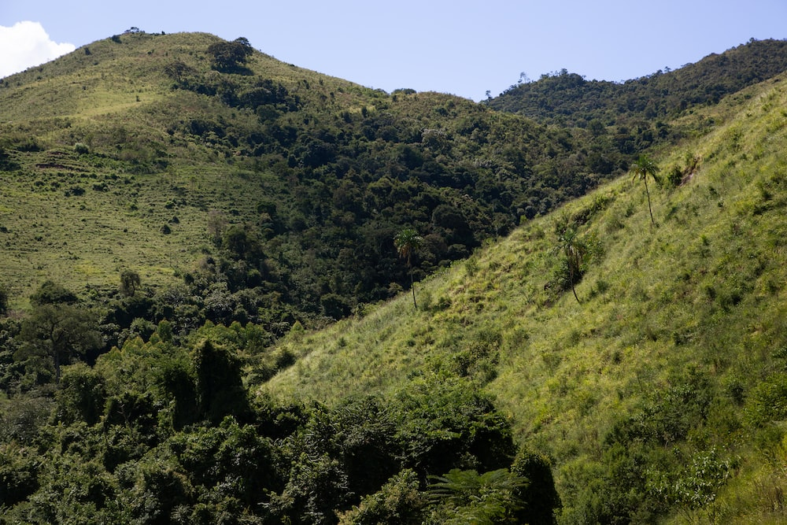
Angola: Effects of climate change have resulted in fires due to agricultural practices, hunting exploitative practices of inert materials.
Côte D’Ivoire: Land and forest degradation have had direct consequences for agriculture, including shorter average vegetative growth periods, weaker biomass growth, reduced productive potential of ecosystems and less arable land, all due to land degradation, greater exposure of plants to water stress and reduced volume of surface water in most regions.
Democratic Republic of the Congo: Decreased rainfall and number of rainy days have resulted in the loss of around 0.4 per cent of Miombo/Katanga forests in 2000, and to date, the country has lost more than 0.8 per cent of its forest. Current climate trends show that by 2030, the DRC is likely to lose up to 1 per cent of its forest cover.
Mali: Land degradation and misuse of natural resources have costed 20 per cent of GDP every year. Croplands are increasingly affected by water and wind erosion, chemical degradation, physical soil degradation, biological degradation, decline in local cultivated varieties and mixed cropping systems, and water degradation due to runoff (surface water pollution).
Malaysia: Maintains at least 50 per cent of the country’s land area consisting of forests and tree cover, in line with their 1992 Earth Summit commitment. This includes permanent reserved forests / forest reserves / permanent forest estates, state land forests and totally protected areas.
Philippines: As of 2010, the Philippines had already lost 60 per cent of its total forest cover. Out of its 16.9 million hectares of forestlands in 1934, approximately 6.84 million hectares remain.
Uganda: Annual forest cover loss was 2.2 per cent of total forest cover over the period 1990 to 2020 due to deforestation. Extreme climatic events such as droughts, windstorms and floods can destroy trees on a massive scale, as observed in Bwindi Impenetrable National Park.
Forest and land degradation
Angola, Benin, Cote D’Ivoire, DRC, Gabon, Ghana, Lesotho, Malawi, Mali, South Sudan, Togo, Uganda, Lao PDR, Malaysia, Philippines
OVERVIEW
Credit: unsplash.com

Slide 67
LAND AND FOREST DEGRADATION
1. SCOPING AND ASSESSMENT (Evaluating potential impacts and specific vulnerabilities)
Triggers: Increased average maximum temperature range (drought/extreme weather), projected loss of productive and habitable land/forestry, impacts on production, projected reduction in water supplies
ACTION | GAPS | NEEDS
Conduct monitoring & risk analysis assessments Establish early warning systems to monitor and predict indicators of land and forest degradation, allowing for timely response to emerging threats such as wildfire risks, pest outbreaks, or unsustainable land practices; Monitor forest reference emission level (FREL) monitoring; Carry out risk analysis and assessments using monitoring data utilizing land-use maps, wood tracking systems, national land coverage maps, forest degradation maps for selected forest reserves; Identify the habitats, ecosystems, vulnerable areas, and any other species that can be aided. Map hotspot areas Research & identify areas for capacity building Conduct technical studies (e.g., Gabon would like to carry out studies on how its forests will adapt to climate change, valuation of forest carbon; management systems for phenomena related to forest degradation; population management during displacement/relocation); Engage tropical ecology research, national scientific and technological research, and collaboration of institutes; Research and assess carbon credit markets and possibility of engagement. | Limited models and information of real-world dynamic situations to assess biodiversity impacts to a changing climate. Lack of up-to-date knowledge of climate trends. Lack of capacity/robust early warning system. Specifically, to address forestry and land degradation; for forestry incidents (warning of fires, landslides, erosion based on meteorological, hydrological, and oceanographic data, etc.) Forest cover data is often outdated and fails to distinguish forests from plantations, leading to flawed conservation policies and management strategies. Lack of good-quality data about the definition of a forest, the extent of forest cover, loss of forest, (un)sustainable yields. Gap in monitoring the survival rate of planted trees/reforestation projects over time. Limited information and knowledge of climate change impacts on vulnerable sectors including downscaled climate scenarios as well as limited technical knowledge and capacity of concerned sectors. Absence of sectoral strategies, action plans, and indicators in most key sectors. Lack of best practice and climate smart technology scaling-up. | Indicators identification of deteriorating land/forest thresholds. Development of a hydro-climatic risk assessment system. Databank of biophysical, cartographic, and other data, as well as geographic information system on soils to guide public decisions and actions on sustainable land management. Projection system to monitor the evolution of land degradation, vegetation cover, and climate variability. Agrometeorological warning system to provide producers with reliable information on rainy season forecasts. Enhanced monitoring/surveillance brigades (training, provision of equipment, maintenance facilities at strategic sites). National databases on forest and land degradation status, information, etc. Technical support for the downscaling of global and regional climate impact and vulnerability assessments for forest sector to the national and local scale in a way that can support local and sector planning. Data gathering, monitoring and evaluation methodology to account the extent of deforestation and land degradation. Spatial analysis of impacts of climate variability on forest cover, biodiversity loss, etc. Using a participatory approach, study the possibilities of popularizing agroforestry systems based on fruit species, with a view to enabling producers to limit the reduction in their income due to the drop in food crop yields. Further research into the relationship between climate change and agricultural exit strategies, such as migration and rural exodus. Technical studies, e.g., forest adaptation and carbon credit markets. Further study of carbon sequestration rate of indigenous trees (Philippines) Economic valuation of forestry and ecosystem. Quantification of carbon sinks

Slide 68
LAND AND FOREST DEGRADATION
2. PLANNING AND PREPARATION (Exploring policy options and strategies to reduce identified risks and vulnerabilities)
ACTION | GAPS | NEEDS
Develop policies, plans, technical capacities, and programmes Action plans: Develop national climate action plan outlining adaptation and mitigation measures focusing on achieving the protection and rehabilitation of critical ecosystems, and the restoration of ecological services; Develop sustainable land management plan, demarcation of classified forests, the drafting of management plans (e.g., Plan d’Aménagement General, PAG, Mali) for classified forests, protected areas, and village massifs (e.g., Mali), and the registration of classified forests. Prepare national documents and plans, along with corresponding programs/activities: National REDD+ strategy, transformation acceleration plans (e.g., Plan d’Accélération pour la Transformation, PAT, Gabon); National land allocation master plans; National strategy to reduce emissions from deforestation and forest degradation, foster conservation, sustainable management of forests, buffer zones of protected areas and other preserves, and enhancement of forest carbon stocks. Develop/enhance forestry code To provide a framework for sustainable forest management; strengthening of integral protection of forests and protected areas (e.g., Malaysia, gazette forest areas as “Permanent Reserved Forest” and/or “Reserved Land). Set-up programmes to repair dunes and riverbanks, wetland preservation. Initiate participatory sustainable forest management with village forest management plans. Prepare collaboration and finance measures Facilitate the coordination and uniformity of governance policies of the sectors related to lands, mining, agriculture, and forestry between different levels of government (e.g., federal and state governments for Malaysia); Ensure agency collaborations tasked with forest-cover monitoring and managing protected areas/national parks; Develop Forest Investment Programs (e.g., PIF, Côte D’Ivoire) / forest management fund aimed at restoring the productivity of forest resources and managing them sustainably; Create incentives, secure land tenure and access rights to create an environment conducive to transformation, and towards implementing zero-deforestation agriculture; African Forest Landscape Restoration Initiative (AFR100) and the Great Green Wall for the Sahara and Sahel initiative. Empower communities, raise awareness, and build capacity Promote community capacity building and local-led approaches to environmental and biodiversity issues related to land & forest degradation; Launch land protection awareness-raising projects and programs implemented by the public, private, and NGO sectors. | Gaps in national capacity to mobilize resources. Institutional fragmentation and difficulties with effective policy implementation. Limited access to climate finance Inadequate individual technical capacity. Inadequate legal frameworks to manage land and forest resources especially at lower local governance (e.g., community ordinances and by-laws). Weak cross-sectoral coordination. Weak institutional capacity to mainstream climate change into development plans or translate them into actionable measures at local level. Adaptation projects not covering entire geographic needs (e.g., Togo reports projects cover only 2 out of 5 regions). Ecosystem based adaptation remains an untapped opportunity. Gap in erosion control. Gap in hydro-climatic risk assessment systems. Unavailability of traditional seeds. Low prioritization of climate interventions and response in terms of national budget. Limited technology to carry out land use / land cover change especially for degraded forest resources. Lack of access to appropriate technologies Lack of management and maintenance by farmers. Lacking public awareness. | Build the capacity of stakeholders (communes, NGOs, private sector) to develop and submit sustainable land management (SLM) / climate change adaptation (CCA) projects to various financial mechanisms. Create an official framework for dialogue and awareness-raising between spiritual leaders and the administrative authorities, to prevent social conflicts. Finance resources for the effective implementation of national forestry, SLM, and climate change adaptation policies/projects. Access to international and regional technologies and know-how Promote agricultural credits Support for the implementation of requisite legal mechanisms. Improved cross-sectoral governance and coordination structures, drawing on international best practices and lessons learned. Early warning systems for forestry incidents (warning of fires, landslides, erosion based on meteorological, hydrological, and oceanographic data, etc.). Capacity-building for agents in forest governance, improving biodiversity conservation, sustainable land management Measures to promote activities that diversify sources of sustainable income, such as livestock breeding and agri-food processing. Measures to mainstream climate change issues in producers' action programs. Support producers in reforestation operations to protect soil against erosion via systems for erosion control. Provide training to all levels of implementers regarding forest management certification standards. More frequent up-to-date monitoring of national climate plans to include milestones, gaps, and challenges in the implementation of activities and outputs. Raise public and producers' awareness of the realities of climate change to raise their consciousness and help them make right decisions. Focus on strengthening resilience of ecosystems and communities in drought-prone areas. Support to conduct forestry inventory

Slide 69
LAND AND FOREST DEGRADATION
3. ADAPTATION IMPLEMENTATION PHASE (Implementation of action plans, policies, response/relief efforts)
Triggers: Loss of human life, loss of biodiversity, national declaration of state of emergency, reduction in water supply capacity, degrading quality of forest and other ecosystem components such as flora, fauna, soil, and water, extinction of flora and fauna
ACTION | GAPS | NEEDS
Implement sustainable land management and restoration measures Initiate sustainable land management practices to minimize land degradation and improve soil health Implement erosion control measures, conservation agriculture, terracing, agroforestry systems and rotational grazing; Restore degraded lands (protected areas, degraded natural forests, mangroves and river-banks). Engage forest planation management Forest plantation design and layout - Where the forest plantation is located adjacent to an environmentally sensitive area, establish adequate buffer zone; Launch afforestation and reforestation programs; reforestation of large estates and planting native tree species, implementing agroforestry practices, and promoting sustainable tree cover to enhance ecosystem services, carbon sequestration, and biodiversity conservation; Manage timber harvesting sustainably; Establish requirements for buffer strips for permanent streams and rivers in Inland Forest and Peat Swamp Forest of at least 5 m in width on both sides of the stream or river. Activate measures for agriculture, natural ecosystems Implement energy and water resource management, e.g., alternative sources of cooking energy, uptake in the use of drip irrigation; Protect and build resilience of biodiversity and habitats; Take actions to increase ecosystem resilience and promote sustainable agriculture practices; Increase resilience of natural ecosystems to climate change via programmes such as implementation of connectivity and corridors between forests and other ecological areas (i.e., Malaysia’s Central Forest Spine (CFS) and Heart of Borneo (HoB) programmes). Promote and encourage sustainable mining, lumbering, and sand winning. Implement additional adaptation and response measures a. Strengthen forest governance Strengthen forest governance by publicizing and raising awareness of relevant legislation; Strengthen law enforcement and governance structures to combat illegal logging, land encroachment Empower forest good governance. b. Engage Disaster Containment and Humanitarian Impact Mitigation Combat bushfires by supporting technical services and conducting awareness raising campaigns; Search and rescue operations in response to emerging hazards (i.e., following emergency declarations). | Legislative power and management of forests rests with state authorities, rather than the federal government (Malaysia). And so, regulating sustainable land and forest plantation management requires approval and implementation by the individual states which is time-consuming and prone to conflict as the states rely on forests as core economic resources. Open vegetable farming has the highest erosion rate – runoff that flows into the water bodies carried together with the eroded soil carrying a significant amount of nutrient and heavy metals. Limited information on the impacts of climate change on natural ecosystems and their biodiversity pool. Limited information on potential impacts to endangered species and which ecosystems need to be prioritized. The lack of legal mechanisms for resolving conflicts between industries and indigenous communities. Unsustainable logging practices (i.e., maintaining Malaysia’s status in the global timber trade). | Adequate and sustainable financial resources. Legislation which proposes uniformity of law and policy between state governments. Planting trees that require the least earthwork and minimal soil erosion to cultivate and that provide dense ground cover that can absorb the raindrop impacts. Strengthen mechanized farming polices by providing farmers with machines. Providing producers with machinery adapted to the soil characteristics of each and by easing the conditions of access to these machines. Establishing compensatory plantations of fast-growing species in damaged, degraded, or unproductive forest areas. Heavy metal content from agriculture activities must be below permissible levels.

Slide 70
LAND AND FOREST DEGRADATION
4. RETREAT/RECOVERY PHASE (Rebuilding, restoring of essential services, relocation and retreat where needed)
Triggers: Opportunity to restore lands and forests, boosting/restoring economic activity in the forest sector. (Timeframe: 2–10 years)
ACTION | GAPS | NEEDS
Implement land and forest restoration policies - i.e., integrated landscape planning; Updating the periodic forestry inventory (Angola) Rehabilitate degraded lands and ecosystems through various techniques such as soil conservation measures, revegetation, watershed management, and land rehabilitation practices. Sustainably manage and rehabilitate forests and lands degraded by mining and oil operations. Reconstruct following onset of hazards and impacts due to degraded land. Implement mechanisms to incentivize and reward landowners and communities for sustainable land and forest management practices. (i.e., payment of exploitation fees). Reform policy and governance (i.e., environmental education and awareness plan) Implement national climate change adaptation plans.

Slide 71
Morocco: Caused by factors such as over-irrigation, use of low-quality irrigation water, lack of drainage, and overuse of fertilizers. The issue affects more than 1 million hectares of land, approximately 10% of Morocco's arable land.
Maldives: With 80 per cent of its islands being less than 1m above mean sea-level, sea-level rise has caused groundwater salinization, posing a threat to water security across the nation. The country heavily depends on groundwater and harvested rainwater for drinking, and during dry seasons, many inhabited islands face water shortages due to salinization.
Thailand: Affected the province of Samut Song Krami in Thailand, located near the capital and known for its fruits. Proximity to the sea has led to the common occurrence of brackish water. Periods of intense salinization have caused issues such as fish migration and loss of flora and plants, with more being pulled into the sea due to salt waves.
Salinization
Angola, Benin, Cote D’Ivoire, DRC, Gabon, Ghana, Lesotho, Malawi, Mali, South Sudan, Togo, Uganda, Lao PDR, Malaysia, Philippines
OVERVIEW
Credit: unsplash.com

Slide 72
SALNIZATION
1. SCOPING AND ASSESSMENT (Evaluating potential impacts and specific vulnerabilities)
Triggers: Projected sea-level rise, increase in groundwater salinity, requests for freshwater, high temperatures, urbanization which occurred without comprehensive planning requiring intervention.
ACTION | GAPS | NEEDS
Conduct monitoring and risk analysis assessments Monitor water salinity by the authorities related to water and irrigation - salinity of water, lack of water and increased temperature leading to salinity and sea water instruction; Monitor groundwater; Monitor precipitation; Monitor water levels and sea level intrusion; Ensure national communication providing risk assessments, interlinkages and connectedness to salinity. Research and identify areas for capacity building Develop crops that are more tolerant to salt, which could help farmers to continue to cultivate crops in salt-affected areas; Conduct research and knowledge management/ sharing. | Gaps in targeted/regular monitoring, reporting, and management of data gathered. The slow onset nature of salinization does not leave much room for realizing its impacts and it is difficult to assess and create projections on how it will develop in the future. Another difficulty is the causal link i.e. differentiating between cause and effect with respect to other impacts of climate change The vicious cycle - which is the cause, and which is the consequence: rising sea levels, drought and scarcity of water resources. land degradation, etc. Lack of capacity to conduct regular groundwater monitoring. Financial support / technical support for risk assessments lacking. Financial support needed for generating/collating data, evidence, and research. Gaps in institutional support for sustaining data and knowledge. | Institutional and technical capacity for data management at all levels. Updated data for development of risk assessments. Technical equipment for conducting monitoring. Comprehensive assessments for water and other resource needs for activities to be conducted. Mapping of restoration efforts, and suitable approaches for restoration based on risk assessments and soil salinity levels etc. Financial and technical support is needed for effective and sustained monitoring of sea level rise and data related to it. Sea level rise assessments. Enhanced ground water monitoring. Improved research and evidence on water and sewerage sector to support policymaking. Knowledge and data management.

Slide 73
SALNIZATION
2. PLANNING AND PREPARATION (Exploring policy options and strategies to reduce identified risks and vulnerabilities)
Triggers: Increase in average sea-level rise, groundwater salinity, requests for freshwater, high temperatures.
ACTION | GAPS | NEEDS
Address water salinity and planning Develop plans for the provision of water supply to inhabited islands. Develop plans for water resource conservation, security, and management. Create plans for water and irrigation system management and practices. Budget for the provision of emergency water supply. Improve policy, legal, and regulatory framework to ensure the provision of safe water supply and sewerage services to all inhabited. Locate alternative sources of clean water and prepare contingency measures for water supply Develop and introduce a private sector investment framework for development of water and sewerage facilities. Promote more efficient use and manage of water (drip irrigation) such as: Optimizing irrigation (drip irrigation); Avoiding deep tillage; Utilizing permaculture and organic agriculture; Avoiding evapotranspiration through the cover vegetation; Utilizing crops that tolerate salt; Utilizing mechanical action to pump out salt water. Address reducing salinity in agriculture lands Develop agriculture related policies for soil salinity and water supply for agricultural practices, as well as other relevant policies and regulations related to land restoration, and water management; Promote more efficient use and management of land (better soil management); Build capacity for institutional coordination with regards to actions related to salinity; Mobilize projects and finance. Raise awareness of communities Raise awareness of the local population. Raise awareness of decision makers. | Inter-institutional and cross-sectoral coordination gaps. Technical capacity gaps for conducting necessary actions in drafting of plans. | Means of implementation, financial and other forms of support needs. Coordination support and cross-sectoral engagement for effective policy development for inter and cross-sectoral approaches.

Slide 74
SALNIZATION
3. ADAPTATION IMPLEMENTATION (Implementation of action plans, policies, response/relief efforts)
Triggers: Steady increase in groundwater salinity, requests for freshwater during dry seasons, lack of fresh water, sea-level rise, droughts and seawater intrusion, ground water related impacts, damage to agriculture land in certain areas, loss of livelihoods and agriculture land, salinity intrusion and damage to water distribution structures by extreme events including floods. Droughts, and sea-level rise, migration of sea-life to other locations, land is decreasing in size.
ACTION | GAPS | NEEDS
Implement water conservation measures to address salinity and ensure population supply Implement national water resource conservation, security, and management plans. Protect and conserve ground water. Establish salinity barriers in rivers where intakes are subjected to climate change influenced saline water intrusion during the drought season (i.e., Sri Lanka - covering Kelani Ganga, Kalu Ganga, and Malwathu Oya). Provide water to areas where salinity has impacted drinking water. Establish water supply systems (reverse osmosis plants) in inhabited islands. Provide fresh water via water supply networks. Provide emergency desalinated water. Construct drainage systems. Restore land and ecosystems Ensure land restoration practices to reduce salinity of agricultural land. Implement better irrigation practices. Restore ecological systems. Implement industry and additional targeted measures Establish new fish breeding units with indoor hatchery facilities and design constructions enabling control of temperature and salinity for breeding tolerant strains of selected species. Create of natural habitats for animals to lay eggs and shelter from storms. | Means of implementation for conducting the needed activities. Gaps in financial and technical support for technology needs for enhanced and effective barriers and to enable construction. Technology for land restoration efforts.

Slide 75
SALNIZATION
4. RETREAT/RECOVERY (Long-term: Restoring of essential services, relocation and retreat where needed)
Triggers: Loss of homes and livelihoods, established water supply network.
ACTION | GAPS | NEEDS
Evacuate affected populations. Bolster water management and irrigation system enhancement. Support continued development and establishing of water supply systems. Incorporate and implement groundwater recharge mechanisms in land use plans of all inhabited islands. Scale up renewable energy and hybrid systems to operate existing water and sewerage facilities. | Evacuations requires increased financial and human resources. Relocation efforts require additional financing in addition to an inclusive approach involving the local affected population.
5. MONITORING AND EVALUATION
ACTION | GAPS | NEEDS
Review and revise existing water supply system design specifications based on latest research and monitoring. Continuously monitor groundwater levels and salinity.

Slide 76

Bhutan: Climate change is causing an increased risk of hydrometeorological hazards due to melting glacial lakes, which can lead to Projected Glacial Lake Outburst Floods (GLOFs), flash floods and landslides.
Kazakhstan: Faces similar risks to Bhutan’s, with over 1,000 moraine lakes, 156 of which are identified as most dangerous outburst lakes. Glacial retreat poses a threat to the country’s water supply as glaciers contribute approximately 20 per cent of the volume of mountain rivers.
Nepal: Has approximately 2,315 glacial lakes and 20 potential GLOF sites.
Glacier retreat
Bhutan, Kazakhstan, Nepal
OVERVIEW
Credit: unsplash.com

Slide 77
GLACIER RETREAT
1. SCOPING AND ASSESSMENT PHASE (Evaluating potential impacts and specific vulnerabilities)
Triggers: Projected Glacial Lake Outburst Flood (GLOF), soil erosion, river water current increase, projections of flooding/landslides/droughts.
ACTION | GAPS | NEEDS
Monitor disaster risk and vulnerabilities Conduct risk and vulnerability assessments. Identify potentially dangerous lakes. Initiate GLOF hazard-zonation mapping. Create automated monitoring system, Engage air-visual monitoring/on-ground monitoring. Map glaciers and glacier lakes. Create a multi-hazard regional early warning system for Central Asian countries. Identify impacts on vulnerable area Identify risk areas and conduct vulnerability assessments of the glacial lakes and its outbursts; Identify the quantity of moraine lakes. Research and raise public awareness Raise public awareness and education in identified vulnerable communities; Conduct scientific research of glaciers. | Lack of baselines to conduct assessments. Hazard-zonation mapping not completed for all GLOF vulnerable communities. Limited hydrometeorological data. Lack of human resources and Geographic Information System (GIS) specialists. Lacking capacity of GIS systems. Lack of scientifically based methodology. Government possesses knowledge of glacial retention and its impacts to vulnerable areas/sectors/populations but does not have a clear vision and strategy in place to address all gaps in response. Lack of continuity of public education and awareness raising programs. | Financial and technical assistance to conduct comprehensive assessments. Expansion of the number of automated monitoring stations in mudflow prone areas. Database on spatial distribution of glaciers in detail. Introduction of innovative technologies for monitoring, such as drones. Technological transfer and expert support. Enhanced capacity / creation of GIS system that will be capable of processing data from hydrological posts and satellite data as well and could provide recommendations for action to be taken in concrete situations. Crucial to raise awareness of the impacts of GLOF at the community level and among decision makers to gain financial support. Glaciological study should be included in school and university courses.

Slide 78
GLACIER RETREAT
2. PLANNING AND PREPARATION PHASE (Exploring policy options and strategies to reduce identified risks and vulnerabilities)
Triggers: GLOF, significant soil erosion, projected loss of agriculture/productive land, projections of impaired hydropower capacity, increasing size of glacial lakes.
ACTION | GAPS | NEEDS
Prepare disaster risk reduction and capacity building plans Develop science-informed methodology for disaster risk reduction. Initiate community-based disaster risk reduction program – develop disaster management and contingency plans. Launch capacity building programs to reduce risks and vulnerabilities from GLOF (e.g., Punakha, Wangdue and Chamkhar Valley). Strengthen institutional capacities and create financial plans to adapt vulnerabilities to impacts. Emergency warning systems and evacuations Issue notifications to avoid constructions and settlement in the red-zone areas as per GLOD hazard zonation mapping. Ensure timely testing and maintenance of EWS. Identify and plan safe evacuation drills and safe sites for vulnerable communities. | Financial constraints on ability to develop response and emergency capacity. Lack of policy related to adaptation and mitigation plans regarding glacier retention. Gaps in community based Early Warning Systems. Poor compliance to early warning notifications. False alarms due to sensitive indicators. Relocation issues in terms of people’s acceptance and concerns with land fertility. | Development of the Scientific Methodology for DRR including process and approach of emptying moraine lakes. Should make clear policy, vision, and strategy on climate change and its effects on glaciers. Identification of practical solutions or alternatives to mitigate future risk. Financial support/assistance to ensure adequate early warning systems are installed. Vulnerable communities should be aware and pre-notified about the probable occurrence of disasters, high-risk areas, and evacuation/response procedures.
3. ADAPTATION IMPLEMENTATION PHASE (Implementation of action plans, policies, response/relief efforts)
Triggers: Glaciers retreating at an alarming rate, increased risk of flooding events and devastating mudflow, hazard by-products of desertification such as drought, recurrence of slide and avalanches, risk of another GLOF occurrence, threats to hydropower, critical infrastructure, residential households and facilities due to mudflows and floods.
ACTION | GAPS | NEEDS
Install automatic early warning systems / improve existing early warning systems Implement mudflow and flood preventative measures Construct dams in densely populated areas. Install monitoring sensors on the most dangerous outburst lakes and mudflow hazardous basins. Improve drainage systems. Construct gabion walls for settlements which are situated along rivers. | Projects are time-bound and lack continuity (sustainability issue). Pilot-based concerns. Too expensive to construct gabion walls.

Slide 79
DZUD
1. SCOPING AND ASSESSMENT (Evaluating potential impacts and specific vulnerabilities)
ACTION | NEEDS
Monitor disaster risk and vulnerabilities Establish enhanced data systems. Update dzud maps at local levels based on monitoring. Assess impacts on vulnerable sectors (i.e., health, agriculture, etc.) Identification of suitable solutions based on context-based localized approaches. Conduct research and raise public awareness Conduct research on early warning and impact-based forecast. | Provision of equipment for information receiving for vulnerable communities. Develop multi-hazard mapping and risk assessment.
2. PLANNING AND PREPARATION PHASE (Exploring policy options and strategies to reduce identified risks and vulnerabilities)
ACTION | GAPS
Establish/maintain/build capacity of early warning systems Expand of early warning systems by sector-based needs, community and livelihood related data sharing and systems updates. Develop dzud anticipatory programmes, plans/frameworks, and projects Develop programmes for capacity building of technical staff working on response to the issue. Support for development of project proposals for accessing funding. Enhance technical assistance through global experiences/cooperation to scale-up existing projects and activities related to dzuds and droughts. Rearrange institutions, response arrangements, and access to key resources/funding Invest in market expansion of meat, milk dairy farm production. Invest in different businesses and industries, mental and medial health care, stress and resilience management. Invest in insurance products for herders/index-based insurance. | Sharing of available data applicable for planning action.

Slide 80
APPENDICES

Slide 81
Santiago network Functions
DECISION 2/CP.19, PARA 7
Facilitate support of actions to address loss and damage;
Improve coordination of the relevant work of existing bodies under the Convention;
Convene meetings of relevant experts and stakeholders;
Promote the development of, and compile, analyse, synthesize and review information
Provide technical guidance and support;
Make recommendations, as appropriate, on how to enhance engagement, actions and coherence under and outside the Convention, including on how to mobilize resources and expertise at different levels;
1
Contribute to the
Warsaw International Mechanism (WIM)
in line with the provisions in paragraph 7 of decision 2/CP.19 and Article 8 of the Paris Agreement
ARTICLE 8 OF PARIS AGREEMENT
Early warning systems;
Emergency preparedness;
Slow onset events;
Events that may involve irreversible and permanent loss and damage;
Comprehensive risk assessment and management;
Risk insurance facilities, climate risk pooling and other insurance solutions;
Non-economic losses; and
Resilience of communities, livelihoods and ecosystems.

Slide 82
Santiago network Functions
DECISION -/CMA.3
9 (b) (i) Identifying, prioritizing and communicating technical assistance needs and priorities;
9 (b) (ii) Identifying types of relevant technical assistance;
9 (b) (iv) Accessing technical assistance available under the network;
9 (c) ... considering a wide range of topics relevant to averting, minimizing and addressing loss and damage approaches, including on:
Current and future impacts
Priorities, and actions related to averting, minimizing, and addressing loss and damage pursuant to decisions 3/CP.18, and 2/CP.19
The areas referred to in Article 8, paragraph 4, of the Paris Agreement
The areas referred to in the strategic workstreams of the five-year rolling workplan of the Executive Committee
2
Developing countries addressing loss and damage
9(b) implement relevant approaches to averting, minimizing and addressing loss and damage, by

Slide 83
Santiago network Functions
DECISION -/CMA.3
3
9(b) (i) Identifying, prioritizing and communicating technical assistance needs and priorities;
9(b) (ii) Identifying types of relevant technical assistance;
9 (b) (iii) Actively connecting those seeking technical assistance with best suited organizations, bodies, networks and experts;
9(b) (iv) Accessing technical assistance available under the network;
Through the Santiago network Secretariat
Providers of technical assistance
Assist developing countries as they implement relevant approaches to averting, minimizing and addressing loss and damage (9b), in the following:

Slide 84
Santiago network Functions
DECISION -/CMA.3
Host to the SN Secretariat
The SN Secretariat
Providers of Technical Assistance
Advisory body for the SN
9(c) Facilitating the consideration of a wide range of topics relevant to averting, minimizing and addressing loss and damage approaches
Catalysing providers of technical assistance to facilitate the following in developing countries:
  9(b)(iii) Actively connecting those seeking technical assistance with best suited organizations, bodies, networks and experts;
  9(f) access to action and support (finance, technology and capacity building) under and outside the Convention and the Paris Agreement
9(d) Facilitate and catalyse collaboration, coordination, coherence and synergies to accelerate action by organizations, bodies, networks and experts, across communities of practices, and for them to deliver effective and efficient technical assistance to developing countries
9(e) Facilitate the development, provision and dissemination of, and access to, knowledge and information on averting, minimizing and addressing loss and damage, including comprehensive risk management approaches, at the regional, national and local level
4
Structure to manage the interface between the countries and providers of technical assistance (Institutional structure )
Through the SN Secretariat

