Slide 1



Empowering Change: Building Capacities for a Just Energy Transition, Energy DAY

Slide 2
Agenda
1
Opening Remarks: Prof. Dr. Edeltraud Guenther – Director of UNU-FLORES
  2
Presentation of the session and discussion tables:
  Dr. Ambe Emmanuel Cheo – UNU-VIE
  3
World Café Tables
  Mario Heredia, PUCE
  Gissele Flores, Asoclima
  Carole Tankeu, W4SECA
  Muyiwa Oyinlola, CEPREC
  4
Closing Remarks: Federico Burone – LAC Regional Director for IDRC

Slide 3

Just Energy Transitions
Opening remarks
Prof. Dr. Edeltraud Guenther – Director of UNU-FLORES
15 November 2025

Slide 4
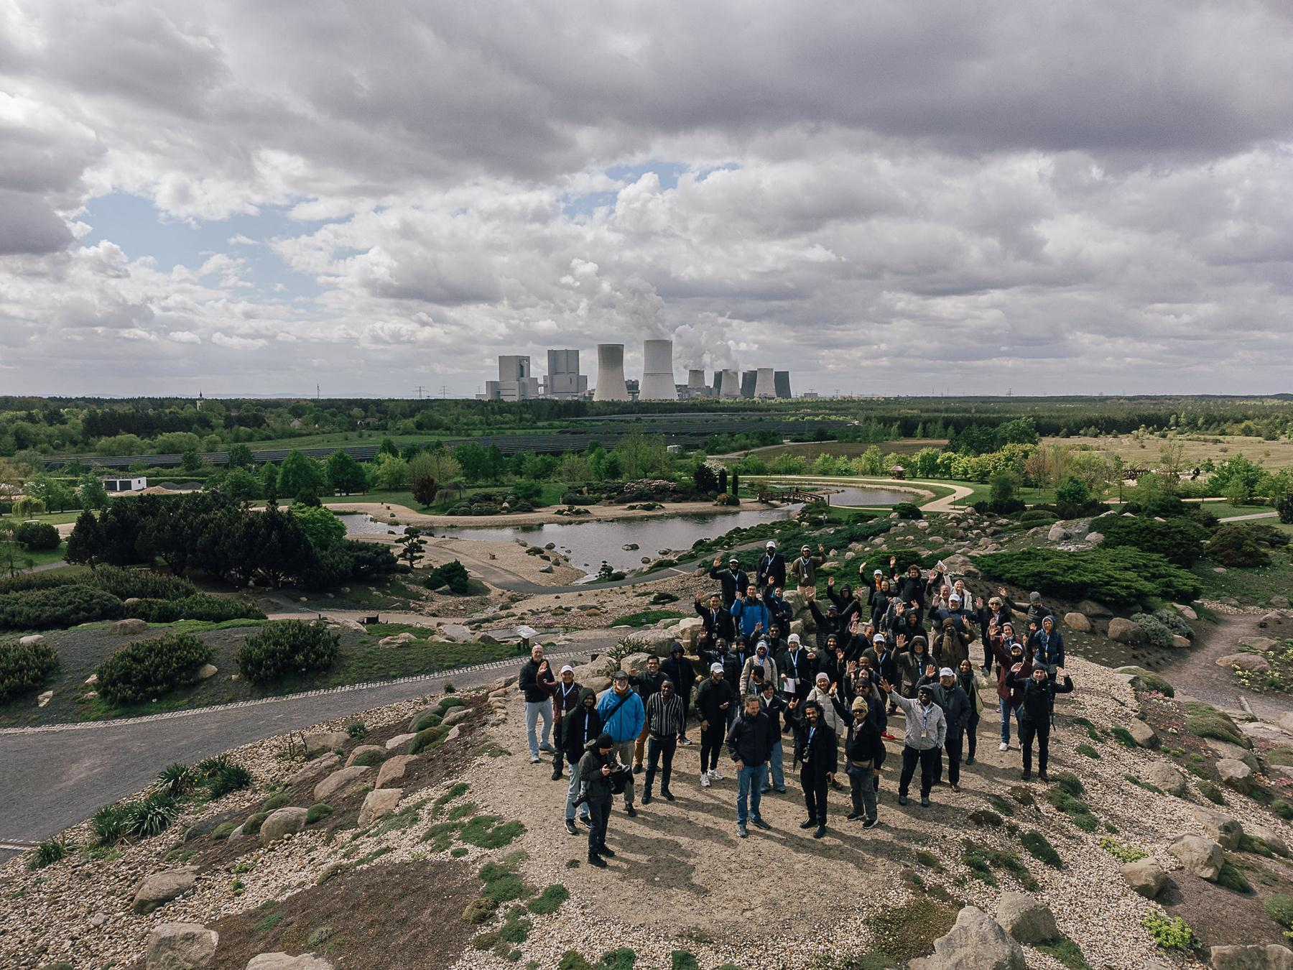

Empowering Change:
Building Capacities for
Just Energy Transitions
Five messages
1. From extraction to empowerment: rethinking transitions
2. The land as a classroom for transition
3. Building institutions that include
4. The Resource Nexus: seeing the whole system
5. Scaling local wisdom, not just technology
Photo: UNU-FLORES / Paul Glaser
Former coal mine transformed into the inclusive landscape park

Slide 5
Diversity
of lignite energy transition
Mining and Gender:
  underrepresented sector for women
  ranges from 8 to 17 percent
  lack of intellectually challenging work
  perceived fewer advancement opportunities
  notable gap in operational experience and mentorship
  receiving equal promotion opportunities
  standards for promotion in technical, operational, and executive roles
  experiencing ineffective or nonexistent sponsorship.
Source: https://www.mckinsey.com/industries/metals-and-mining/our-insights/why-women-are-leaving-the-mining-industry-and-what-mining-companies-can-do-about-it

Slide 6
Diversity
of lignite energy transition
Gender and transition
  Different understanding of transition
  Decisions of men
  Less visibility of minorities and vulnerable groups
  Stereotypes and clichés
  Intersectionality as accepting process
  Few data
Role of women in the energy transition
  Participation opportunities different
  Surveys: Women more sustainable and interested in sustainable lifestyle
  Sustainability supports (gender-) justice
  Diversity supports economic growth
Source: https://www.wecf.org/de/84729-2/ https://www.diw.de/documents/publikationen/73/diw_01.c.822824.de/dp1963.pdf

Slide 7
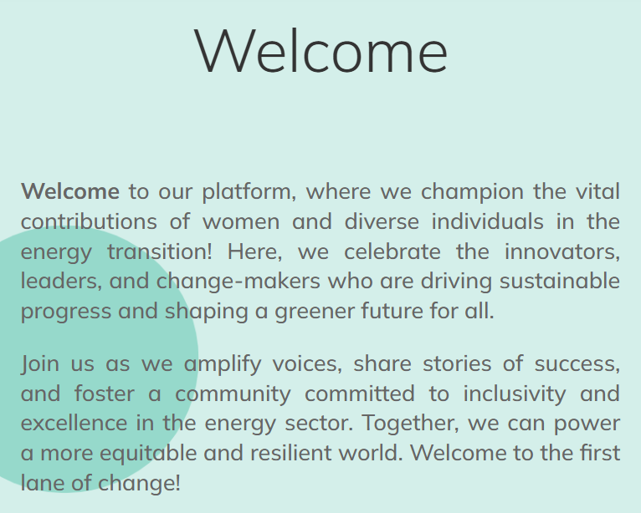
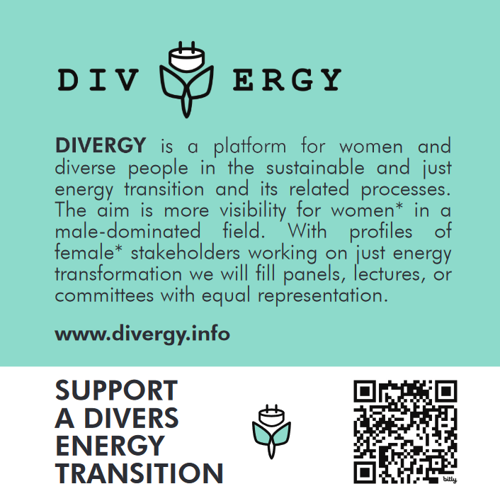
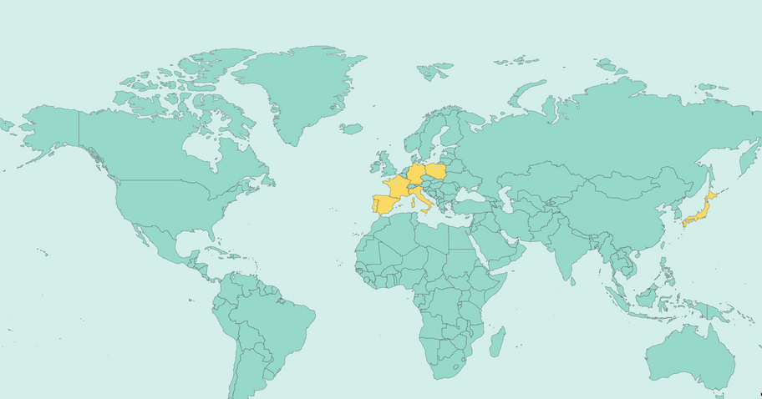
Divergy.info

Slide 8
Energy Day
Presentation of the session and discussion tables
Dr. Ambe Emmanuel Cheo
15 November 2025

Slide 9

World Café Discussion Table Rotation
  Participants choose 2 of 4 discussion tables
  Spend 30 minutes at each table
  Explore capacity-building initiatives
  Learn how each builds skills within local and national contexts
  Share your insights and ideas with your peers

Slide 10
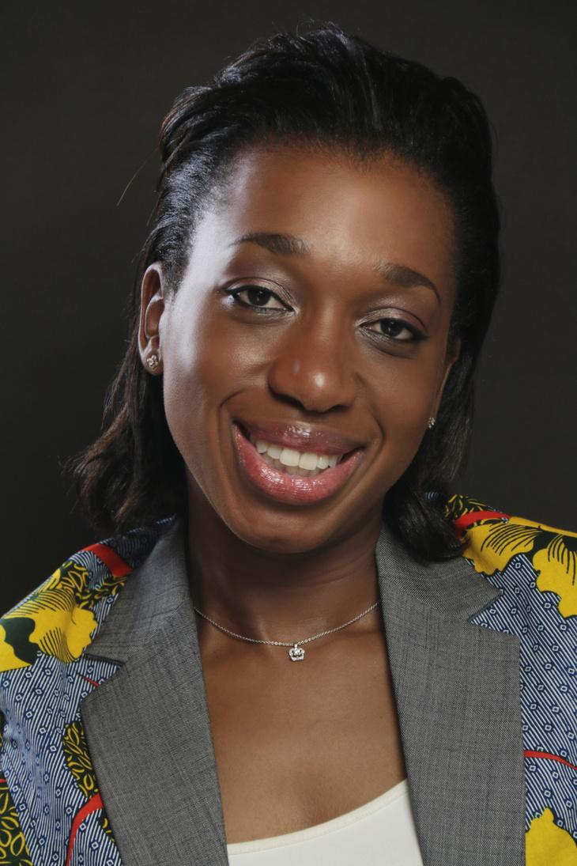
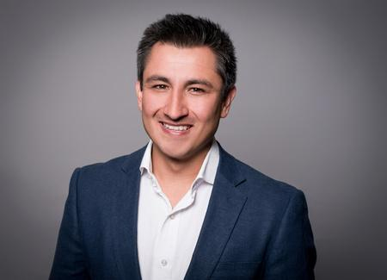
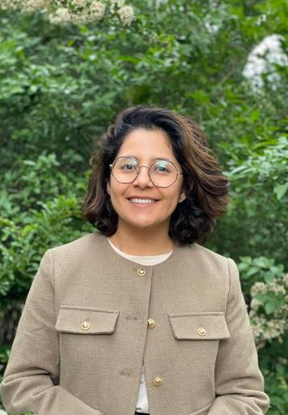
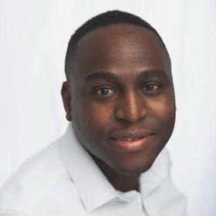
Carole Tankeu
W4SECA
Dr. Eng Mario A Heredia S. PUCE
Gissele Flores
ASOCLIMA
Prof Muyiwa Oyinlola CEPREC
Training on promoting women's participation in renewables through entrepreneurship in Cameroon rural areas
A question-led session on building capacities through entrepreneurship for internally displaced women. We will explore the best practices in the Global South.
Capacity Building Program in the scope of the PLANMICC (National Mitigation Plan)
A Canvas template to develop Energy Transition Projects; Gamification and mentoring for incubation and acceleration processes, construction of a portfolio of energy transition projects as a result of the CBP.
Building Capacities through Entrepreneurship for Internally Displaced Women
This is a facilitated, question-driven session that enables participants to learn from our experience, while also giving them the opportunity to share their best practices or provide recommendations for Just Energy Transitions.
Building Institutional Innovation Ecosystems for a Just and Circular Energy Transition
Guided by the Triple-Helix model, participants will rotate through short, structured conversations to share institutional challenges and co-create solutions for embedding innovation and circularity in the energy transition.

Slide 11
Energy Day
Closing remarks
Federico Burone, LAC Regional Director for IDRC
15 November 2025

Slide 12


