Slide 1
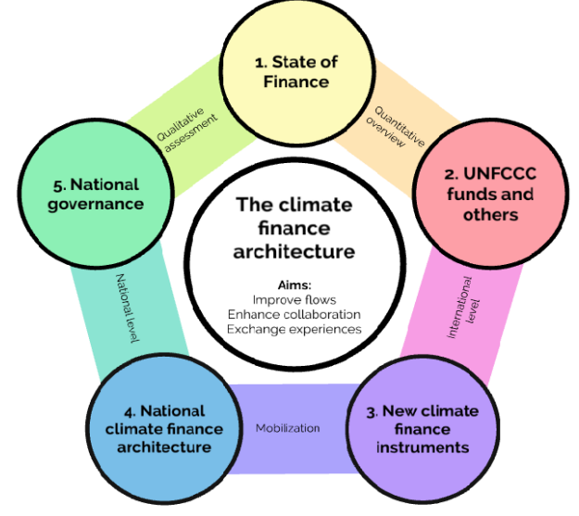
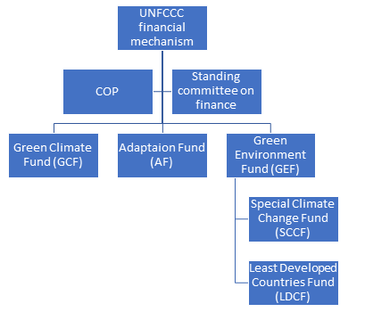






















CC$ landscape for PSIDS
FRLD
Foreign
Affairs
Works & Infra
Climate Change
Communities
Tourism
Enviro
Health
Private
Sector
Fisheries
Agricult

Slide 2
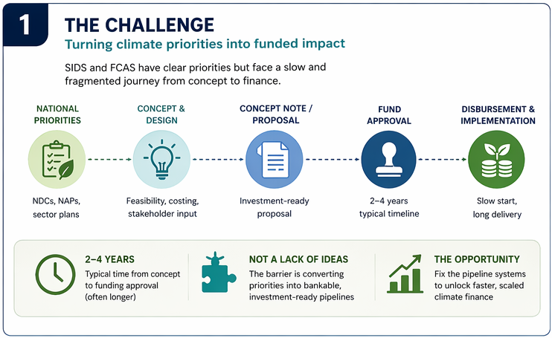

Slide 3
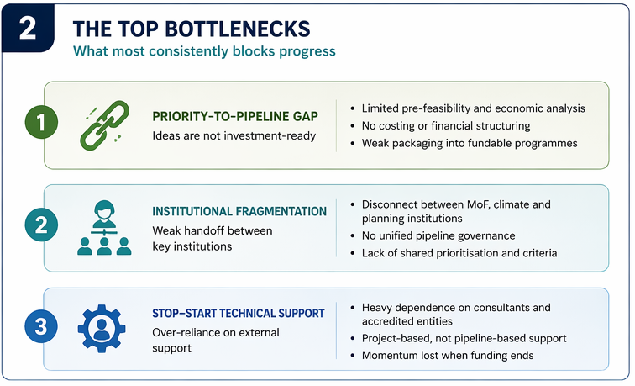

Slide 4
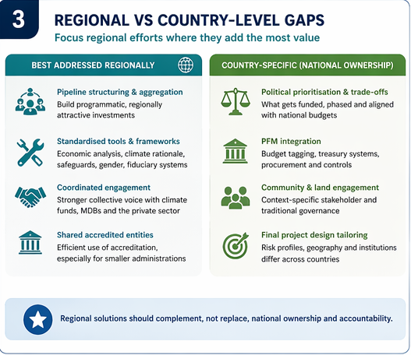

Slide 5
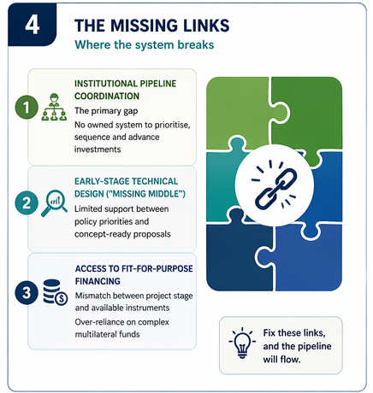

Slide 6
