Slide 1



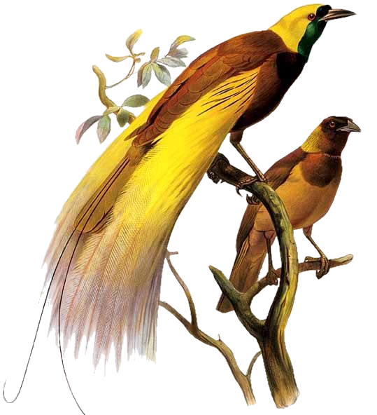
Session 7: Papua New Guinea – Early Warning Systems Investment Pitch
Asian Climate Week/Climate Capital Market Place, 24 April 2026
Notes:
[Sources]
- Mid mission findings Aug 6 Sanny Jegillos.docx
- 2025-10-06 Options for NDC.docx
- UNDP Review of Draft NEMA Bill V4.docx
[/Sources]

Slide 2
Why PNG?
Papua New Guinea, a Pacific Small Island Developing State, is highly vulnerable to climate hazards, including floods, droughts, landslides, and coastal erosions
High climate vulnerability: Papua New Guinea faces multiple hazards—floods, droughts, landslides, and coastal flooding—with annual economic losses from cyclones and floods exceeding USD 29 million, and total exposure to natural hazards estimated at USD 49.2 billion
Rural population at risk: Approximately 85% of PNG’s population (~10 million people) live in rural areas and depend on subsistence agriculture and fisheries, making them highly vulnerable to climate shocks and extreme weather events
Increasing climate impacts: Temperatures have already risen by ~0.2°C per decade, with projections of up to 3°C warming by 2100, alongside increased rainfall intensity and more frequent extreme events such as floods and landslides.
Human and economic impacts: The 2015–2016 drought affected ~2.5 million people, with 500,000 facing severe food shortages, while maritime risks contribute to 50–60 serious incidents and up to 300 fatalities annually
Critical EWS gap: Despite ongoing investments, PNG still lacks a fully integrated Multi-Hazard Early Warning System, leaving over 1.9 million people without reliable access to timely forecasts and early warning information

Slide 3
Investment Pitch: PNG Multi-Hazard Early Warning System (MHEWS)
SMART Climate Programme (GCF)
Concept Note Stage
SOFF Investment Phase (Observation Backbone) (ProDoc Development Stage)
To strengthen meteorological observation systems (surface and upper-air stations) to improve climate data for early warning, implemented by UNDP and WMO with the National Weather Service (NWS).
To establish a national end-to-end Multi-Hazard Early Warning System (MHEWS) covering risk, forecasting, dissemination, and early action, implemented by UNDP in partnership with CCDA and national agencies.
Implementing Partner/Accredited Entity: UNDP
Notes:
Papua New Guinea is seeking a blended package of grant financing, technical support, and partnerships to deliver a national end-to-end Early Warning System, anchored on SOFF-enabled observation infrastructure and scaled through SMART Climate

Slide 4
The Precise Ask (Core Pitch)
SMART Climate Programme (GCF)
Concept Note Stage
SOFF Investment Phase (Observation Backbone) (ProDoc Development Stage)
Primary ask:
  GCF grant financing (USD ~24.3M) for full MHEWS system development
Additional asks:
  Co-financing (Government + partners)
  Technical assistance (AI forecasting, impact-based warnings, Impact-based Forecasting systems)
  Private sector partnerships (telecom, maritime data, dissemination)
Primary ask:
  SOFF grant financing (~USD 6M) for GBON-compliant observation systems
Additional asks:
  Co-financing (Government + partners ADB CADIP, etc.)
  Technical partnership (WMO, BoM)
  Capacity development (NWS operations, ICT, maintenance)
Key message: SOFF builds the “eyes” of the system; SMART builds the “brain and delivery system.”
Notes:
Combined Strategic Ask (SMART + SOFF) Integrated package: ➤ End-to-end system financing (GCF + SOFF)➤ Sequenced investments: SOFF → Data (observations)SMART → Intelligence + Action (forecasting, dissemination, response)

Slide 5
What Is the Biggest Blocker (Next 6 Months)?
Single Biggest Constraint: Fragmented technical and financing alignment across the EWS value chain
Specifically:
  SOFF (observations) and SMART (end-to-end system) are not yet fully programmatically synchronized
  Lack of:
    Final institutional coordination model (NWS–NDC–CCDA integration)
    Bankable sequencing of investments
    Clear pipeline packaging for investors/donors
Operational bottlenecks:
Limited forecasting + ICT capacity at NWS
Weak last-mile dissemination systems (SMS, cell broadcast)
Incomplete interoperability between data → forecast → action systems
👉 Bottom line: The issue is not concept readiness, but system integration and investment sequencing.

Slide 6
Solution: Integrated Investment Logic (SMART + SOFF)
SMART Climate Programme (GCF)
Concept Note Stage
SOFF Investment Phase (Observation Backbone) (ProDoc Development Stage)
Forecasting hub + AI-enabled analytics
Multi-hazard modelling (floods, landslides, coastal)
Dissemination systems (SMS, radio, digital)
Community-level early action:
Surface + upper-air observation stations
GBON-compliant data systems
Strengthened NWS capacity
➡ Converts data → actionable early warnings
➡ Enables reliable climate and weather data
Notes:
[Sources]
- Structure and messaging synthesized from the three uploaded source documents.
[/Sources]

Slide 7
Why Invest Now?
High impact: 1.9M+ indirect beneficiaries
High urgency: increasing climate risks and economic losses
High readiness:
  Advanced concept design
  Strong institutional ownership
  Pipeline already structured
High leverage:
  SOFF + GCF + Government + Private Sector
  Regional alignment (EW4All, Pacific systems)

Slide 8
Who Does What Next?
Immediate Next Steps (0–6 Months)
CCDA (Lead – Government)
  Finalize national MHEWS coordination framework
  Ensure alignment of SMART + SOFF into a single national investment narrative
UNDP (Accredited Entity)
  Finalize the SMART Climate Concept Note and submit to GCF
  Ensure technical alignment with SOFF outputs
  Finalise the SOFF Proposal and ensure co-financing by partners (ADB, BoM, etc.)
  National Weather Service (Technical Lead – Observations)
    Confirm SOFF implementation readiness Advance GBON compliance roadmap

Slide 9
THANK YOU!

