Slide 1
JCM for waste sector mitigation:
WtE and semi-aerobic landfill
Investment-focused event @ Addis Ababa
6 September 2025
HIRATSUKA Jiro
Office of Climate Change Negotiation and Cooperation,
Ministry of the Environment, Japan

Slide 2
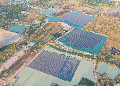
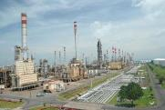
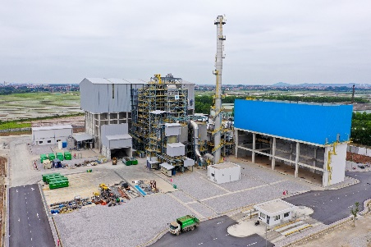
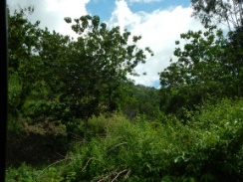
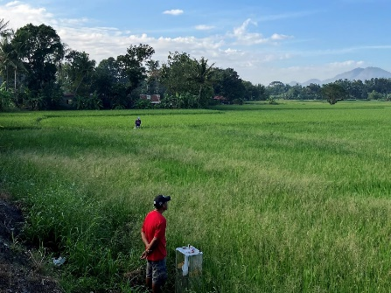
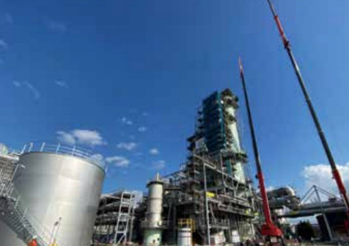
Overview of Joint Crediting Mechanism (JCM)
JCM is a carbon market tool where Japanese companies and government cooperate with mitigation activities in partner countries (31 as of Today).
Among total mitigation outcomes, both governments conservatively calculate, authorize and share JCM credits between the companies/countries in proportion to their contributions, in line with Article 6 of Paris Agreement.
JCM incentivizes Japan’s investment in decarbonization projects bringing various benefits including achievement of NDC and sustainable development.
Decarbonization projects invested by Japan
Mitigation outcome and its transfer
Partner Country
Count toward NDC of partner county
Both governments co-host
Measurement
Reporting
Verification
Authorization
Total Mitigation Outcome
    Renewable
    Energy Saving
Count toward NDC of Japan
Can be used as offset in GX-ETS
GHG Emissions
Credits
Transfer
Japan
    Waste
    Forestry
GHG
Emissions
project
Corresponding Adjustment
(Will not count them toward NDC of partner county)
    Agriculture※
    CCS※
※ under development phase
Notes:
JCM is a market tool, Japanese companies conduct mitigation activities in PCs
This reduces GHG emission from baseline, and both countries calculate credits in a conservative manner
Part of credits transfer to Japan to count in the achievement of NDC
The transferred credits won’t be used in PC by corresponding adjustment to avoid double counting in line with A6PA

Slide 3
























List of JCM 31 partner countries as of August 2025
※Numbers are in order of signing
East Asia, Central Asia, Caucasus
Eastern Europe
1. Mongolia:11 projects
21. Moldova
20. Azerbaijan
29. Ukraine
22. Georgia
29
28
1
24. Uzbekistan
21
22
27
27. Kyrgyz: 1 project
19
20
24
28. Kazakhstan
13
26
12
18
Latin America
Africa
3
9
9. Costa Rica: 2 projects
3. Ethiopia
4
12. Mexico: 5 projects
4. Kenya: 5 projects
14. Chile: 16 projects
18. Senegal: 1 project
30
19. Tunisia: 4 projects
30. Tanzania
14
Middle East
Southeast Asia, South Asia,
Oceania
13. Saudi Arabia: 3 projects
26. UAE
2. Bangladesh: 5 projects
31
2
5. Maldives: 4 projects
15
7
6
6. Viet Nam: 48 projects
7. Laos: 6 projects
16
17
8. Indonesia: 56 projects
11
10. Palau: 7 projects
23
10
11. Cambodia: 7 projects
5
15. Myanmar: 8 projects
16. Thailand: 54 projects
17. Philippines: 21 projects
8
23. Sri Lanka: 3 projects
25
25. Papua New Guinea: 1 project
31. India
Notes:
Most recently India last month
5 countries in Africa

Slide 4
JCM Financing Programme by MOE Japan (FY2013-2025) as of August 2025
Total 268 projects (21/31 partner countries)
(●Model Project: 247 projects(including Eco Lease: 7projects), ▲F-gas: 4 projects, ■ADB: 10 projects, ■UNIDO: 3 project, ●New Technology : 2 project, ◆ REDD+: 2 projects)
213 underlined projects have been started operation. 83 projects with * have been registered as JCM projects.
Cambodia:7 projects
●LED Street Lighting* ●200kW Solar PV at International School*
●1MW Solar PV & Centrifugal Chiller ●Inverters for Distribution Pumps*
●0.9MW Solar PV ●10MW Solar PV and 3MWh Storage Battery
●20MW Solar PV
Mongolia:11 projects
●Heat Only Boiler (HOB)** ●2.1MW Solar PV in Farm* ●10MW Solar PV* ●8.3MW Solar PV in Farm*
●15MW Solar PV1* ■Upscaling Renewable Energy Sector ●Fuel Conversion by Introduction of LPG Boilers
●15MW Solar PV2 ■Improving Access to Health Services ●Green Hydrogen Production and Heat Supply
●15MW Solar PV and 80MWh Storage Battery
Myanmar:8 projects
●700kW Waste to Energy Plant* ●Brewing Systems to Brewery Factory
●Once-through Boiler in Instant Noodle Factory
●1.8MW Rice Husk Power Generation
●Refrigeration System in Logistics Center ●4.3MW Solar PV
●8.8MW Waste Heat Recovery in Cement Plant
●Brewing Systems and Biogas Boiler to Brewery Factory
Viet Nam:48 projects
●Digital Tachographs* ●Amorphous transformers1* ●Air-conditioning in Hotel1* ●Air-conditioning in Lens Factory*
●Container Formation Facility* ●320kW Solar PV in Shopping Mall* ●Amorphous transformers 2* ●Air-conditioning Control System
●Electricity Kiln ●High Efficiency Water Pumps* ●Energy saving Equipment in Lens Factory* ●Amorphous transformers 3* ●Energy Saving Equipment in Wire Production Factory* ●Amorphous transformers 4 ●Energy Saving Equipment in Brewery Factory
●High Efficiency Chiller ●Modal Shift with Reefer Container ●Inverters for Raw Water Intake Pumps
▲ F-gas Recovery and Dedicated Destruction Scheme ●Biomass Boiler to Chemical Factory ●Air Cooled Chillers
●49MW solar PV ●57MW solar PV ●Once-through Boiler to Food Factory ●Biomass Boiler
●Air-conditioning in Hotel2 ●Waste to Energy ●LED Lighting to Office Building ●3.7MW Solar PV ●12MW Solar PV
●6.5MW Solar PV ●2.5MW Solar PV ●Chiller and LED ▲ F-gas Recovery and Mixed Combustion
●20MW Biomass Power Plant ●16MW Mini Hydro Power Plant ●7.9MW Solar PV ●0.4MW Solar PV (Eco Lease)
●5.8MW Solar PV2 ●40MW Offshore Wind Power ●1.8MW Solar PV ●0.8MW Solar PV ●50MW Biomass Power Plant1 ●50MW Biomass Power Plant2 ●15.9MW Solar PV ●4.1MW Solar PV ●1.9MW Solar PV ●1.25MW Solar PV
Bangladesh:5 projects
●Centrifugal Chiller ●Loom at Weaving Factory*
●315kW PV-diesel Hybrid System*
●Centrifugal Chiller* ■High Efficiency Transmission Line
Tunisia:4 projects
●50MW Solar PV1 ●50MW Solar PV2
●100MW Solar PV
■ waste management in the Fukuoka method
Kirghiz：1 projects
■Low-carbon Municipal Building
Philippines:21 projects
●1.53MW Rooftop Solar PV* ●1MW Rooftop Solar PV* ●1.2MW Rooftop Solar PV*
●4MW Solar PV* ●9.6MW Solar PV ●Biogas Power Generation and Fuel Conversion
●29MW Binary Geothermal Power Generation ●20MW Flash Geothermal Power Plant
▲ F-gas Recovery and Destruction Scheme ●28MW Binary Geothermal Power Generation
●14.5MW Mini Hydro Power Plant ●9MW Solar PV ●0.8MW Solar PV (Eco Lease)
●5.6MW Binary Geothermal Power Generation
●6MW Waste Heat Recovery in Cement Plant ●27MW Solar PV ●1.2MW Solar PV (Eco Lease)
●11.3MW Mini Hydro Power Plant ●10MW Solar PV ●7MW Solar PV
●4.5MW Mini Hydro Power Plant
Mexico:5 projects
●1.2MW Power Generation with Methane Gas Recovery System
●Once-through Boiler and Fuel Switching
●30MW Solar PV1
●Energy Efficient Distillation System
●0.5MW Solar PV (Eco Lease)
Saudi Arabia:3 projects
●Electorolyzer in Chlorine Production Plant*
●400MW Solar PV ●100MW Solar PV
Senegal：1 projects
■Energy-Efficient Refrigeration System and Solar PV
Sri Lanka:3 projects
●13.5MW Solar Power Project
●26MW Solar Power Plants
●10MW Solar Project
Costa Rica:2 projects
●5MW Solar PV*
●Chiller and Heat Recovery System
Maldives:4 projects
●186kW Solar Power on School Rooftop*
■Smart Micro-Grid System*
■Greater Male Waste to Energy Project
■BESS and Ocean Energy
Papua New Guinea：1 projects
■Energy efficient transmission conductors
Chile:16 projects
●1MW Rooftop Solar PV* ●3.4MW Rice Husk Power Generation
●3MW Solar PV1* ●3MW Solar PV2* ●25.8MW Solar PV
●9MW Solar PV1 ●9MW Solar PV2 ●3MW Solar PV3
●6MW Solar PV ●9MW Solar PV3 ●9MW Solar PV4
●28MW Solar PV ●2.0MW Solar PV
●34MW Solar PV and 104MWh Storage Battery ●338MWh Storage Battery in PV Plant
●12MW Solar PV and 33MWh Storage Battery
Kenya:5 projects
●1MW Solar PV at Salt Factory*
● 2.9MW Solar PV
● 2.3MW Solar PV
■ 220kW Solar PV and Storage Battery
●1.7MW Solar PV
Laos:6 projects
◆REDD+ through controlling shifting cultivation
●Amorphous transformers1*
●14MW Floating Solar PV*
●11MW Solar PV* ●7MW Solar PV
●Amorphous transformers2
Palau:7 projects
●370kW Solar PV for Commercial Facilities* ●155kW Solar PV for School*
●445kW Solar PV for Commercial Facilities Ⅱ* ●0.4MW Solar PV for Supermarket*
●1MW Solar PV for Supermarket* ■Clean Energy Financing Project
●0.6MW Solar PV and 0.3MWh Storage Battery
Thailand:54 projects
●Energy Saving at Convenience Store ●1MW Solar PV on Factory Rooftop* ●Upgrading Air-saving Loom*
●Centrifugal Chiller & Compressor* ●Centrifugal Chiller in Tire Factory ●Co-generation in Motorcycle Factory*
●Air Conditioning System & Chiller* ●Refrigeration System* ●Ion Exchange Membrane Electrolyzer
●Chilled Water Supply System ●LED Lighting to Sales Stores ●2MW Solar PV1
●12MW Waste Heat Recovery in Cement Plant * ●Co-generation System PV ●3.4MW Solar PV*
●Refrigerator and Evaporator ●Heat Recovery Heat Pump* ●30MW Solar PV*
●5MW Floating Solar PV* ●Boiler System in Rubber Belt Plant ●Air-conditioning Control System
●Biomass Co-generation System ●Co-generation in Fiber Factory ●Biomass Boiler
●17.8MW Solar PV in Industrial Park ●3.4MW Solar PV ●0.8MW Solar PV and Centrifugal Chiller
▲ F-gas Recovery and Destruction Scheme ●37MW Solar PV and Melting Furnace ●Heat Exchanger in Fiber Factory ●8.1MW Solar PV ●Centrifugal Chiller to Machinery Factory ●5MW Solar PV ●2.6MW Solar PV
●2MW Solar PV2 ●2.7MW Solar PV with Blockchain Technology ●18.9MW Solar PV and Floating Solar PV
●Once-through Boiler in Garment Factory ●Boiler, Chiller and PV ●2MW Solar PV3 ●1.3MW Solar PV (Eco Lease)
●0.13MW Solar PV (Eco Lease) ●Gas Co-generation System & 22MWSolar PV ●ORC Waste Heat Recovery
●4MW Solar PV ●2.9MW Solar PV ●0.9MW Solar PV ●1.6MW Solar PV (Eco Lease)
●Biomass Co-generation System ●Productivity Improvement of Aluminium Ingots ●Perovskite Solar Cell
●104MW Solar PV and 129MWh Storage Battery ●48MW Solar PV and 60MWh Storage Battery ●Solar PV and Heat Battery
Indonesia:56 projects
●Centrifugal Chiller at Textile Factory1* ●Energy Saving at Convenience Store* ●Refrigerants to Cold Chain Industry**
●Double Bundle-type Heat Pump* ●Centrifugal Chiller at Textile Factory 2* ●30MW Waste Heat Recovery in Cement Industry*
● 500kW Solar PV and Storage Battery* ●Regenerative Burners* ●Centrifugal Chiller at Textile Factory*
●Old Corrugated Cartons Process* ●Upgrading to Air-saving Loom* ●Centrifugal Chiller in Shopping Mall*
●Smart LED Street Lighting System* ●Once-through Boiler System in Film Factory* ●Gas Co-generation System*
●Once-through Boiler in Golf Ball Factory* ●1.6MW Solar PV in Jakabaring Sport City* ◆REDD+ through controlling slush-and burn
●10MW Hydro Power Plant1* ●Looms in Weaving Mill* ●LED Lighting to Sales Stores*
●2.7MW Solar PV ●Industrial Wastewater Treatment System ●0.5MW Solar PV*
●Gas Co-generation system ●0.7MW Solar PV ●Absorption Chiller* ●High Efficiency Autoclave1*
●CNG-Diesel Hybrid Public Bus* ●Rehabilitation of Hydro Power Plant* ●Injection Molding Machine
●2MW Mini Hydro Power Plant ●Boiler to Carton Box Factory ●10MW Hydro Power Plant2 ●6MW Hydro Power Plant1
●6MW Hydro Power Plant2 ●5MW Hydro Power Plant ●4.2MW Solar PV* ●Thermal Oil Heater System
●2.1MW Solar PV1 ●6MW Hydro Power Plant3 ●2.3MW Hydro Power Plant ●High Efficiency Autoclave2*
●Once-through Boiler in Chemical Factory●5MW Solar PV ●3.1MW Solar PV ●2.1MW Solar PV2
●3.5MW Hydro Power Plant ●Energy Saving and Solar PV ■55MW Geothermal Power Generation
●12MW Biomass Power Plant ●3MW Solar PV ●Improvement of Flat Glass Production Melting Furnace
●0.8MW Solar PV ●Energy Saving in Glass Manufacturing Process ●1.5MW Solar PV
3
Notes:
Financing project – a subsidy to JCM projects

Slide 5
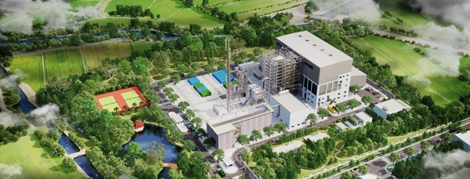
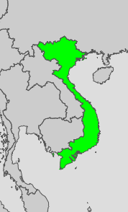
Waste-to-energy facility in Bac Ninh Province, Vietnam
★
Construction started in January 2022 and completed in January 2024
Introduced 500t/d waste-to-energy facility
(350t/d from MSW and 150t/d from non-hazardous ISW)
Covering MSW treatment from 470,000 inhabitants
an 11.6MW power generation capacity, generating 72,250MWh per year
Reducing 40,000tCO2eq of GHG (CO2 + CH4) emission per year
Notes:
500 of which 350 from MSW generated from 470 000 inhabitants, 150 from ISW

Slide 6

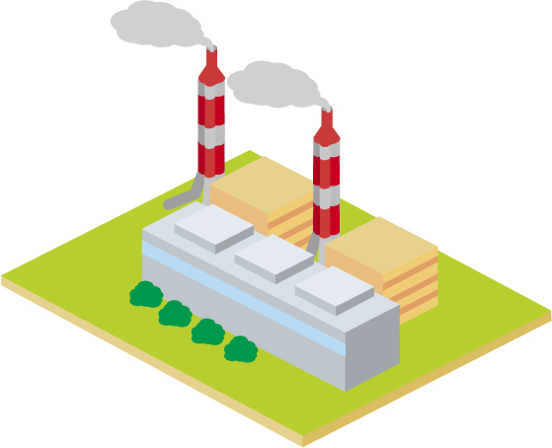
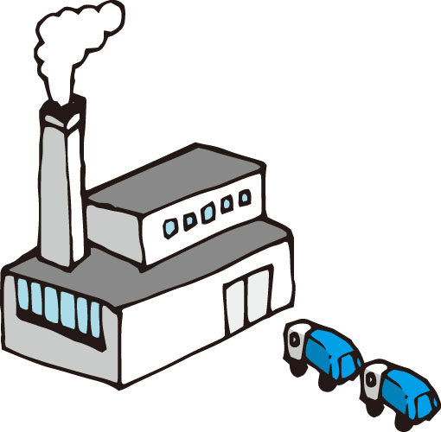


GHG emission reduction effects through a WtE project
Reference (baseline)
WtE project
Power generation using fossil fuel
Incineration of waste
with power generation
CO2
CO2
plastics
Direct landfilling of waste
landfilling of ash
(no GHG emission)
CH4
GHG emission reduction
= + -
food, paper, wood etc.
CO2
CH4
CO2
Part of waste is incinerated in reference scenario and excluded in calculating
Notes:
Emission reduction can be calculated by comparing reference scenario and project scenario
WtE plant incinerates waste and generates electricity, while reference generate E using FF, waste goes to landfill

Slide 7
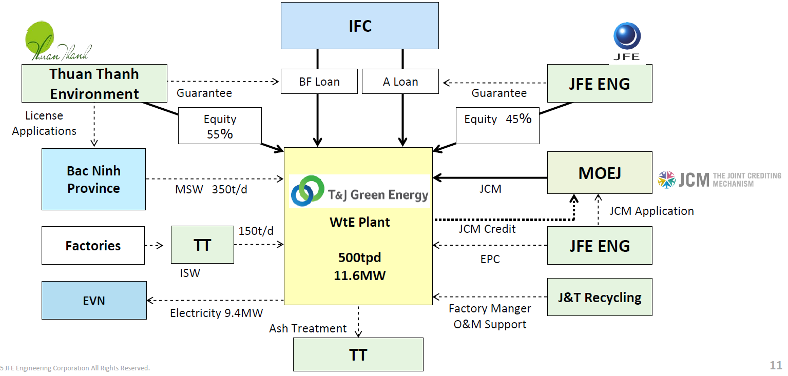
Project scheme of Bac Ninh WtE in Vietnam
Source: JFE Engineering Corporation
Total project cost: $74.2M
Notes:
JFE and Thuan Thanh established a SPV – T&J Green Energy
Waste: MSW + ISW, generate ash to landfill
Electricity: rest of the internal use to EVN by feed-in-tariff
Finance: IFC senior loans: A loan (from its own account) + BF loan, JCM grant from MOEJ
O&M supports from Japan side: JFE group has a company operating waste treatment plants

Slide 8
Investment risks and actions to address them
Investment risk | Details
Construction risk | Construction cost overruns, construction delay
Legal/Contract risk | Waste contracts and PPAs
Waste supply risk | Waste quality (low calorific value, high moisture content) and quantity (insufficient supply)
Tipping fee risk | Decrease in tipping fee (especially ISW)
Offtaker credit risk | Credit of local government and ISW suppliers
Financial risk | Limited case to arrange loans to WtE project
References: Convergence, JFE Engineering Corporation
Key Actions to address these risks
JCM business matching between Japanese and Vietnamese companies
JCM financing programme to reduce overall cost of financing
Blended finance from the Finland-IFC Blended Finance for Climate Program
Inclusion to the master plans on power development and waste treatment
Notes:
Japanese company looks for a local partner: env week in Vietnam 2019
Finance: JCM grant + blended finance
WtE in PDP, this plant in waste treatment MP

Slide 9
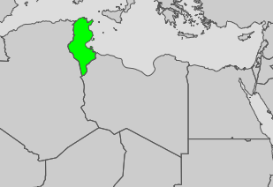
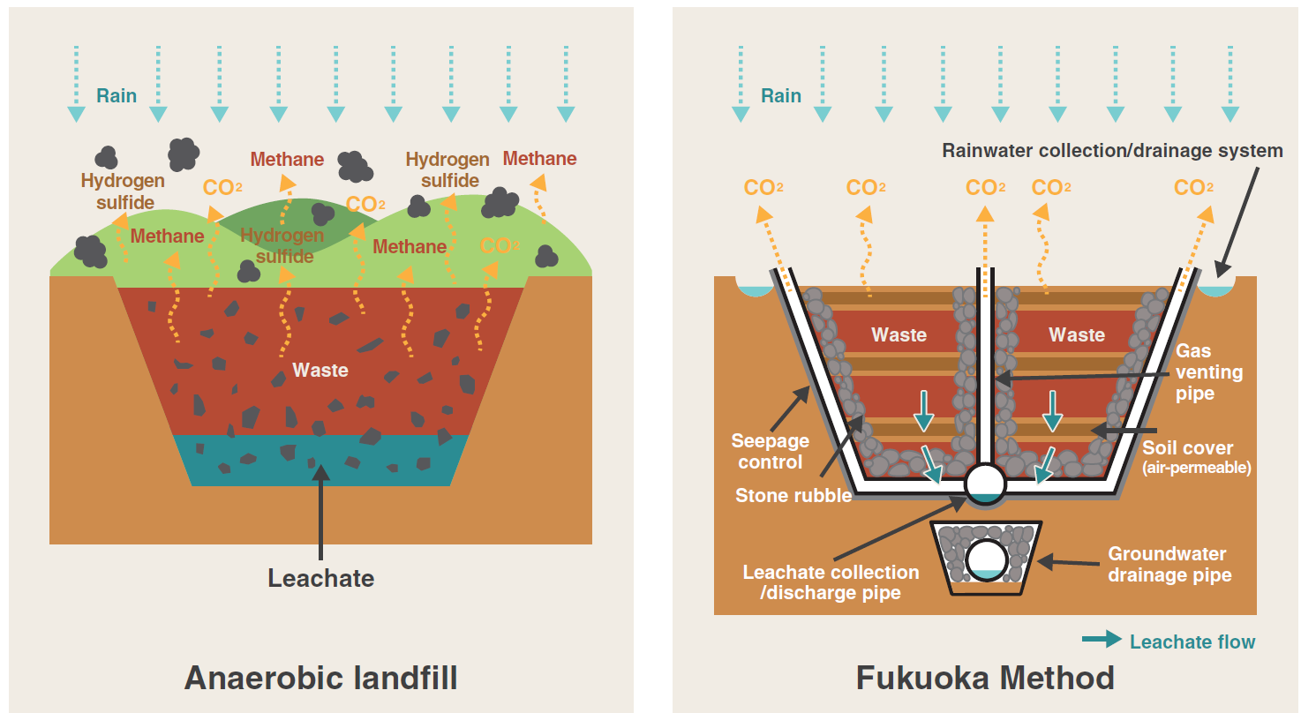
Semi-aerobic landfill “Fukuoka Method”
“Fukuoka Method” not only reduces CH4 emission, but also addresses environmental and social problems, also applicable to existing landfill sites.
A first JCM project applying the Fukuoka method at Beja disposal site, utilizing UNIDO-JCM grant support funded by the Ministry of the Environment of Japan.
CH4
Odor
Safe landfill friendly to climate, environment, health
Beja, Tunisia
Health risk
Fire risk
Air & water
★
Source: Fukuoka Prefecture
Notes:
Another case study is FM
Open dumpsites without oxygen occur many problems
FM install gas venting pipes to supply air can promote aerobic decomposition and thus reduce CH4 emission
FM was developed in Fukuoka university, and has been introduced 20+ countries worldwide, and 1st JCM project is ongoing in Beja, Tunisia

Slide 10
“Fukuoka Method” applied in Malaysia (first site outside Japan)
Simple and low-cost method without special technology – bamboo and used steel drums were used for leachate collection and gas ventilation
Open dumping
(1988)
After improvement by Fukuoka Method (1996)
Source: Fukuoka City

Slide 11
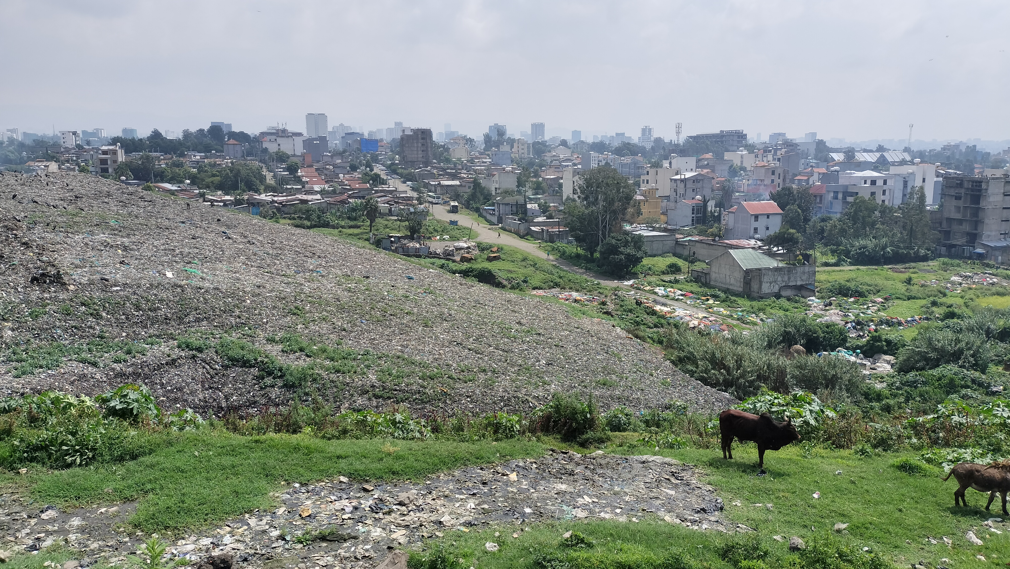
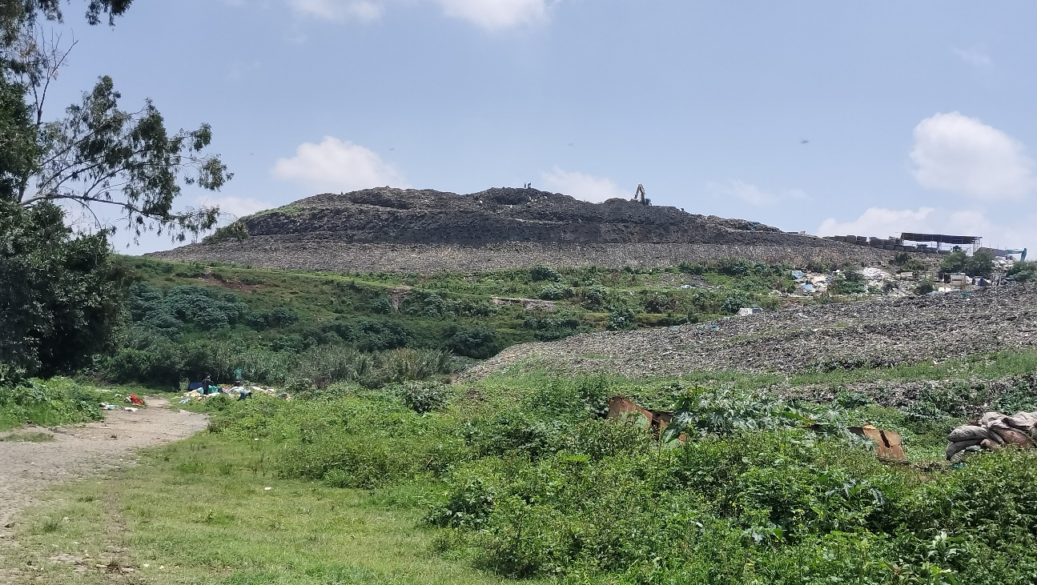
Conclusions
While waste hierarchy – reduce, reuse, recycling – is priority, but hard-to-recycle waste can generate energy through WtE
WtE project has several risks, including for construction, waste quality & quantity, and finance in formulating projects and operation
JCM contributes to financing and deployment of experienced technology for construction and O&M of WtE
Semi-aerobic landfill “Fukuoka Method” to reduce methane emission has applied in Tunisia as the first JCM project (UNIDO-JCM)
Fukuoka Method has been applied to Koshe landfill at Addis Ababa, after the tragic landslide accident in 2017

Slide 12
Thank you for your attention!

