Slide 1
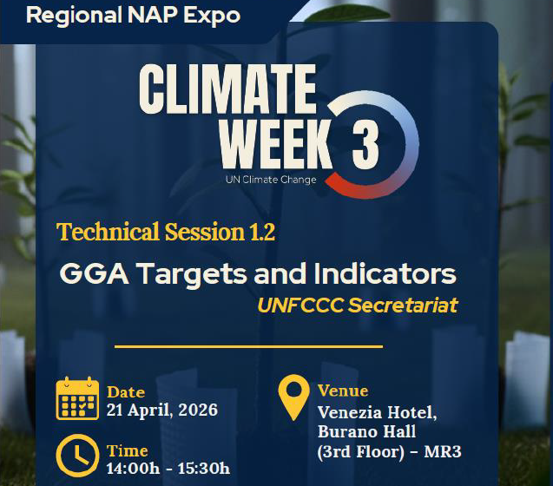

Slide 2

Background
Moderator:
Tiffani Van Ravenswaay
(Adaptation Committee Member)
Welcome

Slide 3
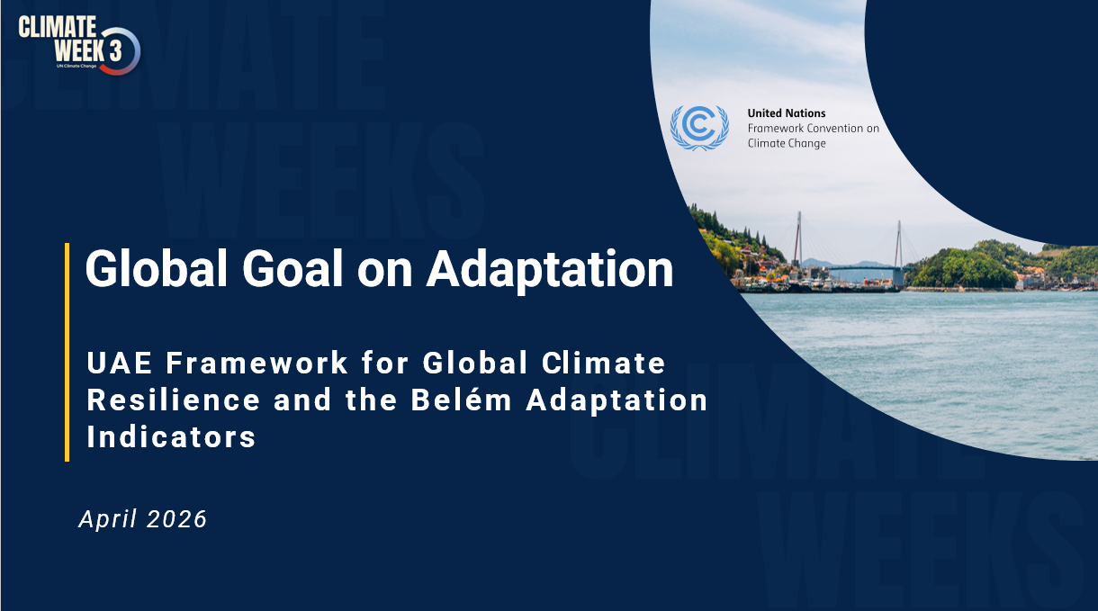
  Venezia Hotel, Burano Hall (3rd Floor) - MR3
  Yeosu, Republic of Korea
  21 April 2026
Notes:
OPENING
Good afternoon, distinguished colleagues.
It is a pleasure to present key highlights of the work of the Least Developed Countries Expert Group in advancing adaptation.
I will focus on three elements: the evolution of the adaptation architecture, the Global Goal on Adaptation, and what this means for implementation moving forward.

Slide 4
Background

Slide 5
Evolution of the UNFCCC Adaptation Architecture
1994–2000
2001-2010
2010-2015
2015-2021
2021–onwards
Observing impacts, assessing risks and vulnerabilities
Initial planning, pilot implementation, knowledge sharing
Comprehensive adaptation
framework
Paris
Architecture
Implementation, financing, measurable progress
Article 4: obligation for Parties to formulate adaptation programmes; limited institutional structure; focus largely on mitigation; early adaptation activity centered around vulnerability assessments and national communications;
Adaptation funds (LDCF, SCCF, AF); addressing urgent and immediate needs for the LDCs (National Adaptation Programmes of Action); support for the LDCs (LDC work programme, LDC Expert Group); Nairobi work programme;
Adaptation Committee, National Adaptation Plans; work programme on loss and damage;
Global Goal on Adaptation; Adaptation Communications; Funding for NAPs through the Green Climate Fund; Global stocktake;
Thematic and dimensional targets of the GGA (by 2030 and beyond); GGA indictors; tripling of adaptation finance; implementation acceleration.
Notes:
You don’t have tEVOLUTION OF THE ADAPTATION ARCHITECTURE
Adaptation under the UNFCCC has evolved significantly over three decades.
In the early phase, the focus was understanding risks and vulnerabilities, with limited institutional support.
This transitioned into planning and pilot implementation, including the establishment of funds and support mechanisms for LDCs.
From 2010 onwards, a more structured system emerged, including National Adaptation Plans and constituted bodies.
Today, under the Paris Agreement, we have a comprehensive and forward-looking framework anchored in the Global Goal on Adaptation, with a strong emphasis on implementation, finance, and measurable progress.
Key message: We have moved from assessing risk to planning to full-scale implementation and accountability.
o go into a lot of detail here, but it is useful for giving the full picture/history

Slide 6
UNFCCC adaptation architecture
Global Goal on Adaptation (GGA)
… of enhancing adaptive capacity, strengthening resilience, reducing vulnerability to climate change …
Where do we need to go
What does it look like / how do we know where that is
ACTORS:
UAE Framework for Global Climate Resilience (on GGA)
Constituted bodies (per mandates)
AC
LEG
CGE
WIM ExCom
FWG
Others
Thematic targets (7)
Wate & sanitation, food & agriculture, health, ecosystems & biodiversity, infrastructure & human settlements, poverty & livelihoods, cultural heritage
Dimensional targets of iterative adaptation cycle (4)
Impact, vulnerability and risk assessment; planning; implementation, MEL
Cross-cutting considerations
Gender; participatory; transparent, human rights approaches; vulnerable groups, communities, ecosystems; traditional, local, Indigenous knowledge; adaptation approaches, etc.
Sources of information
AdComs, NDCs, NAPs, BTRs, NatComs, IPCC reports, UN, other sources
Indicators
How do we get there
Programmes/ platforms
LCIPP
NWP
National Adaptation Plan (NAP)
Hazards → Impacts → Risk Pathways → Adaptation Functions → GGA Targets → NAP-GGA Systems
M&E ← Financing ← Implementation Portfolio ← Essential Adaptation Solutions
Adaptation information basis for
NDCs, adaptation communication, BTR
What does it take to get there
Financial Mechanism entities
GCF
GEF
AFB
WB/FRLD
Finance, technology, capacity-building
UNFCCC Funds: GCF, ACF, LDCF, SCCF, FRLD
Other: bilateral, domestic, private, etc.
Data, science, knowledge
(Climate data, scenarios, best available science, traditional knowledge, knowledge of indigenous peoples and local knowledge systems, etc.)
Foundation
Non-State Actors / Action Agenda
COP guidance and guidelines
National systems (essential functions)
Leadership & coordination; legal & regulatory frameworks; data systems (collection, analysis, etc.); planning, implementation, MEL & reporting systems; resource mobilization (finance, human)
UN, Others
Notes:
CURRENT ADAPTATION ARCHITECTURE
The current system is multi-layered and interconnected.
It combines global guidance, national systems, finance and means of implementation, and actors across all levels.
At the center is the National Adaptation Plan, which translates global goals into national action, links science, policy, and investment, and aligns reporting instruments.
Key message: The system is in place—what matters now is coherence and delivery.

Slide 7
Global goal on adaptation – a timeline (overview)
Establishes the Global Goal on Adaptation of enhancing adaptive capacity, strengthening resilience and reducing vulnerability to climate change, with a view to contributing to sustainable development and ensuring an adequate adaptation response in the context of the temperature goal referred to in Article 2.
Article 7.1 of the Paris Agreement
(2015)
Adopted the UAE Framework for Global Climate Resilience with 7 (seven) thematic targets and 4 (four) dimensional targets of the adaptation iterative cycle
Launched the UAE-Belém work programme on the indicators
CMA 5
(2023)
CMA 6
(2024)
Launched the Baku Adaptation Roadmap (BAR)
Provided further guidance and criteria relating to the indicators
Adopted Belém Adaptation Indicators (59 indicators)
Established the Belém-Addis Vision on Adaptation (BAVA)
Adopted activities for the 1st phase of the Baku Adaptation Roadmap (2026-2028)
CMA 7
(2025)
Notes:
GLOBAL GOAL ON ADAPTATION
The Global Goal on Adaptation provides a shared global direction.
It focuses on enhancing adaptive capacity, strengthening resilience, and reducing vulnerability.
Recent decisions have operationalized this goal through the UAE Framework, the Baku Adaptation Roadmap, and the Belém Adaptation Indicators.
Key message: For the first time, adaptation has a measurable global framework.

Slide 8

UAE Framework for Global Climate Resilience
The UAE Framework for Global Climate Resilience guides the achievement of Global Goal on Adaptation (GGA) and reviews the overall progress in adapting to climate change. The framework is forward-looking, with indicators designed to measure progress towards targets set for achievement by 2030 and progressively beyond
THEMES
DIMENSIONS
Impact, vulnerability and risk assessment
Planning
Water & sanitation
Infrastructure & human settlements
Agriculture, food & nutrition
Poverty eradication & livelihoods
Iterative adaptation cycle
+ INDICATORS
Health
Cultural heritage
Monitoring, evaluation and learning
Ecosystems & biodiversity
Implementation
Cross cutting issues:
Gender; participatory; transparent, human rights approaches; vulnerable groups, communities, ecosystems; traditional, local, Indigenous knowledge; adaptation approaches, etc.
MOI
Finance
Technology
Capacity-building
Sources of information:
AdComs, NDCs, NAPs, BTRs, NatComs,
IPCC reports
UN, other sources
Ref: UNFCCC decisions 2/CMA.5, 3/CMA.6 and 12/CMA.7
Notes:
UAE FRAMEWORK
The framework translates the GGA into actionable structure through seven thematic targets: water, food, health, ecosystems, infrastructure, livelihoods, and cultural heritage.
It also includes four dimensions: risk assessment, planning, implementation, and monitoring, evaluation and learning.
It integrates cross-cutting principles such as gender, inclusion, and Indigenous knowledge.
Key message: This is a common language for global adaptation action.

Slide 9
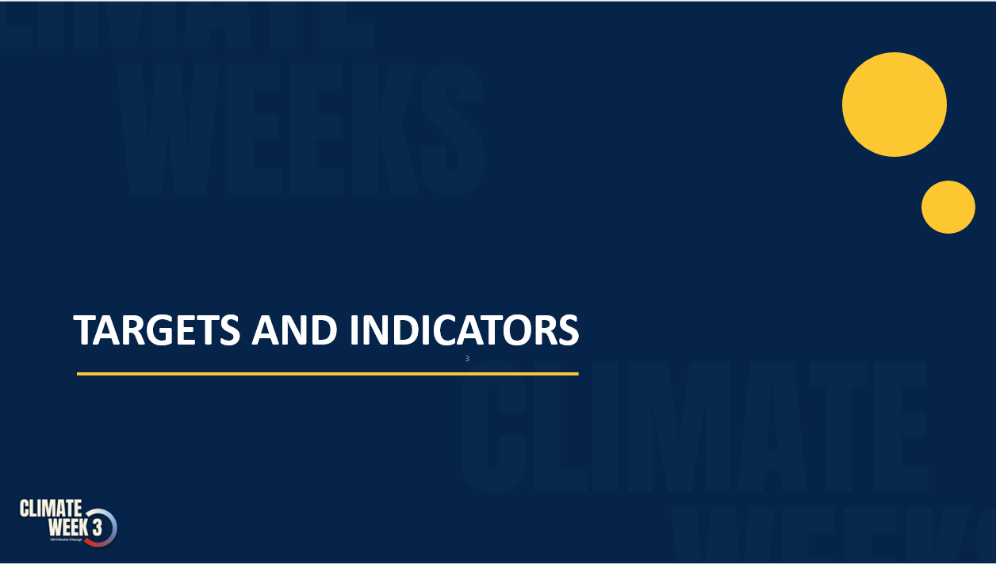
Targets and indicators

Slide 10
Targets (thematic)
Achievement
of the following targets
by 2030 and progressively beyond
Water & sanitation
Agriculture, food and nutrition
Health
Ecosystems and biodiversity
Significantly reducing climate-induced water scarcity and enhancing climate resilience to water-related hazards towards a climate-resilient water supply, climate-resilient sanitation and towards access to safe and affordable potable water for all;
Attaining climate-resilient food and agricultural production and supply and distribution of food, as well as increasing sustainable and regenerative production and equitable access to adequate food and nutrition for all;
Attaining resilience against climate change related health impacts, promoting climate-resilient health services, and significantly reducing climate-related morbidity and mortality, particularly in the most vulnerable communities;
Reducing climate impacts on ecosystems and biodiversity, and accelerating the use of ecosystem-based adaptation and nature-based solutions, including through their management, enhancement, restoration and conservation and the protection of terrestrial, inland water, mountain, marine and coastal ecosystems;
Infrastructure and human settlements
Poverty eradication and livelihoods
Cultural Heritage
Increasing the resilience of infrastructure and human settlements to climate change impacts to ensure basic and continuous essential services for all, and minimizing climate-related impacts on infrastructure and human settlements;
Substantially reducing the adverse effects of climate change on poverty eradication and livelihoods, in particular by promoting the use of adaptive social protection measures
for all;
Protecting cultural heritage from the impacts of climate-related risks by developing adaptive strategies for preserving cultural practices and heritage sites and by designing climate-resilient infrastructure, guided by traditional knowledge, Indigenous Peoples’ knowledge and local knowledge systems;
Notes:
TARGETS AND INDICATORS
The adoption of 59 Belém Adaptation Indicators marks a major milestone.
These indicators shift the focus toward progress on resilience outcomes.
They are voluntary, non-prescriptive, and respect national sovereignty.
They are not for ranking countries and are not linked to access to finance.
Key message: We are building trust-based measurement, not compliance-driven reporting.

Slide 11

Targets (dimensions of the iterative adaptation cycle)
Impact, vulnerability and risk assessment
by 2030 all Parties have conducted up-to-date assessments of climate hazards, climate change impacts and exposure to risks and vulnerabilities and have used the outcomes of these assessments to inform their formulation of national adaptation plans, policy instruments, and planning processes and/or strategies, and
by 2027 all Parties have established multi-hazard early warning systems, climate information services for risk reduction and systematic observation to support improved climate-related data, information and services;
Planning
by 2030 all Parties have in place country-driven, gender-responsive, participatory and fully transparent national adaptation plans, policy instruments, and planning processes and/or strategies, covering, as appropriate, ecosystems, sectors, people and vulnerable communities, and have mainstreamed adaptation in all relevant strategies and plans;
Monitoring, evaluation and learning
by 2030 all Parties have designed, established and operationalized a system for monitoring, evaluation and learning for their national adaptation efforts and have built the required institutional capacity to fully implement the system.
Implementation
by 2030 all Parties have progressed in implementing their national adaptation plans, policies and strategies and, as a result, have reduced the social and economic impacts of the key climate hazards identified in the assessments referred to in paragraph 10(a) above;

Slide 12
UAE–Belém work programme on indicators – timeline
CMA 5 established the UAE-Belém work programme on indicators, under the guidance of the SB Chairs
78 technical experts were convened to lead the work
Initial list of over 9000 indicators, reduced to 490, with an expert list of 100 published in September 2025
  Parties provided guidance and criteria for this process during SB 60, CMA 6 and SB 62
Parties provided views on the indicators during SB 63/CMA 7, and adopted a list of 59 indicators in Belém
Notes:
TARGETS AND INDICATORS
The adoption of 59 Belém Adaptation Indicators marks a major milestone.
These indicators shift the focus toward progress on resilience outcomes.
They are voluntary, non-prescriptive, and respect national sovereignty.
They are not for ranking countries and are not linked to access to finance.
Key message: We are building trust-based measurement, not compliance

Slide 13
Indicators (Belém Adaptation Indicators)
The indicators guide future adaptation efforts by assessing advancement towards the targets rather than comparing against past baselines
The indicators measuring levels or progress use, as a reference point, the optimal scenario identified by each Party, representing the level of resilience and adaptive capacity required to achieve the target.
Notes:
IMPLEMENTATION
The priority now is operationalization.
This includes testing indicators, strengthening national systems, and aligning finance, technology, and capacity-building.
The Belém–Addis Vision and ongoing work will refine methodologies and support countries.
Key message: The next phase is about turning frameworks into real resilience gains.

Slide 14
Disclaimers and disaggregation
Indicators are to be voluntary, non-prescriptive, non-punitive, facilitative, global in nature, respectful of national sovereignty and national circumstances and country-driven, and that the indicators should not create additional reporting burdens, particularly for developing country Parties, are not intended to serve as a basis for comparison among Parties, shall not become a barrier and shall not be used under any circumstances as a condition for developing country Parties to access funding under the Convention and the Paris Agreement (12/CMA.7, para. 7)
Indicators may be disaggregated by: Social categories, climate-related hazards, geographical characteristics, ecosystems, administrative and settlement levels, types of adaptation measures, thematic sectors, subcomponents of the targets

Slide 15
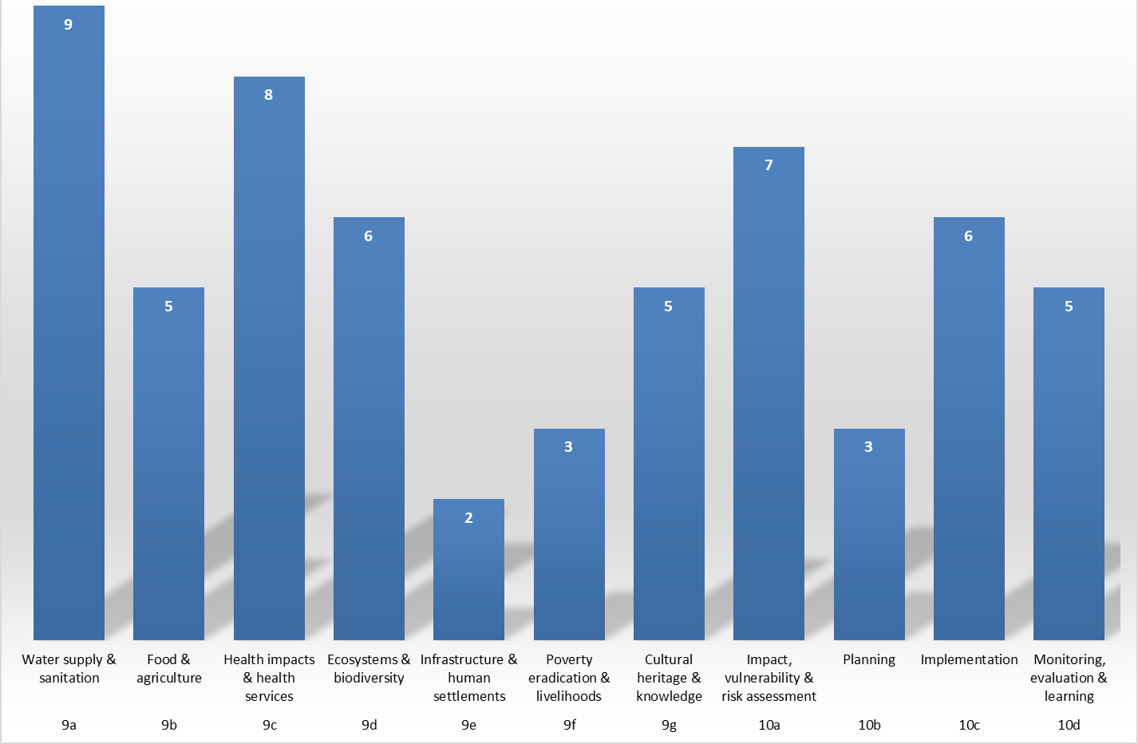
Indicators profile

Slide 16
Next steps
Encourages Parties, as appropriate and at their discretion, to test the Belém Adaptation Indicators, including in consultation with relevant practitioners and other stakeholders (12/CMA.7, para. 11)
Belém–Addis Vision on Adaptation (Two-Year Work Process)
  A two-year policy alignment process by Parties, and the technical work on improving metadata, methodologies
  Work will be undertaken jointly by SBSTA and SBI, including and supporting technical coherence.
  Outcomes will be presented for consideration at CMA 9
  Calls upon international organizations and agencies to support the technical work

Slide 17


Thank you

Slide 18
Background
Speakers
• Maldives → country
• OHCHR → cross-cutting
• IGAD → systems
• GGGI → investment
• UNDP → implementation
• Expert → synthesis
Targeted Interventions

Slide 19
Background
Interactive discussions

Slide 20
Background
Key Messages and Closing (Moderator)

