Slide 1



April 2026
Country Platforms
GCBC’s contribution to the Country Platform Hub
Manshu Deng
GCBC APAC Director

Slide 2
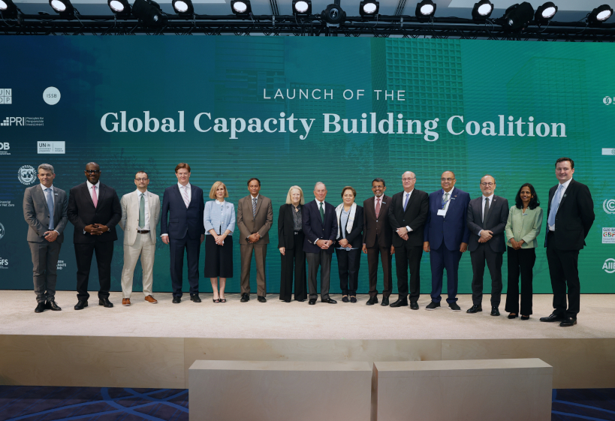
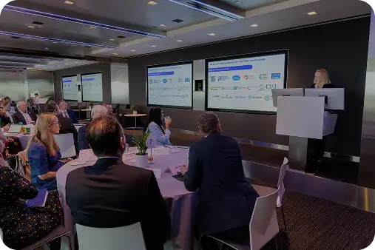

The Global Capacity Building Coalition (GCBC)
Launched at COP28 by Mike Bloomberg, the GCBC is a global alliance of capacity-building providers and funders active in sustainable finance, including UN agencies, MDBs, DFIs, philanthropies, universities, NGOs, think tanks and trade associations.
GCBC’s workstreams
Build and maintain a community of practice for capacity builders on sustainable finance
Improve access and availability of high-quality climate finance knowledge, tools and best practices
Support demand-driven and targeted capacity building at country and delivery-partner level
Progress to-date:
In the two years since its launch, GCBC has attracted ~120 member organisations, hosts a knowledge platform with over 420 resources, launched an Accelerator Program to help scale local capacity building efforts, and supported the launch of the Country Platforms Hub.
Launch of the GCBC at COP28 in 2023
Launch of the GCBC Knowledge Hub at NYCW in 2024

Slide 3


Global Capacity Building Coalition - Country Platforms Hub
Background
Approach
Our Role
The Country Platforms Hub is a structured mechanism linking countries to technical assistance, knowledge, and finance to design and operationalize country platforms.
The Hub was launched at COP30 during a high-level session with representatives from 14 countries, and is co-chaired by Brazil and Ugandan finance ministries.
The Global Capacity Building Coalition (GCBC) - launched by Mike Bloomberg alongside major MDBs, UN agencies, and others and chaired by Mary Schapiro - helped to launch the Country Platforms Hub. The GCBC is a Core Partner alongside the GCF, UNDP, NDC-P.
The Country Platform Hub works first and foremost through its Core Partners (GCBC, GCF, UNDP, NDCP, FiC), who have existing memberships / partnerships and workstreams focused on country platform development, including technical assistance, pipeline generation and supply-side blended finance.
The Secretariat of the Country Platforms Hub manages a pool of “sparkplug” funding that allows it to engage in technical assistance work with key stakeholders and government partners.
The Country Platforms Hub is actively fielding requests from government partners for support on early-platform setup, and collaborating with the Core Partners on program delivery.
Our work to support the Country Platforms Hub is focussed on three major workstreams:
Knowledge curation: Building a knowledge portal with resources to guide governments and other key stakeholders in country platform development
Convenings: Host and support a series of high-level and working capacity building sessions and convenings in support of country platforms
Technical Assistance: in collaboration with GFANZ, provide targeted early support to countries as they navigate early platform setup.
‹#›

Slide 4
The GCBC is leading build-out of the Country Platform Knowledge Portal
The Country Platform Knowledge Portal will be a curated website that organizes complex policy, governance, and finance material into a clear, practitioner-oriented structure, grounded in lessons from direct country engagement.
The Knowledge Portal is focused on what governments and secretariats need to design, govern, and deliver country platforms.
As much as possible, it will have interoperability with existing knowledge platforms; GCBC is working closely with other Core Partners of the Country Platform Hub and drawing on input from the wider country platform ecosystem, including country partners.
The Knowledge Portal will have a beta launch in June of 2026, at London Climate Action Week, and a full launch at COP31.
Pillars of the Knowledge Portal
1
What is a Country Platform
Plain language explainers, summaries of existing platforms
2
Governance & Institutional Setup
Secretariat models, organisation structures
3
Diagnostics & Design
Financial assessments, emissions mapping, energy modelling
4
Comms & Stakeholder Engagement
Stakeholder mapping & comms strategy templates
5
Investment Planning & Capital Mobilisation
Investment plan blueprints, budget alignment tools
6
Policy Reform
Info on relevant reform areas (e.g., energy tariffs), policy reform roadmaps
7
Implementation & Delivery
Investor engagement tools, procurement & project prep workflows

Slide 5






Convenings: GCBC will utilize its network to support a series of conveings focused on country platform capacity building
The focus of these convenings will be to bring together public and private partners to discuss lessons learned and encourage peer-to-peer knowledge exchange for the next generation of country platforms
Oct 12-18
WB/IMF Annual Meetings
Bangkok
26-28 May
IDB Sustainability
Week
Bridgetown
Jun 20-28
LCAW
London
Apr
May
Jun
Oct
Nov
Nov 9-20
UNFCCC COP 31
Antalya, TK
13 - 18 Apr
WB/IMF Spring Meeting
Washington D.C.
18 - 21 May
Ecosperity Forum
Singapore
Notes:
rearrange order

