Slide 1
Costa Rica’s Forest Sector
Climate change mitigation and adaptation
World Bank contributions to Innovative Investments, Policy Frameworks, and Lessons Learned
Fifth Investment-Focused Event
Sharm el-Sheikh Work Programme
Erwin De Nys, World Bank
Giovanna Valverde Stark, Government of Costa Rica
May 20, 2025

Slide 2
Costa Rica's Leadership in Forest and Climate Action
Near 58% forest cover and net-zero deforestation since 2012
Global pioneer in Payment for Environmental Services (PES)
The country’s forest sector is central to its Nationally Determined Contribution (NDC) under the Paris Agreement, particularly Article 5.
Integration of agricultural and environmental policies for climate resilience
Strong biodiversity conservation record through SINAC

Slide 3
World Bank’s Support to Costa Rica's Forest Sector
Long-standing partnership supporting sustainable forest management and climate goals.
Focus areas:
  Strengthening institutional capacity
  Mobilizing climate finance
  Supporting results-based payments for emissions reductions
Key instruments: FCPF Carbon Fund, PES, and now SCALE.

Slide 4
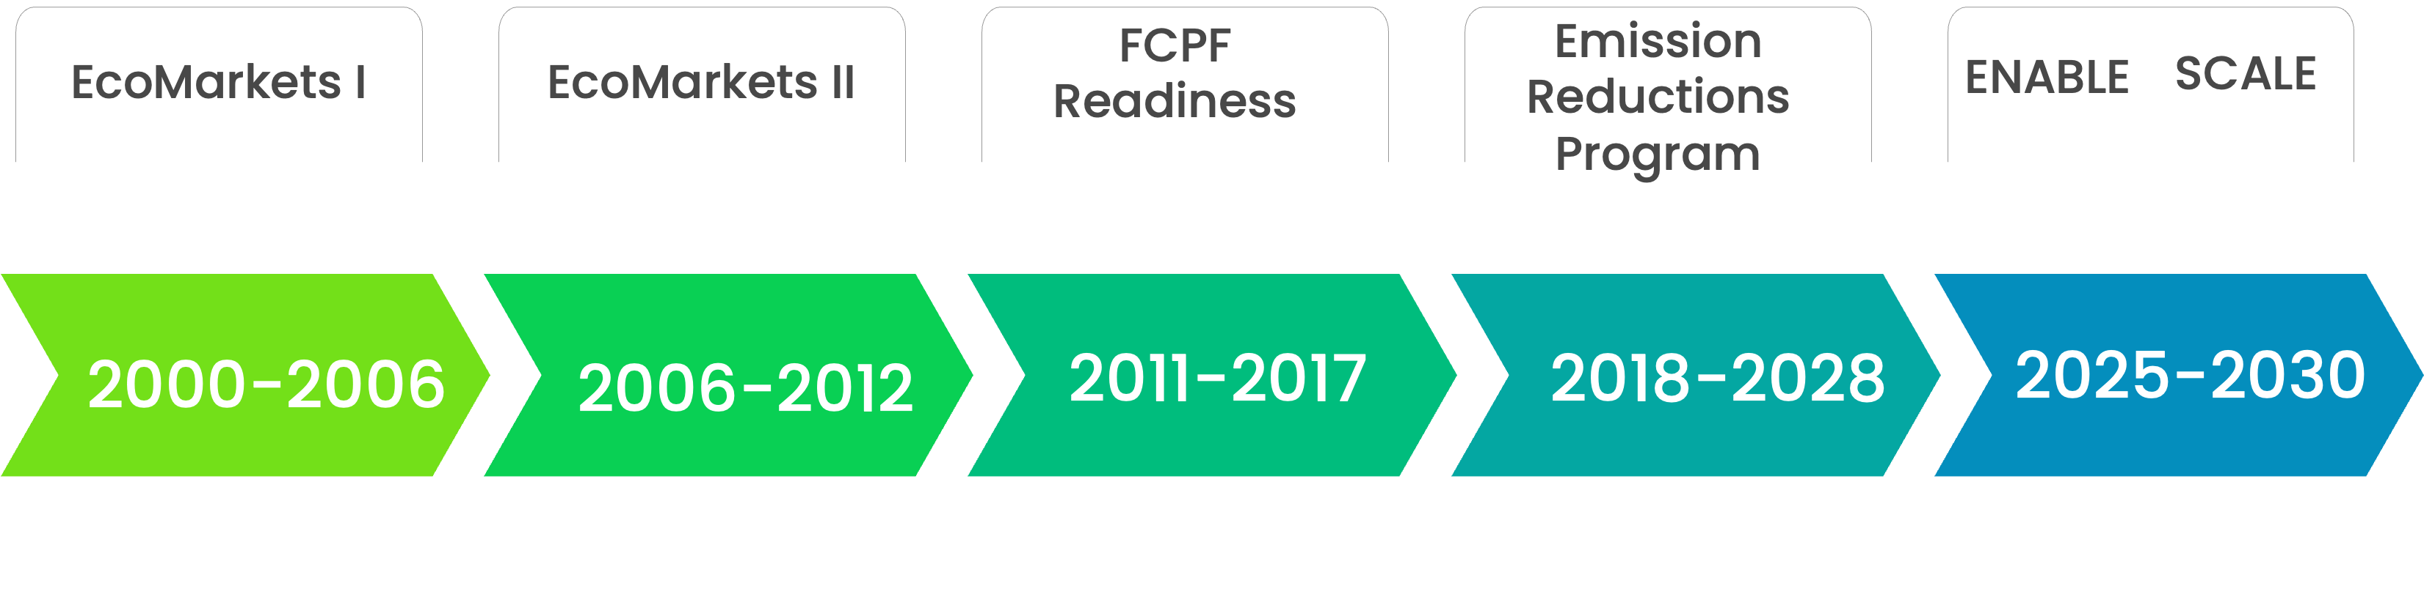
World Bank’s Strategic Support to
Costa Rica's Forest Sector
US$32.6M
US$30M
US$9.38M
US$60M
US$3.6M
US$0.35
PES Program expansion
Institutional strengthening
Enhanced social inclusion
Development of sustainable financing mechanisms
Promotion of Environmental Service markets (market development, policy integration)
National REDD+ Strategy
REDD+ governance structures
E&S Safeguards
Forest Reference Emission Levels
Forest Monitoring Systems
Institutional strengthening
Widened participation: indigenous territories, SINAC, FONAFIFO, and private actors
Transparent benefit-sharing
Legal frameworks for ER title transfer
Results-based climate finance
Entry point to carbon markets
AFOLU readiness
Green business promotion
Strengthened social inclusion
Co-benefits
Expansion of the Payment for Environmental Services (PES) Program
Strengthening institutional capacity (FONAFIFO, SINAC)
Development of sustainable financing mechanisms (Trust Fund establishment, Private Sector Engagement)
Promotion of Environmental Service markets (market development, policy integration
  Mobilizing climate finance
  Supporting results-based payments for emissions reductions
Key instruments: FCPF Carbon Fund, PES, and now SCALE.

Slide 5
Costa Rica’s PES Mechanism
Payment for Environmental Services (PES) launched in 1997.
Incentivizes people who own forests to preserve them, reforest, and sustainably manage land.
Funded through fuel taxes, water tariffs, international cooperation, and results-based climate finance.
Over 500,000 hectares protected; significant social and biodiversity co-benefits.
New PES 2.0 in 2024 focused on a different structure, for the environmental services: CO2 emissions captured + biodiversity, other pluses are freshwater resources protection and megadiverse biodiversity another plus.
With previous PES we reached 60,000 new has. per year, with PSA2.0 we will reach 120,000 new ones annually.

Slide 6
Enabling Policy Frameworks
Strong legal, policy and institutional foundation:
  Forestry Law 7575 (1996)
  National REDD+ Strategy (prep.2011-2015 ofic.2021)
  National Decarbonization Plan 2018-2050
  NDC 3.0 under completion (October 2025)
Inclusive governance: Indigenous Peoples and rural communities are key stakeholders.
Transparent MRV systems, benefit sharing, and national forest monitoring.

Slide 7

Pioneering Results-Based Climate Action under FCPF
Early leadership in carbon finance
  Among the first to sign an ERPA with the FCPF Carbon Fund
  Target: 12 million tCO₂e in verified ERs by 2025, unlocking US$60M
  Milestones achieved
  2022: First results-based payments received (∼US$17M)
  2024: Second payment received (∼US$17M)
  2027: Third and final payment scheduled
Innovating carbon market access
  2025: Pilot sale of 100,000 "Excess ERs" to third-party buyers at a higher price
  Opening pathways for broader engagement in international carbon markets

Slide 8
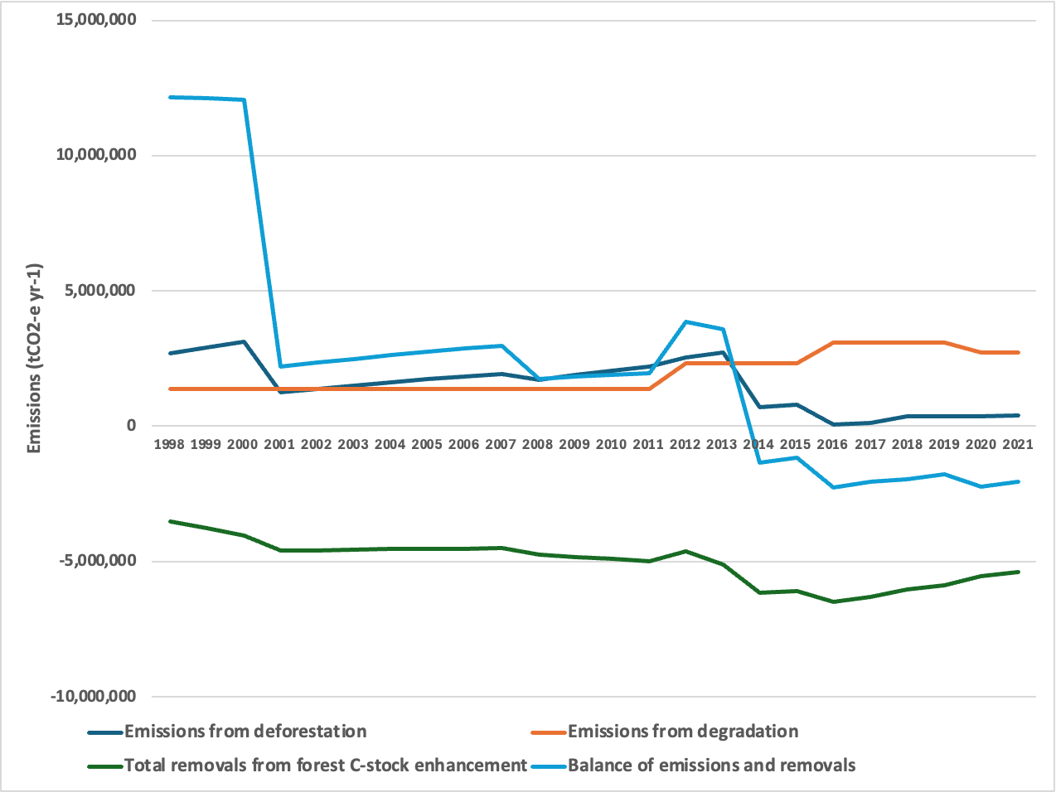
Transformational impact
Emissions from deforestation reduced dramatically from 11.6MtCO2e in 2000 to 0.2MtCO2e in 2021
Costa Rica successfully leveraged various sources of finance to support its REDD+ agenda (GCF, WB, carbon markets)
  REDD+ serves as a cornerstone in Costa Rica's strategy to meet its NDC​
FONAFIFO, May 2025

Slide 9
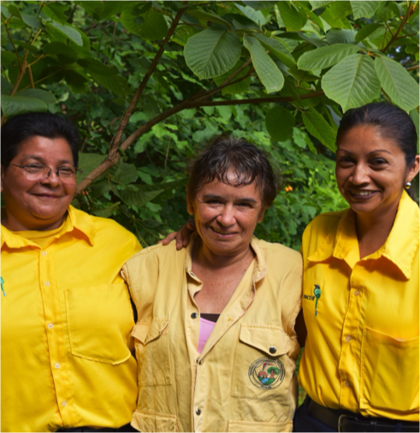
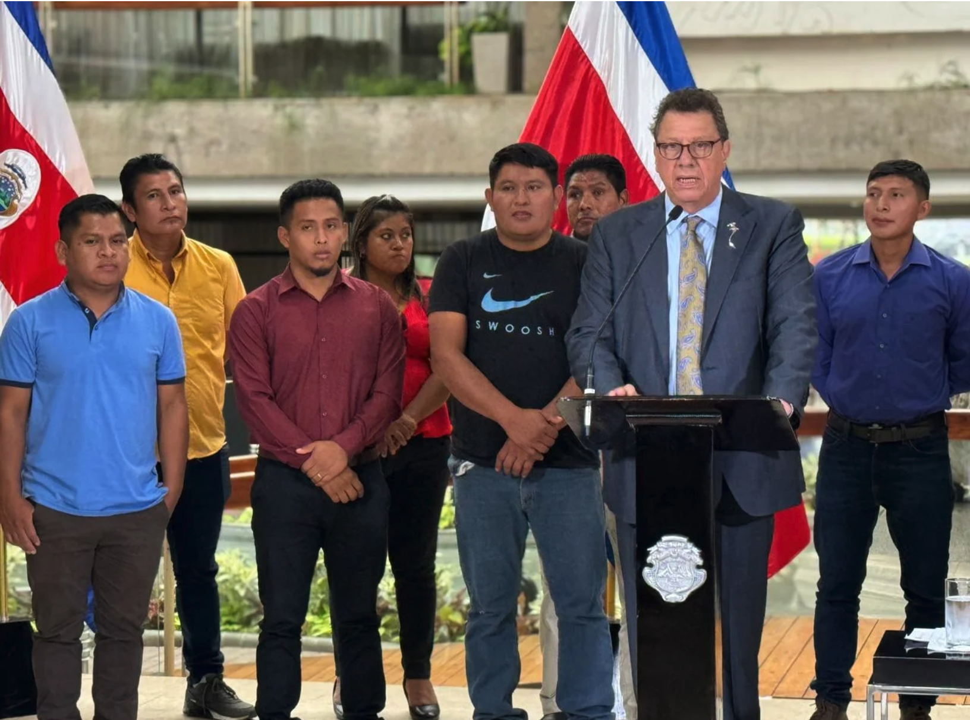
Transformational impact
Equity and inclusion in REDD+ benefit sharing​
Inclusive benefit sharing with Indigenous Peoples and rural communities recognized and rewarded for their contributions
19 Indigenous Territories have signed Emission Reduction Contracts (CREFs), covering 120,000 ha
Payments support their Territorial Forest Environmental Plans (20 PAFTs finished)
PAFTs align with Indigenous needs and cosmovision, promoting participatory monitoring and transparency

Slide 10
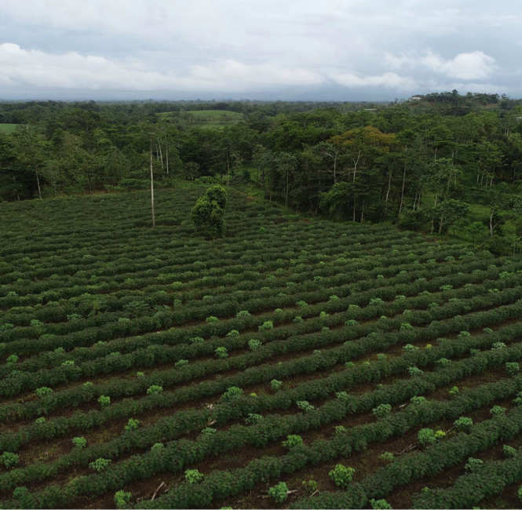
Transformational impact
Environmental co-benefits
Forest conservation
  83% of forest lands with potential for seven co-benefits covered
  Focus on biodiversity, water regulation, and eco-tourism value
  Driven by state-owned lands and PES program
Agroforestry systems
  Implemented in 10% of areas with co-benefit potential
  Led by coffee producers on private lands
  Concentrated in biodiversity-rich zones

Slide 11

Transformational impact: Linked to PES 2.0
Forest restoration
  Implemented mainly via PES
Biodiversity & ecosystem services
  Strengthened biological corridors and fire control
  Enhanced connectivity and forest resilience
Water regulation & erosion control
  Activities implemented in zones vulnerable to water stress and erosion
  Improved ecosystem resilience to climate impacts

Slide 12

Costa Rica’s next step beyond FCPF
Scaling Up with the SCALE Initiative
Aims to integrate forest-sector mitigation into broader climate finance architecture.
Focus on long-term sustainability, private sector engagement, and alignment with Article 6 mechanisms.
Builds on PES and FCPF experience to expand impact.
Current Technical Assistance to support the Government on exploring (i) new financing mechanisms opportunities for ER; (ii) biodiversity credits; (iii) improvement needs for MRV system and (iv) ER for the entire AFOLU sector.

Slide 13

Costa Rica’s next step beyond FCPF
Transition to other carbon standards
Costa Rica is transitioning to ART TREES Standard for the quantification, monitoring, reporting, and verification of GHG emissions and removals from REDD+ activities at a jurisdictional and national scale
ART TREES is consistent with UNFCCC

Slide 14
Lessons Learned
Success factors:
  Political commitment and legal continuity
  Blended finance and diversified funding sources
  Community engagement and benefit-sharing
Challenges:
  Sustaining long-term finance
  Scaling up while maintaining environmental integrity
Replicability: Costa Rica’s model offers valuable insights for other countries.

Slide 15
Looking Ahead
Expand SCALE to include new sectors and financing mechanisms.
Strengthen links with biodiversity, jobs creation and adaptation goals.
Continue fostering partnerships with financial institutions and donors.
Leverage Costa Rica’s experience to support regional and global forest mitigation efforts.

Slide 16
Q&A and Discussion
What aspects of Costa Rica’s approach could be adapted in your context?
How can financial institutions better support forest-sector mitigation?

