Slide 1
Early Warning Systems and DRR

Slide 2
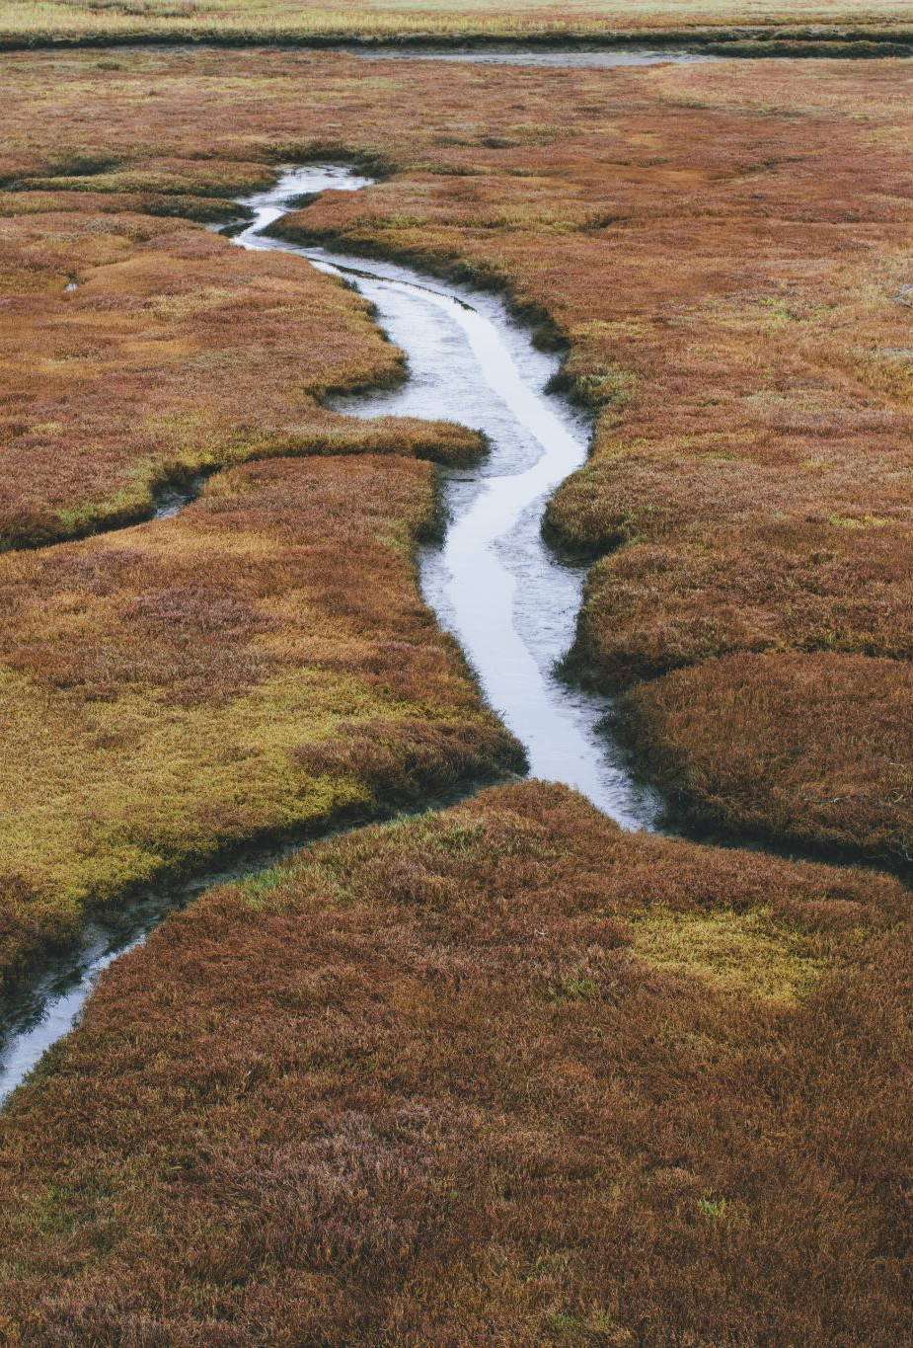
Problem statement
Regional cooperation between TM and UZ (potentially + TJ) in the areas of transboundary data exchange in water resources is insufficient with upcoming risks associated with non-stationarity and increased seasonal disasters related to water resources.

Slide 3
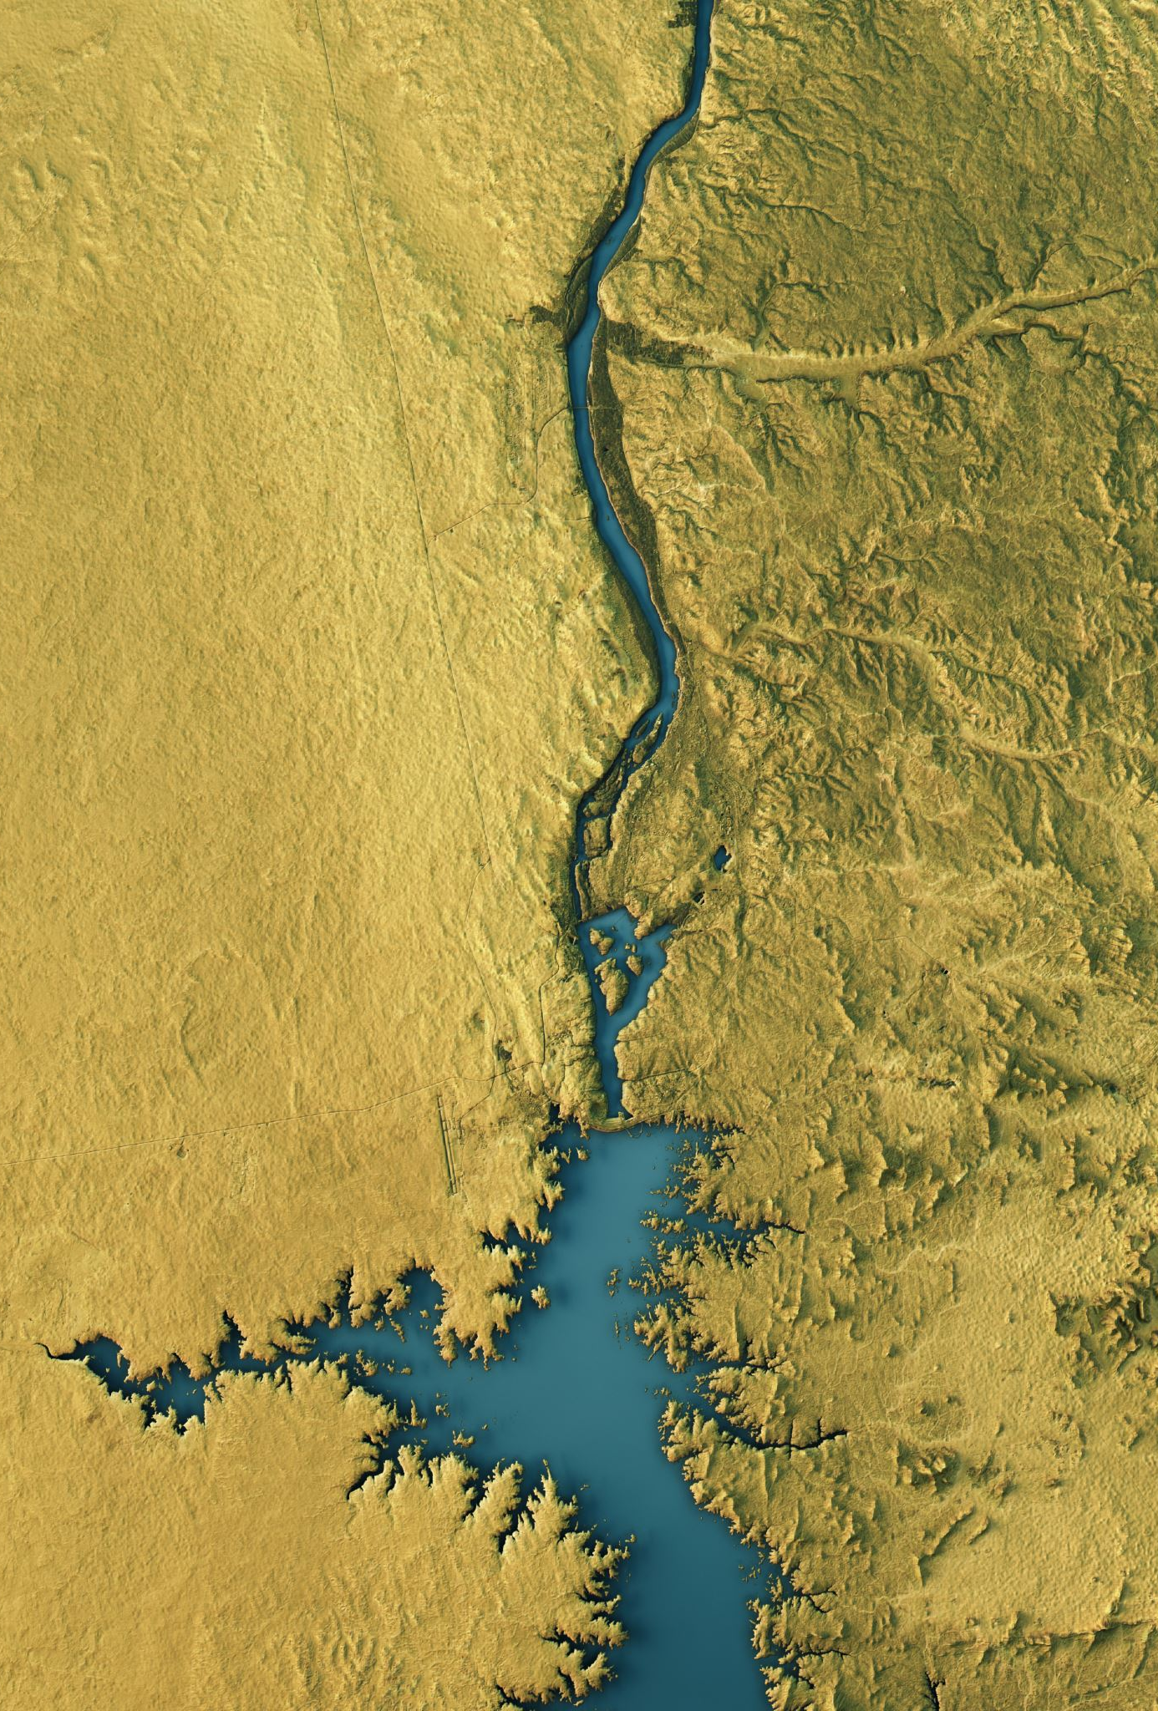
Context and baseline
Water scarcity is a global problem that is particularly acute in Central Asia in light with ongoing climate change and drought intensification.
Present information exchange between the countries is limited both at regional and national levels especially in terms of DR.
Level of hydrological development (observation practices) vary between the countries so that we need to harmonize the practices.
Management quality is different.
Agricultural practices are experiencing troubles with receiving acute data on DRR.
External data exchange is limited among the stakeholders at all levels.

Slide 4
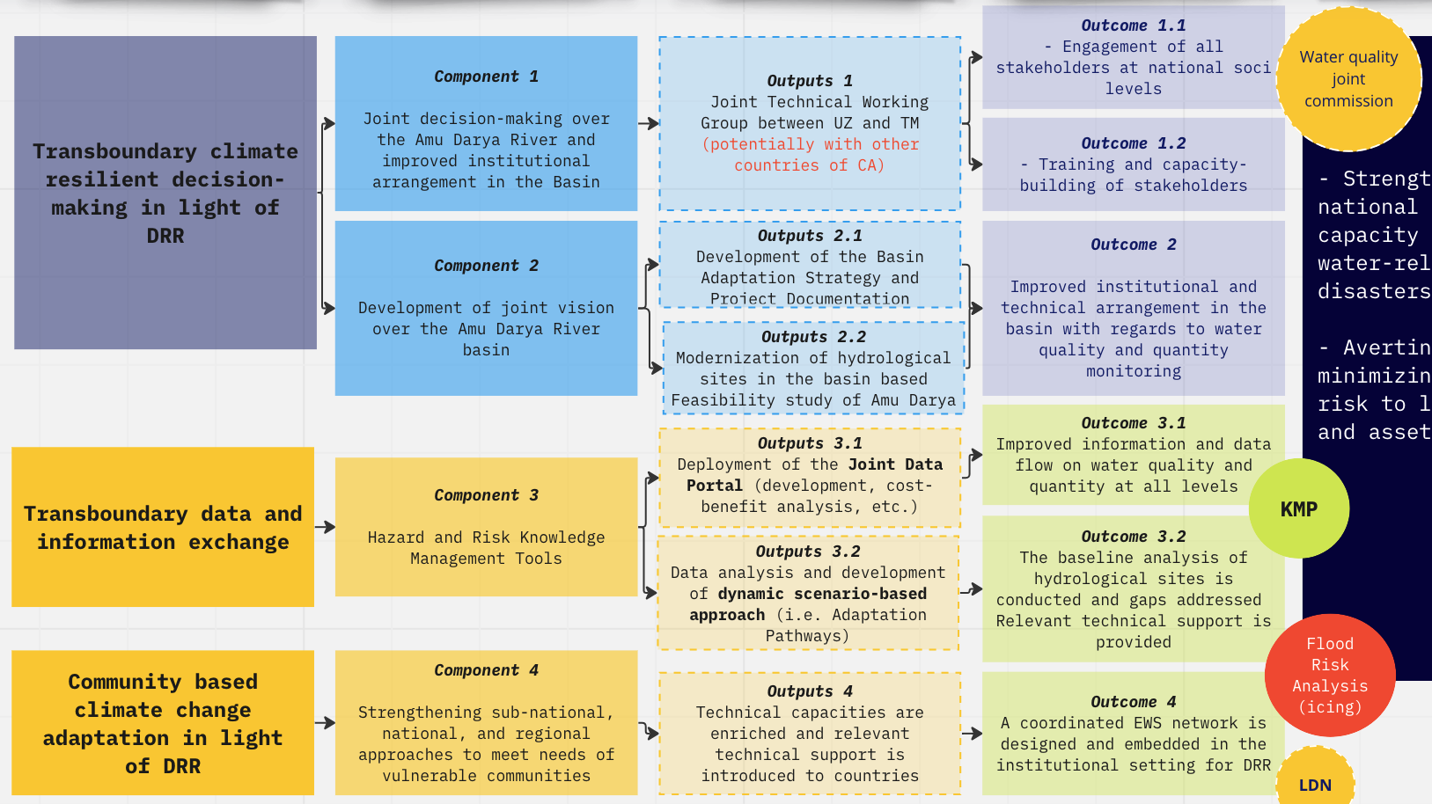

Slide 5
Agencies
National Entities
Ministry of Foreign Affairs
Ministry/Committee of Environment/ Agriculture resources
Ministry/ Committee for Water Resources
Ministry of defense (Min of Emergency Situations) + borderline dep.
Meteorological Services (UzGidromet and TurkmenGidromet)
Hyakimliks/Hakimats (local municipalities)
Scientific-Research Institute of Hydrometeorology of UZ + Giprovodkhoz of TM
University of Agriculture (TM) + Tashkent Institute of Irrigation and Agricultural Mechanization Engineers (TIIAME)
National Red Crescent Societies (TM + UZ)
Local communities, community leaders
Local Water Associations (if any)
International entities
UNESCO, UNDP, WMO, GIZ, WB
Universities/Research Institutes: Potsdam University (GIZ) and IHE-Delft, SDC (Blue Peace), IWMI, Zoi Environment
Regional Entities
Amu Darya BWO (БВО Амударья) (ICWC IFAS)
Interstate Sustainable Development Commission (ICSD of IFAS)
Regional Center of Hydrology (KZ)

Slide 6
Assumptions and Risks
- Both climate systems and EWS are in charge of key Ministries and departments (Min of Defense, Min of Environment and Agriculture, Min of Water, etc.)
- Technical equipment that will be supplied to both UZ and TM need to derive from similar resources, however there might be some complications receiving confirmation from both countries on certain equipment.
- Receiving permission to do an assessment of the borderline hydroposts might take more time than envisioned
- NAPs will come late affecting general coordination of actions
- Qosh-Tapa canal will call for an immediate action (a parallel mechanism might be established by states)

Slide 7
Key Next steps
0. Concept Note to be prepared and submitted to the fund to recieve the PPG grant
1. we discuss with UNDP whether they will be interested to be a lead agency in charge of PPG
2. parallel to that ICSD applies to NDC Partnership and could be lead/partner organization to the project
3. On the basis of Amu Darya BWO + Joint Agreement of UZ+TM Technical Group we create a Joint Technical Working Group

Slide 8

Financial investment
Adaptation Fund providing with 14 mln USD + 100,000 PFG
GCF - supporting Climate Information and EWS
NDC Partnership for pooled funding on conducting high-level events in DRR preparedness, etc.

Slide 9
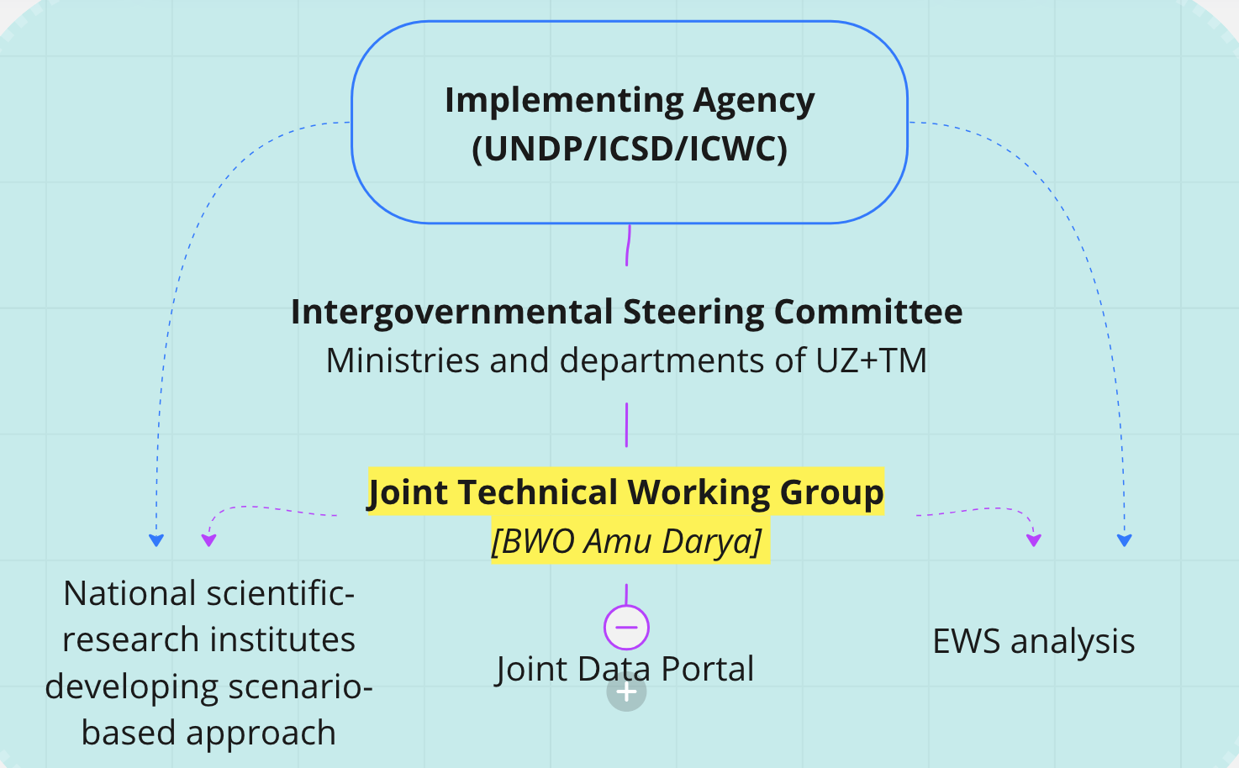
Potential project structure

