Slide 1




Provision of support to developing country Parties for ETF
UNFCCC Transparency division
19 November 2024

Slide 2
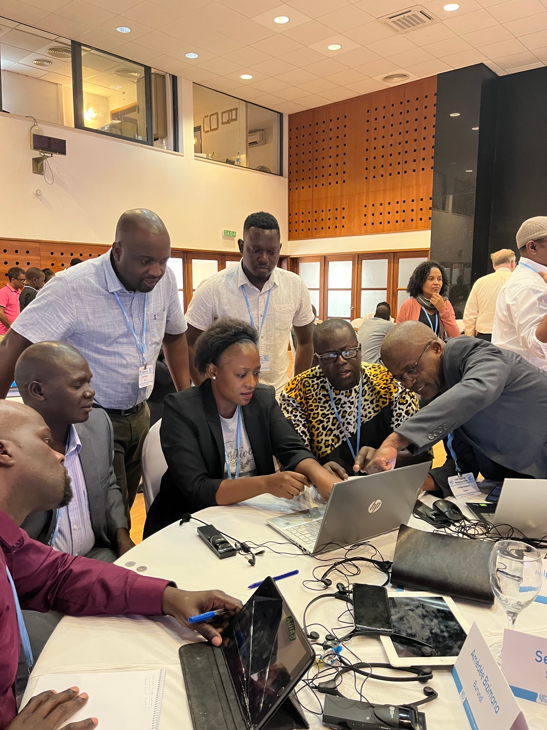


Overview of CGE activities and achievements
Technical materials
Collaboration, outreach
CGE side-events
Annual CGE Informal Forums since 2019
Collaboration with other IOs and CBs:
  IPCC, UNEP, UNDP, WMO, FAO …
  AC, ExCom, LEG, LCCIP, PCCB, PAICC, …
Outreach
  CGE webpage, MRV helpdesk
  LinkedIn and Facebook accounts
CGE annual capacity building needs assessment (CBNA) reports
Technical handbook on MRV
CGE toolbox on institutional arrangements
ETF technical handbook
CGE training material on adaptation
CGE training material on mitigation/NDC reporting
……
Workshops, trainings, …
90+ CGE regional workshops, 3000+ national experts.
45+ CGE webinars, 2400+ experts
16 rounds of TTE training
CGE eLearning courses: 300+ experts
Notes:
It is not easy to briefly provide all the achievements of the CGE’s 25 years of work. I will be highlighting here a few key areas and activities.

Slide 3


Some of the activities carried out by secretariat together with partners in 2024
In-person workshops in 2024 | No. of participants
CASTT Adaptation Academy workshop | 34
First BTR preparation workshops with AfDB, BOAD, US-EPA, Government of Azerbaijan, AIDA and others (Lome and Nairobi) | 58
First BTR preparation workshops Central Asia, the South Caucasus, and Eastern Europe (Kazakhstan) | 66
ASEAN Asia-Pacific region BTR workshop (Singapore) | 38
LDC BTR workshop with the LDC Group and IIED (Malawi) | 38
BTR training workshop with UNEP and CBIT-GSP (Maldives) | 25
Fast-tracking BTR preparation ECCAS, ICAT and other partners (Congo) | 30

Slide 4
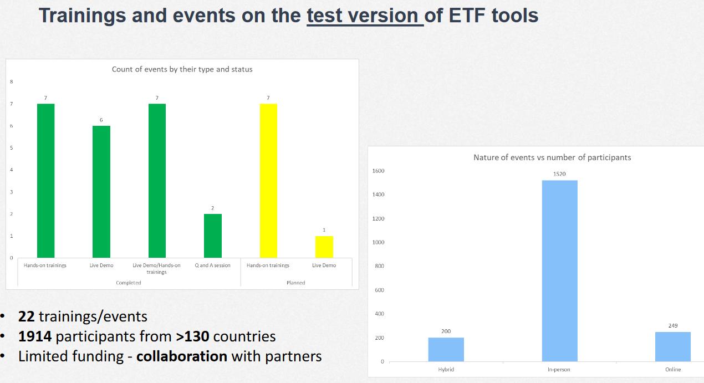
ETF reporting tools training

Slide 5
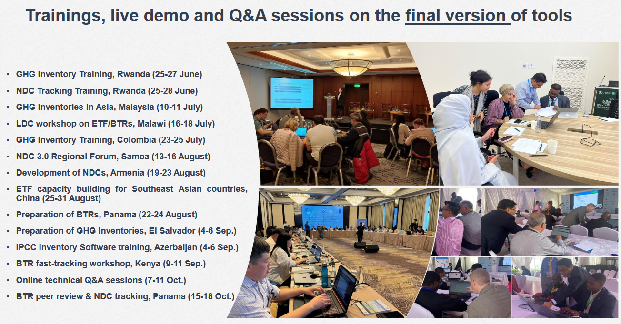
ETF reporting tools training

Slide 6

Outcomes from COP28
On Provision of financial and technical support to developing country Parties for ETF

Slide 7




Outcomes from COP28 on support for ETF
01
02
03
04
Awareness
Delivery
Collaboration
Coordination
Raise awareness of opportunities for support for reporting under the Paris Agreement
Ensure that technical support and training is made available to developing country Parties for reporting under the Paris Agreement
Facilitate regional cooperation for promoting exchange of experience, lessons learned and best practices and networking among Parties
Promote better coordination of information on channels of support for implementation of the enhanced transparency framework

Slide 8


Dubai outcome on provision of support for ETF
2024
2024
2025
2025
Prior to SBI 60
31 October
31 March
SBI 62 (June)
Regional online workshops on support available to developing country Parties for ETF; and in providing guidance to the GEF on the application process
Summary report on the lessons learned and best practices shared at the facilitative dialogue
Submission of views by Parties on their experience and challenges related to implementing ETF
Facilitative dialogue to discuss the findings in the synthesis report
Consider outcomes of the facilitative dialogue
01
02
03
04
05
06
07
08
378 experts
111 countries
14 support providers
SBI 60 (June)
CMA 6 (Nov)
3 wks prior to SBI 62
CMA 7 (Nov)
June 4: In-person workshop on support available to developing country Parties for BTRs and IAs
June 10: In-session facilitative dialogue to share experience in gathering, analysing and managing data
Consider provision of financial and technical support under CMA
Synthesis report on progress, best practices and remaining challenges contained in the submissions and BTRs
Draft decision, including future activities, as appropriate
147 participants
13 support providers
2024
2024
2025
2025
150+ participants, Experience sharing from 10 Parties

Slide 9
Activities carried out in 2024
Regional online workshops on support available to developing country Parties for preparing their biennial transparency reports and enhancing sustainable institutional capacity and national reporting systems within their governments for implementing the ETF, and in providing guidance on the application process for transparency-related projects https://unfccc.int/ETF_online_workshops_2024
In-person workshop on support available to developing country Parties for preparing their biennial transparency reports and enhancing sustainable institutional capacity and national reporting systems within their Governments for implementing the ETF, and in providing guidance on the application process for transparency-related projects https://unfccc.int/event/in-person-workshop-on-support-available-to-developing-country-parties-for-preparing-their-biennial
In-session facilitative dialogue on sharing of experience in gathering, analyzing and managing data, in particular by developed country Parties, that may be helpful for developing country Parties for implementing the enhanced transparency framework https://unfccc.int/event/in-session-facilitative-dialogue-on-sharing-of-experience-in-gathering-analyzing-and-managing-data
Summary report of the facilitative dialogue: https://unfccc.int/sites/default/files/resource/cma1014_04.pdf?download

Slide 10
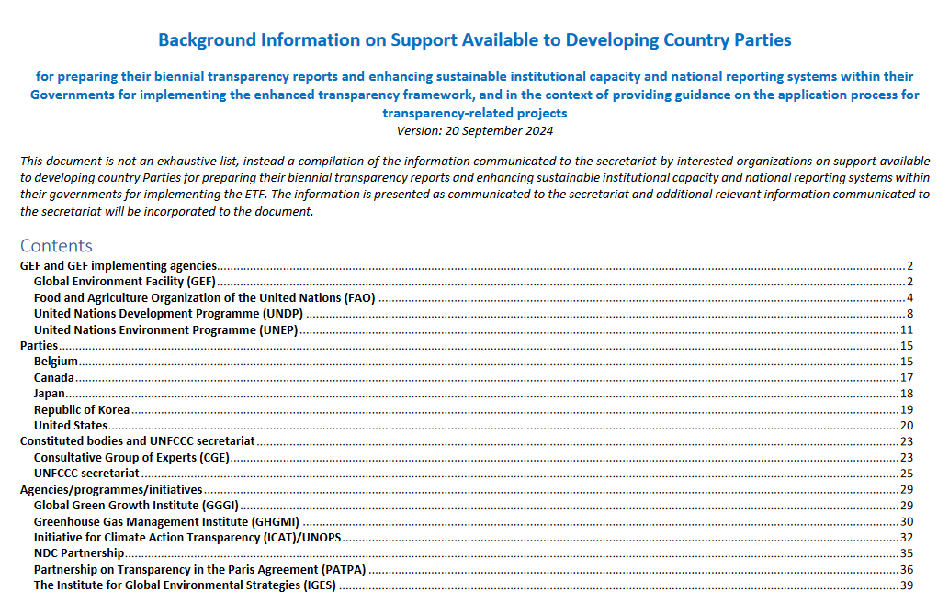
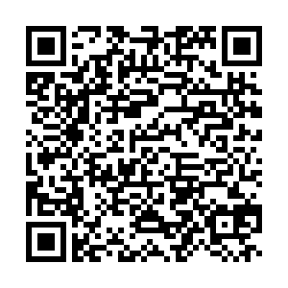
Support available

Slide 11
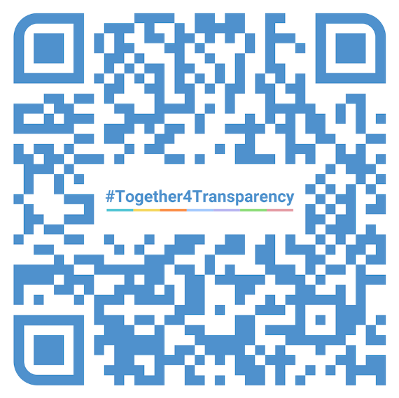

Thank you!
Let’s work #Together4Transparency!
bit.ly/T4TGroup
bit.ly/T4TCalendar
Join our LinkedIn Community
Explore all COP29
Transparency Events

