Slide 1
5th Capacity Building Hub: Monitoring, evaluation and learning for adaptation: interactive feedback session on new toolkit
Technical paper on monitoring and evaluation of adaptation at the national and subnational level
Britta Horstmann, Member of the Adaptation Committee
10 December 2023
Notes:
Thank you very much. It is a pleasure to be here today on behalf of the Adaptation Committee to present our newest technical paper on monitoring and evaluation.
By way of background, the Adaptation Committee was established in 2010 and is the principal body under the UNFCCC providing expert guidance on adaptation and ensuring that adaptation is addressed coherently under the UNFCCC process and in line with the Paris Agreement.

Slide 2
I. AC work on Monitoring and Evaluation of Adaptation
Workshop: national adaptation goals and indicators & links with SDGs/Sendai
Technical paper: approaches to reviewing overall progress made in achieving the GGA
2013
2021
2023
2018
2021
Workshop: monitoring and evaluation of adaptation
Adaptation Forum: M&E systems - Measuring progress & communicating results
Technical paper: M&E at national & subnational levels
Notes:
Before we turn to this new paper, I would like to take a step back and look at the AC’s history of work on the vital topic of monitoring and evaluation.
The Adaptation Committee has long prioritized work on monitoring and evaluation (M&E). This topic featured in the first-ever workplan of the AC and has remained a continuous theme in its events and publications ever since.
Some highlights of this work include:
The AC held workshops on M&E in Fiji in 2013, which addressed topics such as building a common understanding of adaptation success, and in Japan in 2018, focusing on national adaptation goals and indicators and their relationship with the SDGs and the Sendai Framework.
In 2021, we held our Adaptation Forum on the topic of Monitoring and evaluation systems at the national and subnational level, with a focus on measuring progress and impacts and communicating results.
Towards the end of 2021, we published a technical paper on Approaches to reviewing the overall progress made in achieving the global goal on adaptation.
Last month, we published a reference paper on Methodologies for reviewing the adequacy and effectiveness of adaptation and support. Additionally, this year we also published our latest technical paper on M&E at the national and subnational levels, which I will now present in detail.

Slide 3
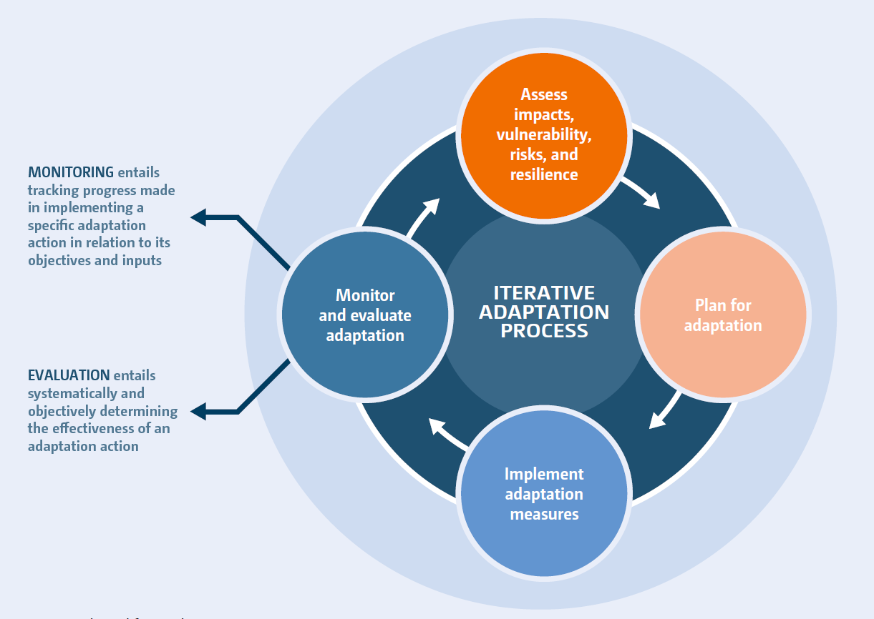
II. Methodological and conceptual challenges in M&E
Notes:
The paper begins with an overview of M&E for adaptation.
The importance of M&E for adaptation is clear; it is a core part of the adaptation cycle. It is also enshrined in Article 7.9 of the Paris Agreement, and highlighted by the IPCC as “a prerequisite for successful iterative risk management and achieving effective and just adaptation outcomes.”
Progress on M&E continues, however, to be slow at both the national and subnational level.
This is, in part, due to a range of challenges that complicate adaptation M&E. These challenges were discussed in depth in our paper on the global goal on adaptation; they include, for example, methodological, empirical, and conceptual challenges, as well as capacity constraints and resource limitations.

Slide 4
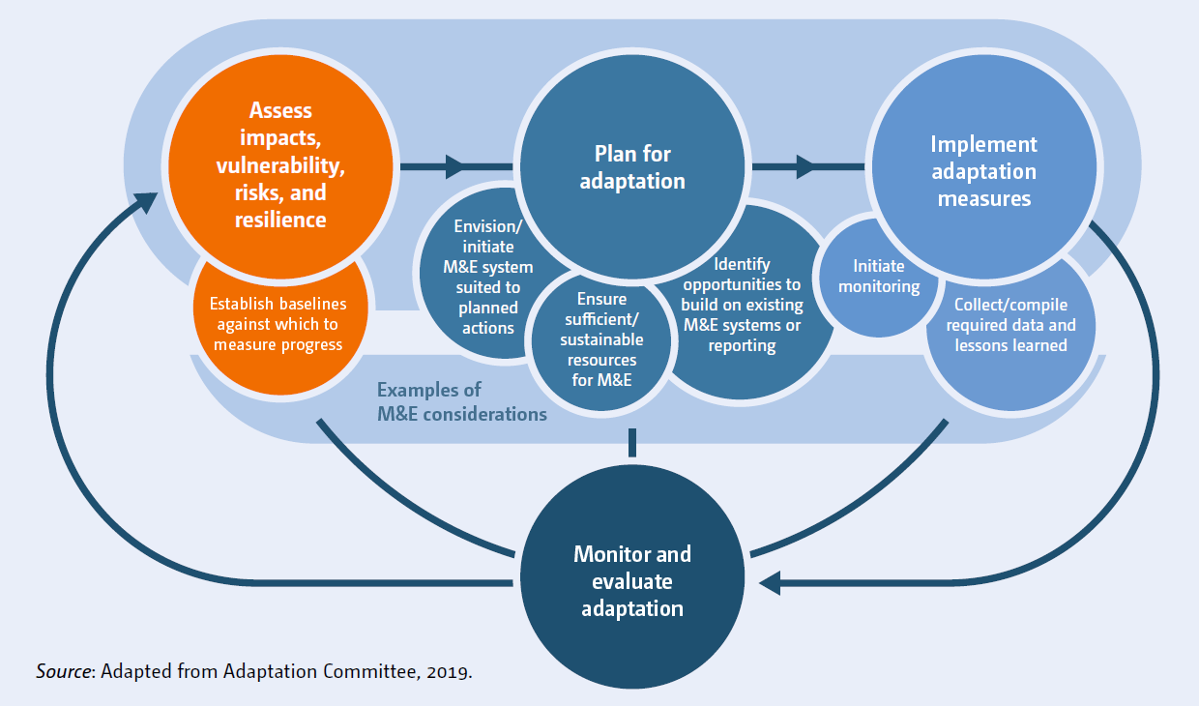
II. Methodological and conceptual challenges in M&E
Notes:
The paper stresses that, while represented as the fourth step in the iterative adaptation process, adaptation monitoring and evaluation should be taken into consideration and facilitated at each and every step of this cycle.
Assessing impacts, vulnerability, risks, and resilience, for example, can set the stage for M&E by establishing baselines against which to measure progress.
There are several relevant considerations at the adaptation planning stage, including that it provides the opportunity to envision and initiate an M&E system suitable for the set of actions included in the plan.
Finally, implementation should signal the beginning of the monitoring half of the M&E equation. It is also important that data and lessons learned needed to enable evaluation are diligently collected and compiled throughout the implementation stage

Slide 5
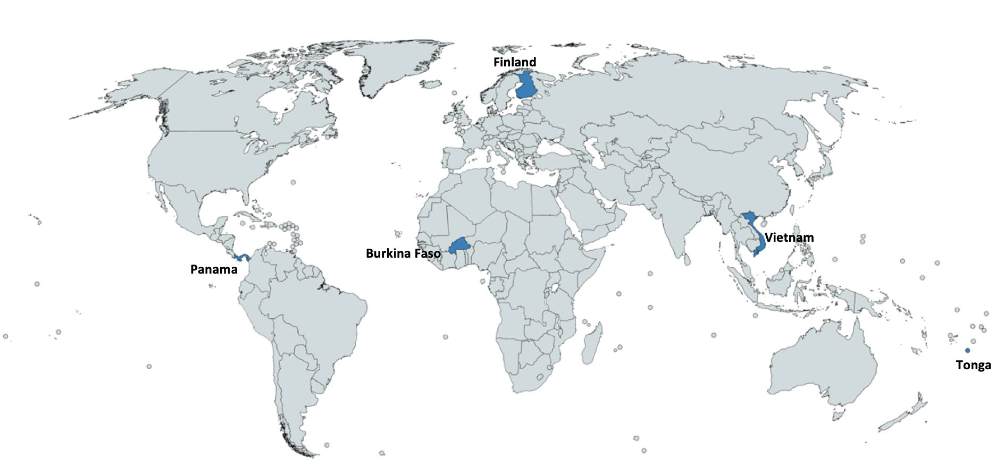
III. Case studies: National level
Notes:
The paper is centered around a set of ten case studies, five of which are at the national level and five at the sub-national level.
The case studies have been chosen with the aim of ensuring a regional balance and showcase a variety of experiences, in order to gain some insights into the global state of adaptation M&E. These case studies help to demonstrate examples of how the different challenges identified manifest and are being overcome by governments in different jurisdictions.
At the national level, the case studies that feature in the paper include Burkina Faso, Finland, Panama, Tonga, and Vietnam.

Slide 6
III. Case studies: National level findings
Examples of challenges:
  Weak data management and difficulty with institutional coordination
  Inadequate financial, capacity-building, and technology transfer support
  Designed systems prove too difficult to implement in practice
Examples of opportunities and trends:
  Support for developing countries is often instrumental in making progress on M&E
  Alignment with international commitments and reporting systems is key opportunity
  Various countries prioritizing initiating M&E as soon as possible over building perfect/robust systems from the start
  Several options and approaches for engaging stakeholders throughout the M&E process
Notes:
Examples of challenges include:
Weak data management and difficulty with institutional coordination
Inadequate financial, capacity-building, and technology transfer support
Systems that are designed or envisioned in adaptation plans and policies prove too difficult to implement in practice
Examples of opportunities and trends include:
Support for developing countries through different funds and initiatives is often instrumental in making progress on M&E.
Alignment with international commitments and reporting systems, including the enhanced transparency framework, is a key opportunity for countries currently developing or updating their M&E systems. In doing so, countries can both generate information that can be used domestically to enhance adaptation, but also feed into the national documents and reports that they produce for the UNFCCC and other associated frameworks.
Various countries are initiating M&E as soon as possible rather than trying to build perfect or robust systems from the start. Examples include selecting indicators based on existing data and methodologies; undertaking evaluations with simplified methodologies; and moving ahead with evaluations in the absence of complete indicator data. This is consistent with the idea of M&E is an iterative process that can become increasingly sophisticated over time, and it reflects the urgency of undertaking adaptation M&E.
Finally, there are options for engaging various stakeholders throughout the entire M&E process, from development to application. This helps to ensure the feasibility of proposed indicators or mechanisms, as well as the comprehensiveness and accuracy of captured information.

Slide 7
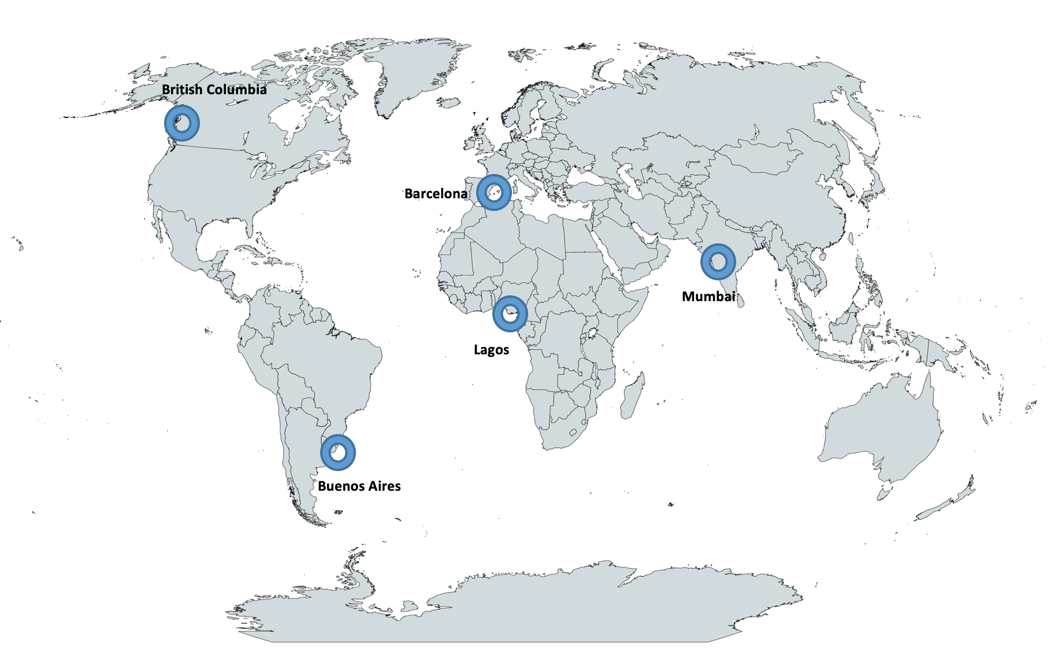
III. Case studies: Sub-national level
Notes:
At the sub-national level, the paper looks at both cities and provinces, once again maintaining a regional balance.
The case studies that are included in the paper include Barcelona, British Columbia, Buenos Aires, Lagos, and Mumbai.

Slide 8
III. Case studies: Sub-national level findings
Examples of challenges:
  Need for dedicated institutional structures at the sub-national level
  Lack of awareness of the importance of M&E at the local level
  Inadequate financial resources
Examples of opportunities and trends:
  Potential for complementarities between sub-national and national level M&E
  Sectoral, non-climate specific systems and indicators can guide sub-national efforts
  Inclusion of an active learning system can help generate a constant feedback loop of lessons learned
Notes:
The case studies chosen at the sub-national level have likewise generated valuable insights.
Examples of challenges include:
The need for dedicated institutional structures for M&E at the sub-national level. Such structures help ensure that the responsibility of M&E is not simply absorbed into the responsibilities of existing staff and institutions, and that comprehensive monitoring, reporting and evaluation is routinely carried out.
There is often a lack of awareness of the importance of M&E and slow uptake of adaptation M&E frameworks at the local level. This, in turn, constrains the potential for climate resilient development pathways.
As with M&E and adaptation more broadly, inadequate financial resources can pose a challenge.
Examples of opportunities and trends include:
There is potential for complementarities between M&E at the sub-national and national levels. Sub-national governments can often use and learn from existing national M&E systems. Likewise, piloting M&E systems at the sub-national level is helpful for national governments, who can use these as tests to then scale up to the national level.
Sectoral, non-climate specific indicators and systems can guide sub-national efforts. Using "pre-tested and accepted" sectoral indicators can make M&E at the sub-national level easier and help to avoid duplication.
Inclusion of an active learning system can help generate a constant feedback loop of lessons learned. It is essential that M&E is an iterative process which continues to integrate lessons learned back into the system. Actively including such a function within the M&E system can therefore help ensure both thorough evaluation and constant improvement.

Slide 9
IV. Observations and insights
Indicators commonly central components of M&E systems – advantages are clear but important to carefully consider role and selection of indicators
Tension between establishing M&E systems that yield best possible understanding of adaptation vs. those that are feasible in the near-term
Various opportunities to work towards more ambitious and innovative practices over time
Notes:
Based on the analysis, the paper distills various observations and insights.
First, both the case studies and the existing literature demonstrate that indicators are commonly developed as central components of M&E systems at the national and sub-national level.
While the appeal and advantages of indicators are clear – for example, they enable measurement of variables relevant to adaptation and facilitate the tracking of progress over time – it is important to carefully consider the role and selection of indicators.
Expectations surrounding what indicators can and cannot do are not always realistic; and they have limitations in terms of facilitating decision-making in the face of competing interests or revealing how and why a given change has taken place.
Second, there is a tension in the M&E of adaptation between establishing a process that results in the best possible understanding of adaptation progress and one that is feasible in the near-term.
A common pattern is governments elaborating ambitious M&E plans, then implementing more limited approaches due to capacity, resource, or methodological or other constraints.
Often, these more limited approaches are focused more on assessing the process of adaptation rather than its outcomes.
Finally, while governments may choose more pragmatic approaches in the near-term, there are also various opportunities to work towards more innovative and ambitious systems over time.
This may include, for example, promoting a systems innovation approach to adaptation and its M&E, or field testing new and riskier approaches to M&E.

Slide 10
V. Recommendations
Governments should design and implement the most robust M&E systems that are feasible given their data, capacity, and resources, while also seeking to improve the sophistication and comprehensiveness of these systems over time.
Multilateral funds and agencies supporting adaptation projects and programmes should align their M&E efforts with the broader M&E systems at the national or subnational level, and provide technical and financial support for their development and application.
Subnational and national governments can benefit from aligning with existing M&E systems and reporting obligations or processes at different levels of governance.
Notes:
Finally, I’ll share the recommendations included in the paper.
National and subnational governments should design and implement the most robust M&E systems that are feasible given their data, capacity, and resources, while also seeking to improve the sophistication and comprehensiveness of these systems over time.
This may involve starting with systems that focus on the process and outputs of adaptation action, and then incorporating more indicators and methods to measure the long-term impact of adaptation.
Multilateral funds and agencies supporting adaptation should align their M&E efforts with the broader M&E systems at the national or subnational level, and provide technical and financial support for their development and application.
This can help ensure that support provided is holistic, extending beyond project or programme boundaries to enhance systematic adaptation efforts, and that additional reporting or monitoring burdens are avoided.
Subnational and national governments can benefit from aligning with existing M&E systems and reporting obligations or processes at different levels of governance.
For example, national-level systems can build on subnational systems while also helping to generate information required for reporting and communications efforts under the UNFCCC and other international fora. This can reduce burdens associated with M&E and reporting as well as enhance the quality and transparency of the information communicated at the international level. This information can inform processes such as the global stocktake.

Slide 11

V. Conclusion and next steps
Relevant upcoming work in 2024: State of Adaptation Action by Parties country profiles; biennial report on recognition of adaptation efforts of developing country Parties; MEL toolkit with NAP Global Network.
We always welcome ideas and inputs: ac@unfccc.int
Download the paper here:
http://bit.ly/AC-MandE
Notes:
As highlighted earlier, this paper marks the latest in a long series of work by the Adaptation Committee on monitoring and evaluation, and there will certainly be more work on this critical topic to come.
I can already highlight a few relevant products that are being developed:
We will soon launch an interactive data portal showcasing the State of Adaptation Action by Parties, with a wealth of information collected from the national reports.
We will prepare our next biennial synthesis report on recognizing the adaptation efforts of developing country Parties next year, which will look at setting up institutional arrangements for and engaging stakeholders in adaptation planning and implementation, which will offer an opportunity to look at these topics with respect to M&E systems.
And finally, we are working together with the NAP Global Network to develop a toolkit on monitoring, evaluation and learning, which will be the focus of this session today.

Slide 12
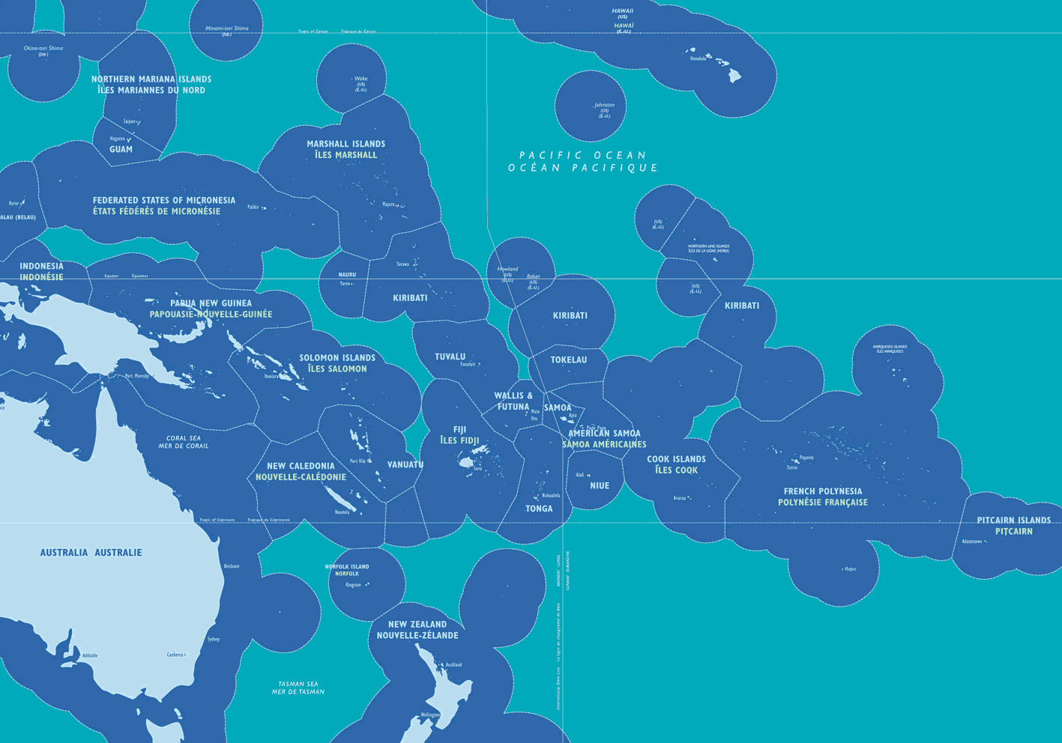

Sala Dr George Carter
Australian National University
george.carter@anu.edu.au

Slide 13









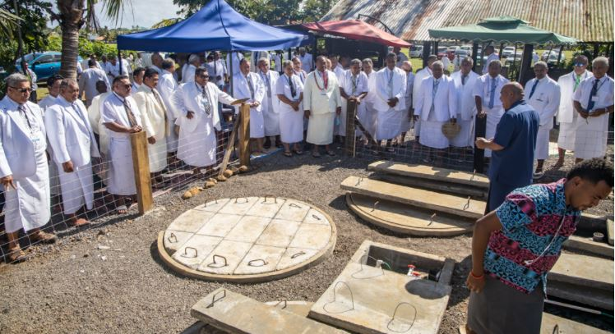


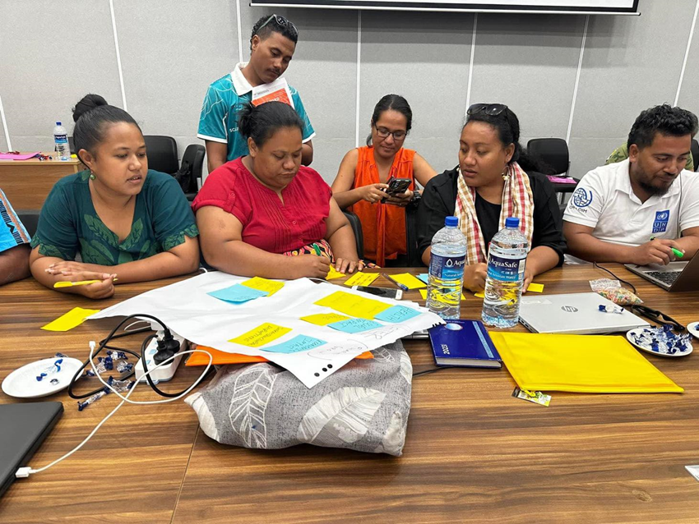
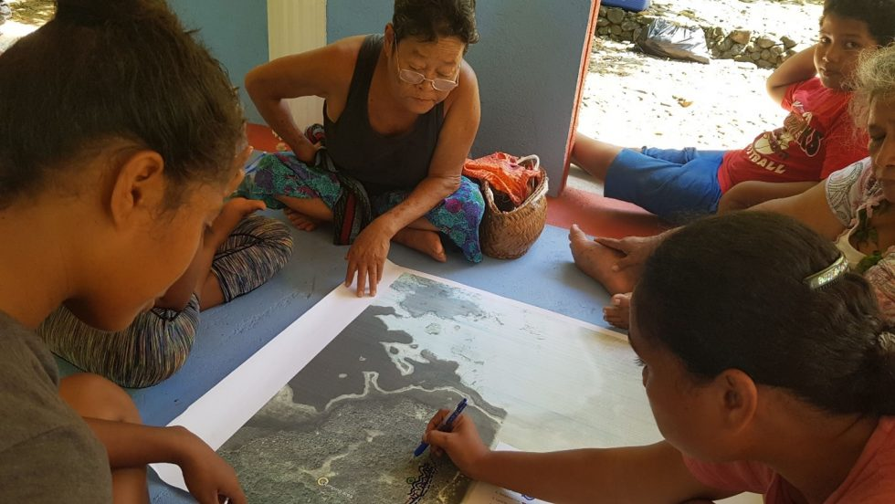

Sala Dr George Carter
Australian National University
george.carter@anu.edu.au

Slide 14


Developing a Toolkit for MEL of national adaptation planning processes
December 9th 2023
COP28, Capacity Building Hub, Dubai
Emilie Beauchamp, Lead of MEL for climate change adaptation
IISD
Hellen Agor Yayra, Lensational trainee, Ghana (2021)

Slide 15



About the NAP Global Network
Our Goal: Enhance national adaptation planning and action in developing countries
What
we do
Support national-level action on NAP development & implementation.
63 developing countries have received direct technical support​.
Help countries learn from each other through South-South peer learning and exchange.
400+ people from more than 55 countries in peer learning & exchanges.
Generate, synthesize, & share knowledge on NAP processes.
300+ knowledge materials have been produced.
Our
reach
Notes:
NAP GN started in 2014 – a result of the Cancun framework and the NAP in 2010.
63 developing countries have received direct technical support​.
400+ people from more than 55 countries in peer learning & exchanges
300+ knowledge materials have been produced.

Slide 16
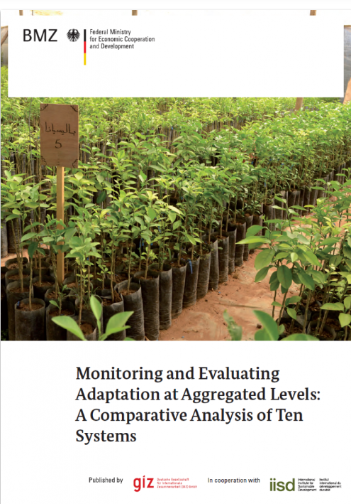
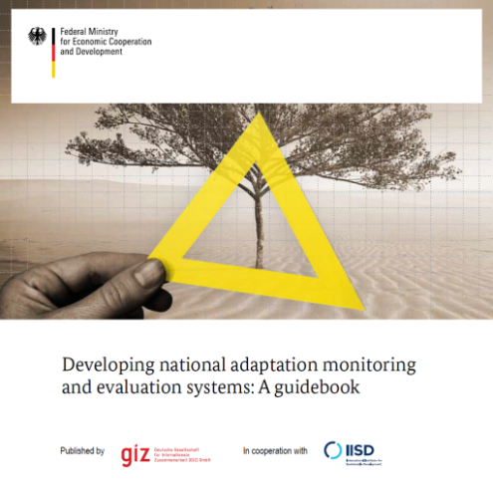
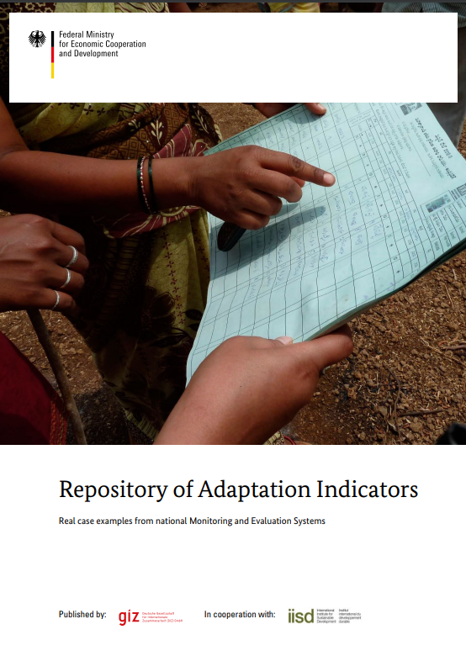
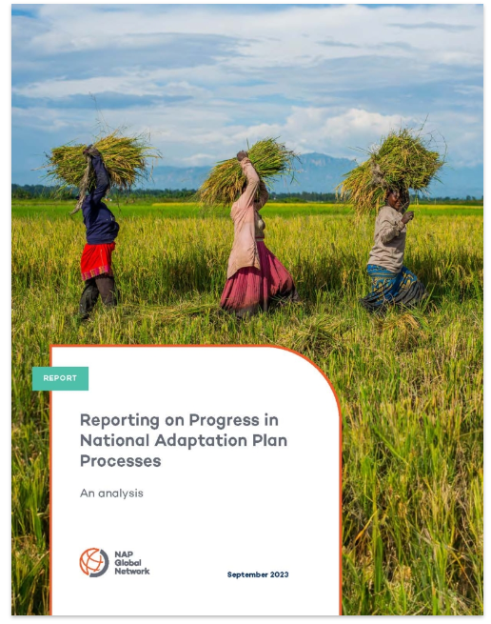
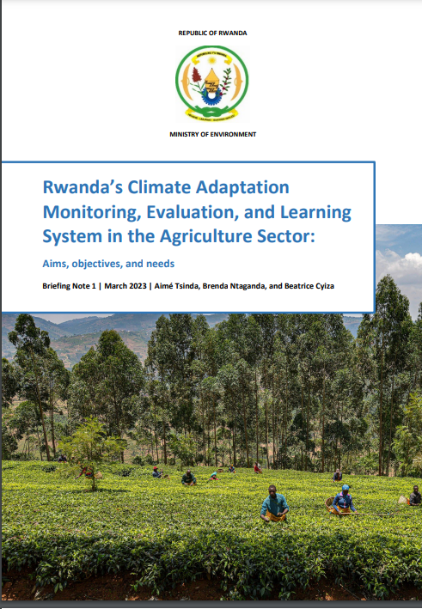
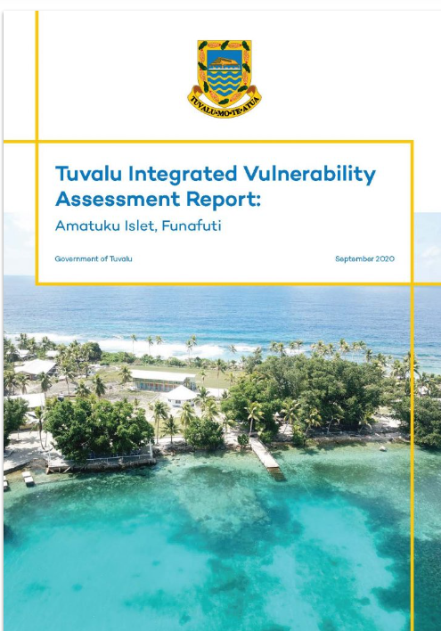
Nine years of supporting developing country partners on MEL
Country partners: Albania, Benin, Belize, Brazil, Burkina Faso, Cameroon, Colombia, Costa Rica, Fiji, Grenada, Ghana, Guyana, Guinea, Kenya, Kiribati, Lesotho, Liberia, Namibia, Peru, Philippines, Rwanda, Somalia, Vietnam, Zambia
From early knowledge products on M&E…
We have delivered:
  32 technical assistance requests across 25 countries
  7 peer learning events
  Over 40 knowledge products
Time to translate the experiences of country and what we have learned into an updated toolkit!
Notes:
Ove the past nine years of the NAP GN, MEL, or M&E back then, was part of our work from the beginning – in fact we have two publications in 2014 itself, starting to take stock of different M&E systems, and of their indicators. And the 2015 Guidance on M&E – which is still being a highly downloaded publication today.
Over the years, we have worked to support countries in streghtneing their MEL of NAP processes – and adaptation in general – not just NAP, but ada NDC, green growth etc.
I want to point out some new numbers following up on Timo’s 40% of countries with a NAP
NAP 33 countries in 2021
Now 45 =>
49% of 45 countries mentioning M&E frameworks
55% with indicators
In early 2021, 40% of countries were tracking their NAP implementation (Leiter, 2021).
In 2022, 139 of 154 developing countries reported having started a NAP process (UNFCCC Secretariat).
BUT The steps of designing and implementing a MEL system can be followed in different approaches, depending on the country’s context. Some countries such as Zambia first start by developing an overarching national MEL system that then needs to be broken down further into sector-specific activities. Others start by tackling priority sectors—for example, Namibia focusing on agriculture.
As Britta mentioned earlier there are quite a bit of challenges – and opportunities – and the discussions on the GGA that will be a key agenda item at COP28 have shown the increase in awareness of the important of MEL at national and international levels. But… how to accelerate the design and implementation of MEL systems?
And so when the team for MEL of climate change adaptation was created last year in the RL group, one of the first things we realised was: Time to translate the experiences of country and what we have learned into an updated toolkit!

Slide 17
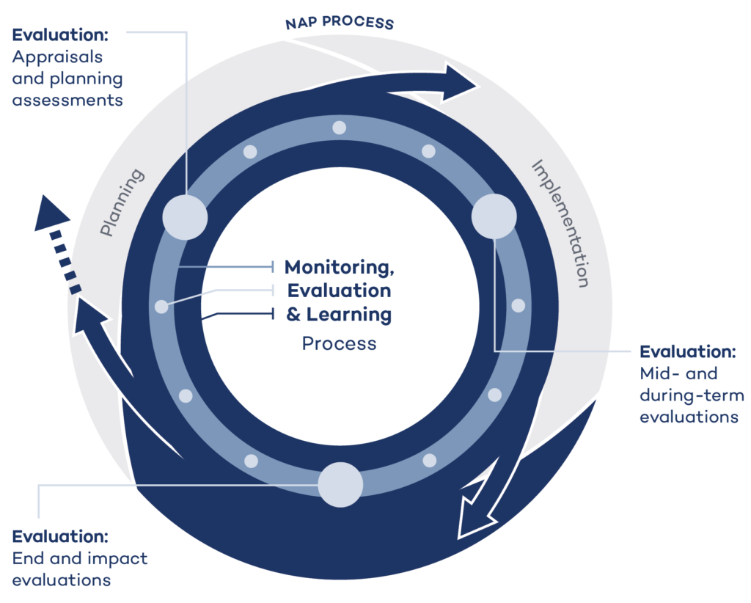
Reframing Monitoring, Evaluation, and Learning in National Adaptation Planning Processes
MEL occurs to both a distinct phase and a dedicated set of activities throughout the adaptation process.
Monitoring and evaluation must be embedded in learning throughout the NAP process
Notes:
We started by Reframing Monitoring, Evaluation, and Learning in National Adaptation Planning Processes
- Going beyond results framework, emphasizing and detailing the Learning aspect – and really re-thinking – you are these MEL systems serving and informing now…? And actually who should they serve/inform…?
By thinking what is the aim of MEL? The development of a MEL system provides a structured and systematic way of thinking about how to integrate MEL activities at different stages of the NAP process, and we really wanted to emphasize three points:
MEL occurs to both a distinct phase and a dedicated set of activities throughout the adaptation process.
Over the past decades, MEL has been overly considered – first as a sideline of key project activities - but the purpose of MEL is much bigger and it’s time to focus on using MEL to fosters transparency and trust between different actors. It promotes mutual accountability–both top-down and bottom-up—by creating spaces for dialogues and exchange on the collection, analysis, and interpretation of evidence.
Monitoring and evaluation must be embedded in learning throughout the NAP process
Ensuring MEL is well integrated in NAP processes means countries can continuously improve and adapt their climate change adaptation strategies to ensure their effectiveness and equity.
Adaptation is a learning process in itself! Without learning, there is no adaptation - and of course here we speak of learning as a result of M&E processes – get to that later – but important to
Caveat that you can learn from other points than just M&E data, activities and processes.
Too often, learning is mentioned as an afterthought or not planned accordingly. This highly limits the influence of MEL processes to improve adaptation outcomes for the most vulnerable communities.
The success of adaptation action depends on their ability to create and share knowledge that supports learning across multiple actors, sectors, and scales of governance to accelerate the implementation of adaptation actions. This is critical as we face unpredictability in the magnitude and frequency of climate impacts and shocks in today’s world.
So we want to emphasize the importance of L and new perspectives of thinking about MEL

Slide 18

What does this mean for a toolkit on MEL?
The toolkit is:
Produced in collaboration with the Adaptation Committee
Going to be an evolving piece of work – with revisions every 2-3 years
Based on consultations with country partners and other stakeholders active in MEL for adaptation
Not reinventing the MEL wheel: focused on presenting comprehensive yet crucial and feasible actions for MEL of adaptation by country actors.
Notes:
Produced in collaboration with the Adaptation Committee – given the NAP guidelines and the development on the GGA, it’s important for us to be anchored in existing processes that countries are following (we’re also the NAP GN, so)
Going to be an evolving piece of work – with revisions every 2-3 years – the toolkit, in its current draft is already 100 pages to cover main elements of MEL, but it’s also going to be updated based on the experience of countries and practitioners… Main audience are countries and NAP team, or national MEL stakeholders, but we recognise – CSOs, consultants, etc.
Based on consultations with country partners and other stakeholders active in MEL for adaptation – this links with my last point that we are not reinventing the wheel – we are pulling several, many many sources of info together trto give a broad pictures- including links and resources: we want this publication to serve as a hub. So we’ve consulted with several other international and national organisations working on MEL of adaptation and sustainable development, on experts academics and of course with some of our great country partners.
Not reinventing the MEL wheel: focused on theory and actions that are crucial and feasible for MEL of adaptation by country actors.
Meaning We also focus on what differentiate MEL for adaptation nationally – and on what is feasible
Based on the above, I want to share three elements that we are highlighting in the toolkit.

Slide 19




Current status: first full draft done
1
2
3
4
Presenting the Toolkit at a COP28 side event to gather further feedback.
Revisions based on the reviews from internal and external peers.
Publication in March 2024!
Development of a self-online directed course over 2024.
The Toolkit will involve ongoing gathering of feedback from implementation, and revisions.

Slide 20

Today we need your views!
Are we missing anything?
Is the structure clear and accessible?
Do you have examples?

Slide 21
A toolkit on MEL targeted for an audience of national adaptation planning teams
Difficult to capture complexity into a linear PDF document!
Common toolkits structures
Monitoring
Monitoring
Evaluation
Learning
Evaluation
Learning

Slide 22
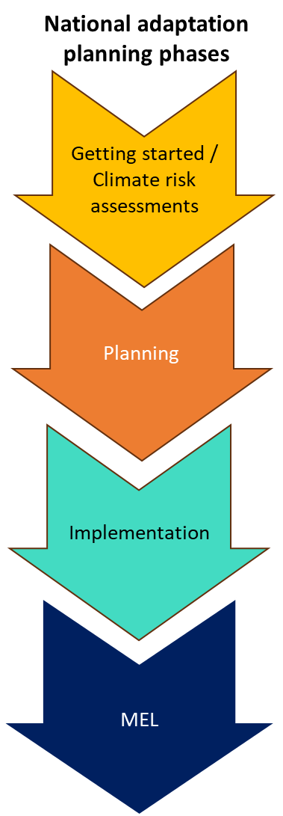
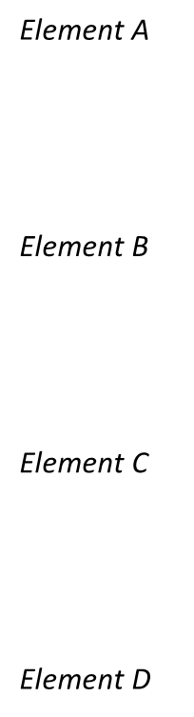
Presenting actions structured according to phases of the national adaptation planning process
Monitoring
Evaluation
Learning

Slide 23
Presenting actions structured according to phases of the national adaptation planning process
Monitoring
Evaluation
Learning
AM1 -Define the purpose of your MEL system
AM2. Link your CRAs and MEL system
AM3. Understanding your enabling factors
AM4. Link with your CRAs
AM5. Connect with the theory of change
AM6. Identify methods and data collection approaches
AM7. Select adaptation indicators
AE1. Evaluation options: prioritization and feasibility assessments
AL1. Commit and plan for learning activities (trainings, workshops, peer exchanges, etc.)
AM8. Collect, analyse and manage the data
AE2. Implement mid-term and formative evaluations
AL2. Communicate continually and creatively
AM9. Ongoing monitoring!
AE3. Conduct an impact or end of programme evaluation
AL3. Progress and other reporting
AL4. Assessing and reviewing your MEL system (MEL of MEL)

Slide 24
Acknowledging critical realities of countries
Countries start working on their MEL systems at different phases of the NAP process… there is rarely nothing in place!
  We provide easy and navigable links between sections for the readers to read according to their starting point(s)
Countries have different levels of capacities and resources
  We provide a comprehensive pictures of what MEL systems can comprise of… countries must contextualise to their priorities and capacities – not all compulsory!
  We provide many examples and case studies to make the theory closer to realities, and encourage peer learning

Slide 25
Presenting actions structured according to phases of the national adaptation planning process
Monitoring
Evaluation
Learning
AM1 -Define the purpose of your MEL system
AM2. Link your CRAs and MEL system
AM3. Understanding your enabling factors
AM4. Link with your CRAs
AM5. Connect with the theory of change
AM6. Identify methods and data collection approaches
AM7. Select adaptation indicators
AE1. Evaluation options: prioritization and feasibility assessments
AL1. Commit and plan for learning activities (trainings, workshops, peer exchanges, etc.)
Read by NAP phase (comprehensive view)
AM8. Collect, analyse and manage the data
AE2. Implement mid-term and formative evaluations
AL2. Communicate continually and creatively
AM9. Ongoing monitoring!
AE3. Conduct an impact or end of programme evaluation
AL3. Progress and other reporting
AL4. Assessing and reviewing your MEL system (MEL of MEL)

Slide 26
Presenting actions structured according to phases of the national adaptation planning process
Monitoring
Evaluation
Learning
AM1 -Define the purpose of your MEL system
AM2. Link your CRAs and MEL system
AM3. Understanding your enabling factors
AM4. Link with your CRAs
Read by action type
(order for monitoring,
evaluation and
learning actions)
AM5. Connect with the theory of change
AM6. Identify methods and data collection approaches
AM7. Select adaptation indicators
AE1. Evaluation options: prioritization and feasibility assessments
AL1. Commit and plan for learning activities (trainings, workshops, peer exchanges, etc.)
AM8. Collect, analyse and manage the data
AE2. Implement mid-term and formative evaluations
AL2. Communicate continually and creatively
You start work on your MEL systems at implementation stage…
AM9. Ongoing monitoring!
AE3. Conduct an impact or end of programme evaluation
AL3. Progress and other reporting
AL4. Assessing and reviewing your MEL system (MEL of MEL)

Slide 27
Today we need your views!
Are we missing anything?
Is the structure clear and accessible?
Do you have examples?
Two moderated breakout groups
25 minutes – GO!
And please keep in touch: ebeauchamp@iisd.org

Slide 28
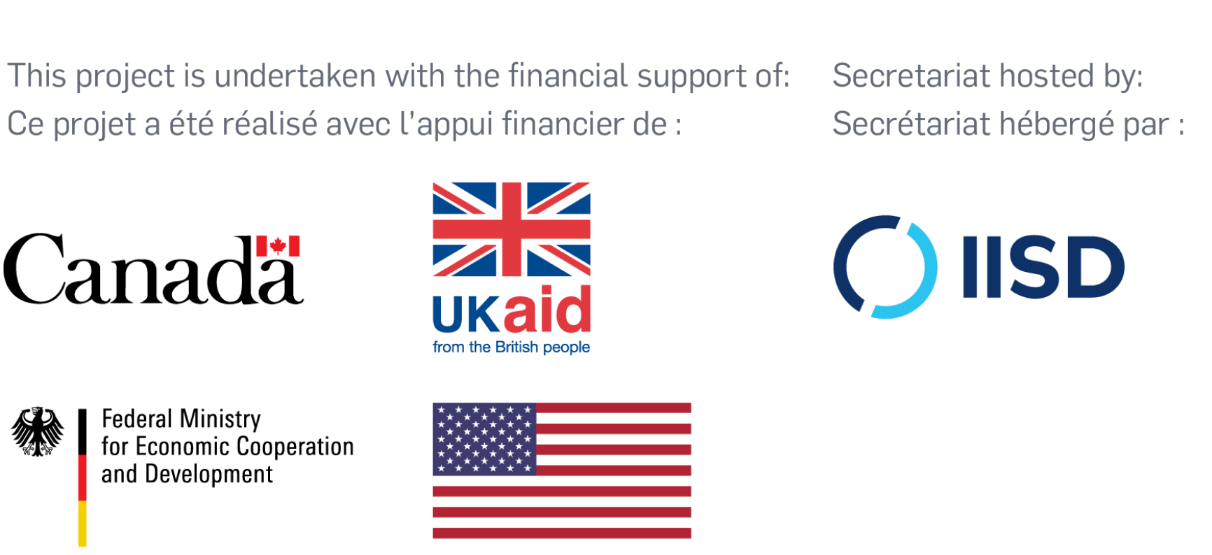


Thank you!
Email:
Emilie Beauchamp
ebeauchamp@iisd.org
Website:
www.napglobalnetwork.org
@NAP_Network
NAP Global Network

Slide 29

Stay in touch on the MEL toolkit
https://bit.ly/MEL-Toolkit-Updates

