Slide 1











CB FRIENDS: OPENING OF THE 7TH CAPACITY-BUILDING HUB
7th Capacity-building Hub
12th November 2025
12:00-13:00 GMT-3
7th

Slide 2

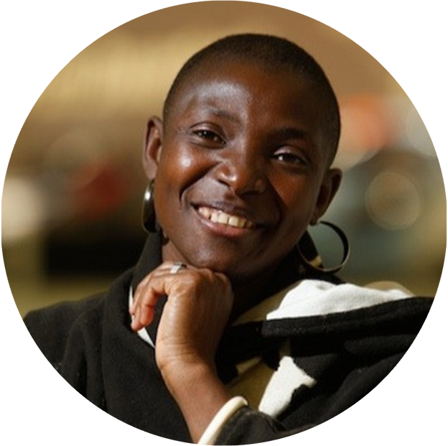
OPENING OF THE 7TH CAPACITY-BUILDING HUB
OPENING
H.R.H Princess Abze Digma
PCCB Co-Chair

Slide 3
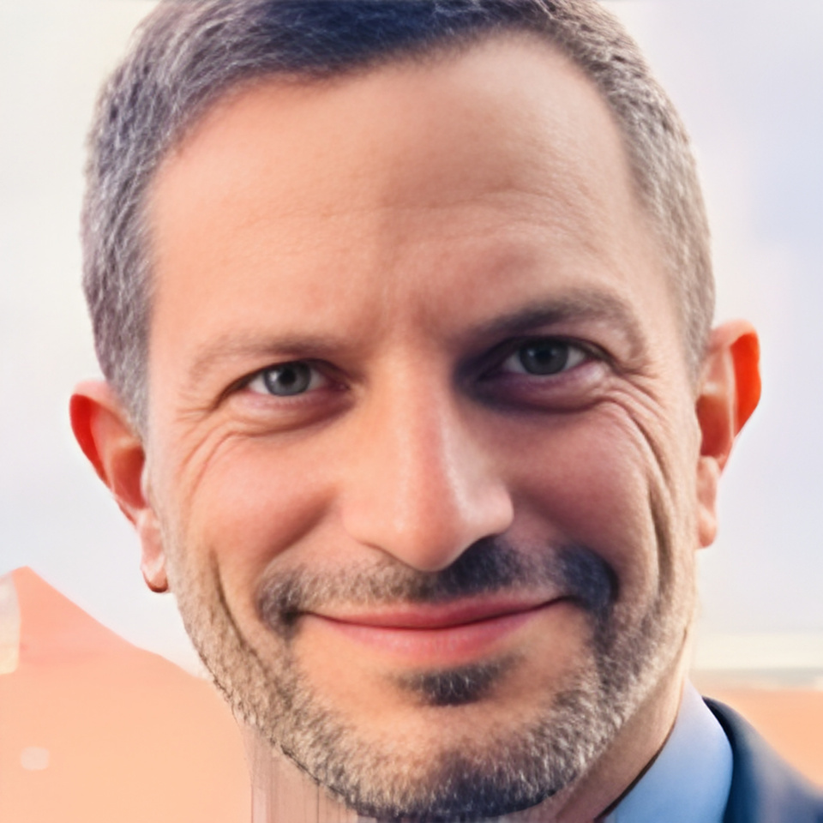
OPENING OF THE 7TH CAPACITY-BUILDING HUB
OPENING
Daniel Leitão
COP30 Presidency Focal Point for Observer Engagement

Slide 4
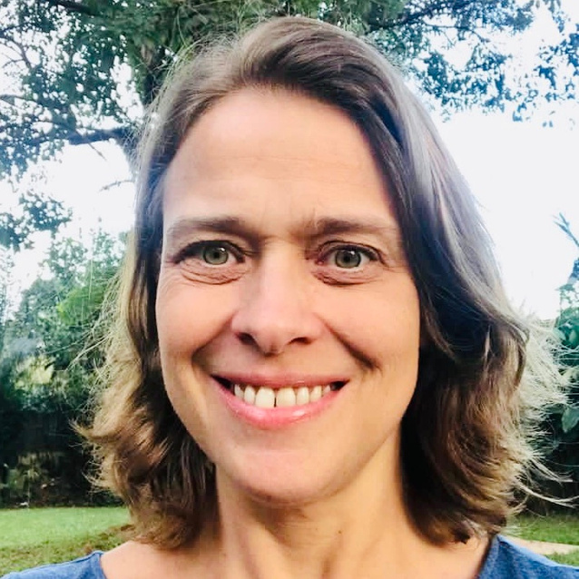
OPENING OF THE 7TH CAPACITY-BUILDING HUB
OPENING
Sophie de Coninck
Director
UNFCCC MOI Division

Slide 5


7th

Slide 6
OPENING OF THE 7TH CAPACITY-BUILDING HUB
OVERVIEW
12 Nov.
15 Nov.
17 Nov.
18 Nov.
19 Nov.
20 Nov.

Slide 7
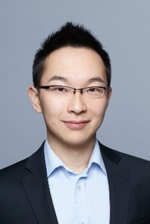
CAPACITIES FOR ENERGY TRANSITION DAY
Longfei Li
Senior Manager
GEIDCO
15 NOV.

Slide 8
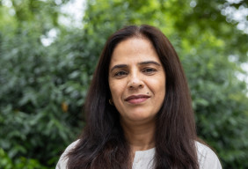
FOCUS ON FINANCE DAY
Khalida Bashir
PCCB Member
17 NOV.

Slide 9
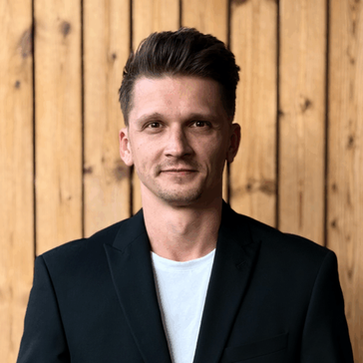
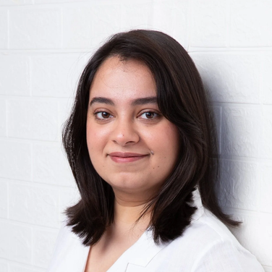
CULTURAL HERITAGE AND ARTS DAY
Daniel Cervenka
Founder
The Convergence
Gunjan Nanda
18 NOV.
Co-Founder
Entertainment + Culture Pavilion

Slide 10
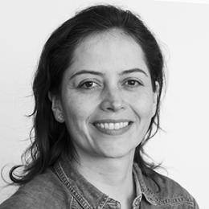
CAPACITIES FOR THE FUTURE DAY
Andrea Ramirez
Senior Researcher
UNU EHS
19 NOV.

Slide 11

NATURE-BASED SOLUTIONS DAY
20 NOV.

Slide 12
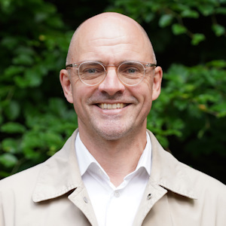
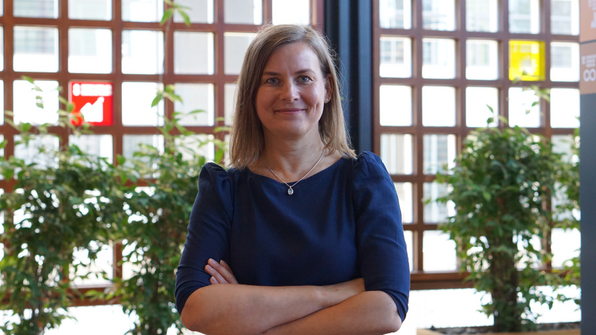
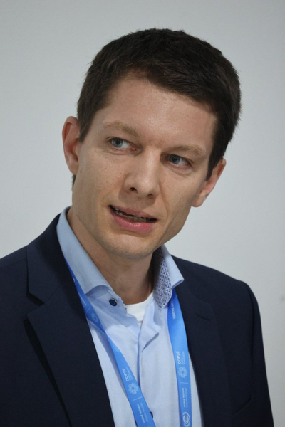
OPENING OF THE 7TH CAPACITY-BUILDING HUB
Rogier van den Berg
Global Director for WRI Ross Center for Sustainable Cities
Simone Sandholz
Head of Urban Futures & Sustainability Transformation Programme at UNU-EHS
Lutz Morgenstern
International Climate Initiative (IKI), BMUKN)

Slide 13

FULL CB HUB PROGRAMME
12-20 November 2025
7th
12 Nov.
15 Nov.
17 Nov.
18 Nov.
19 Nov.
20 Nov.

Slide 14
OPENING OF THE 7TH CAPACITY-BUILDING HUB
CLOSING
H.R.H Princess Abze Digma
PCCB Co-Chair

Slide 15
7th

