Slide 1



Session 4: Identifying needs and challenges, and opportunities for action and collaboration in relation to adaptation monitoring, evaluation and learning
Emilie Beauchamp, Lead on MEL for adaptation
NAP Global Network / IISD
Adaptation Forum - March 19th 2024

Slide 2

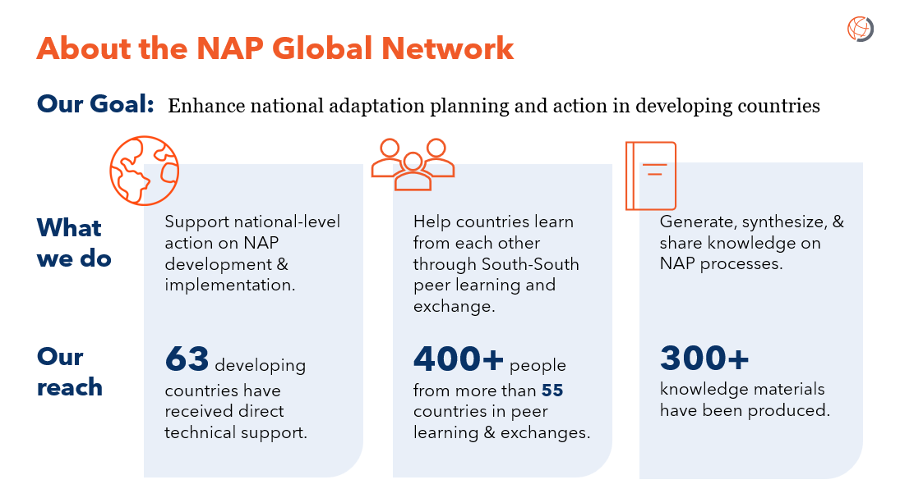

Emilie Beauchamp
Lead, MEL for Adaptation
NAP Global Network, IISD

Slide 3

Agenda
1. The UNFCCC framing for MEL – in line with the UAE Framework for Global Climate Resilience (FGCR)
What are challenges – for countries?
What are good practices – for countries?
What are opportunities - for countries and globally?

Slide 4
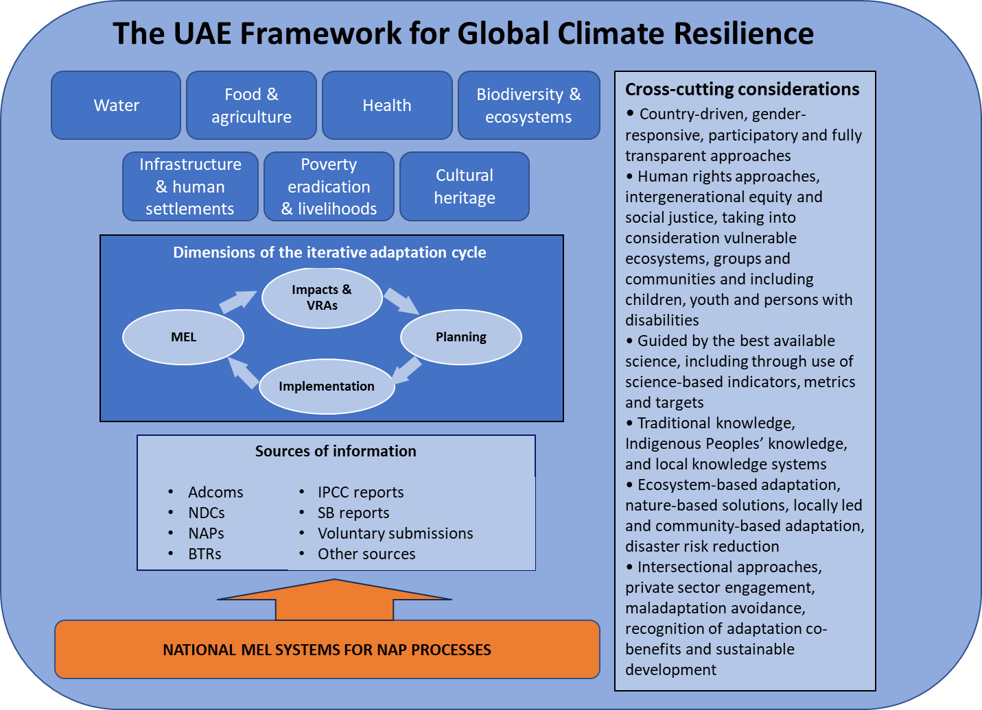
The recent UAE Framework for Global Climate Resilience gives us incentives and framings for assessing adaptation progress – through MEL systems

Slide 5
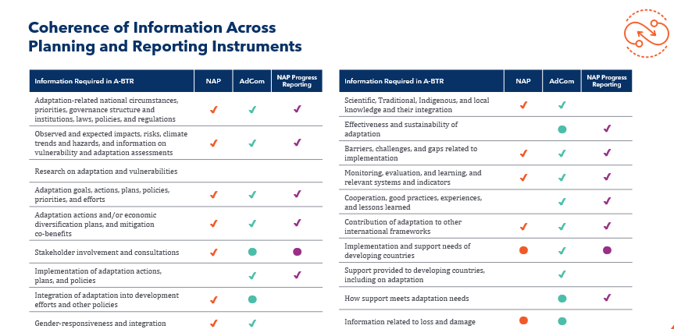
The Enhanced Transparency Framework and the UNFCCC provide
There are a variety of planning, communicating and reporting instruments – which serve as sources of information for the UAE FGCR: NDCs, NAPs, Adcoms, National Communications, BTRs, other national progress reports
This means reporting burden on countries should be reduced…
… yet without national MEL systems for NAP processes (including reporting governance) countries can difficulty organize to use and provide this information locally, nationally and globally.

Slide 6
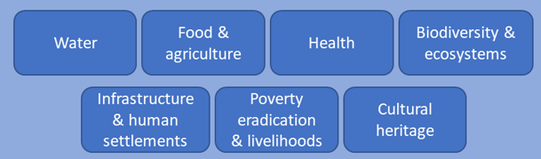
Challenge(s): MEL systems for adaptation must be contextual and nationally / locally owned to be effective
You cannot copy/paste a MEL system from a country to the other, nor apply top-down indicators without contextualization.
Countries must follow the iterative adaptation cycle to identify which priorities, sectors, actions – which their MEL system must track and assess
  E.g. Fiji’s cross-referencing adaptation and SDGs
Resources for MEL of adaptation actions and processes are not budgeted proportionally to achieve the goal of learning from M&E, and improving adaptation decisions
Complexity (and lack of resources) in integrating gender responsive and socially inclusive views, priorities, and groups in MEL processes.
Dimensions of the iterative adaptation cycle
Impacts & VRAs
MEL
Planning
Implementation
Dimensions and themes… where to start?
Notes:
When thinking of propositions for the GGA, the international community and UNFCCC parties themselves could benefit by taking stock internally of the priorities and actions that parties have already communicated rather than looking outward to examples of frameworks that could be replicated. For example, Fiji developed a catalogue of adaptation measures with relevant tags to cross-reference different sustainable development policies and agendas as part of their NAP.

Slide 7
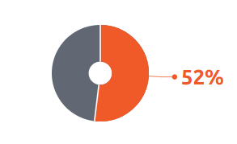
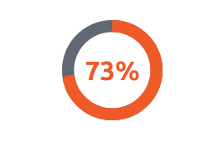
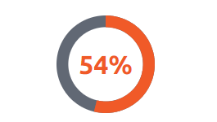

What is the status of MEL across NAP documents to date?
trends.napglobalnetwork.org
% of NAPs with monitoring, evaluation & learning (MEL) frameworks
% of NAPs with commitment to progress reporting
% of NAPs with adaptation indicators defined
Notes:
Currently

Slide 8
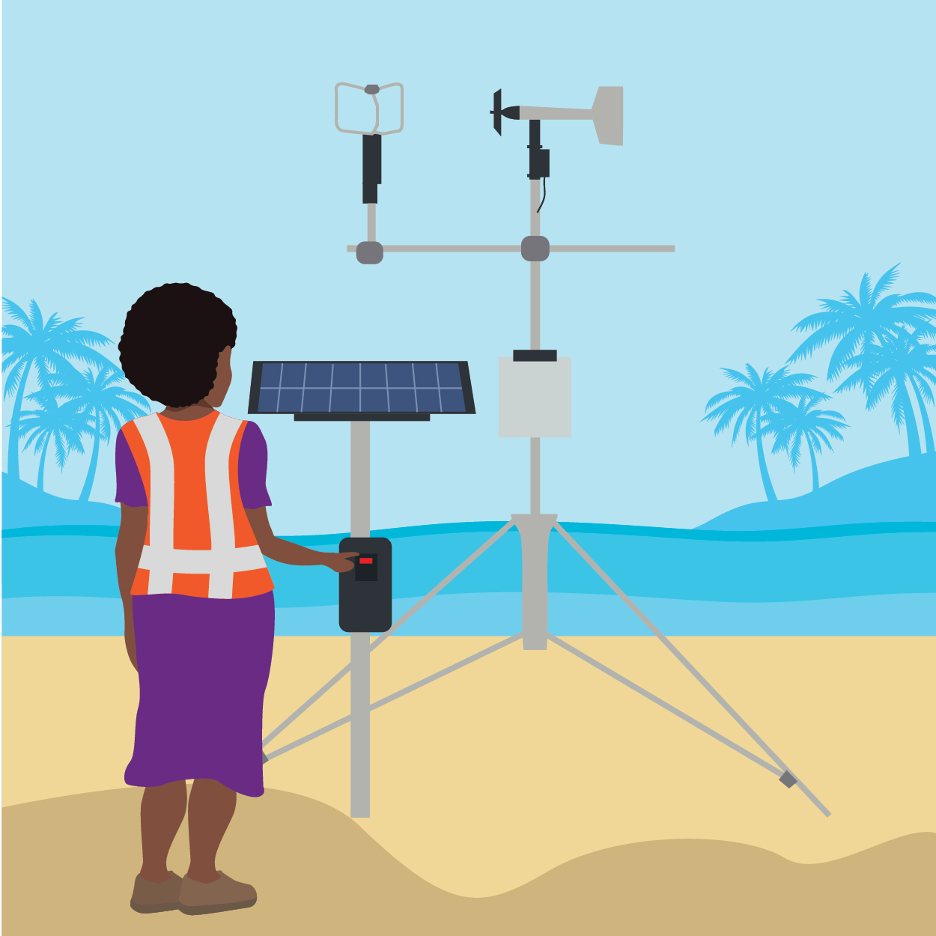
Good practices: Exchanges should focus on the process of developing & implementing M-E-L
All countries have some data on adaptation. All countries are continuously improving their MEL systems for adaptation. All countries nonetheless struggle to collate, coordinate, analyze, report, and learn….
Using a phased approach(es) - whether regional, sectoral, vertically integrated, time bound.
Start small, pilot, scale up.
Start planning and implementing your MEL system from the onset of your adaptation planning.
Budget MEL as an activity as part of your NAP processes, not as an aside. Your MEL system must go beyond project or strategy time frames to assess outcomes and impacts.

Slide 9
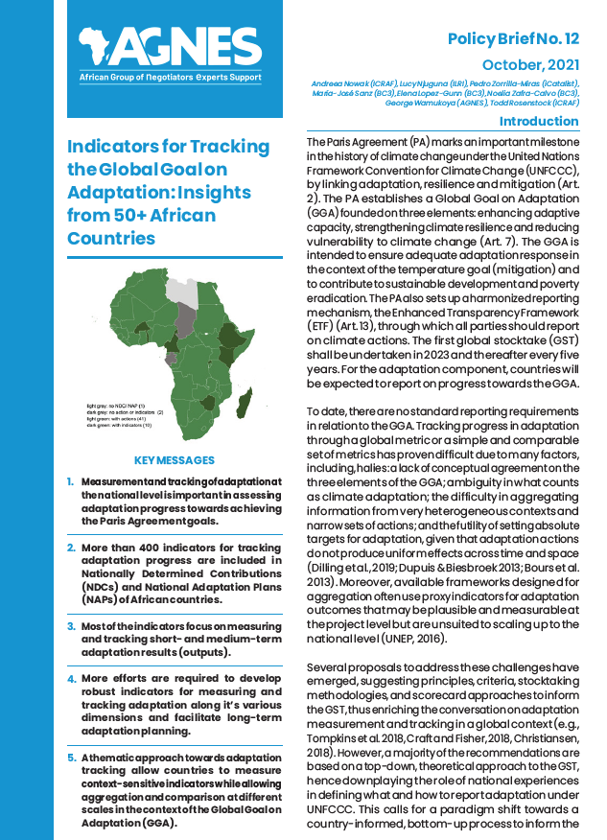
Opportunities: Exchanges should focus on the process of developing & implementing M-E-L
A variety of learning-oriented activities are needed to support countries in developing, implementing and strengthening MEL systems.
Focus on sharing how rather than what: overfocusing on compiling indicators does not share applicable knowledge; countries need support to develop and contextualize their own systems.
There is a need to increase understanding of Evaluations and Learning vs. monitoring.
Peer-to-peer learning that builds partnerships between countries, and between actors within countries, are critical to set new relationships, trust – and sharing data.
  E.g.: learning cohorts, group peer learning, 1:1 as part of the NAP Global Network
Alignment, integration and reviews with other global frameworks (Sendai, SDGs, CBD)…
“More than 400 indicators for tracking adaptation progress are included in Nationally Determined Contributions (NDCs) and National Adaptation Plans (NAPs) of African countries.”
Nowok et al,. 2021. https://agnes-africa.org/wp-content/uploads/2021/10/Policy-brief-12_Indicators_for_tracking_the_Global_-Goal_on_Adaptation_insights_from_50_African_countries_07102021.pdf

Slide 10

Opportunities: for global learning and sharing
Several opportunities in the next years to support MEL systems in countries – which are the building blocks for global MEL and evidence.
The review of the LEG’s Technical Guidelines for NAP Process – in line with Decision 2/CMA5
Mandates and invitations for the AC, LEG, and CGE to provide support and guidance for MEL – to support the UAE FGCR
Biennial Transparency Report deadline – countries can start putting together progress reports
  E.g.: learning cohorts, group peer learning, 1:1 as part of the NAP Global Network
Ongoing work of the AC (and other bodies) on M&E and MEL
  E.g.: forthcoming Toolkit on MEL for NAP processes (publication April 2024)
Tune in for the NAP Global Network’s webinar on “FAQs on A-BTRs”
Wednesday 20th March
13h00 GMT

Slide 11

- WHAT do you want to learn more specifically about MEL systems for adaptation?
- HOW do you want to learn (what modality)?
Thank you!
Emilie
ebeauchamp@iisd.org

Slide 12




Thank you!
Email:
info@napglobalnetwork.org
Website:
www.napglobalnetwork.org
@NAP_Network
NAP Global Network

