Slide 1




18-19 March 2024
Monitoring and evaluation systems at the national and subnational level
ADAPTATION FORUM 2024
Adaptation Committee
Notes:
Thank you. I will present some of the findings from our recent Technical paper on monitoring and evaluation of adaptation at the national and subnational level, which was published last October.

Slide 2


The UAE Framework for Global Climate Resilience –
Target on monitoring, evaluation and learning
By 2030 all Parties have designed, established and operationalized a system for monitoring, evaluation and learning for their national adaptation efforts and have built the required institutional capacity to fully implement the system
Notes:
Before we turn to the paper, let’s recall the target related to monitoring, evaluation and learning included in the UAE Framework, as this will be the key reference point for our discussions in the breakout groups this afternoon.
It aims at ensuring all countries have designed, established and operationalized a system for monitoring, evaluation and learning for their national adaptation efforts. In addition, by 2030, all have built the required institutional capacity to fully implement the system.
While the technical paper that I will present was published before this target was set, its findings offer some valuable insights into the challenges on the path towards meeting this target, as well as some important opportunities that we should harness.

Slide 3

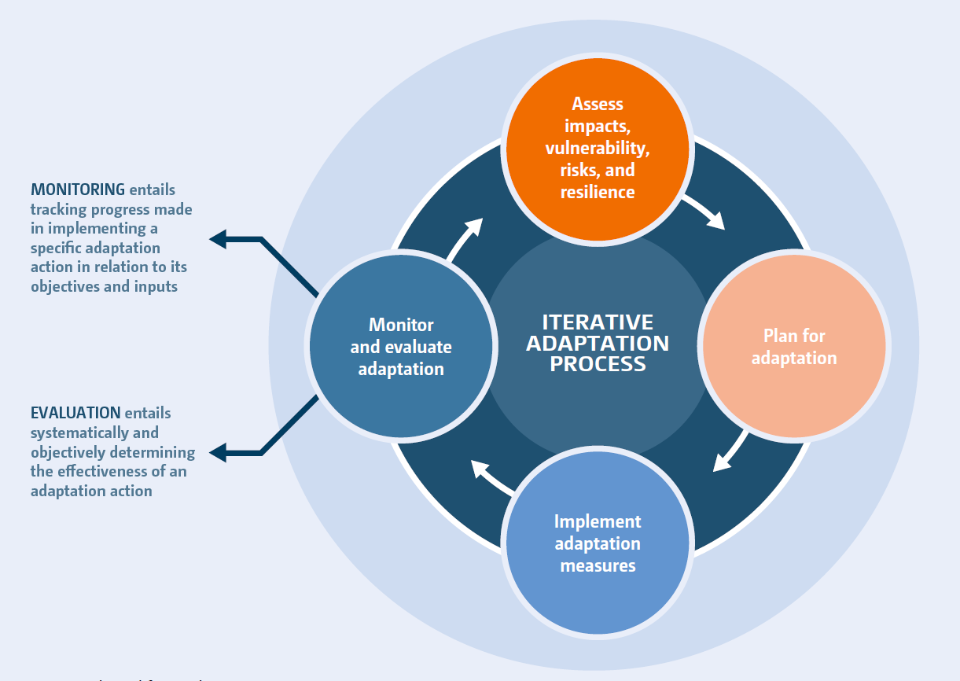

The importance of monitoring and evaluation
Notes:
Now, let’s turn to the paper itself. It begins with an overview of M&E for adaptation.
The importance of M&E for adaptation is clear; it is a core part of the adaptation cycle. It is also enshrined in Article 7.9 of the Paris Agreement, and highlighted by the IPCC as “a prerequisite for successful iterative risk management and achieving effective and just adaptation outcomes.”
This has been recognized by the Adaptation Committee since its inception. Monitoring and evaluation was part of the very first workplan of the AC, and continues to be a core part of our technical work.
Progress on M&E continues, however, to be slow at both the national and subnational level.
This is, in part, due to a range of challenges that complicate adaptation M&E. These challenges were discussed in depth in our paper on the global goal on adaptation; they include, for example, methodological, empirical, and conceptual challenges, as well as capacity constraints and resource limitations.

Slide 4
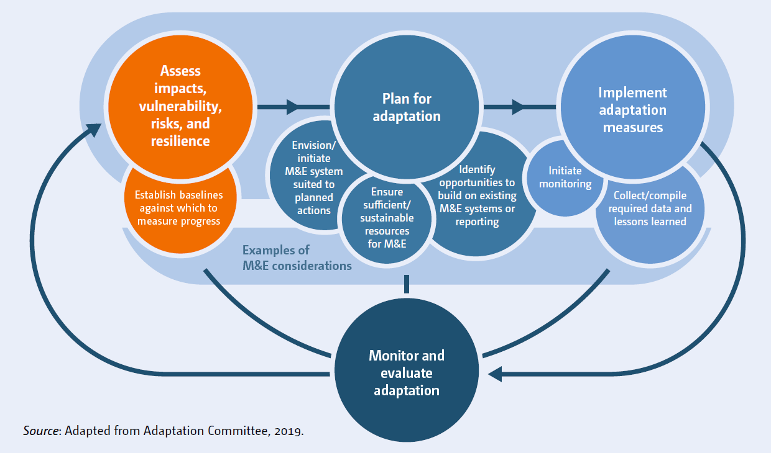
Monitoring and evaluation in the adaptation process
Notes:
The paper stresses that, while represented as the fourth step in the iterative adaptation process, adaptation monitoring and evaluation should be taken into consideration and facilitated at each and every step of this cycle.
Assessing impacts, vulnerability, risks, and resilience, for example, can set the stage for M&E by establishing baselines against which to measure progress.
There are several relevant considerations at the adaptation planning stage, including that it provides the opportunity to envision and initiate an M&E system suitable for the set of actions included in the plan.
Finally, implementation should signal the beginning of the monitoring half of the M&E equation. It is also important that data and lessons learned needed to enable evaluation are diligently collected and compiled throughout the implementation stage

Slide 5
Developing and applying monitoring and evaluation systems at the national level:
Key findings
Notes:
The paper is centered around a set of ten case studies, five of which are at the national level and five at the sub-national level.
The case studies have been chosen with the aim of ensuring a regional balance and showcase a variety of experiences, in order to gain some insights into the global state of adaptation M&E. These case studies help to demonstrate examples of how the different challenges identified manifest and are being overcome by governments in different jurisdictions.
At the national level, the case studies that feature in the paper include Burkina Faso, Finland, Panama, Tonga, and Vietnam.

Slide 6



National level findings: challenges
Weak data management and difficulty with institutional coordination
Inadequate financial, capacity-building, and technology transfer support
Designed systems prove too difficult to implement in practice
Notes:
Examples of challenges at the national include:
Weak data management and difficulty with institutional coordination.
Inadequate financial, capacity-building, and technology transfer support
Systems that are designed or envisioned in adaptation plans and policies prove too difficult to implement in practice

Slide 7




National level findings: opportunities and trends
Support for developing countries is often instrumental
Alignment with international commitments and reporting systems
Various countries prioritizing initiating M&E as soon as possible over building perfect/robust systems
Several options and approaches for engaging stakeholders throughout the M&E process
Notes:
Examples of opportunities and trends include:
Support for developing countries through different funds and initiatives is often instrumental in making progress on M&E.
Alignment with international commitments and reporting systems, including the enhanced transparency framework, is a key opportunity for countries currently developing or updating their M&E systems. In doing so, countries can both generate information that can be used domestically to enhance adaptation, but also feed into the national documents and reports that they produce for the UNFCCC and other associated frameworks. This aspect is also relevant to the AC’s new mandate in relation to improving reporting on adaptation action and progress.
Various countries are initiating M&E as soon as possible rather than trying to build perfect or robust systems from the start. Examples include selecting indicators based on existing data and methodologies; undertaking evaluations with simplified methodologies; and moving ahead with evaluations in the absence of complete indicator data. This is consistent with the idea of M&E is an iterative process that can become increasingly sophisticated over time, and it reflects the urgency of undertaking adaptation M&E.
Finally, there are options for engaging various stakeholders throughout the entire M&E process, from development to application. This helps to ensure the feasibility of proposed indicators or mechanisms, as well as the comprehensiveness and accuracy of captured information.

Slide 8
Developing and applying monitoring and evaluation systems at the sub-national
level: Key findings
Notes:
At the sub-national level, the paper looks at both cities and provinces, once again maintaining a regional balance.
The case studies that are included in the paper include Barcelona, British Columbia, Buenos Aires, Lagos, and Mumbai.

Slide 9



Sub-national level findings: challenges
Need for dedicated institutional structures at the sub-national level
Lack of awareness of the importance of M&E at the local level
Inadequate financial resources
Notes:
The case studies chosen at the sub-national level have likewise generated valuable insights.
Examples of challenges include:
The need for dedicated institutional structures for M&E at the sub-national level. These help ensure that the responsibility of M&E is not simply absorbed into the responsibilities of existing staff and institutions, and that comprehensive monitoring, reporting and evaluation is routinely carried out.
There is often a lack of awareness of the importance of M&E and slow uptake of adaptation M&E frameworks at the local level. This, in turn, constrains the potential for climate resilient development pathways.
As with M&E and adaptation more broadly, inadequate financial resources can pose a challenge.

Slide 10



Sub-national level findings: opportunities and trends
Potential for complementarities between sub-national and national level M&E
Sectoral, non-climate specific systems and indicators can guide sub-national efforts
Inclusion of an active learning system can help generate a constant feedback loop of lessons learned
Notes:
Examples of opportunities and trends include:
There is potential for complementarities between M&E at the sub-national and national levels. Sub-national governments can often use and learn from existing national M&E systems. Likewise, piloting M&E systems at the sub-national level is helpful for national governments, who can use these as tests to then scale up to the national level.
Sectoral, non-climate specific indicators and systems can guide sub-national efforts. Using "pre-tested and accepted" sectoral indicators can make M&E at the sub-national level easier and help to avoid duplication.
Inclusion of an active learning system can help generate a constant feedback loop of lessons learned. It is essential that M&E is an iterative process which continues to integrate lessons learned back into the system. Actively including such a function within the M&E system can therefore help ensure both thorough evaluation and constant improvement.

Slide 11
Observations, insights, and
recommendations
Notes:
Let’s finally turn to some of the observations, insights, and recommendations that the paper offers based on the analysis.

Slide 12
Observations and insights
Indicators commonly central components of M&E systems – advantages are clear but important to carefully consider role and selection
Tension between establishing systems that yield best possible understanding of adaptation vs. those that are feasible in the near-term
Various opportunities to work towards more ambitious and innovative practices over time
Notes:
First, both the case studies and the existing literature demonstrate that indicators are commonly developed as central components of M&E systems at the national and sub-national level.
While the appeal and advantages of indicators are clear – for example, they enable measurement of variables relevant to adaptation and facilitate the tracking of progress over time – it is important to carefully consider the role and selection of indicators.
Expectations surrounding what indicators can and cannot do are not always realistic.
Second, there is a tension in the M&E of adaptation between establishing a process that results in the best possible understanding of adaptation progress and one that is feasible in the near-term.
A common pattern is governments elaborating ambitious M&E plans, then implementing more limited approaches due to capacity, resource, or methodological or other constraints.
Often, these more limited approaches are focused more on assessing the process of adaptation rather than its outcomes.
Finally, while governments may choose more pragmatic approaches in the near-term, there are also various opportunities to work towards more innovative and ambitious systems over time.
This may include, for example, field testing new approaches to M&E.

Slide 13
Recommendations
Governments should design and implement the most robust M&E systems that are feasible while also seeking to improve the sophistication over time.
Multilateral funds and agencies supporting adaptation projects and programmes should align their M&E efforts with the broader M&E systems at the national or subnational level, and provide technical and financial support for their development and application.
Notes:
Finally, I’ll share the recommendations included in the paper.
National and subnational governments should design and implement the most robust M&E systems that are feasible given their data, capacity, and resources, while also seeking to improve the sophistication and comprehensiveness of these systems over time.
This may involve starting with systems that focus on the process and outputs of adaptation action, and then incorporating more indicators and methods to measure the long-term impact of adaptation.
Multilateral funds and agencies supporting adaptation should align their M&E efforts with the broader M&E systems at the national or subnational level, and provide technical and financial support for their development and application.
This can help ensure that support provided is holistic, extending beyond project or programme boundaries to enhance systematic adaptation efforts, and that additional reporting or monitoring burdens are avoided.

Slide 14
Recommendations
Subnational and national governments can benefit from aligning with existing M&E systems and reporting obligations or processes at different levels of governance.
Notes:
Third, Subnational and national governments can benefit from aligning with existing M&E systems and reporting obligations or processes at different levels of governance.
For example, national-level systems can build on subnational systems while also helping to generate information required for reporting and communications efforts under the UNFCCC and other international fora. This can reduce burdens associated with M&E and reporting as well as enhance the quality and transparency of the information communicated at the international level. This information can inform processes such as the global stocktake.

Slide 15



Conclusion and next steps
Download the paper here:
https://bit.ly/AC-ME23
Notes:
The AC will consider opportunities for new work on monitoring and evaluation in our upcoming workplan for 2025-2027, which we will develop this year. In doing so, we will take into account discussions at this Forum.
In addition, we are actively working on a toolkit for monitoring, evaluation and learning with the NAP Global Network, who we will hear from next.
Thank you.

