Slide 1
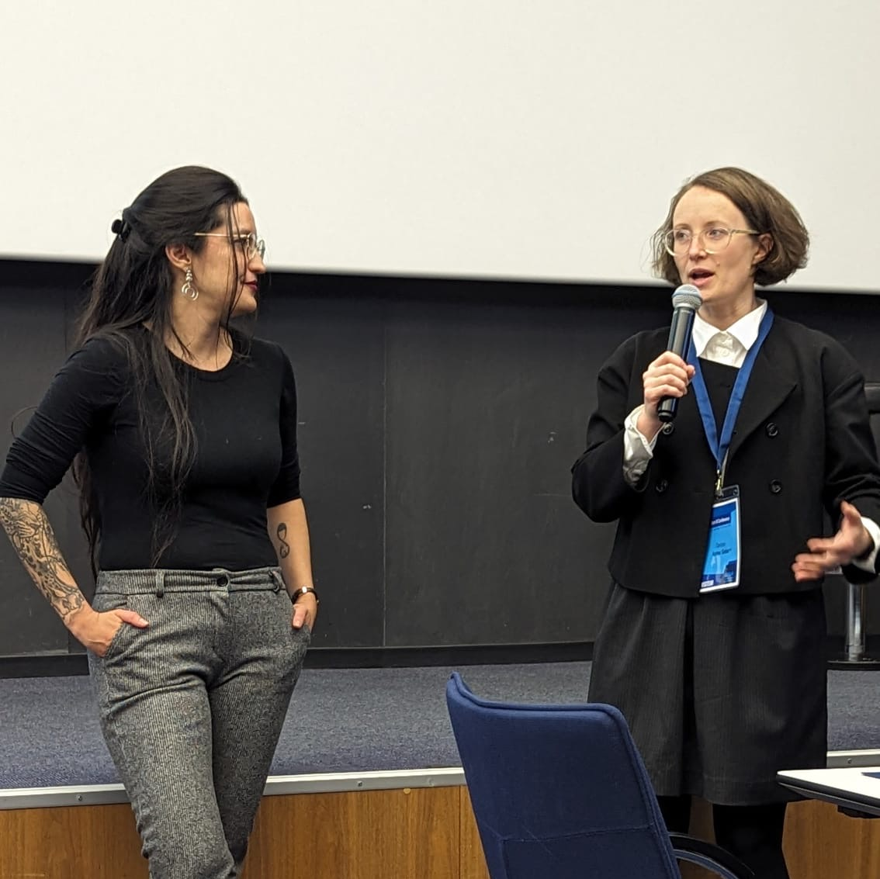
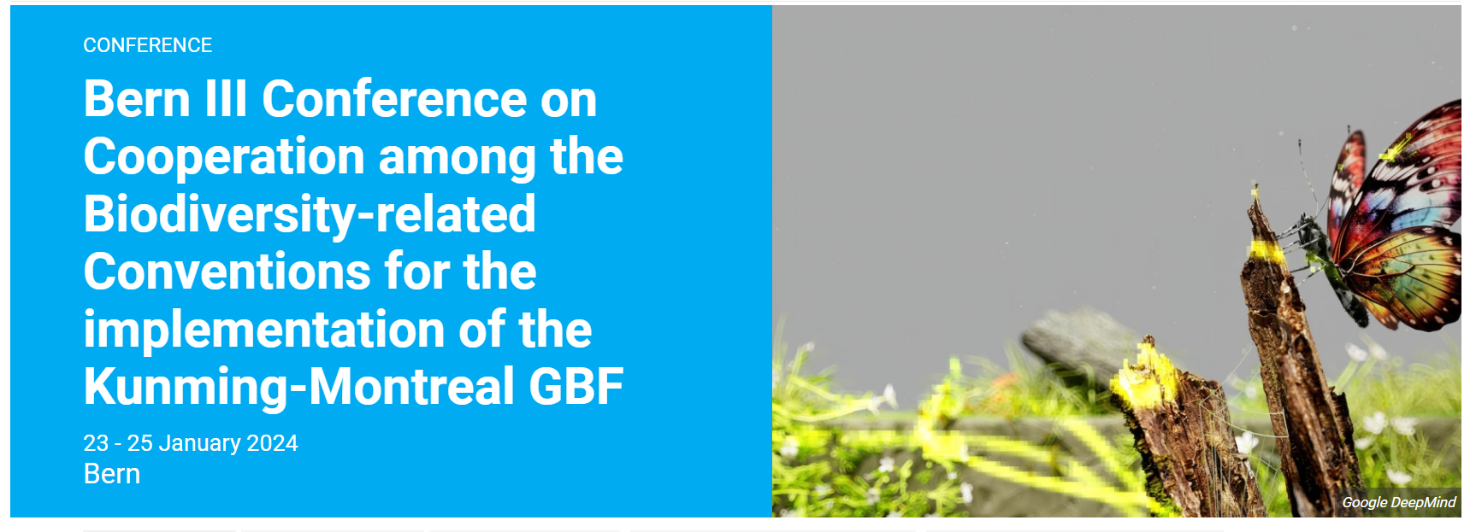
A presentation for Adaptation Forum 2024 on
Outcomes of the Bern Conference relevant to adaptation and experiences to implement the Kunming–Montreal Global Biodiversity Framework
Bern Conference co-chairs Clarisse Kehler Siebert and Camila Zepeda Lizama
19 March 2024
Bern III Con

Slide 2
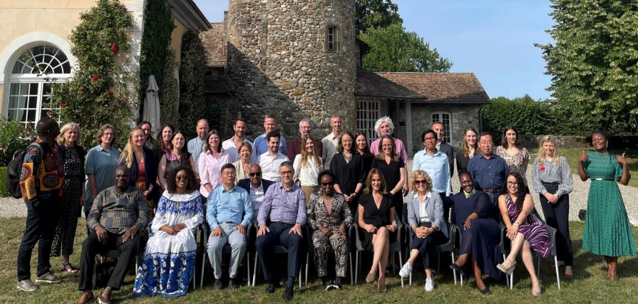
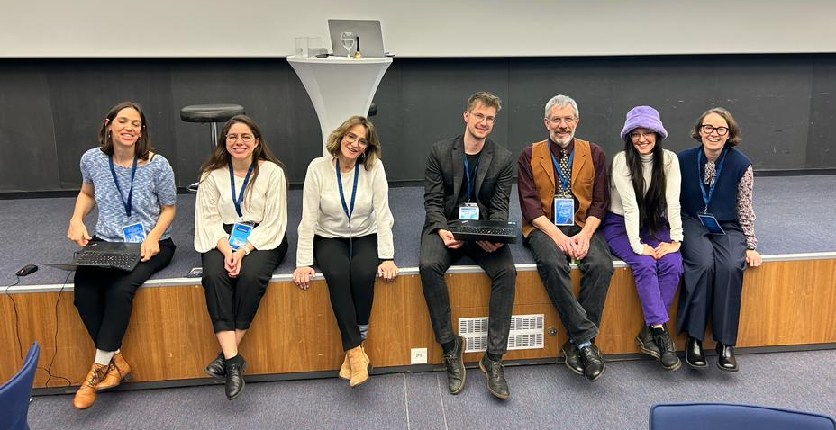
What is the Bern Process?
ITPGRFA GB resolution 13/2022 on cooperation with the CBD:
(International Treaty on Plant Genetic Resources for Food and Agriculture)
“Invites the United Nations Environment Programme to build on the Bern Process and continue to strengthen cooperation and coordination among biodiversity-related conventions contributing to effective and efficient implementation of the Post-2020 GBF, when adopted, by facilitating the process for cooperation among Parties to the relevant biodiversity-related conventions;” (Paragraph 19)
(emphasis added)
CBD COP decision 15/13 on cooperation with other conventions and international organizations:
“Invites the United Nations Environment Programme to build on the Bern Process and continue to strengthen cooperation and collaboration among biodiversity-related conventions, contributing to effective and efficient implementation of the Kunming-Montreal Global Biodiversity Framework by facilitating a process for cooperation among Parties to the relevant biodiversity-related conventions;” (Paragraph 13)
(emphasis added)
Minamata Convention COP decision MC-5/17 on Mercury and the Kunming-Montreal Global Biodiversity Framework
“Welcomes the “Bern meetings” initiated by Switzerland to support synergies between relevant Multilateral environmental agreements, including the Minamata Convention;” (Paragraph 3) (emphasis added)
Ramsar COP resolution XIV/26 on enhancing the Convention’s visibility and synergies with other MEAs and international institutions:
“Invites UNEP to build on the Bern Process and continue to strengthen cooperation and coordination among biodiversity-related Conventions contributing to effective and efficient implementation of the post-2020 Bern III Conference, 23-25 January 2024 December 18, 2023 Global Biodiversity Framework, when adopted, by facilitating the… (emphasis added)

Slide 3

Bern III Conference
Conference aims:
  Identify opportunities & make recommendations to strengthen collaboration among Parties to implement the Kunming-Montreal Global Biodiversity Framework at all levels
  Share practical experience of cooperation and collaboration among MEAs in addressing biodiversity and other environmental challenges
  Foster a community of “synergy champions” committed to working across conventions to solve environmental issues holistically

Slide 4

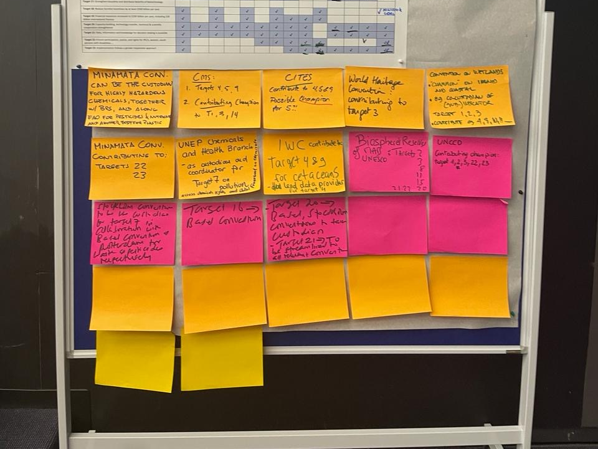
Who?
Parties and Secretariats from 16 MEAs
→ including biodiv. and chemicals conventions, UNCCD, UNFCCC

Slide 5

Kunming-Montreal Global Biodiversity Framework - Vision, Mission, Goals and Targets
Current
2030
2050
t
Mission : To take urgent action to halt and reverse biodiversity loss to put nature on a path to recovery for the benefit of people and planet by conserving and sustainably using biodiversity and ensuring the fair and equitable sharing of benefits from the use of genetic resources, while providing the necessary means of implementation.
2030 Action Targets
2050 Goals
Direct drivers
People’s Needs
9. Species
10. Sustainable ecosystems
11. Regulating ecosystem services
12. Urban ecosystems
13. Access Benefit Sharing
2050
Vision
Living in Harmony with Nature
Reducing Threats
Plan & Retain
Restore
Protect & Conserve (30x30)
Species
Harvest & Trade
Invasive alien species
Pollution
Climate
A. Ecosystems, Species & Genetic diversity
Land/sea use change
Direct exploitation
B.
Sustainable use/ Meeting human needs
Tools & Solutions
14. Government actions
15. Business actions
16. Citizens actions
17. Biosafety and risks
18. Subventions and incentives
19. Increase resources
20. Capacity building
21. Information, ILK & data
22. Engagement
23. Gender
Indirect drivers
Climate change
C.
Equitable sharing of benefits
Pollution
Section C: Implementation guidance
…rights, Indigenous Peoples, Gender, Other value systems…
D.
Means of implementation
Invasive species
Supporting implementation
Decision 15/5: Monitoring Framework & Indicators
Decision 15/6: Mechanisms for planning, monitoring, reporting and review
Decision 15/7: Resource mobilization
Decision 15/8: Capacity building and cooperation
Decision 15/9: Digital sequence information on genetic resources

Slide 6
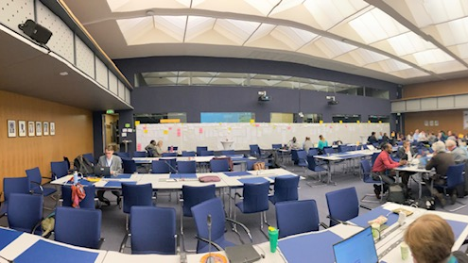
Some of the key recommendations/ What next?
  Encourage Bern process ‘equivalent’ at national level
  Formalise “coalitions”, “custodians” or “champions” among MEAs for individual targets
  Use the ‘golden opportunity’ of the Rio convention COPs in 2024 to recommit to collaboration & joint activities, re-activation of JLG
  Increase reporting alignment, integrated monitoring & assessment
  Keep Bern III dynamic, spirit, and network alive
  Processes – UNEA-6, Global Adaptation Forum

Slide 7
Monitoring Framework for the GBF
CBD Parties must report progress in implementing the GBF using mandatory indicators
  - GBF T8 : Minimize the impact of climate change and ocean acidification on biodiversity and increase its resilience through mitigation, adaptation, and disaster risk reduction actions, including through nature-based solution and/or ecosystem-based approaches, while minimizing negative and fostering positive impacts of climate action on biodiversity
  - GBF T11 : Restore, maintains and enhance nature’s contributions to people, including ecosystem functions and services, such as regulation of air, water, and climate, soil health, pollination and reduction of disease risk, as well as protection from natural hazards and disasters, through nature-based solutions and ecosystem-based approaches for the benefit of all people and nature.
Ad Hoc Expert Group on Indicators set up by COP15 to operationalize the GBF MF
The revised Monitoring Framework will be negotiated at CBD SBSTTA26 in May in Nairobi and adopted at CBD COP16 in October 2024 in Colombia
The options for the creation of a Global Knowledge Support Service for Biodiversity (GKSSB) as global knowledge hub interconnecting with (sub)regional technical and scientific cooperation centres to support the implementation of the GBF are still being discussed under the umbrella of the CBD and should be launched at CBD COP16, Colombia, October 2024.

Slide 8
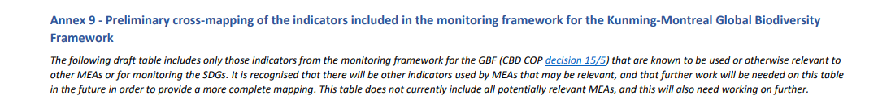
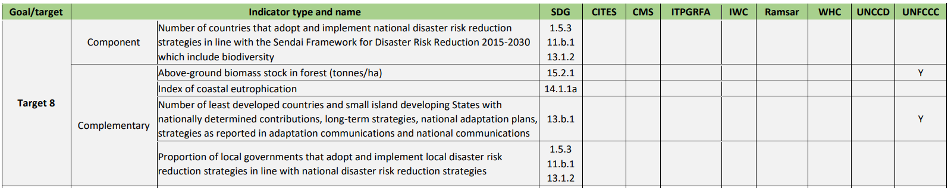
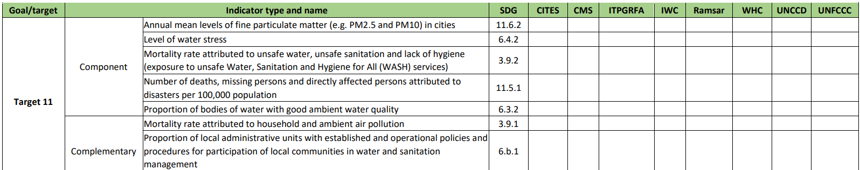

Slide 9
Thank you!

