Slide 1
Overview of the IPCC Inventory Software for National Greenhouse Gas Inventories
IPCC TFI Side Event, UNFCCC SB 58
6 June 2023, Bonn, Germany
Pavel Shermanau, IPCC TFI TSU

Slide 2
IPCC Inventory Software
IPCC Inventory Software was produced in 2012. Initially, it was designed to be a simple tool implementing only Tier 1 methods according to the 2006 IPCC Guidelines
The latest version is the version 2.861. It has been released on June 6, 2023 at the SB 58
The version 2.861 implements the following:
  all Methodological Tiers & Approaches according to the 2006 IPCC Guidelines, and its
    Wetlands Supplement (in lilac colour)
    in addition, some elements of the 2019 Refinement (in magenta colour) to facilitate Interoperability with the UNFCCC CRT Reporting tool
    Interoperability functionality with the UNFCCC CRT Reporting tool (Energy Sector)

Slide 3
Version 2.861
More features
allows subnational level of reporting (e.g., tracking specific activities or regions)
  allows for each source/sink to use either a single methodological Tier or a mix of Tiers
  allows, in each equation, to input user-specific values for EFs and parameters
  allows different categories/sectors to be developed simultaneously
  implements AR5 GWP₁₀₀ values (and allows any other user-specific metric to be applied)
  stores the entire set of information of NGHGI within a single database

Slide 4
Architecture
Administration functions: Country, Users, Years
Contains default data
Uncertainty analysis, KCA, Reference method
Worksheets for data entry
Data Managers: *Fuel
*Land Representation
* Land Use
*Livestock
*Waste
Data Export
and
Import
Data Archive
ACCDB file, backup function
  MSAccess (ACE OLEDB 12) for WindowsOS
  Microsoft .NET Framework 4.6.2

Slide 5
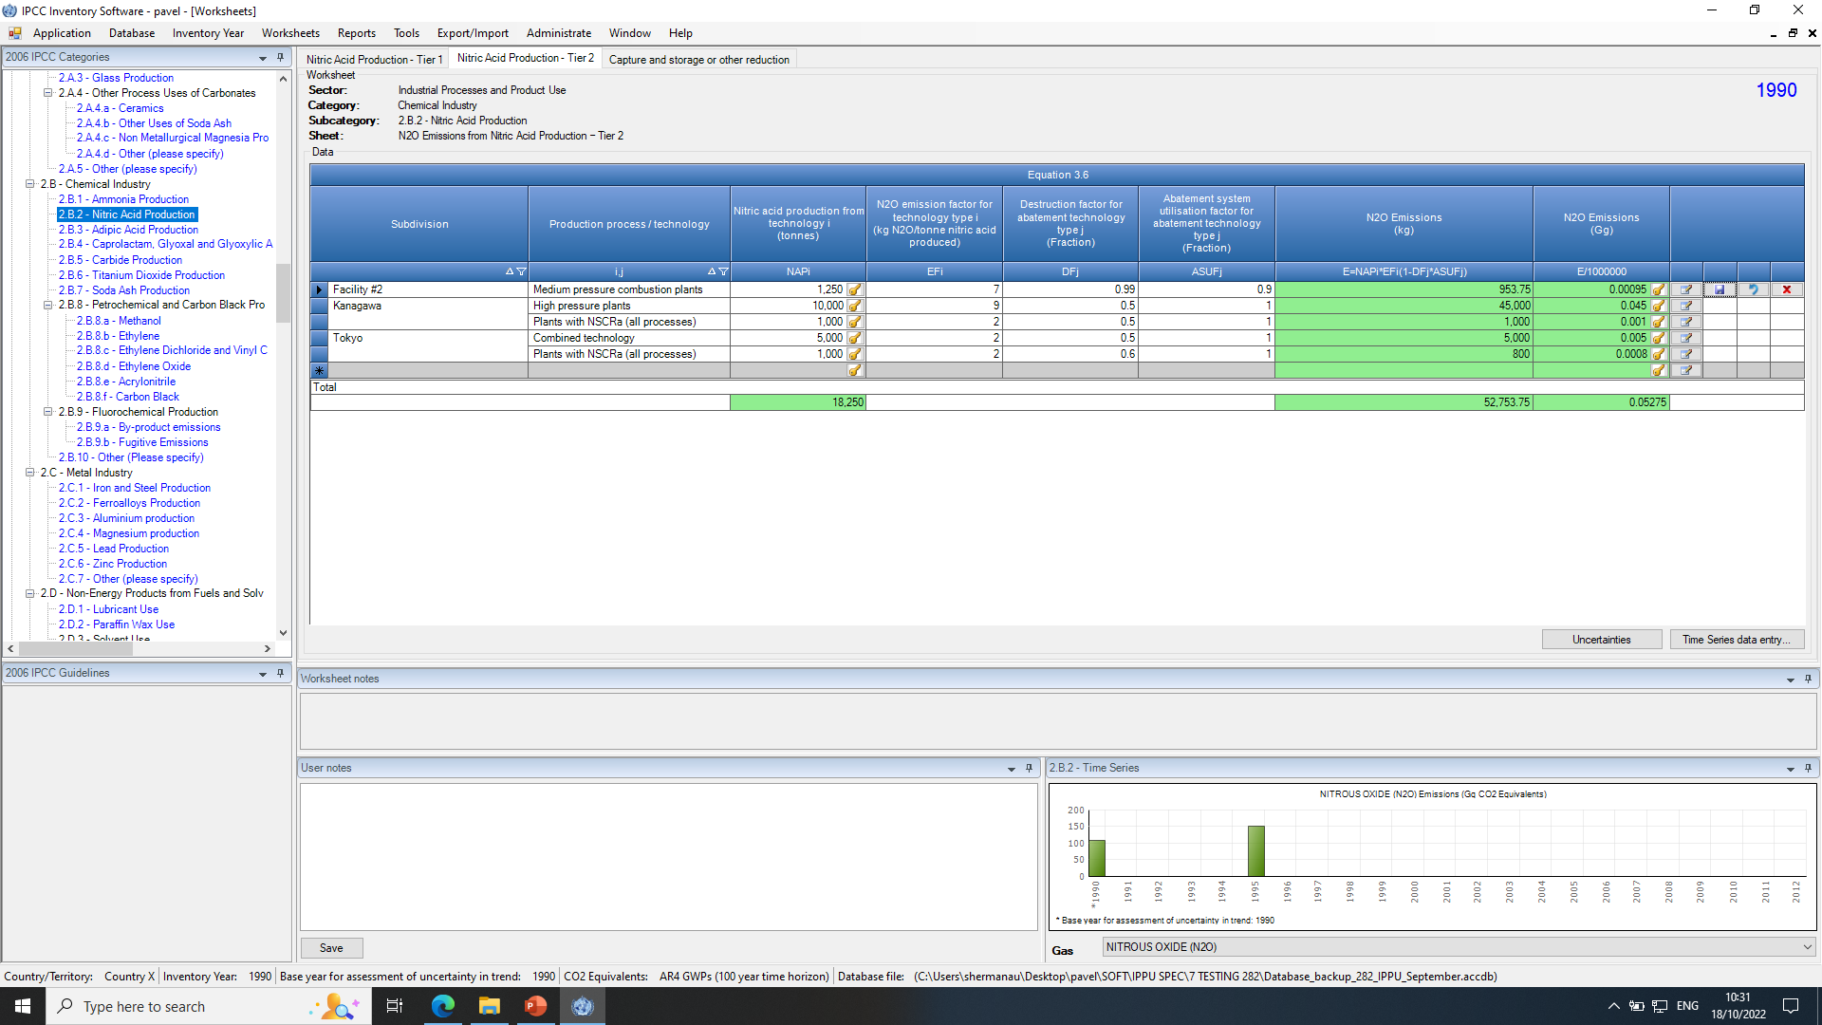
Example of a worksheet
Categories
Worksheets
Sub-divisions
Default or User-defined process/technology
Default or User-defined parameters

Slide 6
Ongoing work
Paris Agreement requirements
Indirect CO₂ emissions
(memo item) Indirect N₂O emissions
Interoperability with UNFCCC reporting tool for Common Reporting Tables (Decision 5/CMA.3)
Other
  Notation Keys
  Time series export/import
  Supporting tools

Slide 7
Guidebook - Scope
Guide to estimate anthropogenic GHG emissions and removals from each inventory category by implementing all methodological Tiers & Approaches according to the 2006 IPCC Guidelines and its Wetlands Supplement with elements of the 2019 Refinement.
Software users must be familiar with the IPCC methodologies and read the Software Manual (downloadable from the “Help” menu) before going through the Guidebook.
The Guidebook does not replace guidance provided in the IPCC Methodology Reports

Slide 8
Guidebook - Structure
  Category by category, the Guidebook shows the workflow of data input and calculation in each worksheet when implementing any of the available IPCC methodological Tiers and Approaches to estimate anthropogenic GHG emissions/removals
  Guidebook Appendices describe the use of multi-category components (e.g., Fuel manager)

Slide 9
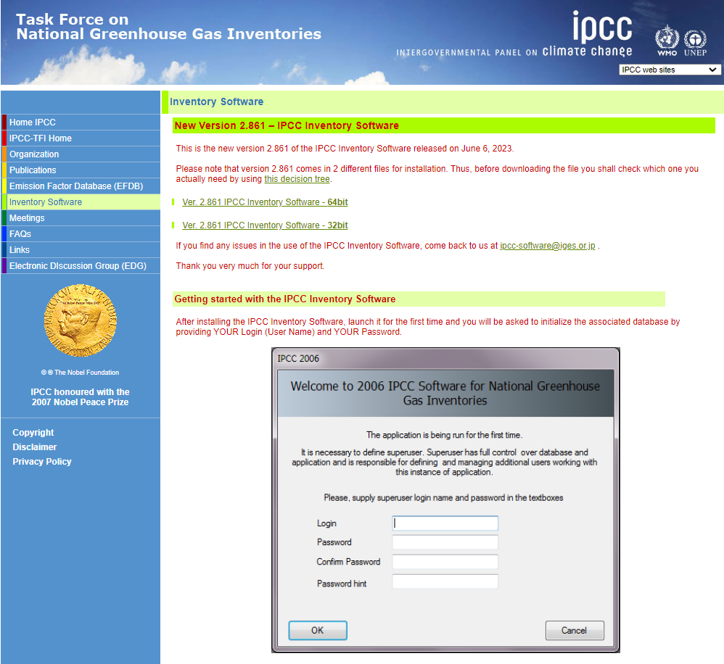
Download https://www.ipcc-nggip.iges.or.jp/software/index.html
  Version 2.861 of the IPCC Inventory Software comes with two alternative installation packages: 32 bit vs. 64bit.
  Please support by using it and reporting any findings to: ipcc-software@iges.or.jp

Slide 10
Support
IPCC TFI TSU is supporting the IPCC Inventory Software:
  User Manual
  Help Desk: ipcc-software@iges.or.jp
  Pool of voluntary testers, to support software development and use
  Cooperation with the UNFCCC at training workshops on the use of the IPCC Inventory Software
  Annual IPCC meetings on feedback from software users, including issues where support is needed or software improvements are envisaged
In the 7th IPCC assessment cycle (from end of July 2023) the plan and support may be subject to changes, depending on consideration by the IPCC and the new Bureau of the Task Force on National Greenhouse Gas Inventories

Slide 11
Thank you
https://www.ipcc-nggip.iges.or.jp/software/index.html
ipcc-software@iges.or.jp

