Slide 1
Synergies and collaboration on Adaptation
Tristan Tyrrell
CBD Secretariat
19 March 2024
Notes:
https://unfccc.int/sites/default/files/resource/UNFCCC-NWP_synergies_NAP-NBSAP_technical-brief.pdf
https://www.cbd.int/doc/publications/cbd-ts-93-en.pdf

Slide 2

The Kunming-Montreal Global Biodiversity Framework
Mission
To take urgent action to halt and reverse biodiversity loss to put nature on a path to recovery by 2030 for the benefit of people and planet by conserving and sustainably using biodiversity
and ensuring the fair and equitable sharing of benefits from the use
of genetic resources, while providing
the necessary means of implementation

Slide 3























The Kunming-Montreal Global Biodiversity Framework
Vision: A world of living in harmony with nature by 2050
Goal A
Protect and Restore
Goal B
Prosper with Nature
Goal C
Share Benefits Fairly
Goal D
Invest and Collaborate
Mission: To take urgent action to halt and reverse biodiversity loss to put nature on a path to recovery
Targets
Reducing Threats
Meeting People’s Needs
Tools and Solutions
9
10
11
14
15
16
17
18
1
2
3
4
5
6
7
8
12
13
19
20
21
22
23
Cross-cutting considerations
Implementation & support mechanisms
Monitoring, reporting
and review
Communication

Slide 4

Cross-Cutting Considerations
Different value systems (different concepts of nature)
Human rights-based approach
Right to a clean, healthy and sustainable environment
One Health approach – biodiversity – health linkages
Contribution and rights of indigenous peoples and local communities
Gender equality and empowerment of women and girls
Intergenerational equity
Whole-of-government and whole-of-society approach

Slide 5
KM GBF & UAE Framework for Global Climate Resilience
(a) Reducing climate-induced water scarcity and enhancing climate resilience to water-related hazards; | (b) Climate-resilient food and agricultural production and supply and distribution of food | (c) resilience against climate change related health impacts | (d) Reducing climate impacts on ecosystems and biodiversity, & accelerating the use of EbA and NbS | (e) Increasing the resilience of infrastructure and human settlements | (f) Substantially reducing the adverse effects of climate change on poverty eradication and livelihoods | (g) Protecting cultural heritage
Target 2: Restore 30% of all Degraded Ecosystems | Target 7: Reduce pollution to Levels That Are Not Harmful to Biodiversity | Target 8: Minimize impacts of climate change | Target 10: Enhance Biodiversity and Sustainability in Agriculture, Aquaculture, Fisheries, and Forestry | Target 11: Restore, Maintain and Enhance Nature’s Contributions to People | Target 12: Enhance Green Spaces and Urban Planning | Target 14: Integrate Biodiversity in Decision-Making at Every Level | Target 21: Ensure That Knowledge Is Available and Accessible To Guide Biodiversity Action | CCP: Contribution and rights of indigenous peoples and local communities Biodiversity and health

Slide 6
Related Decisions
Decision 15/5 : Monitoring framework for the Kunming-Montreal Global Biodiversity Framework
Decision 15/6 : Mechanisms for planning, monitoring, reporting and review
Decision 15/7 : Resource Mobilization
Decision 15/8 : Capacity-building and development and technical and
scientific cooperation
Decision 15/9 : Digital Sequence Information
Decision 15/11: Gender Plan of Action

Slide 7
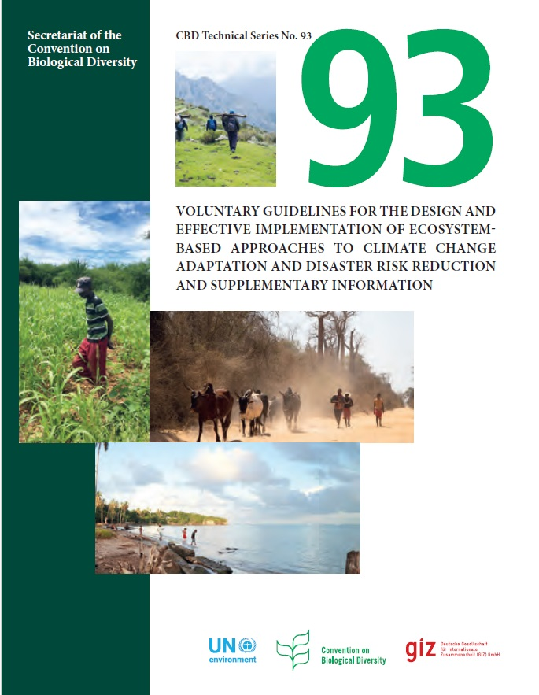
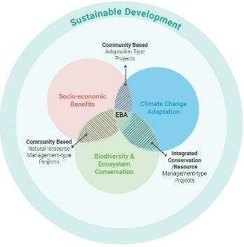
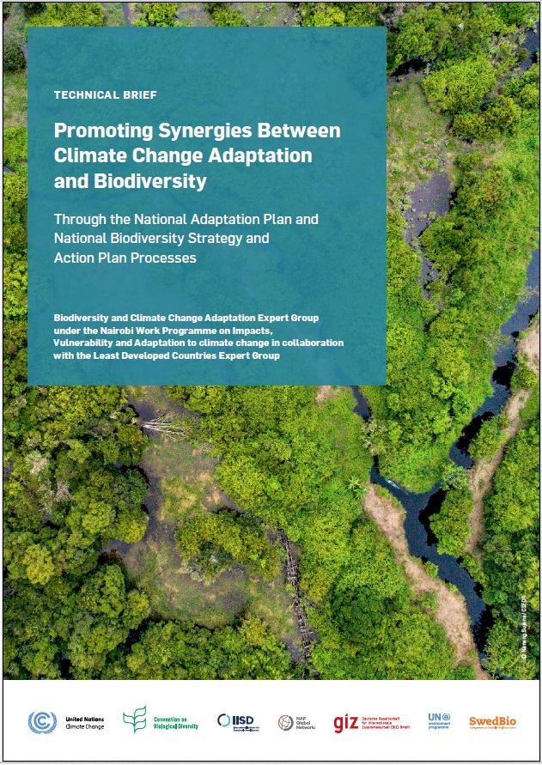
EbA & Eco-DRR under CBD
Bertram et al.
2017
Notes:
https://unfccc.int/sites/default/files/resource/UNFCCC-NWP_synergies_NAP-NBSAP_technical-brief.pdf
https://www.cbd.int/doc/publications/cbd-ts-93-en.pdf

Slide 8
Support from the UN System
NBSAP Forum
NBSAP Accelerator
UN Common Approach
    Supported by UNEP, UNDP and CBD Secretariat
UN Country Teams
Biodiversity plans and strategies developed by agencies
(UNEP, UNDP, FAO ….. )
Decisions on cooperation and synergy
Joint capacity building initiative under the Rio Conventions

Slide 9

COP 16: Colombia
21 October to 1 November 2024
Cali, Colombia
Review the implementation of the KM-GBF
Parties will show the alignment of their NBSAPs with the Framework
Further developments to the monitoring framework
Advance resource mobilization
Finalize the multilateral mechanism on the fair and equitable sharing of benefits from the use of digital sequence information on genetic resources

Slide 10




Some Useful Links
Kunming-Montreal Global Biodiversity Framework (CBD website)
2030 Targets (Guidance)
CBD COP Decision 15/4
(Kunming-Montreal Global Biodiversity Framework)
Global Biodiversity Outlook 5 (GBO5)
facebook.com/UNBiodiversity
twitter.com/UNBiodiversity
instagram.com/UNBiodiversity
linkedin.com/company/UNBiodiversity

Slide 11

Thank You!
Secretariat of the Convention
on Biological Diversity
secretariat@cbd.int
www.cbd.int

