Slide 1



Adaptation Committee: Insights from recent and ongoing work​

Slide 2


Adaptation Committee: Boosting region-wide coherence on adaptation​
AC REGIONAL WORK IN 2023​

Slide 3


The AC organized a series of workshops in 2023 in response to its mandate
  to promote synergy and strengthen engagement with national, regional and international organizations, centres and networks
  to enhance the implementation of adaptation action, in particular in developing countries.

Slide 4

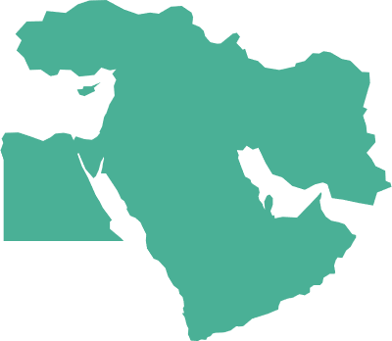
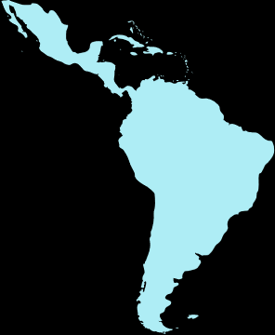
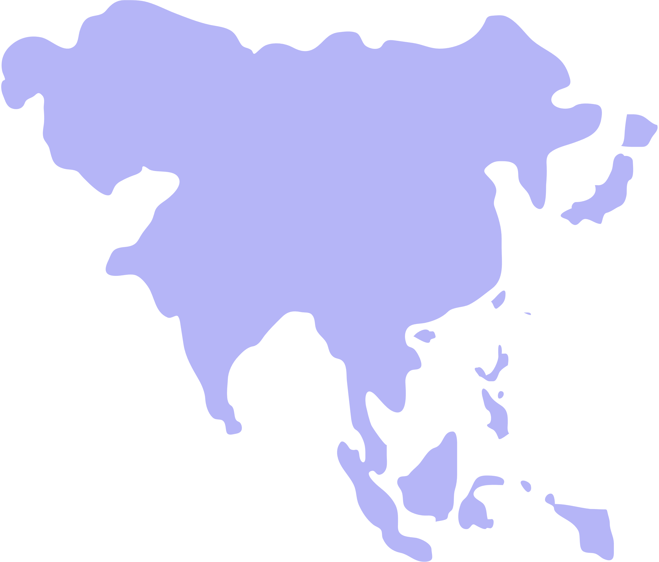


The workshops were integrated into larger events, which provided an opportunity for broader participation and collaboration.
Workshop for Asia-Pacific region, held during the Korea Global Adaptation Week
in Incheon City, Republic of Korea on 28-29 August
Workshop for Africa region held during the Africa Regional Climate Week
in Nairobi, Kenya on 5-6 September
Workshop for Middle East and North Africa held during the MENA Regional Climate Week
in Riyadh, Saudi Arabia on 8 October
Workshop for Latin America and the Caribbean held during LAC Regional Climate Week
in Panama City, Panama on 26-27 October

Slide 5



  The workshops included a presentation from IPCC on the main impacts and risks related to climate change in the specific region.​
  Each workshop started with the presentation of existing multi-country and region-wide adaptation projects and windows of support.

Slide 6




Discussions focused on:
  identifying regional priorities,
  gaps and needs,
  opportunities for enhancing synergies and collaboration on adaptation.​
The workshops provided an
  interactive space for discussions among participants,
  and co-design solutions aligned with global efforts.​
Over 145 organizations participated throughout the workshops.

Slide 7
Findings: Asia Pacific
  Key themes and priorities: Early warning systems; Resilient infrastructure; Biodiversity and ecosystem services; Resilient agriculture and water management.
  Key gaps and needs: Financial, capacity, technology and data gaps; Lack of collaboration and coordination; Need for further engagement of the private sector; Siloed approaches; Lack of sufficient understanding of maladaptation risks.
  Opportunities for action and collaboration: Addressing emerging and cascading risks through a climate adaptation lens; Training and education; Engaging the private sector and integrating technology assessments; Identifying effective financial instruments and simplifying access through a systematic approach.

Slide 8
Findings: Africa
  Key themes and priorities: Food security and resilient agriculture; Sustainable water management; EbA; Education and capacity building; Climate information and data, including early warning systems; Accessibility of funding mechanisms; Diversification of livelihoods.
  Key gaps and needs: Financial, capacity, technology and data gaps; Limited awareness of climate change impacts; Lack of an enabling environment, including strong institutions, governance and legislation; Widespread short-term and fragmented approach to adaptation. .
  Opportunities for action and collaboration: Creating technical platforms at the regional level; Developing regional projects based on shared ecosystems, shared resources or border areas; Collaborating on capacity building for common challenges; Setting up data-sharing schemes, including on best practices. Peer-to-peer learning mechanisms; Common monitoring and evaluation systems.

Slide 9
Findings: Middle East and North Africa
  Key themes and priorities: Resilient agriculture; Food security; Water management; Technical knowledge in Arabic language.
  Key gaps and needs: Financial, capacity, technology and data gaps; Lack of transboundary legal frameworks; Need to strengthen interagency collaboration and a common information platform; Need to further understand how to integrate peace-related considerations.
  Opportunities for action and collaboration: Peer-to-peer learning mechanisms and data-sharing schemes; Development of institutional capacities; common sustainable solutions platform; Implementing multi-hazard approaches for adaptation; Assessing vulnerabilities in urban sectors.

Slide 10
Findings: Latin America and the Caribbean
  Key themes and priorities: Food security and resilient agriculture; EbA; Coastal resilience; Livelihoods; Vulnerability assessments; Migration and human displacement; Forest management and conservation; Sustainable water management; Risks assessments and early-warning systems.
  Key gaps and needs: Financial, capacity and technology gaps; Data gaps; Difficulty in guiding private sector organizations in integrating adaptation into their operations; Awareness and knowledge dissemination gap; Lack of coordination among stakeholders; Fragmentation of adaptation efforts.
  Opportunities for action and collaboration: Incorporating stakeholders outside the environment sector; Building technical capacities; Peer-to-peer learning mechanisms; Aligning different agendas; Regional community of practice on adaptation; knowledge hub for regional engagement and knowledge sharing.

Slide 11
Common themes
  Key themes and priorities: Resilient agriculture and water management; Resilient infrastructure; EbA; Early warning systems;
  Key gaps and needs: Financial, capacity, data and technology gaps; Awareness and knowledge gaps; Lack of coordination among stakeholders; Fragmentation of efforts
  Opportunities for action and collaboration: Peer-to-peer learning mechanisms; Knowledge- and data-sharing schemes; Collaborating on capacity building.

Slide 12
Virtual dialogue: Addressing capacity gaps in accessing adaptation funding
RECENT WORK OF THE AC

Slide 13

AC virtual dialogue on addressing developing countries capacity gaps in accessing adaptation funding – part II
Focus theme:
“Addressing capacity gaps of countries for translating their adaptation priorities into finance and investment strategies, plans and projects”
  Key enabler for countries while transitioning from adaptation planning to implementation
  Requires capacities to access the entire range of financial sources and instruments suitable for addressing adaptation
  Experiences were shared by Fiji, AfDB, GIZ, GCF and OECD
  Provided important basis for follow-up activities
Notes:
The AC has convened a virtual dialogue on 6 March on addressing developing countries capacity gaps in accessing adaptation funding, following previous work on this topic.
The dialogue focused specifically on Addressing capacity gaps of countries for translating their adaptation priorities into finance and investment strategies, plans and projects.
Developing these capacities will be key for countries while they are transitioning from adaptation planning to implementation for which they will need to be able to access the entire range of financial sources and instruments suitable for addressing adaptation, including public and private, domestic and international.
Many interesting experiences were shared during the dialogue from countries that have developed such strategies but also from financiers such as the AfDB and the GCF, technical support organizations such as the GIZ and other organizations such as the OECD which have embarked on supporting countries on this important topic.
The dialogue resulted into a range of very interesting initial findings which the AC will use as a basis for follow-up activities on this topic. At its 25th meeting last week it also decided to continue work on this as part of its new flexible workplan.
The AC will communicate any opportunities for collaboration on this topic and is interested in hearing from other stakeholders on their ideas and initiatives, and any possibilities for cooperation.
It invites participants to consult the website of the dialogue for further background information and the recording.

Slide 14

More information and a recording of the dialogue is available at https://unfccc.int/event/ac-dialogue-gaps-accessing-adaptation-funding-part2

Slide 15
State of Adaptation Action by Parties:
New interactive portal
UPCOMING WORK OF THE AC

Slide 16






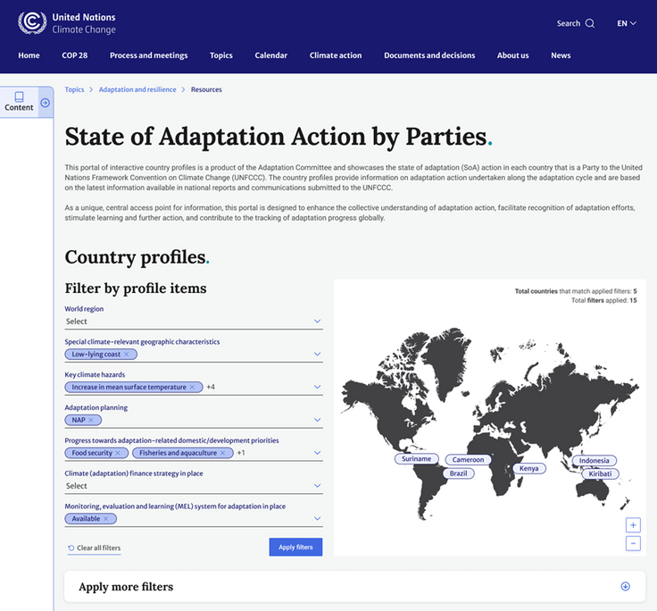
Showcases adaptation action undertaken by countries around the world
Details adaptation action taken along the elements of the adaptation cycle
One country profile for each country that is a Party to the UNFCCC
Based on national reports and communications
State of Adaptation Action by Parties: New interactive portal
Notes:
The AC will soon launch a new interactive portal on the State of Adaptation Action by Parties.
The portal will showcase adaptation action undertaken by countries around the world through interactive country profiles.
One such profile is being developed for each country that is a Party to the UNFCCC. The profiles detail adaptation action taken by each country along the elements of the adaptation cycle, including cross-cutting aspects such as action on gender, particularly vulnerable groups or migration, among others. The template has been developed by taking into account existing reporting guidelines for NatComs, AdComs, BTRs, NAPs (technical guidelines and PEG M&E tool) and principles for adaptation from decisions (NAPs, GGA)
The information contained in the profiles is based exclusively on national reports and communications submitted under the UNFCCC and will be regularly updated

Slide 17
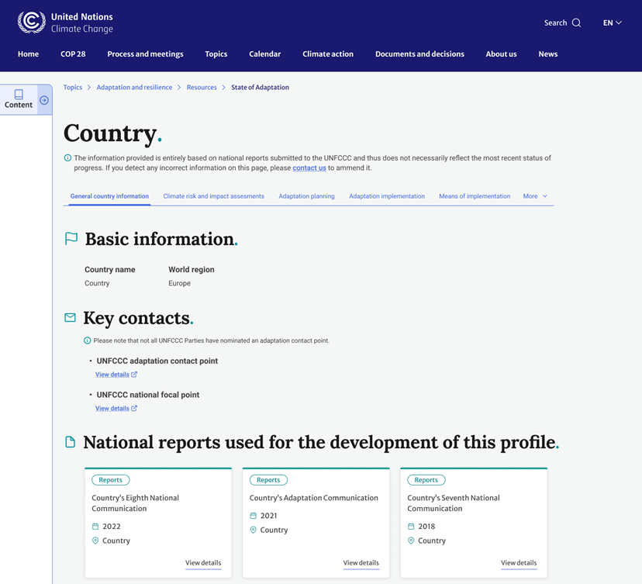
State of Adaptation Action by Parties: New interactive portal
  One-stop shop for information on adaptation action taken by countries
  Large number of filtering options allowing for extraction of various combinations of information according to user interest and needs
  Mutual learning and positive benchmarking among countries
  Identification of gaps and needs
  Monitoring progress over time
Notes:
The portal provides the following value add:
It is a one-stop shop for information on adaptation action taken by countries containing information which is usually spread across several different reports and documents – rich source of information for a diversity of actors
The profiles allow for a range of filtering options, including for thematic areas relevant to those included under the UAE Framework for Global Climate Resilience – this enables the user to extract various combinations of information according to his particular research or learning interest and needs – links are shared wherever available allowing for easy access to additional information
The portal greatly facilitates learning and positive benchmarking among countries
While focusing on action and progress, it can contribute to the identification of gaps and needs
It can facilitate the monitoring of progress over time

Slide 18

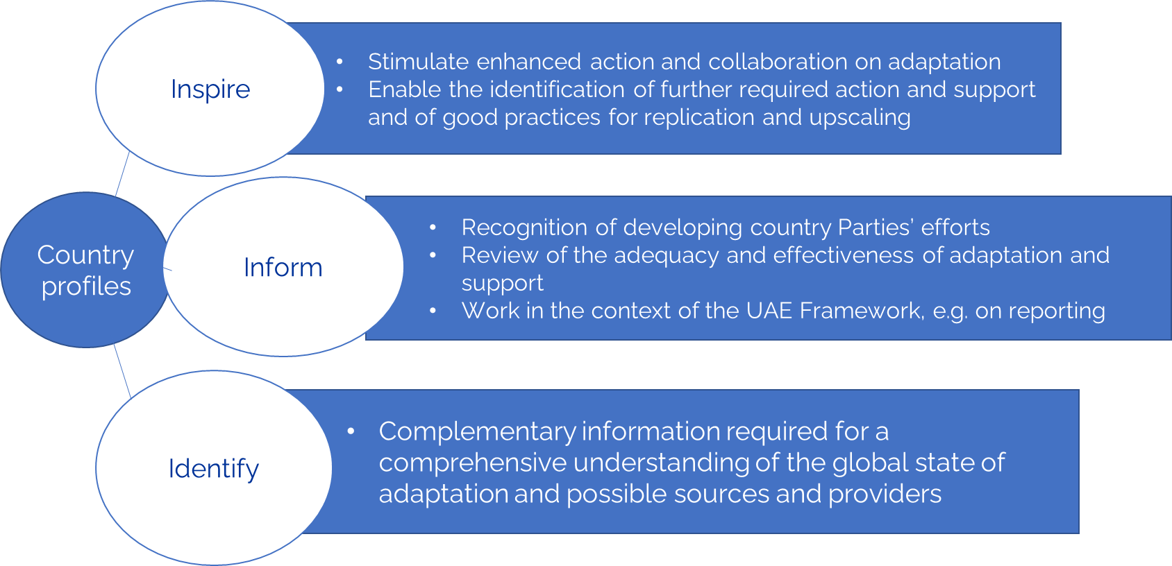

Notes:
The information contained in the country profile portal can facilitate many types of further action and collaboration:
Stimulate learning, but also the identification of gaps and needs and good practices which could be replicated and scaled, including through the support of a range of stakeholders
Contribute to and enrich other ongoing mandates and workstreams, such as the recognition of adaptation efforts of developing country Parties, the ongoing work of compiling methodologies for the review of the adequacy and effectiveness of adaptation and support and other work, e.g. in the context of the new UAE Framework, on which the AC collaborates with various partners
The information contained in the portal provides important information, but for an understanding and review of the overall state of adaptation at a global level it would need to be complemented by information from other sources, such as research, organizations, funds, the private sector and other stakeholders
These could be provided by other partners. The AC is still in the process of discussing the further development and/or enhancement of the portal.

Slide 19

A preview of the portal is available at https://unfccc.int/adapatation_actions_parties

